Slide 1

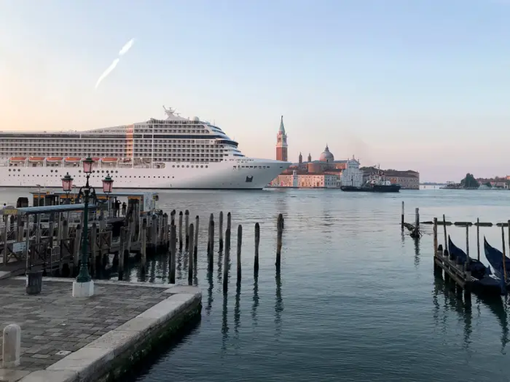
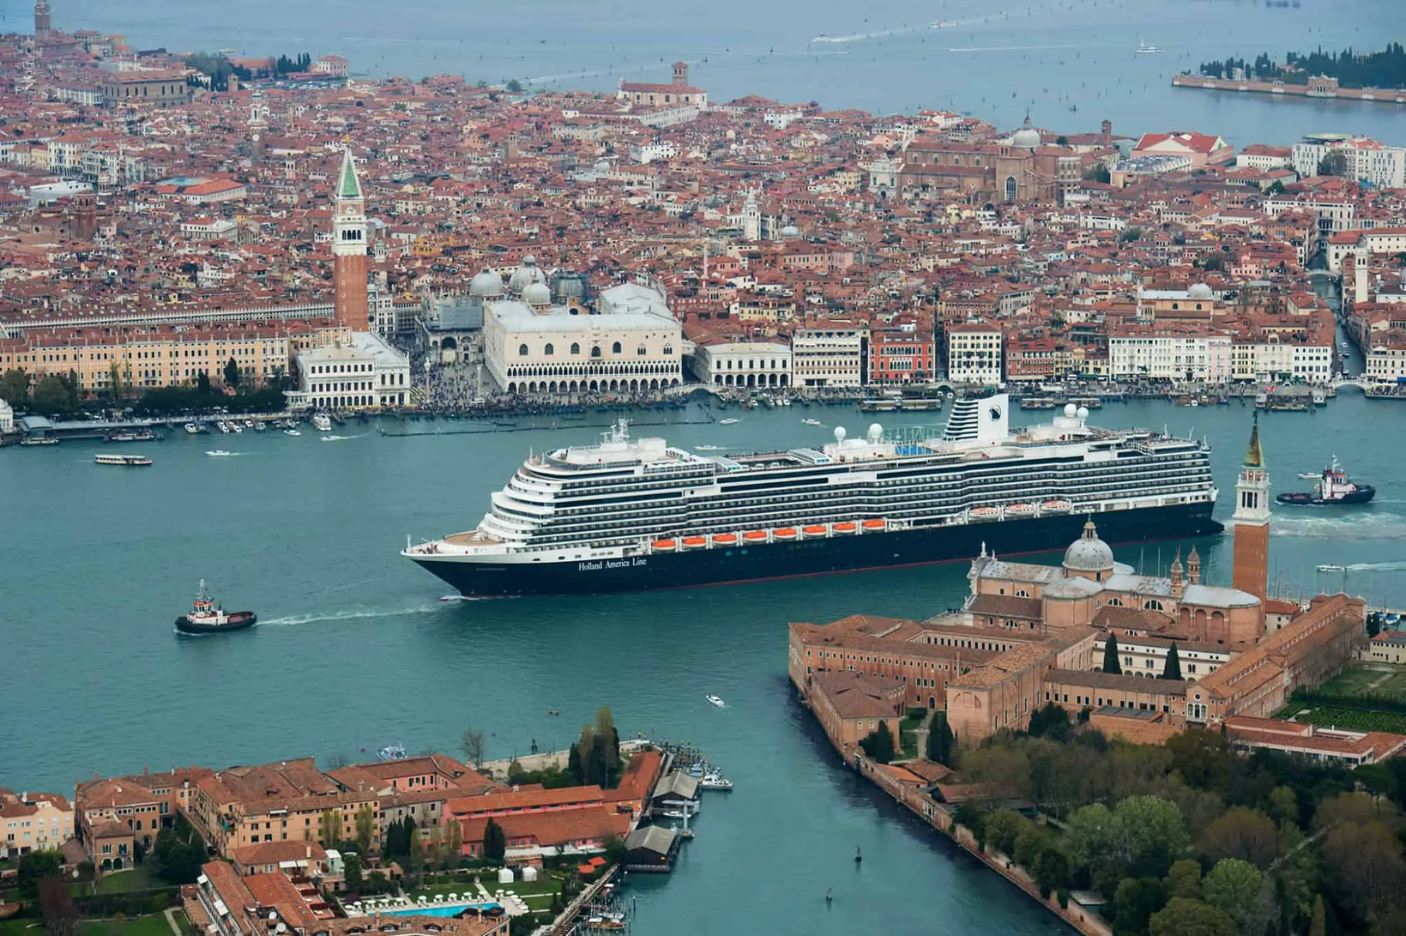
JAZZ
CRUISE SHIP EMISSIONS & STRATEGIES FOR REDUCTION
  2019: 27,500 Sox Emissions
  2021: Emissions fell by 80% after banning large ships and high-sulphur fuel vessels from central areas
  Exceptions: LNG-powered cruise ships/vessels meeting strict environmental and safety standards.
  UNESCO concern: Threatened Venice’s World Heritage status due to noise pollution and damage to the lagoon.
  2030: EU rules require ships to use shore power or zero-emission technologies while anchored

Slide 2

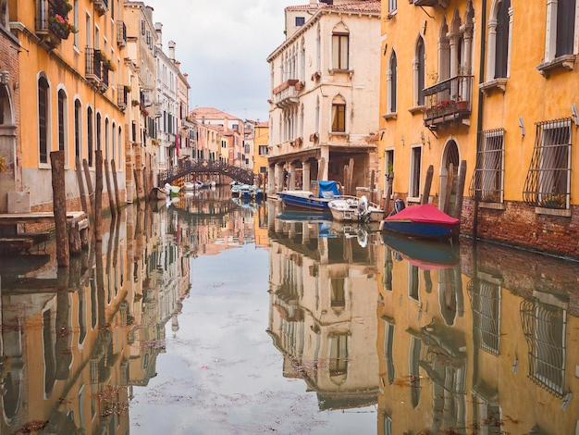
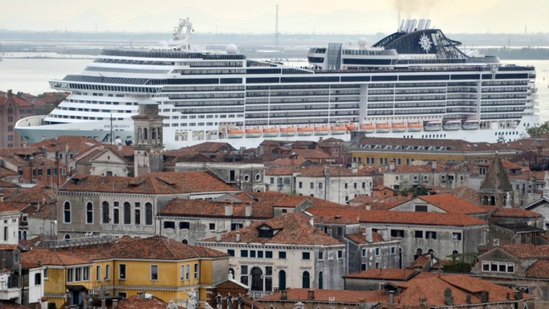
WASTE AND WATER MANAGEMENT SYSTEMS (GREY WATER, PLASTICS, SEWAGE)
  Venice uses septic tanks instead of a traditional sewage system, and wastewater often flows directly into the canals
  Many older tanks leak, allowing wastewater to seep into canals and groundwater, and upgrades are slow and costly
  Wastewater treatment plants become overloaded during peak tourism, leading to untreated sewage entering the lagoon

Slide 3
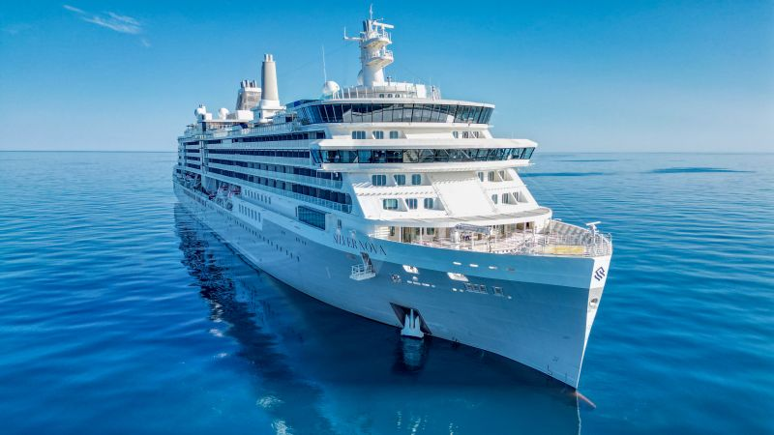
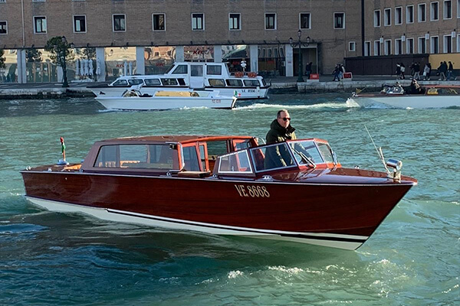
  Silversea’s LNG‑hybrid ship cuts emissions and operates emission‑free in port
  Venice plans to electrify water taxis to reduce local air pollution
  Hybrid‑electric ships lower emissions on short trips but are costly to implement
  Hydrogen is being explored for longer‑distance, zero‑emission travel.
  Fuel‑cell systems emit only water vapour, offering a clean future option
  Sustainable Tourism Theory
ALTERNATIVE FUELS

Slide 4
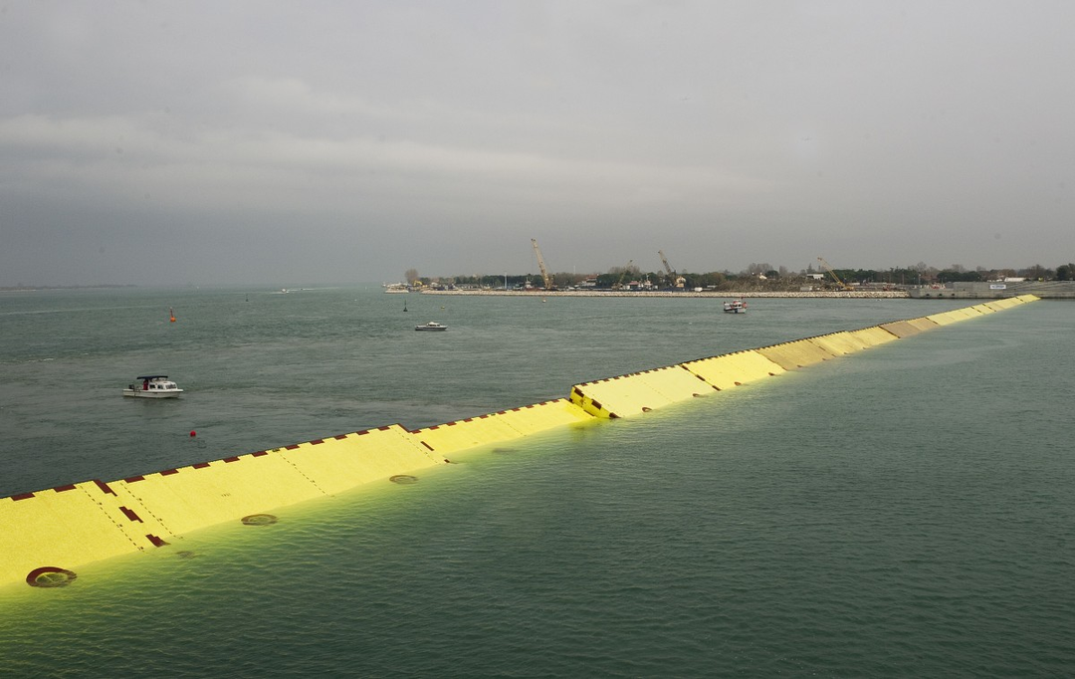
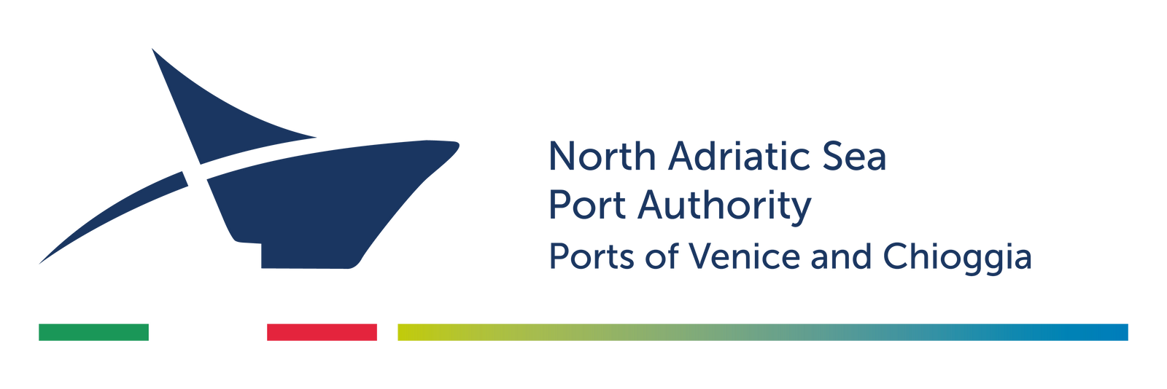
MARINE AND COASTAL ECOSYSTEM PROTECTION IN PORT DESTINATIONS
  MOSE barriers protect Venice from high‑tide flooding while trying to avoid ecological disruption in the lagoon.
  Frequent closures can harm water quality by causing nutrient build‑up.
  North Adriatic Sea Port Authority monitors water quality, manages ship waste and emissions, develops shore power, and protects habitats
  Marine ecosystem protection is vital because cruise traffic can damage sensitive habitats and reduce water quality
  Carrying Capacity Theory

Slide 5
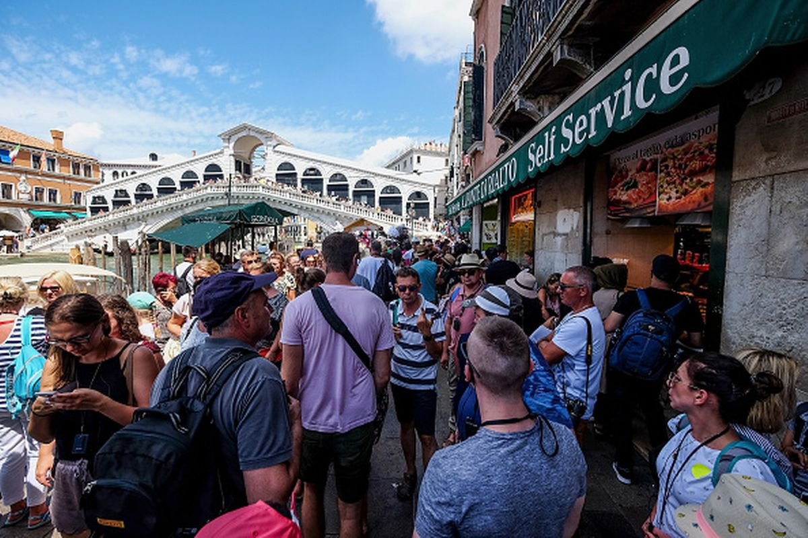
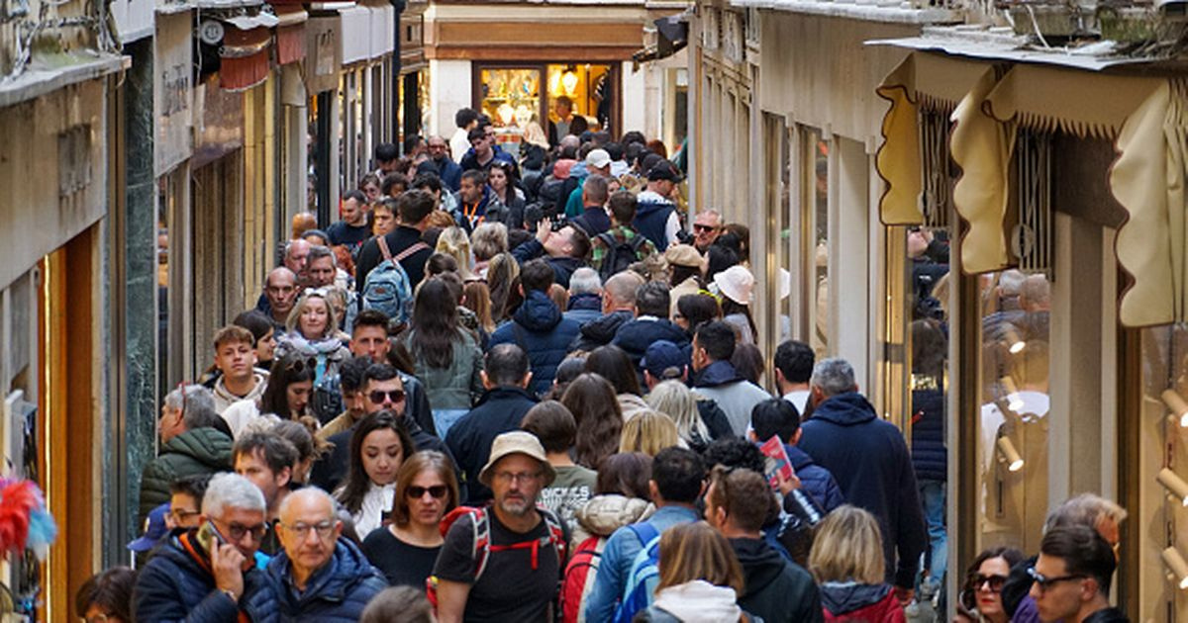
  Authentic shops are replaced by tourist‑focused businesses
  80% of its 20 million visitors being day‑trippers,
  €10 day‑tripper fee
  Tourists are starting to adapt
PREVENTING COMMODIFICATION OF CULTURE

Slide 6
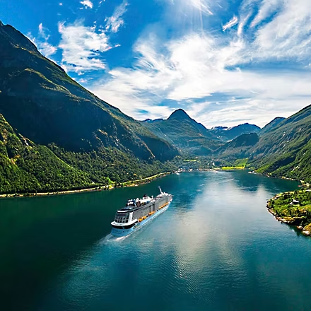
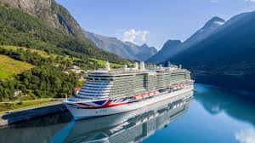
NORWEJIEN FJORDS
  Norway will require zero‑emission cruise operations in its UNESCO fjords from 2026
  Fjord towns like Flåm and Geiranger face overcrowding and “theme‑park” tourism similar to Venice

