Slide 1




Knowledge and Information Management Skills for the Workplace
TASK 2
Name: Andreea Rotariu
ID Student: 2107119
Module: Knowledge and Information Management Skills for the Workplace
Module Code: BMSW5106

Slide 2
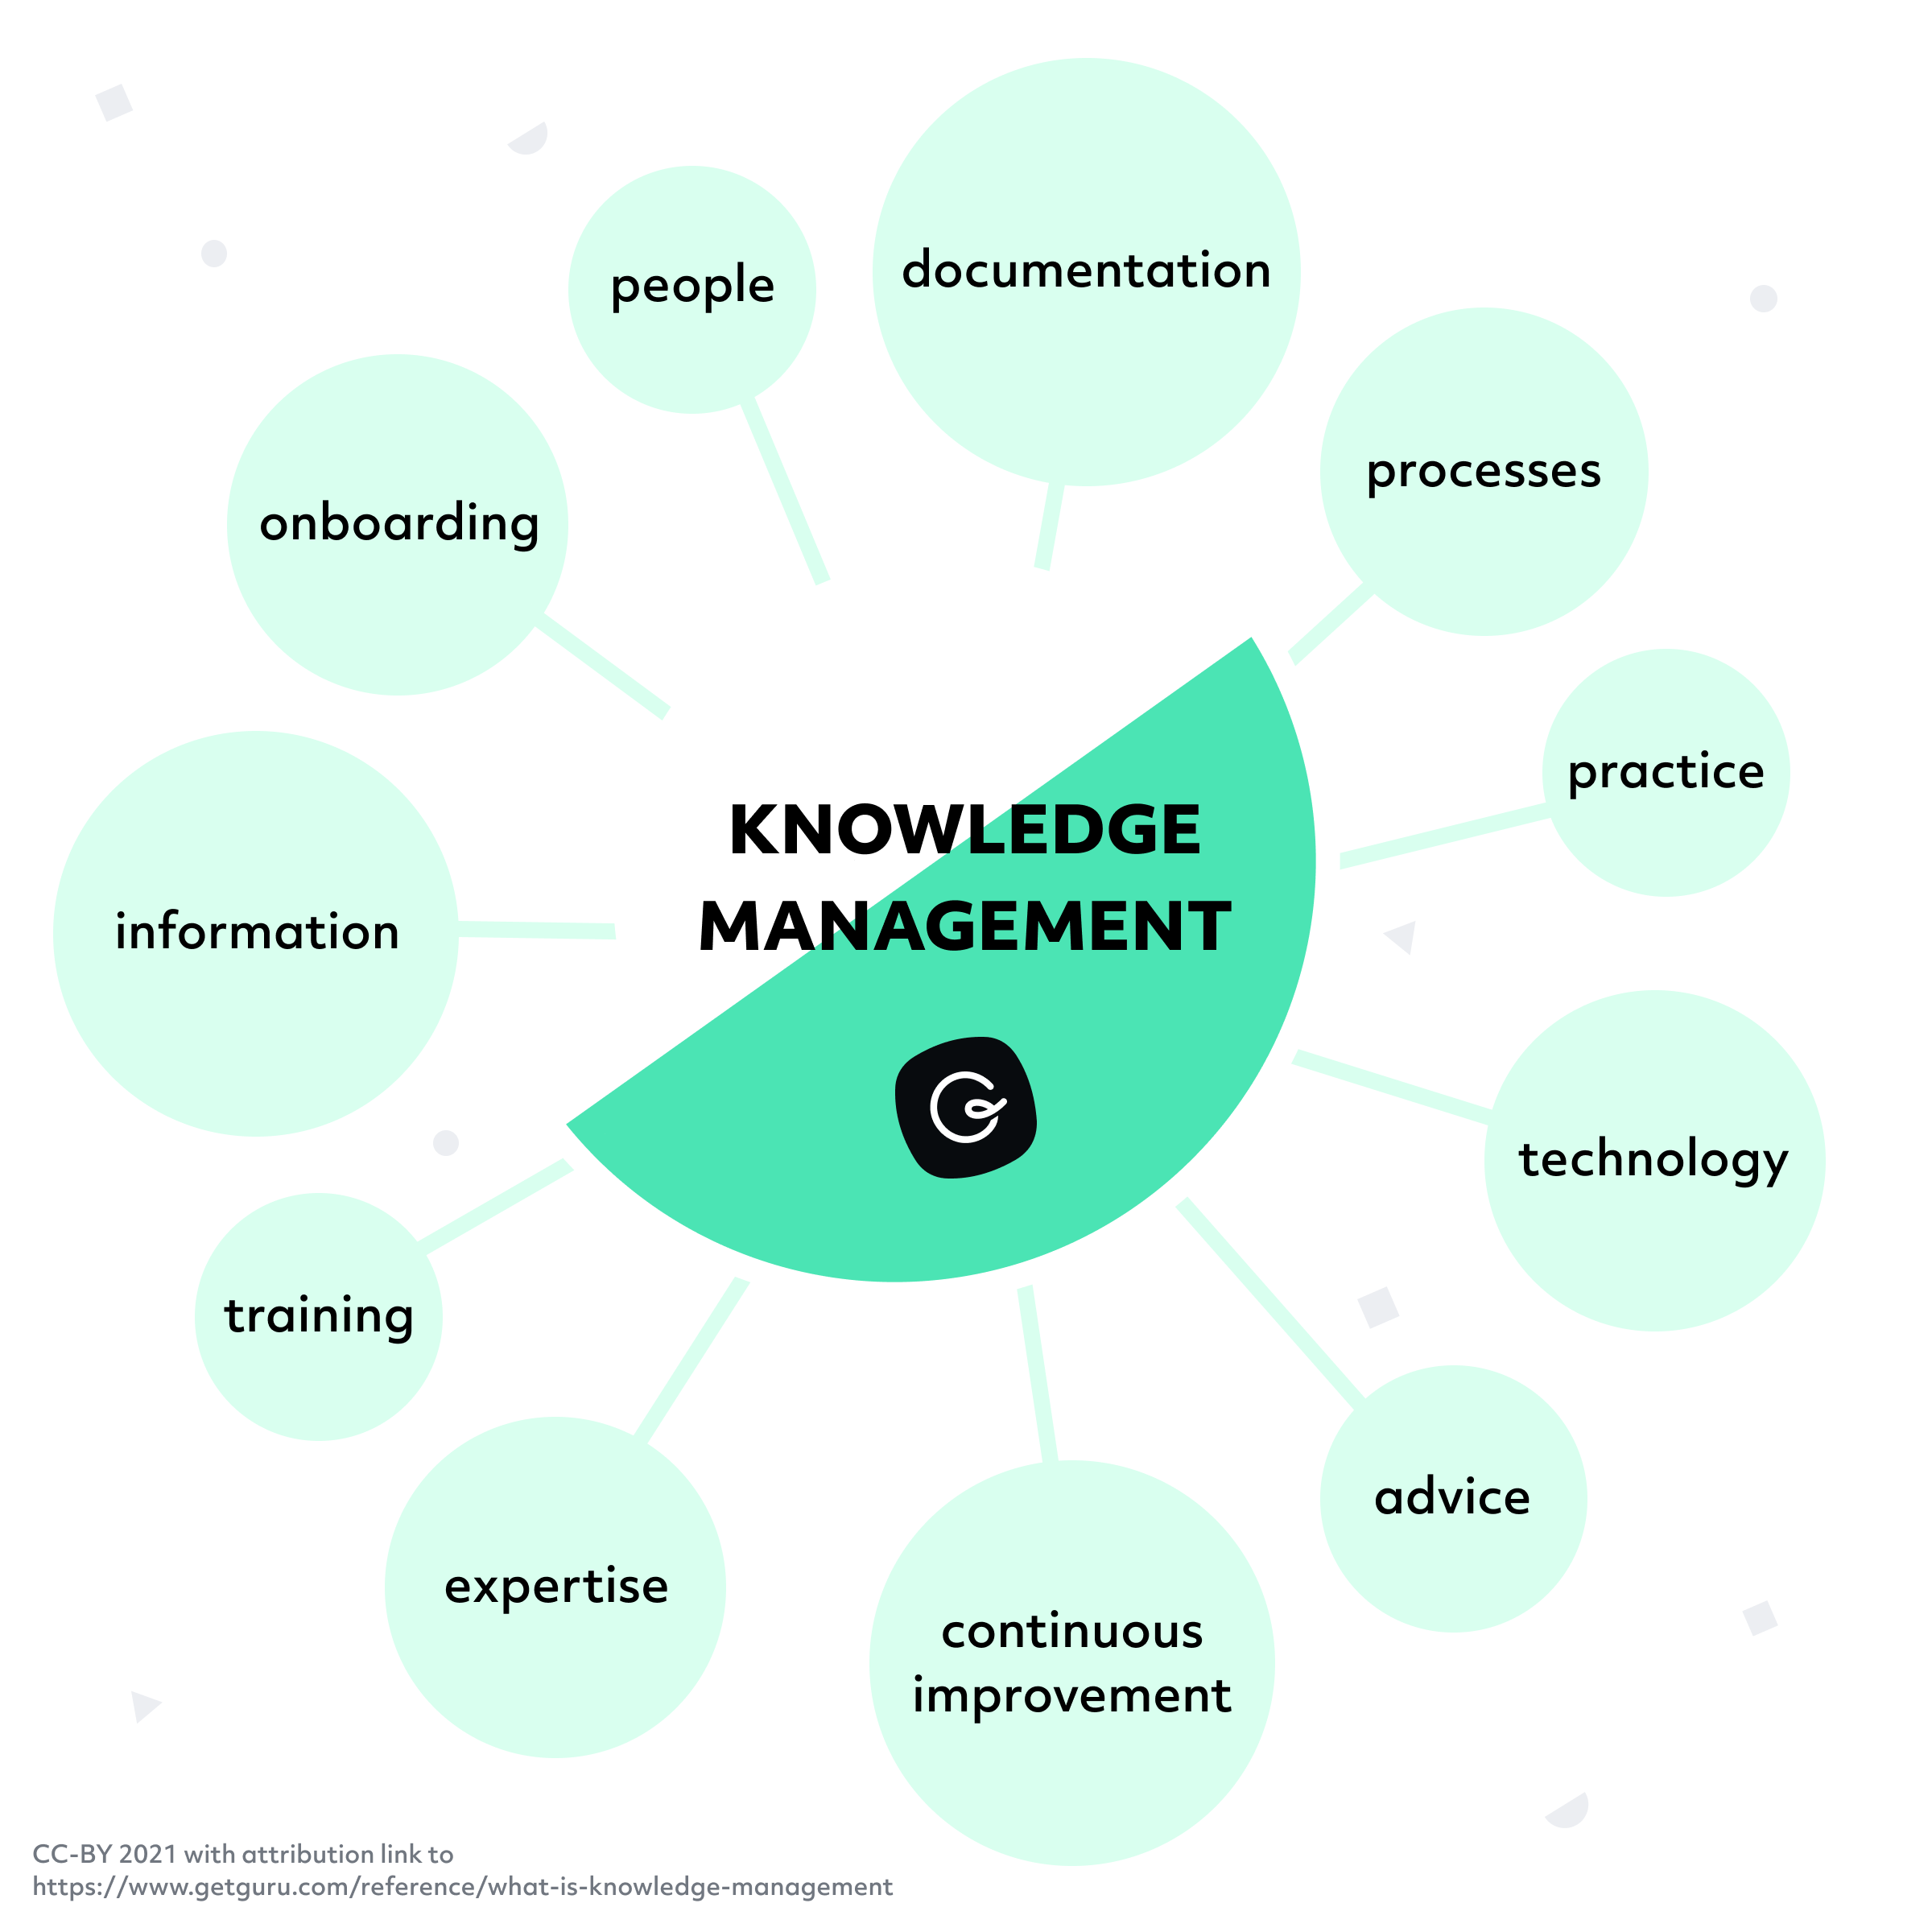
INTRODUCTION
This presentation aims to present the important points covered within the individual report (Task 1). Therefore, the report was based on analyzing and evaluating the Knowledge Management Systems in two e-commerce business: Deliveroo and Amazon. As so, there are pointed out:
The main organizational activities within Amazon and Deliveroo.
The SWOT analysis in report with their Knowledge Management Systems.
Evaluation in-depth of all the Knowledge Systems in the organizations.
Recommendations.

Slide 3

KNOWLEDGE MANAGEMENT SYSTEM
KMS is defined as IT systems that include content, search, guidance, and insight, which include people, process, practices and culture. (eGain, n.d.). Moreover, businesses use this kind of process, as it increases the efficiency and the productivity within the organization.
Amazon is a multinational organization that focuses on e-commerce, cloud computing, online advertising and AI. Moreover, it is the biggest retailer in the world. (Yasar, 2022).
Deliveroo is one British food delivery company from e-commerce industry that partners with many restaurants for satisfy the needs of the customers. (Matthew, 2020).

Slide 4
MAIN ORGANISATIONAL ACTIVITIES IN ORGANIZATIONS
ORGANISATIONAL ACTIVITIES IN AMAZON | IN DELIVEROO
Amazon Store | Using mobile applications to connect customers with restaurant/ groceries stores. (Deliveroo, 2022).
Devices and Services | Administrative services (Cleverism, 2016).
Amazon Web Services | Delivery and logistics
Delivery and Logistics (Amazon, 2023).

Slide 5
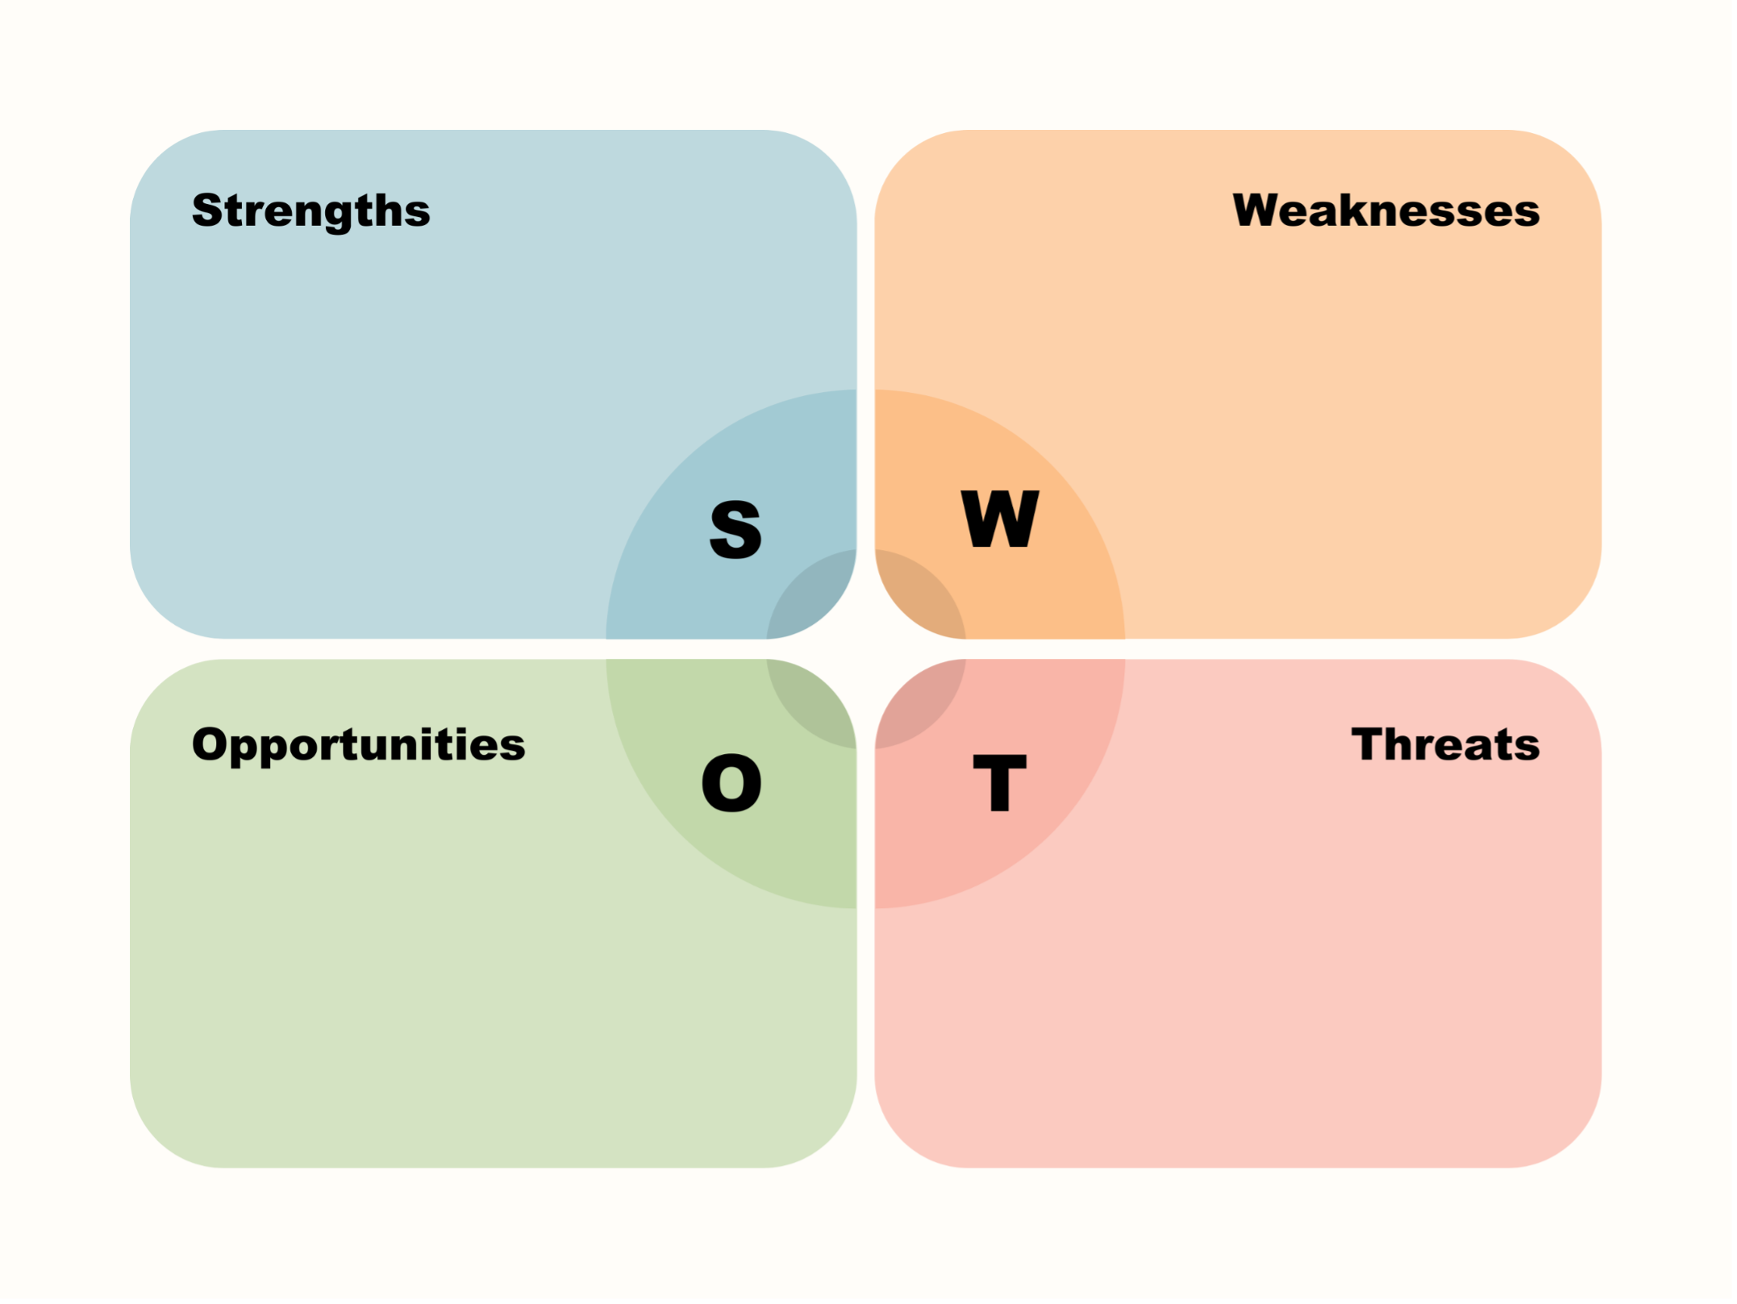
SWOT analysis of organizations in report with their kms.
Amazon
Strengths | Weaknesses
Advanced-knowledge system. Qualitative products. Customer-service. Technological advancements. | Employee engagement. Concerns about data privacy and security.
Opportunities | Threats
New features of AI. Predictive Analysis | Competitive market.

Slide 6
SWOT analysis in Deliveroo
STRENGHTS | WEAKNESSES
Effective operational management. Great connection with the customers and delivery drivers. Advanced technology. | Dependent on third-party companies. The exchange of information is harder.
OPPORTUNITIES | THREATS
New strategies to improve the customer experience. Expansion of AI features. | Competitors. Delay in operations.

Slide 7
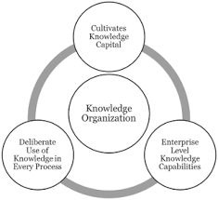

TYPES OF KNOWLEDGE WITHIN AMAZON AND Deliveroo
KNOWLEDGE ORGANIZATION AND ACQUISITION- organizing the resources.
Amazon is organizing the own knowledge by using the website. In addition, there are used intelligent techniques, algorithms, and aspects of artificial intelligence.
Deliveroo is organizing its knowledge by the information received from the drivers, as these are able to update in real-time the services offered and by the feedback received from the customers/ restaurant's partners.

Slide 8

Knowledge distribution
As both of the companies are active e-commerce businesses, they rely on the information technology systems. As so, the information is distributed by different channels, including communication channels, training, support.
Deliveroo and Amazon offers trainings for all the applicants in order to register a higher performance.

Slide 9

KNOWLEDGE STORAGE
Knowledge Storage consists of accumulating and storing the knowledge of the employees. (Andreev, 2019).
Information Technology System comes in many ways for both of organizations:
Cloud storages.
Data bases.
Uses of altgorithms.

Slide 10


MAIN ISSUES IN KMS In the organizations
The main recommendations, as were evidenced through the report for both organizations are:
Investment in technical improvements.
Using the predictive analysis.
To benefit of the KM available resources.
Considering that both organizations are taking part of e-commerce systems, these need to be focused on the latest technological developments, including the new features of Artificial Intelligence as these contribute to improve the services and to increase the performance. In addition, using predictive analysis can represent a way to enhance the customer experience.

Slide 11
Conclusion
Overall, each organization decides the own level of KMS, as presented within this case study. However, knowledge management encourages collaboration, sharing the ideas and access the latest resources designed for businesses to increase the productivity and efficiency.
By analyzing the KM within each organization, there is also measured the performance of the system in present. In addition, there are identified the areas that the organization may need to improve to increase the efficiency.
Both of Amazon and Deliveroo are top e-commerce businesses and as it was evidenced, both are using a complex and sophisticated knowledge systems.

Slide 12
REFERENCES
eGain. (n.d.). What is Knowledge Management System? [online] Available at: https://www.egain.com/what-is-knowledge-management-system/. (Accessed date: 10/07/2023).
Yasar, K. (2022). What is Amazon? [online] WhatIs.com. Available at: https://www.techtarget.com/whatis/definition/Amazon. (Accessed date: 10/07/2023).
Matthew (2020). The Deliveroo Business Model – How Does Deliveroo Work & Make Money? [online] productmint. Available at: https://productmint.com/the-deliveroo-business-model-how-does-deliveroo-work-make-money/. (Accessed date: 10/07/2023).
Amazon (2023). What We Do. [online] About Amazon. Available at: https://www.aboutamazon.com/what-we-do. (‌Accessed date: 11/07/2023).

Slide 13
REFERENCES
Cleverism. (2016). Deliveroo. [online] Available at: https://cleverism.com/company/deliveroo/ (Accessed date: 10/07/2023).
Deliveroo (2022). About us. [online] Deliveroo. Available at: https://deliveroo.co.uk/about-us. (Accessed date: 09/07/2023).
Andreev, I. (2019). What is Knowledge Management? its Importance and Benefits. [online] Valamis. Available at: https://www.valamis.com/hub/knowledge-management. (Accessed date: 11/07/2023).

