Slide 1

Homophones

Slide 2
Objectives
Understand what a “homophone” is.
To identify same sounding words with different meanings and spellings.
Explain how they are used within the different contexts.
Understand the meanings of the words highlighted.
Discuss the importance of using the correct word in English sentence structure.

Slide 3
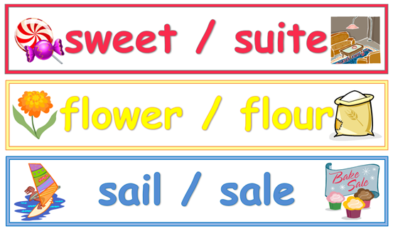
What are “Homophones”?
Homophones are common words that are used frequently within the English language.
They sound the same, however, they have a different meaning and are spelt differently.

Slide 4

Confusion
Within academic writing, it is important to be able to understand the meaning of words.
There are many different words that sound the same, however, they do not mean the same and they are also spelt differently.
Within any writing, not just academic writing, incorrect usage of words can look poor, sloppy and unprofessional.
Being able to distinguish the different meanings of words can ensure that the words are used in the correct context.

Slide 5
Words that sound the same although have different meanings (Homophones).
Words such as two, to and too, all sound the same, however, have very different meanings.
For example;
There are two spaces available within the carpark. Two means the number of something.
The dog runs from door to door. To describes where the dog is going.
He’s only too willing to be of service. Too confirms his willingness to help.

Slide 6
There are a number of homophones within the English language. Listed below are some of the words that are widely used such as:
They’re is the shortened form of they are.
Their means belonging to them.
There has two uses: To mean a place,
For example;
They’re going to visit their Mum.
Someone left their book on the table.
The garage is over there.
There is a green car in the garage.

Slide 7
Remember:
Incorrect usage of words can alter the sentence meaning.
This causes confusion and may also cause you to express something different to what you intended to within the sentence.
It can also cause embarrassment within official letter writing such as job applications/CVs.

Slide 8
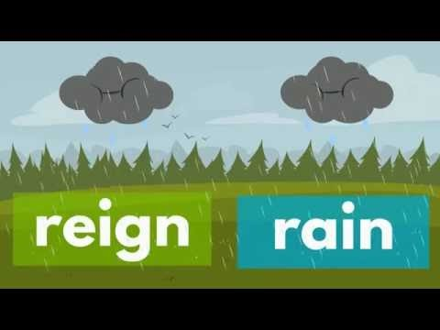
YouTube clip on Homophones

Slide 9
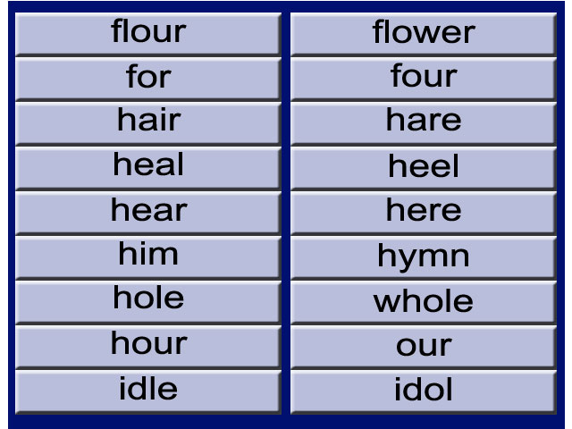
Some words that are spelt differently but sound the same.

Slide 10
Activity:
Students to choose the missing red homophone from the end of the sentence and fill in the missing blank.
There is a big _____ over there. Bare or Bear
That’s my friend over _____. There, their or they’re
Is this _____ mess? Your or you’re
I like to _____250 words every day. Write, right or rite.
That is a beautiful red _____. Flour or flower
There is a great big _____ in your shoe. Whole or hole
You have lovely shiny _____. Hair or Hare
Gareth bale is my _____ Idle or idol
There are _____ parts to the story. For or four
The clock strikes every _____. Our or hour

Slide 11
Examples of Homophones
Please see today’s session on Moodle for a more extensive list of examples of pairs of words which people are often confused by.

Slide 12
Kahoot activity:
https://create.kahoot.it/kahoots/my-kahoots

Slide 13

Summarise
Understand what a homophone is.
To identify same sounding words with different meanings and spellings.
Explain how they are used within the different contexts.
Understand the meanings of the words highlighted.
Discuss the importance of using the correct word in English sentence structure

Slide 14
Any Questions?

Slide 15
References
Kahoot it! (2018) Create it. Available at: https://create.kahoot.it/kahoots/my-kahoots (Accessed 4th December 2018).
YouTube, (2019) Know Homophones. Available at: https://www.youtube.com/watch?v=7OwX6tjOztY (Accessed 22nd January 2019).

