Slide 1
LCLM4003_LON – Effective Teamworking and Communication
Case Study : Flight Foods Ltd.
Student names & ID numbers
Isabel Petkova – 2518088
Desislava Terziyska 2507995
Ramona Solomon - 2513390
Isabella Guthier –2516266
Florencia Joyce Elpedes -2517796
Tutor : Rejwan Bin Sulaiman

Slide 2
What This Presentation Covers
Flight Foods Ltd is a medium sized manufacturer of ready meals for airlines.
Airlines are reporting under cooked food, poor packaging and meat found in vegetarian meals.
The Key Communication barriers include: environmental noise, body language and cultural differences, generational dividers, emotional factors.
Some Theoretical frameworks are Shannon & Weaver, Schramm and Berlo's SMCR model , having one per slide.
There will be practical strategies for Gary and management to reduce each communication barrier.
The Conclusion and References have a summary of key findings and full reference list.

Slide 3



Barrier 1: Cultural Barrier ( Standards and Practices )
The employees of five cultural identities come with completely different notions regarding food safety. Gary discovered trays of chicken left out the whole night, not through thoughtlessness, but because no one had told why chilling was important. The fact that the management did not go through induction training was an indication that the workers began on the floor with no common sense of hygiene expectations.
THEORY
SOLUTION
Hofstede (1980):: cultures vary in uncertainty avoidance, workers have high uncertainty and adhere to rules in a more consistent manner; when presented with sound argument. The rule is meaningless without the why.
Schramm (1954):: communication is effective when there is a sender and the receiver, have a field of experience in common. Gary and his employees are not sharing a lot in the way of food safety standards.
Food is inducted through multilingual training to all new starters, practicing hygiene training in their language prior to handling food. Illustrated signs are used instead of text in English.
Pairs were formed between new starters and experienced workers between cultural groups to strengthen standards on a daily basis. ​ ​

Slide 4

Barrier 2: Environmental noise barrier
Ramona Solomon
The factory floor is packed with old, noisy machines constantly clanking and banging. Gary has to shout just to be heard and even then, workers metres away may catch nothing. Key parts of instructions get physically blocked mid-sentence. Workers who do not understand are too intimidated by the noise to ask questions, so they stay silent, guess what was meant, and carry on which is exactly how food safety failures happen.
THEORY
SOLUTION
Shannon & Weaver (1949): the clanking machines are textbook noise physical interference that corrupts the message mid-transmission. The signal is sent but what arrives at the receiver is incomplete or meaningless.
Berlo SMCR (1960): speech is the primary channel at Flight Foods, and factory noise degrades that channel so severely that even a perfectly constructed message fails to reach the receiver intact.
Bilingual team leaders from each cultural group relay Gary's instructions in workers' own languages.​
​
Multilingual illustrated signs replace English-only text a picture of meat in a chiller needs no translation.​
​
Short induction in workers' own language before starting on the floor.

Slide 5

Ramona Solomon
Barrier 3 — Language Barrier&Communication Barrier
Gary has 40 employees that belong to 5 cultural groups and hardly speak English. All verbalities and every English only sign he puts on the wall does not work since there is no common language. Management's decision to skip induction training
made this worse from day one workers arrived on the floor with no understanding of food hygiene expectations.
THEORY
SOLUTION
Shannon & Weaver (1949): language is the 'noise' corrupting Gary's message before it reaches the workers. The signal is sent but never arrives intact.
Schramm (1954): communication only works when sender and receiver share a common field of experience. Gary and his workforce share almost none.
Bilingual team leaders from each cultural group relay Gary's instructions in workers' own languages.
Multilingual illustrated signs replace English-only text a picture of meat in a chiller needs no translation.
Short induction in workers' own language before starting on the floor.

Slide 6
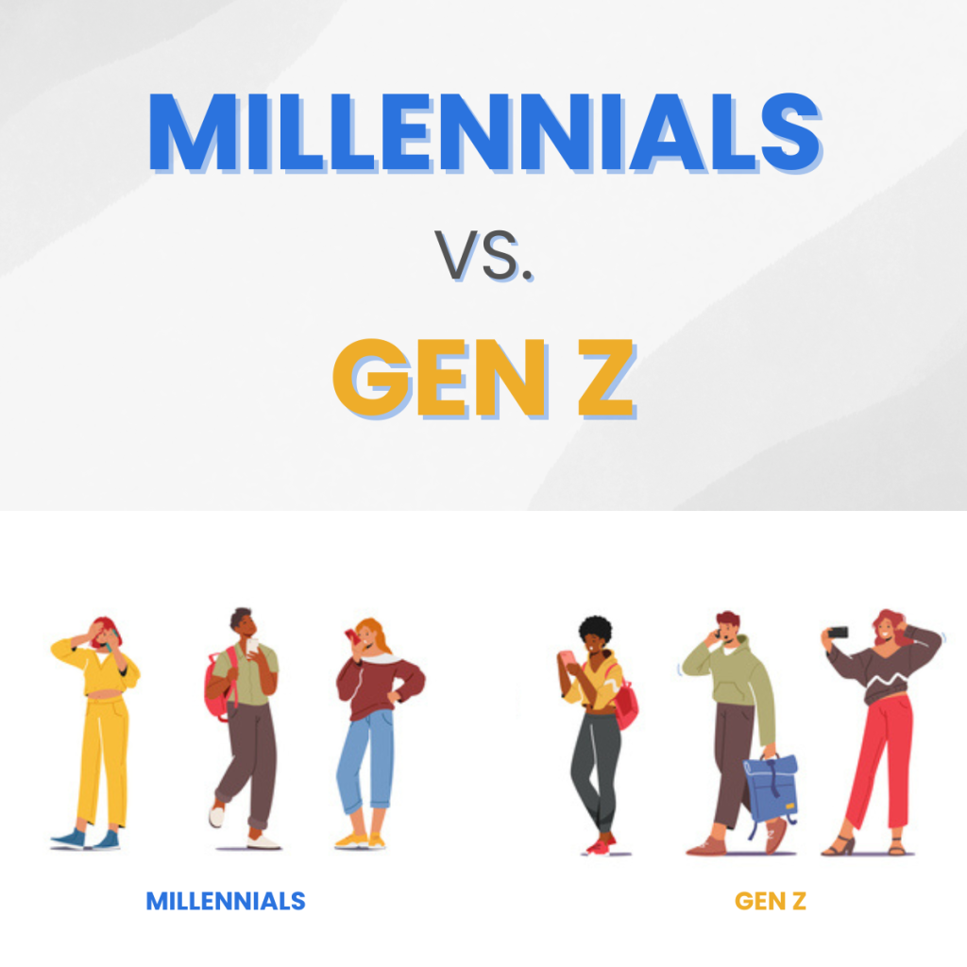
Desislava Terziyska
Barrier 4 : Age/Generational Barrier
Gary manages a workers aged 16 to 60 years old – different generations
He uses authority-— telling people what to do and expecting it to be done
Older workers respond to this approach- the younger ones seem to ignore him.
Generational gap: younger workers need context and reasons, not just commands.
''The younger ones appear to do something else''
THEORY
SOLUTION
Explanation-led communication: Gary should move from 'do this'
to 'do this because' — linking every hygiene rule to a real
consequence, such as a sick passenger or a lost airline contract.
Pair mentoring: Pair older, experienced workers with
younger ones to create learning that authority-led
instruction cannot achieve.
Specific briefings: short, visual briefings for younger workers
and structured verbal instructions for older ones — Gary must
learn to move between both.
Berlo's SMRC Model (1960): Communication depends on sender message, channel, receiver
Effectiveness is based on the age, experience and communication skills
Gary's message is not understood because younger workers have a different interpretation
Mannheim (1929): Generations are shaped by different experiences
Gary and his youngest workers grew up in entirely different worlds —
Leading to different views on authority and communication

Slide 7
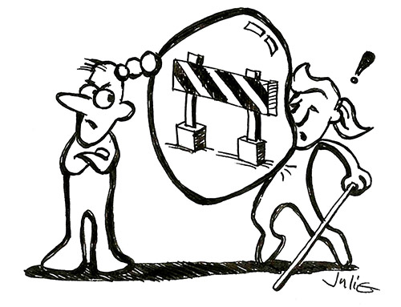
Desislava Terziyska
Barrier 5 : Attitudinal Barrier
Gary manages a workforce where attitudes on both sides create a breakdown in communication. Gary's frustration leads him to call his workers "idiots," while younger workers appear dismissive of instructions. Neither side is fully engaging with the other, making effective communication impossible.
THEORY
SOLUTION
Berlo's SMCR Model (1960): The attitude of both sender and receiver directly affects how a message is encoded and decoded. Gary's attitude affects how his message is delivered and received.
Schramm (1954): There is no communication where there is no mutual willingness to engage. Gary has different attitudes –dismissing his workers and they disengage in return; the feedback loop collapses entirely.
Improve emotional control- Gary has to manage frustration and communicate with patience and respect.
Two-way feedback sessions - Workers feel heard and valued, improving their willingness to engage
Positive reinforcement replacing blame — recognising good practice rather than only reacting to mistakes.

Slide 8

Florencia Joyce Elpedes
Barrier 5 — Educational & Knowledge Barrier
Gary is qualified in Food Hygiene and Safety — he has the knowledge. The problem is that he has no training in how to teach it. He runs around a noisy factory floor trying to explain things verbally to workers who speak limited English, relying entirely on improvised on-the-job instruction and English wall signs. Knowing something and being able to communicate it effectively are two completely different skills, and Flight Foods has invested in only one of them.
THEORY
SOLUTION
Vygotsky (1978): learning happens most effectively within the Zone of Proximal Development the gap between what a learner can do alone and what they can do with guidance.
Shannon & Weaver (1949): effective communication requires a clear channel between sender and receiver. In a loud factory, with no shared language and no structured teaching method, the channel is so full of noise that almost nothing gets through intact
Train the trainer: Gary should receive training in how to teach food safety effectively to multilingual, mixed-ability teams — not just in the content itself.
Bilingual team leaders: appoint a team leader from each cultural group to relay Gary's instructions in workers' own languages, closing the knowledge transfer gap.

Slide 9

Florencia Joyce Elpedes
Barrier 6 — Psychological Barrier
Gary came to work sleepless, in a hurry with his dirty uniform and grease under his nails after having worked on his car until 2am. He was already a weak leader in mind before uttering a single word on the factory floor. When he had left the chicken out overnight he had not judged, justified or reformed--he shouted at the team that they were idiots. His emotional dysregulation was the sole message anyone got that morning.
THEORY
SOLUTION
Goleman (1995): emotional intelligence is the ability to recognise one's emotions is fundamental to effective communication and leadership.
Lazarus & Folkman (1984): people shift from rational problem solving to reactive coping because of stress. Gary's morning was a full of stressors, sleep deprivation, a broken-down car, a late arrival, that primed him for exactly the kind of reactive outburst that followed.
Emotional self-regulation training: Gary should receive coaching in recognising when his emotional state is affecting his judgement, and techniques for pausing before reacting to problems on the floor.
Pre-shift manager protocol: a mandatory checklist before entering the factory uniform, hygiene, and a structured briefing removes the conditions that allow emotion to take hold.

Slide 10

Barrier 7 — Emotional Barrier
Isabella Guthier
Gary is experiencing high levels of stress and frustration due to the pressure of managing a large workforce with little support. He describes the workplace as a “madhouse” and shows emotional reactions such as shouting “Idiots!”, indicating a loss of control and patience. His fatigue and lack of preparation further worsen the situation, leading to poor decision-making and negative interactions with workers. As a result, emotional tension builds within the workplace, reducing overall effectiveness and performance.
THEORY
SOLUTION
Maslow (1943): Employees need a supportive and stable environment to feel secure. Gary’s stress creates an unsafe and uncomfortable atmosphere, preventing workers from feeling motivated.
Goleman (1995) – Emotional Intelligence: Effective leaders must control their emotions. Gary’s frustration and anger show low emotional intelligence, which negatively affects communication and leadership.
Stress management and support: Provide Gary with additional managerial support and training to reduce workload and pressure.
Emotional awareness training: Improve Gary’s emotional intelligence so he can manage frustration and respond calmly.
Positive work environment: Encourage respectful communication and reduce negative reactions to create a more supportive atmosphere.

Slide 11

Conclusion
Flight Food faces multiple communication barriers that lead to the miscommunication, poor hygiene standards as well reduced performance and business loss
The communication theories highlight the importance of clear message transmission and the need to consider receiver understanding .
Effective communication is essential for quality and safety
Sample Footer Text
11

Slide 12

References
Shannon, C.E. and Weaver, W. (1949) The Mathematical Theory of Communication. Urbana: University of Illinois Press. | Schramm, W. (1954) "HowCommunication Works" in W. Schramm (ed.) The Process and Effects of Mass Communication. Urbana: University of Illinois Press, pp. 3–26
Shannon, C.E. and Weaver, W. (1949) The Mathematical Theory of Communication. Urbana: University of Illinois Press. | Berlo, D.K. (1960) The Process of Communication. New York: Holt, Rinehart and Winston.
Hofstede, G. (1980) Culture's Consequences: International Differences in Work-Related Values. Beverly Hills, CA: Sage Publications.
Vygotsky, L.S. (1978) Mind in Society: The Development of Higher Psychological Processes. Cambridge, MA: Harvard University Press.
Griffith, B.A. (2015) Working in teams : moving from high potential to high performance . Los Angeles, [California] :, SAGE.
Goleman, D. (1995) Emotional Intelligence: Why It Can Matter More Than IQ. New York: Bantam Books.
Maslow, A.H. (1943) 'A Theory of Human Motivation', Psychological Review, 50(4), pp. 370-396.

Slide 13
Thank You For Listening
Sample Footer Text
13

