Slide 1
Effective Team-working and Communication
Student Name& Id: Atopa Sangida(2128179)
Julia Zupkova(2314934)
Zaneta Zupkova(2314065)

Slide 2
Introduction
Individually tasks can be done but they require more time and effort. But in teams’ tasks can be done with better ease and in less time. But various techniques are present to make the team tasks to become more effective.
In this task hence here, this is divided in two parts, in the first one the theoretical under pinning is done like how and in which way effective team, team dynamics etc. can be ensured and then in the last part the examples from the practical life are being done.
Notes:
Individually tasks can be done but they require more time and effort. But in teams’ tasks can be done with better ease and in less time. But various techniques are present to make the team tasks to become more effective, because without the application of the techniques an ineffective team will form which will result in a poor performance. In this task hence here, this is divided in two parts, in the first one the theoretical under pinning is done like how and in which way effective team, team dynamics etc. can be ensured and then in the last part the examples from the practical life are being done.

Slide 3
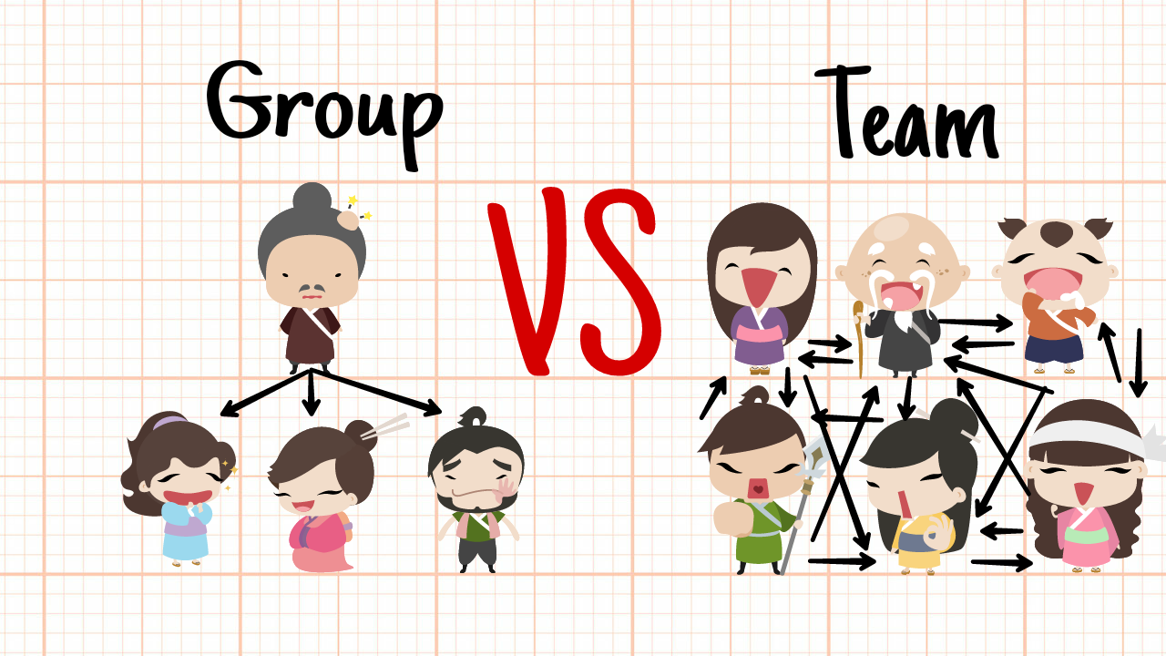
Part 1: Theories and models for effective team formation (in online and offline or hybrid)
1.1 Overview of Teams and groups (effective team characteristics)
Notes:
Teams and the groups are being formed to accomplish any goal of any organization. Here generally it is being known as the collection of some individuals are accumulated to achieve goals. Only the collection of individuals element is the same with team and group but all of the other elements here are totally different from each other. Here the groups are informal and, in the groups, people are not dependent on each other for the execution for any type of tasks. Here no sort of rigid structure is present where the roles and responsibilities are not properly being defined with clear instructions (Ali et al., 2019). On the other hand, teams are more structured and have a common level of goal. More connectivity and interdependence are present which makes the teams to act more dynamic and appropriate in every manner possible. So, in that part it can be said that the teams are the most effective for an organization’s goal achievement. They are the perfect fit in every sense possible, because teams have dynamics like through the interactions, relations, processes an influential benefit curve is being created. With these dynamic features the team becomes much more effective.

Slide 4
1.2 Existing theories and models on teamwork
Tuckman group development stages
Belbin team roles
Heckman effective team conditions
Notes:
There are a lot of the theories are present in the team and group formation. Below some of the famous theories are mentioned and discussed:
Stage of group development by Tuckman: Here through four stages the teams are being formed and operated. At first the forming stage starts, at this part people get to know each other better and build a connectivity. Here a disagreement element on goes in storming where each other do not agree with the proposed ideas. In the norming stage compromising factor works on and people start agree with each other. Then the performing like after a good alignment the real results gets shown.
Belbin’s team roles: Here nine of the roles are being mentioned under this theory. Under these roles the companies identify like which works for which role are to do what. Here some of the people are there to come up with new ideas, then some are to analyse the information and then on to investigate to allocate the required resources (Alkitbi et al., 2020). Some people coordinate, some shape the tasks and then on some of the people become the specialists etc.
Heckman’s team effectiveness: Under this model based on five conditions a team becomes effective enough to provide better results. Here the first one is being the real team, like a team has some clear goals and visions which have the right people to achieve things properly. The goal is properly meaningful to drive actions and then on a structure to provide better results. Then on a proper context for the support, and an expert option for the coaching.

Slide 5
1.3 Theories and models in the business world (applications of these)
Tuckman theory
Belbin team roles
Notes:
In the hybrid or online and offline blend approach the team related models and theories do work much better. These theories do have a proper application thereon because through this an organized format can be created and good results can be extracted (Ashford and DeRue, 2019). The Tuckman and Belbin roles are mostly applicable within the hybrid model of current works.
Tuckman theory: In the forming a proper interaction is required on a better level. In the hybrid format for the offline works interactions are required the most. But the storming mostly happens in the online stage due to miscommunication and misunderstanding of the messages. Here for the norming to start an integrated coordination is required to get a seamless performance. When clear agendas are set then through the blended approach better performance can be ensured.
Belbin team roles: Due the blend a proper role identification is required the most because the more roles are clear hence on better connection can be built (Atrizka et al., 2020). In online the individuals can conduct their tasks on a proper basis like who has tasks like resource allocator, plant etc. then on coordinator and other role work can be done in the offline environment for a better result.

Slide 6
Part 2: Application of the theories (to monitor and improve performance) based on current scenarios of workplace
2.1 Effective teams and theory application (with examples)
Tuckman group development
Hackmen team effectiveness
Social identity theory
Notes:
The theories here are being applied in the real teams and they have an exceptional result when being applied in the hybrid model. The discussions on various of the models with examples are being given:
Tuckman group development: With the help of this theory the groups are being formed and the icebreaking and all sort of elements are being conducted. In the hybrid method the online format is mostly being used to break the ice and to interact on a far better note (Dam and Dam, 2021). Then the mentorship programs are being used to enhance the performance lever. Example: A marketing team of a company for a project hires member but they are seeing many disagreements among them. So, in offline a ‘coffee hour’ is being allocated to chat and this worked better to start the norming process.
Hackmen team effectiveness: Through this model the communication becomes much easier and hence better utilization of the resources is being done. Under this effectiveness of the work is being emphasized rather where it is being completed do not get bothered like was it being done by the team virtually or physically. Example: A team through a company’s intranet properly tracks who has the best performance and then recognizes their achievements in a proper way possible (Fernandez-Vidal et al., 2022). This here enhances the team morale and provides a better effectiveness for the team.
Social identity theory: A shared identity is being followed in here so team members can build a better connection and better value can be generated. In offline and online a better enhancing element should be used so on a better value with connection can create a bigger impact. Example; A team in an organization properly collaborates and organizes meetings so on a better collaboration and creativity can be ensured.

Slide 7
2.2 Performance improvement and monitoring in hybrid model (with examples)
Setting goals and forming alignment
Result oriented management of performance
Notes:
In the hybrid model it is a lot difficult to monitor the performance of the team members because the medium or the place where they work do gets shifted a lot. Here tracking is possible like easy while in the online works but the problem is that not all of the tasks are being done on the online rather maximum is done offline too (Gardas et al., 2019). The visibility to the monitors gets reduced, equity maintenance gets into a challenge. But some of the effective ways are present to undertake that thing up and below the discussions with examples are being made:
Setting goals and forming alignment: Here the SMART goals can be applied so better achievement of the goals can be done with ease. When specificity is being maintained in goals it is much easier to achieve those. An integration with the goals is going to make like the regular updates is going to ensure better performance. Example: A team of sales if being set some specific kind of goals and with virtual meetings the update is known then this offline and online blend will make things awesome.
Result oriented management of performance: The assessment here is most effective when self-assessment and feedback from peers is being taken. More focus on outcomes can be done so better monitoring can be ensured with ease (Jose, 2021). Example; Customer service team to evaluate their members’ performance focuses upon the KPI of the team members.

Slide 8
3.1Team Working
Why is team working important ?
What is the Benefits of team working ?
What is needed for a good team work?
What is the power of working together?
What are team working skills?

Slide 9
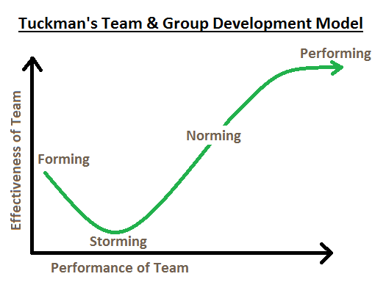
3.2Tuckman
According to Tuckman's approach, relationships form, the leadership style shifts to one that is more collaborative or shared, and the team becomes more capable and mature. Tuckman's initial research only detailed the ways in which he had seen groups change, whether or not they were aware of it.
Teams go through phases that are referred to as forming, storming, norming, performing, and adjourning (or grieving), according to psychologist Bruce Tuckman. Tuckman's concept can be used to improve team performance. Determine which stage your team is in first, then utilize our guidance to help them advance through the stages.

Slide 10
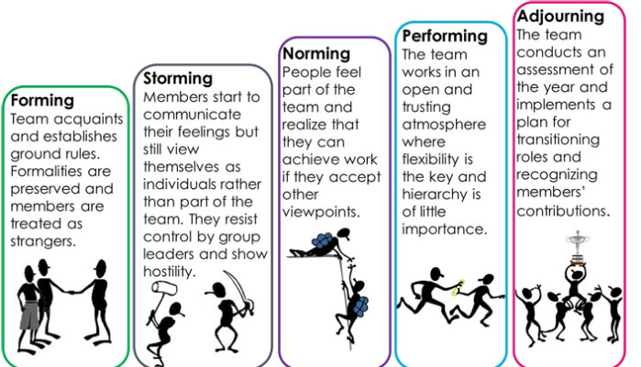
3.4What are the 5 stages of group development ?
Forming – team acquaint and establish ground rules
Storming-members start to communicate their feeling but still view them self as individuals.
Norming-feels part of the team, can achieve work if they accept other viewpoint
Performing- team work works In trusting and
Open atmosphere
Adjourning – the team comes to the end when finishing their task

Slide 11
4.1Belbin Nine Roles
Monitor Evaluator
Another thought-oriented team role is the monitor evaluator , they can put their emotions aside for the problem solving or it’s the project manager strategically scoping projects and connecting the dots across the team.
Plant
Plants help balance out the team , they prefer to brain storm and solidify their own ideas before sharing it out to the team they are highly creative.
Specialist
Their job is specialized on a skill the rest of the team may not have much knowlodge about it.
Resource investigator
They go out and get all the resource and that makes them thrive in product sales.
Shaper
Shapers are natrual leaders.
Completer finisher
They know how to indetify and fix problems in no time.
Implementer
Assesing ways to make the the orginazation processes more efficient.
Team worker
Team workers are natural collaborators, they excel as a product maker within a lager team.
Coordinator
They thrive as team leaders of product developers.

Slide 12
Effective Conflict handling and delegation.
Conflict resolution also builds teamwork, as it brings people together to resolve an issue.
The difference between teams and groups
A group is a number of people who have a common purpose but are to numerous for team role relationship to form.
Group dynamics
Group dynamics refers to the patterns of behavior and interpersonal relationships within a group.

Slide 13
Conclusion
Teams when a perfect model is being applied then the effectiveness of the team increases a lot.
Because these theories and the models are proven and gets more effective when matched with some distinctive individuals. Due to the corona many companies adhered the home office formula but now things have become normal but the companies have seen that home office increases the efficiency of the team members.
Notes:
Teams when a perfect model is being applied then the effectiveness of the team increases a lot. Because these theories and the models are proven and gets more effective when matched with some distinctive individuals. Due to the corona many companies adhered the home office formula but now things have become normal but the companies have seen that home office increases the efficiency of the team members. So, now the hybrid model of workplace is being followed the most so better results can be generated with ease. In this task with various examples hence on the results are discussed, here Belbin, Tuckman, Heckman etc. theories are being discussed with examples.

Slide 14
References
Ali, A.S., Hermawan, A. and Asnawi, Y.H., 2019. Konsep dan tantangan dalam implementasi talent management di perusahaan multinasional: Studi kasus PT Unilever Indonesia Tbk. Journal of Theory and Applied Management (Jurnal Manajemen Teori dan Terapan), 12(1), pp.1-17.
Alkitbi, S.S., Alshurideh, M., Al Kurdi, B. and Salloum, S.A., 2020, September. Factors affect customer retention: A systematic review. In International Conference on Advanced Intelligent Systems and Informatics (pp. 656-667). Cham: Springer International Publishing.
Ashford, S.J. and DeRue, D.S., 2019. Developing as a leader: The power of mindful engagement. Organizational Dynamics, 41(2), pp.146-154.
Atrizka, D., Lubis, H., Simanjuntak, C.W. and Pratama, I., 2020. Ensuring Better Affective Commitment and Organizational Citizenship Behavior through Talent Management and Psychological Contract Fulfillment: An Empirical Study of Indonesia Pharmaceutical Sector. Systematic Reviews in Pharmacy, 11(1).
Dam, S.M. and Dam, T.C., 2021. Relationships between service quality, brand image, customer satisfaction, and customer loyalty. The Journal of Asian Finance, Economics and Business, 8(3), pp.585-593.
Fernandez-Vidal, J., Perotti, F.A., Gonzalez, R. and Gasco, J., 2022. Managing digital transformation: The view from the top. Journal of Business Research, 152, pp.29-41.
Gardas, B.B., Mangla, S.K., Raut, R.D., Narkhede, B. and Luthra, S., 2019. Green talent management to unlock sustainability in the oil and gas sector. Journal of Cleaner Production, 229, pp.850-862.
Hongal, P. and Kinange, U., 2020. A study on talent management and its impact on organization performance-an empirical review. International Journal of Engineering and Management Research, 10.
Jackson, N.C. and Dunn-Jensen, L.M., 2021. Leadership succession planning for today’s digital transformation economy: Key factors to build for competency and innovation. Business Horizons, 64(2), pp.273-284.
Jose, J., 2021. Analyzing the necessity and impacts of organizational culture on the performance of Unilever UK Ltd (Doctoral dissertation, Dublin, National College of Ireland).
Khan, R.U., Salamzadeh, Y., Iqbal, Q. and Yang, S., 2022. The impact of customer relationship management and company reputation on customer loyalty: The mediating role of customer satisfaction. Journal of Relationship Marketing, 21(1), pp.1-26.
Kurdi, B. and Alshurideh, M., 2020. Employee retention and organizational performance: Evidence from banking industry. Management Science Letters, 10(16), pp.3981-3990.
Kwon, K. and Jang, S., 2022. There is no good war for talent: A critical review of the literature on talent management. Employee Relations: The International Journal, 44(1), pp.94-120.
Reis, I., Sousa, M.J. and Dionísio, A., 2021. Employer branding as a talent management tool: A systematic literature revision. Sustainability, 13(19), p.10698.
Shet, S.V., 2020. Strategic talent management–contemporary issues in international context. Human Resource Development International, 23(1), pp.98-102.

