Slide 1
Critical Reading, Thinking & Writing
BSc Professional Investigation
19.10.22

Slide 2

Aim
To introduce you to the following academic skills:
Critical Reading
Critical thinking
Academic writing

Slide 3

Learning Outcomes
Critical Reading –
Define ‘critical reading’
Become a more selective reader
Critical Thinking
Define ‘critical thinking’
Apply critical thinking to
your own work
Identify 3 key parts of an assignment

Slide 4

Academic Reading
Reading whilst studying for a degree IS different
You have to read more
Content is different
Textbooks/journals are difficult to understand/use complex concepts
You have to understand AND remember it!
Do NOT get overwhelmed!
Reading lists provided
Essential reading/key texts

Slide 5

Stages & Types of Reading
3 stages of reading
1.Early stage – thorough & slow
2. Middle stage – precise in selection of sources, faster
3.Final stage – check specific points or follow up ideas – fast
4 Types of reading
Systematic – slow & careful – summarising, evaluating
Standard – answer specific questions, explain to someone else
Scanning – faster, general ideas, gist of topics
Skimming – faster, searching for something

Slide 6

Purpose of Academic Reading
The 3 main purposes of academic reading are:
Information
Understanding
Analysis

Slide 7

Reasons for Academic Reading
Reading for INFORMATION
Overview: Looking for specific pieces of data
Example: getting directions, finding specific information about drink/drive limits, age limits for certain activities etc.
Technique: scanning a text to look for keywords or phrases that answer your question then moving on
Reading for UNDERSTANDING
Overview: gaining a general overview of a topic, area of study
Example: background reading into a specific topic, pre-reads
Technique: reading a text once from start to finish, often passively

Slide 8

Reasons for Academic Reading 3
Reading for ANALYSIS
Overview: using your prior knowledge and applying it to what you are reading
Example: reading for an assignment, dissertation, literature review etc.
Technique: reading a text actively multiple times, asking questions of the text

Slide 9
What is ‘Critical reading’?
Analyse what you are reading
Establishing validity and significance of the text
  What is it claiming?
  What are the reasons for the author to make that claim?
  Do any other authors support that text?
  How does that text relate to other available texts?
Distinguish between FACT and OPINION of the author
Fact = can be verified/checked for accuracy
Opinion = cannot!
Academic opinion – evidence, fact and reason to convince reader that it is a valid opinion

Slide 10
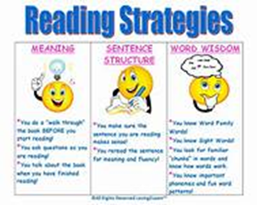
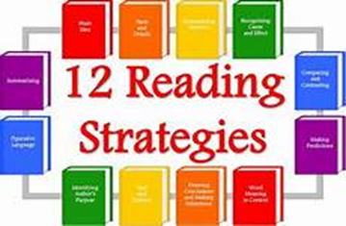
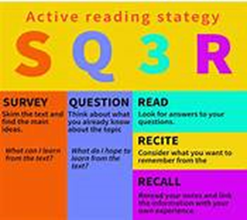
Critical Reading Strategies
5 step tool to aid you – there are others out there!
1.Predict
2. Identify
3. Question
4. Clarify
5. Summarise

Slide 11
Critical Reading Strategy
PREDICT
Guides your reading in a purposeful way and creates links
Ask:
What do you want to get out of reading it?
What are your expectations?
What is your goal?
What are your limits?
What do you think the main arguments of the text will be?
IDENTIFY
Focus on understanding the text by identifying main themes/ideas
Ask:
What are the main ideas/themes in the text?
What are the key pieces of information?
What links these together?
How do these ideas link with others you’ve read?

Slide 12
Critical Reading Strategy
Question
This is where your analysis begins
Look for weaknesses or limitations in the arguments, discussions etc
Ask:
Is there any information missing?
Are the arguments valid?
Is the data reliable?
What is the author’s position?
Any bias?
How does it fit with other evidence/what you already know about topic?
Clarify
Developing your understanding of the text
Ensure you understand terminology
Ask:
Are words/phrases or sentences unclear?
Terminology?
Are there any other authors/theories referred to that are relevant to your reading?

Slide 13

Critical Reading Strategy
Summarise
Vital to cement your understanding, grasped important concepts & can explain in your own words
Summarise key arguments of text in your own words
* If you cannot summarise the text you’ve just read – you haven’t understood it!*

Slide 14
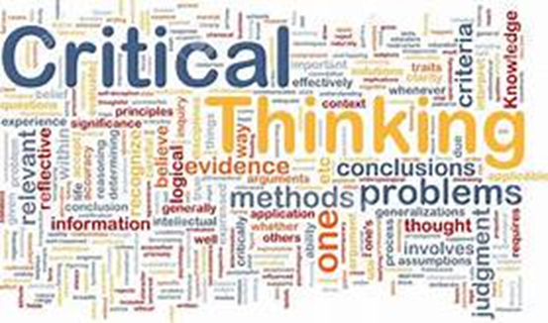
Critical Thinking
Not a new concept
1930’s - Dewey defined as:
“Active, persistent and careful consideration of any belief or supposed form of knowledge in the light of the grounds that support it and the further conclusions to which it tends” (1933, p118)
2009 – Judge et al defined as:
“questioning, challenging approach to knowledge and perceived wisdom which involves examining ideas and information from an objective position and then questioning this information in the light of our own values, attitudes and personal philosophy” (2009, p2)

Slide 15
Cottrell (2005) - Critical thinking
Identifies range of skills and attitudes that constitute critical thinking:
Identifying other people’s positions, arguments and conclusions
Evaluating the evidence for alternative points of view
Weighing up opposing arguments and evidence fairly
Being able to read between the lines, seeing behind surfaces and identifying false or unfair assumptions
Recognising techniques used to make certain positions more appealing than others, i.e. false logic
Reflecting on issues in a structured way, bringing logic and insight to bear
Drawing conclusions about whether arguments are valid and justifiable, based on good evidence and sensible assumptions
Presenting a point of view in a structured, clear, well reasoned way that convinces others

Slide 16

Identifying and analysing an argument
What is an argument?
Disagreement or dispute
What is an academic argument?
An attempt to persuade others (of the validity of a conclusion) by offering at least one reason that supports that conclusion.
i.e. an argument begins with an issue, which is followed by a line of thinking/reasoning, leads to a conclusion

Slide 17
Evaluating the evidence of an argument
The author
Specialist knowledge
Bias and hidden agendas
Ambiguity
Inconsistency
Fact or opinion

Slide 18

Group Task
How would you critically question the following claim:
‘In the last year crime figures have dropped by 10 per cent’.

Slide 19
Suggestions…
What is meant by CRIME? It could be that certain acts, previously considered as a crime are no longer so
HAS there been a drop in reported crime? Or is it still going on but we don’t know about it
What does 10% mean? Is it likely to have an impact? Is 10% just an average drop – which means some may go up?
Who made the claim? Newspaper or H.O.
Was the drop in crime nationwide or just within one particular area?
How recent is the claim and/or statistics? Always look for up to date figures/data
Are there other reports that support the claim or claim other stats
DON’T just accept what you are told….QUESTION IT!

Slide 20

Applying critical thinking to your work
Try to convince your readers of your view/conclusion by offering appropriate, logical reasoning
Take a step back from your work – pretend to disagree with the conclusion –
  Where can you see the gaps in your argument, which elements are weak/not supported well
  List all the reasons leading to your conclusion – adequate/sufficient?
Be careful using general statements – ‘all, every, never, always’ – do you have the evidence to make the claim?
Keep your argument factual

Slide 21
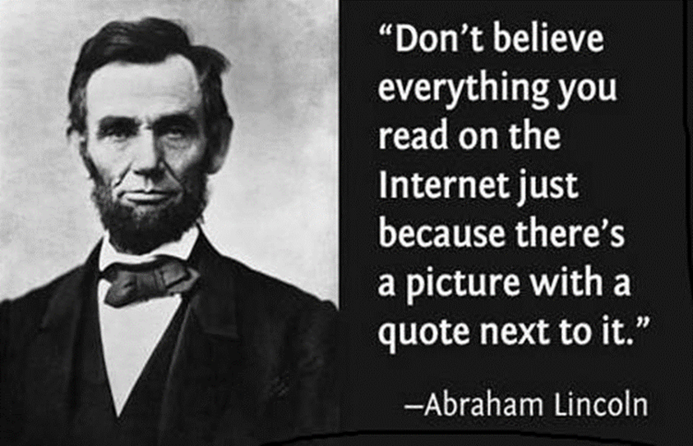
If in doubt – question it!

Slide 22

Academic Writing
Differentiate between four different writing styles
Able to identify process/content/limiting words
Structure an essay/assignment

Slide 23
The 4 Types of Academic Writing
Descriptive
Describe the facts.
Precise and accurate – what happened, what someone said or describe key features.
Associated with report writing.
Ok to use if giving background information
Analytical/argumentative
Your opinion about the subject with evidence to support your opinion
State your point of view
Validity of position supported by evidence or examples
Consideration of counter-argument, including evidence
Persuades others that your position is the strongest
Analytical/Evaluative
Always consider two or more theories/beliefs/ideas that you compare and contrast
By comparing you bring out similarities
By contrasting you focus on the differences
You evaluate your findings – strengths/limitations/implications
Make a judgement on the findings – justify your choice
Must be balanced
4. Personal/experiential
Where you relate theory to your practice/experience
Supportive or contradictory
Does NOT usually form part of essay

Slide 24
Academic Writing
Purpose
To demonstrate-
  Knowledge and understanding of a topic
  Ability to research specific aspect of topic set in the assignment and
  Ability to organise supporting information/evidence within a structured piece of writing
What is an essay?
‘a short piece of writing on a set topic’ (Chambers and Northedge, 2008 . P.153)
2. ‘your opinion about a little bit of a subject, in which you use evidence to support your opinion’ (Mounsey, 2002. p10)

Slide 25
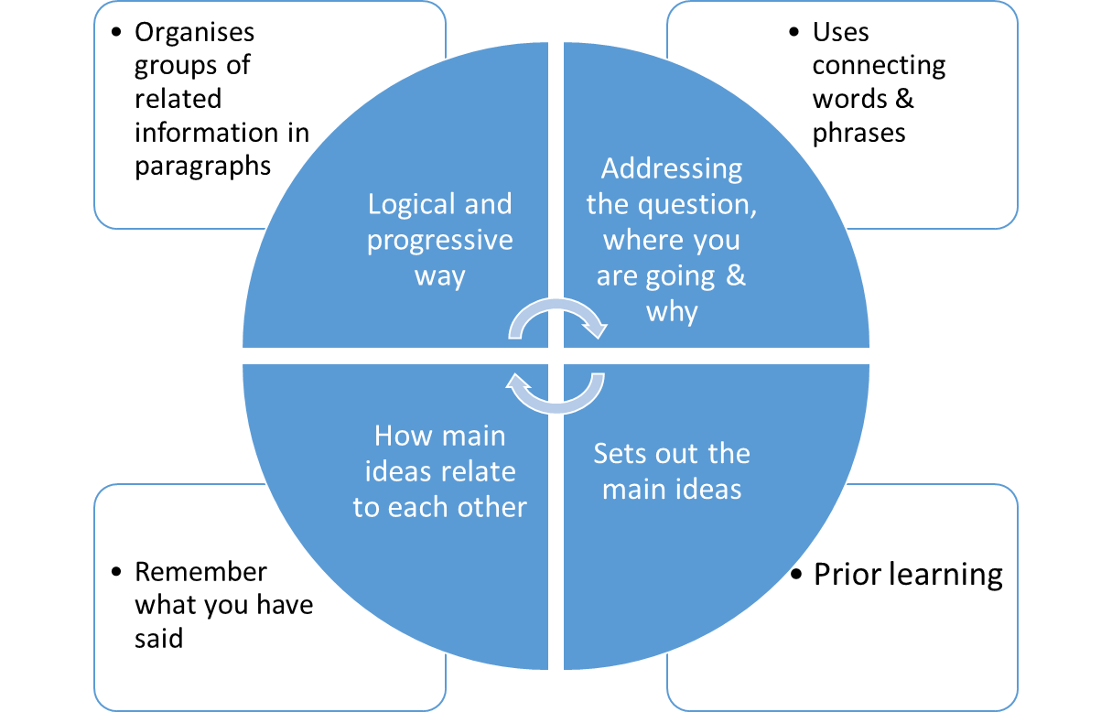
Ingredients of a Good Essay

Slide 26
Understanding the Assignment
Read the assignment brief
Underline words that guide you on the subject/topic information you need ( i.e. content related)
Underline words that are process related known as Directive Words (i.e. what to do with the subject - instructions)
Underline limiting words (i.e. word count, specific instruction)
Content words – are specific to the module
Process/instruction words – may be used in any module

Slide 27
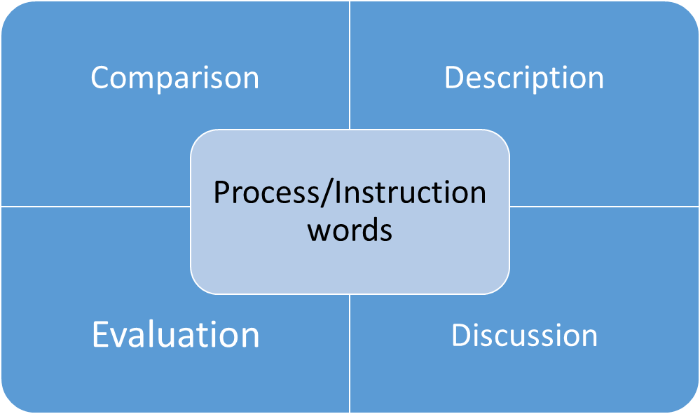
Directive Words
Directive words –
tell you what to do

Slide 28
Directive Words (2)
Description
Give the main information on a topic without comment
Evidence and specific examples are sometimes needed to support these main facts
Discussion
Give main points of topic then examine each point and look at different arguments
Requires more ‘critical thinking’ and organising
Select material and discuss it – support with evidence

Slide 29
Directive Words (3)
Evaluation
Most challenging essay type
Present selected facts, discuss them in way to direct reader to a conclusion
Back up your view – discuss evidence or reasoning involved
Comparison
Requires you to find similarities and/or differences between evidence/facts/viewpoints
Clear structure to essay
Can require description, discussion or evaluation depending on what asked

Slide 30
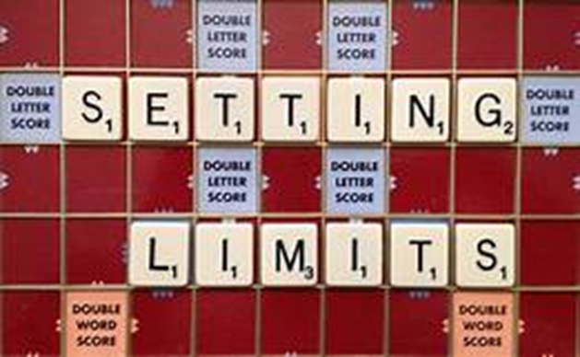
Limiting words
Words which provide boundaries or constrains for your assignment
e.g. word count or subject specific

Slide 31
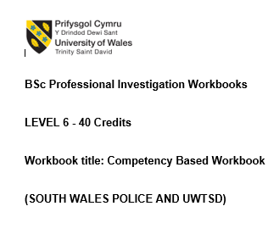
Workbook 1 – Identifying key words
Directive Words
Topic
Limiting words

Slide 32
Workbook 1 - Task 1
Focussing upon the last 12 months of your career, critically evaluate your own performance using principles of reflection ( e.g., skills development, academic achievements, CPD and training).
Analyse the importance of continuous personal and professional development in achieving organisation objectives and the use of reflective practice in personal and professional development.
2000 words (+/- 10% include your actual word count at the end of each section)

Slide 33
Workbook – task 2
Give a brief description of the investigation including social and legislative contexts and any relevant cultural, ethnicity and language issues.
Demonstrate your critical thinking, analysis and evaluation of assumptions, generalisations and material (that may be incomplete) and how you communicated your conclusions to specialist and non-specialist investigators/departments
Critically evaluate the challenges associated with the investigation and the actions undertaken to effectively deal with such challenging situations.
2000 words (+/- 10%: include your actual word count at the end of each section)

Slide 34
Workbook – Task 3
Give a brief description of the incident including social and legislative contexts and give any relevant cultural, ethnicity and language issues.
Analyse how you employed established techniques to progress the investigation
Critically evaluate how you applied specific legislation and or powers to the investigation.
Explore the use of the techniques you applied to the investigation and demonstrate your understanding of their use.
2000 words (+/- 10%: include your actual word count at the end of each section)
Notes:
I’ve missed one directive word out – can you see where it is?

Slide 35
Workbook – Task 4
Research and critically analyse current theories and methodologies relevant to your own specified are of investigation (e,g, use of specialist interviewing techniques, crime scene management, NDM)
Evaluate the importance of applying skills, knowledge and experience to reach appropriate investigative outcomes.
2000 words (+/- 10%: include your actual word count at the end of each section)

Slide 36

Extra – tips - Paragraphs
Building blocks of the essay
Each paragraph should contain:
  A topic sentence ( or idea) that states your point
  An explanation of the point you are making
  Evidence – support your point with evidence from reading/example

Slide 37

Extra tips - Signposting
Paragraphs will require signposts/linking – these are words you use to join sentences
Will make your essay flow

Slide 38

Any questions?

