Slide 1
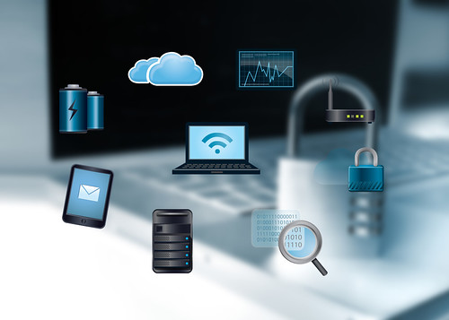
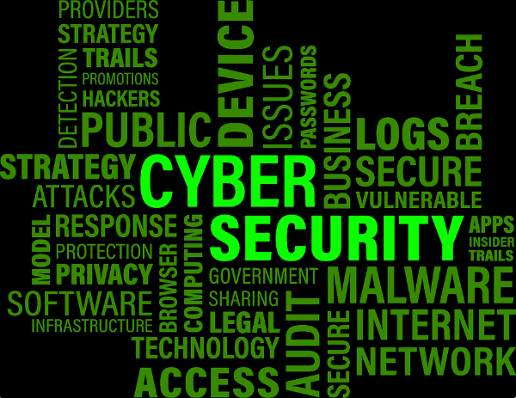

BASIC DIGITAL SAFETY
NAME; SIRAJE BBAALE
STUDENT ID; 2414383
MOODL ID; LCL4002
GROUP; 6
LECTURER NAME; KOUSHIK MODAK
Digital safety in the workplace, also known as cyber security,
Todays world industries, skills are dominating into digital as the companies and employees there all engaged in digital
From all the sources across the website
Be careful of a website
In todays world day by day the hackers they will be looking for unsquared computer so that they start there business of attacking your computer there and then.
Be careful of Wi-Fi your using
There are several ways to check the safety of a wi-fi connection, you can use a security check tool.
Perfecting when inserting password.
Inserting a password in your computer helps you to secure your work project you will be doing .
Try not to share your password to same Boday , the fact its help
A cyber security analyst for work place ;
Protect company hardware and software from cybercriminals.
Evaluate the threats that could potentially make the network unsecure. Furthermore, security analysts are responsible for keeping the companies and organization's system up to date. Then help to protect their computer systems and networks. Regularly keep on checking company financial accounts, statements, and digital payments, if you do this regularly it will help your self and the company or the organization.
In digital safety you should back up your data regularly when your using external storage on the device, business and companies should either manually backup all date to an external hard drive
References: Tech.co(2024) “Cyber Security Measures” , available at : https://tech.co/vpn/cyber-security-measures , (accessed on 26/11/2024) .

