Slide 1

apple
An organisational examination and assessment.
Assignment 2
Benedict Michael Gibson 2114133
Carmarthen Business School UWTSD
BMSP4002 Contemporary Management Approaches
Glenn Behenna
21st December 2021

Slide 2
Table of Contents
An organisational overview of Apple incorporated
Approach to strategy
Approaches to organisation, management and leadership
Groups and teamwork
Corporate Social Responsibility
Conclusion
Notes:
Table of contents.

Slide 3
Organisational overview
Founded by Steve Jobs and Stephen Wozniac in 1976
1980 valued higher than Ford at $2billion (Levy, 2021)
Computing revolution and Inventiveness race.
2011 Tim cook became CEO (Appleinsider.com, n.d.)
2018 Apple valued at $1trillion (Kolakowski, 2021)
2020 Apple valued at $2,08trillion, higher than Italy’s GDP (Kolakowski, 2021)

Slide 4
“Strategy- noun
: a careful plan or method for achieving a particular goal usually over a long period of time
: the skill of making or carrying out plans to achieve a goal” (merriam-webster, n.d.)
‘Competitive strategies are as a result of tools used to find a unique position in the industry’ (Porter, 1998)
Strategies are actions “in response to what can be a demanding environment” (Mintzberg, et al., 1998)

Slide 5
An organisation is management of people to achieve a goal or goals. (Haney, 1934)
Vision statement:
“We believe that we are on the face of the earth to make great products and that’s not changing.” (Mission-Statement.com, n.d.)
Mission statement:
“ to bringing the best user experience to its customers through its innovative hardware, software, and services.” (Mission-Statement.com, n.d.)
Strategies are planned actions in order to achieve goals.

Slide 6
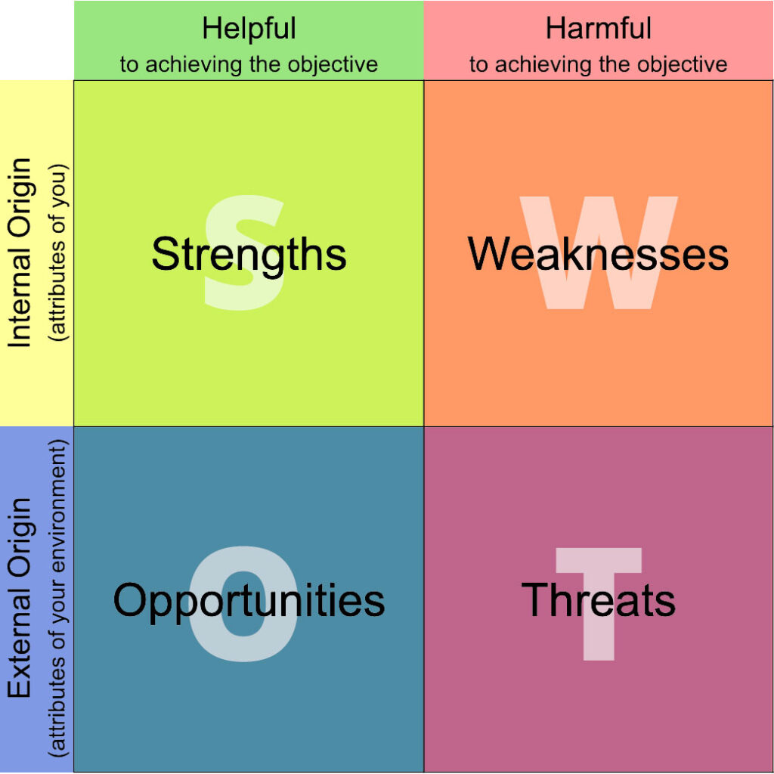
S.W.O.T analysis
(Bird-Harris, 2020)

Slide 7
Political
Economic
P.E.S.T.E.L
Analysis
Social
Technological
Environmental
Legal
(De Bruin, 2016)
Notes:
Pestel

Slide 8

Taxes, Privacy laws, Political lobbying, Global politics such as trade wars.
Currency exchange rates, interest rates, cost of labour, inflation rates.
Affordability, Child influence.
Tech Battles, Limited new products, competitors more capable with manufacture.
Materials and manufacture process detrimental to the environment
Anti-competition and competition laws, Copyright law.
(David, 2020)
(Dudovskiy, 2021)

Slide 9
Strengths
Product variety
Software development
Strong R&D department
Great workforce
Strong brand image
Financially strong
Design
Innovation
Global market position
Weaknesses
Expensive products
Weak manufacture
Inflexible connectivity
Narrow product line
Niche market
Limited distribution network
S.W.O.T Conclusion
Threats
Cost of foreign trade and labour
Dependency on external manufacture
Affordability
Tech battles
Environmental impact of materials and manufacture
Copyright laws
Opportunities
Demand for computers and laptops
Technological dependency
Globalisation
R&D e.g. AI
Product diversity
Expansion of distribution network
(Bird-Harris, 2020)
(Haque, n.d.)

Slide 10
Categorised theories:
Classical
Including:
Fayol’s five-point personnel interaction to achieve control and planned production (Krenn, 2011)
Weber’s Bureaucratic management system (managementstudyhq, n.d.)
Taylor’s motivation (scientific) theory (Taylor, 1911)
Human relations
Including:
Mary Porter Follet’s management theory (Porter G. , 1995)
Landsberger’s exploration of the Hawthorne experiments (Landsberger, 1958)
Systems
Including:
Von Bertalanffy’s systems theory of management (von Bertalanffy, 1968)
Contingency
Including:
Fiedler’s Theory of leadership (Fiedler, 1958)
Approaches to management and leadership
Management theory
All managerial acts are based on theory (Cutcher-Gershenfeld & McGregor, 2006)

Slide 11
Apples theoretical approach
Hypothetical elements of Human relations approach
Strong elements of Systems
influences of classical management approach
Overall adoption of the contingency approach

Slide 12
Groups
Organisations are made up of people.
*
Group: “a number of people who are connected by some shared activity, interest, or quality” (merriam-webster, n.d.)
*
Durkheim’s Collective consciousness concept; sharing attributes, goals, beliefs with a ‘group’ influences individual behaviour and sense of belonging and identity (Cole, 2019)
*
In 1979 Tajfel and Turner introduced a Social Identity Theory giving processes relevant to identifying as part of an in-group or an out-group (age-of-the-sage, n.d.)
*
A managers understanding and identifying with groups within an organisation instrumental to achieve desired influences.

Slide 13
Teams
Groups can be divided into social or task orientations (Tuckman, 1965)
*
Task groups can become a functioning team through a “developmental sequence” (Tuckman, 1965)
*
Team members can be from differing social groups with differing expertise for the benefit of the team, as demonstrated by Apples board of directors (Apple, n.d.)

Slide 14
Corporate Social Responsibility
“to engage in CSR means that, in the ordinary course of business, a company is operating in ways that enhance society and the environment, instead of contributing negatively to them.” (Fernando, 2021)
Apple; “We do the right thing, even when it’s not easy.” and apply an ethical honest and legally compliant approach. (Apple, n.d.)

Slide 15
Conclusion
In order to achieve its success, Apple have demonstrated;
A well-founded strategy
A good understanding and successful application of management theory and leadership
Hypothetically good application of knowledge on groups and team formation
Clear principles and ethics
Continuing apple could;
Continue with their contingency management approach
Continually adapt strategies depending on the situations that arise
Adapt their primary income focus to be less physical goods dependant

Slide 16
END

Slide 17
References
age-of-the-sage. (n.d.). Social Identity Theory. Retrieved 12 20, 2021, from age-of-the-sage.org: https://www.age-of-the-sage.org/psychology/social/social_identity_theory.html
Apple. (n.d.). Ethics and compliance. Retrieved 12 21, 2021, from Apple.com: https://www.apple.com/compliance/
Apple. (n.d.). Leadership. Retrieved 12 21, 2021, from Apple.com: https://www.apple.com/uk/leadership/
Appleinsider.com. (n.d.). Tim Cook. Retrieved december 13, 2021, from Appleinsider.com: https://appleinsider.com/inside/tim-cook
Bin Sattar, S. (n.d.). Leadership Qualities, Skills and Style of Tim Cook. Retrieved 12 20, 2021, from thestrategywatch.com: https://www.thestrategywatch.com/leadership-qualities-skills-style-tim-cook/
Bird-Harris, S. (2020, june 10). How to Do a Simple SWOT Analysis That Will Boost Your Professional Career. Retrieved from allthingsadmin.com: http://www.allthingsadmin.com/swot-analysis/
Cole, N. L. (2019, jan 16). The Concept of Collective Consciousness. Retrieved from thoughtco.: https://www.thoughtco.com/collective-consciousness-definition-3026118
Cutcher-Gershenfeld, J., & McGregor, D. (2006). The human side of enterprise (Annoted ed. ed.). McGraw-Hill.
David, J. (2020, oct 09). PESTEL analysis of Apple. Retrieved from Howandwhat.net: https://howandwhat.net/pestel-analysis-apple/
De Bruin, L. (2016, september 18). Scanning the Environment: PESTEL Analysis. Retrieved from Business-to-you.com: https://www.business-to-you.com/scanning-the-environment-pestel-analysis/

Slide 18
Dudovskiy, J. (2021, feb 17). Apple PESTEL Analysis. Retrieved from Business Research Methodoligy (BRM): https://research-methodology.net/apple-pestel-analysis-4/
Fernando, J. (2021, sept 04). Corporate Social Responsibility (CSR). Retrieved from investopedia.com: https://www.investopedia.com/terms/c/corp-social-responsibility.asp
Fiedler, F. E. (1958). Leader Attitudes and Group Effectiveness. Urbana, IL: University of Illinois Press.
Haney, L. H. (1934). Business organization and combination; an analysis of the evolution and nature of business organization in the United States and a tentative solution of the corporation and trust problems. New York: Macmillan co.
Haque, F. (n.d.). SWOT Analysis of Apple Inc. Retrieved 12 14, 2021, from The strategy watch: https://www.thestrategywatch.com/swot-analysis-apple-inc/#:~:text=The%20SWOT%20or%20strategic%20analysis%20of%20Apple%20showed,countries%20and%20high%20price%20which%20can%20be%20overcome.
Kolakowski, M. (2021, March 17). At $2.08 Trillion, Apple Is Bigger Than These Things. Retrieved from investopedioa.com: https://www.investopedia.com/news/apple-now-bigger-these-5-things/
Krenn, J. (2011, July 02). Management Theory of Henri Fayol. Retrieved from Business.com: https://www.business.com/articles/management-theory-of-henri-fayol/#:~:text=Articles%2C%20reports%2C%20and%20other%20resources%20on%20Fayol%27s%20management,Commanding.%20...%204%20Coordinating.%20...%205%20Controlling.%20
Landsberger, H. A. (1958). Hawthorne revisited. New York: Cornell University.

Slide 19
Levy, S. (2021, february 02). Apple inc. . Retrieved from Britennica.com: https://www.britannica.com/topic/Apple-Inc
managementstudyhq. (n.d.). Bureaucratic Theory by Max Weber. Retrieved 12 15, 2021, from managementstudyhq.com: https://www.managementstudyhq.com/max-webers-bureaucratic-management-theory.html#:~:text=Max%20Weber%E2%80%99s%20bureaucratic%20management%20theory%20focuses%20on%20is,Plus%20there%20be%20nothing%20like%20a%20flexible%20role.
merriam-webster. (n.d.). Group. Retrieved 12 20, 2021, from merriam-webster.com: https://www.merriam-webster.com/dictionary/group
merriam-webster. (n.d.). Strategy. Retrieved 12 12, 2021, from merriam-webster.com: https://www.merriam-webster.com/dictionary/strategy
Mintzberg, H., Ahlstrand, B., & Lampel, J. (1998). Strategy safari: A guided tour through the wilds of strategic management. Free Press. Retrieved from https://archive.org/details/strategysafarigu0000mint_j2q8
Mission-Statement.com. (n.d.). Apple Mission and Vision Statement Analysis. Retrieved 12 14, 2021, from Mission-statement.com: https://mission-statement.com/apple/#:~:text=Apple%20Mission%20and%20Vision%20Statement%20Analysis%201%20Introduction.,5%20Headquarters%206%20References.%20Apple%20%E2%80%93%20About.%20
Porter, G. (1995). Mary Parker Follett—Prophet of Management: A Celebration of Writings from the 1920s. Academy of Management Executive, 9(1), 86-88. doi:10.5465/AME.1995.9503133526
Porter, M. E. (1998). Competitive strategy : Techniques for analyzing industries and competitors. Free Press. Retrieved from https://ebookcentral.proquest.com/lib/trinity/detail.action?docID=4934952

Slide 20
Taylor, f. w. (1911). The Principles of Scientific Management. Retrieved from https://www.gutenberg.org/cache/epub/6435/pg6435.html
Tuckman, B. w. (1965). DEVELOPMENTAL SEQUENCE IN SMALL GROUPS. Psychological Bulletin, 385, 397. Retrieved from https://the-happy-manager.com/wp-content/uploads/Tuckman_1965_Developmental_sequence_in_small_groups.pdf
von Bertalanffy, L. (1968). General System Theory: Foundations, Development, Applications. New York: George Braziller.

