Slide 1
Introduction to the Law of Succession and Administration of Estates
Week 2 – Gifts in Wills

Slide 2
What is this topic about and why do we study it?
ABOUT: what happens to a person’s property when they die
  What happens to the rights to the property
  Who gets it and who doesn’t
  Is there total freedom
  What are the rules/laws
  What happens when things go wrong

Slide 3
Gifts in Wills

Slide 4
Gifts in Wills – Testamentary gifts
Real property = freehold property - gift is called ‘devise’
Personal property = everything else (incl. leasehold estate, cars, jewellery, wine, books, paintings) – gift is called ‘legacy’
Specific legacy – gift of a specific item or items
General legacy – a horse ( not a specific horse) or a car (not a specific car)
Pecuniary legacy – gift of money
Demonstrative legacy- e.g £100 from my Lloyd’s account ( general in nature but to be paid from a specific fund – if fund insufficient, paid from the rest of the estate)
Residuary legacy - i.e. What is left after the gifts have been made
Class gifts – gift of property to be divided amongst persons who fulfil a general description e.g ‘the children of X’ or ‘the children of X who attain the age of 21’

Slide 5
Gifts: different types contd…..
Immediate vested – where the asset or share of the asset vests immediately in the beneficiary – there is no delay – in terms of a class gift, the class has closed and so the share can be awarded
Deferred vested – where the asset or share will vest at a later date than the date of death of the T e.g when the beneficiary reaches the age of 25
Contingent gifts – the gift is contingent (conditional) upon something happening e.g a gift to any children of X who reach the age of 21

Slide 6
Gifts to children
Contingent
  Subject to a precondition e.g £1000 to X provided he attains the age of 18
Vested
  Gift will vest as long as the beneficiary survives the testator
  Gifts to infants or minors will be placed on trust and given to the minor when they reach 18

Slide 7
Gifts – issues/failures
Gifts may fail for a number of different reasons
  Failure under s 15 Wills Act 1837
  Failure due to divorce or dissolution
  Lapse
  Ademption
  Abatement
  Void for uncertainty
  Void for breaching perpetuity rules
  Forfeiture Act 1982
  Void for being a capricious gift
We will look at different types of gift /situation individually

Slide 8
Failure under s15 Wills Act
S15: any gift in a will to a witness or a witness’s spouse or civil partner is void
Will remains valid
Only extends to actual spouse of civil partner and NOT to other close family or a fiancee or a parent, for example
Note s15 would not apply if the witness was a fiancee and then later married the beneficiary
Also s 15 will not apply if there are more than the required 2 witnesses
An invalid gift in an original will could become valid if confirmed in a later codicil signed by 2 other witnesses.

Slide 9
Failure due to divorce or dissolution
If T dies after 1995 ( this is when law changed) a gift in the will to the former spouse or former civil partner will fail
Gift is treated as if that former spouse or civil partner died on the day of divorce
The gift to them would then either pass to another beneficiary or pass outside of the will on a partial intestacy.
Example: A leaves estate to his wife B and thereafter to their child C. If A and B divorce, when A dies B is treated is having died and so C inherits

Slide 10
Failure due to lapse
Failure links to the beneficiary rather than the ‘gift’ itself eg the beneficiary has died before the T dies
The gift will lapse
What happens to the gift depends on whether the dead beneficiary was the T’s child
S33 Wills Act : if the gift is to T’s child and that child predeceases the T but has children of their own then those children ( the grandchildren) will inherit
In any other situation, the gift will fail and will pass on intestacy

Slide 11
S 33 Wills Act 1837
s33 WA 1837, as amended = exception to the doctrine of lapse if property is left in a will by a testator to their children or remoter issue (i.e. grandchildren, or great-grandchildren).
s33(1) states that where:
(a) a will contains a devise or bequest to a child or remoter descendant of the testator; and
b) the intended beneficiary (child or descendant) dies before the testator, leaving issue; and
(c) issue of the intended beneficiary are living at the testator’s death,
then, unless a contrary intention appears in the will, the devise or bequest shall take effect as a devise or bequest to the issue living at the testator’s death.
The effect of s33 can be excluded by a contrary intention in the will ( see Hives v Machin [2017] )

Slide 12
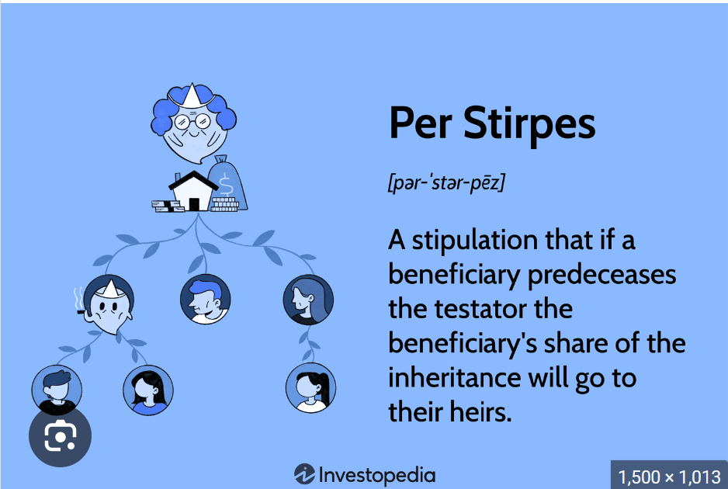
Example
A clause states , “I give £10,000 to my son, Jacob”. If Jacob predeceases the testator, leaving two children, Rebecca and Miriam, they will each receive £5,000. They will therefore inherit Jacob’s legacy per stirpes (s33(3)).

Slide 13
Failure due to no entitlement to dispose of the property by will
If the T was not entitled to the property then the gift will fail
This could occur in the case where property is owned under a joint tenancy (NOT where property is owned as tenants in common)
Under a joint tenancy the property passes automatically on death to the survivor and therefore cannot legally be gifted to anyone.

Slide 14
Ademption
Failure of a SPECIFIC gift: gift fails as T no longer has that ‘specific’ gift – knows as ADEMPTION
  Applies to ‘specific’ gifts e.g ‘my Blue Rolls Royce
  Item may have been sold by the T
  Item may have been lost/destroyed
  It may have changed in nature ( Re Slater [1907])

Slide 15
Example
A clause may state “I give my Picasso painting to George”. Clearly, at the time the will was drafted, the T would hav owned a specific Picasso painting which he wanted to leave to George. If T had sold the Picasso painting before his death, the gift to George would fail. The executors would not be under a duty to acquire another Picasso painting to pass on to George, and George does not receive the sale proceeds.
Ademption can occur also when the specific gift referred to in the will has been destroyed or lost before the T’s death. In Durrant v Friend [1852], there was a gift of personal effects which were lost when the T drowned at sea: the gift failed; it adeemed. This case also confirms that the assumption in a case like this would be that the property is destroyed before the T died.

Slide 16
Another example
Re Clifford [1912] : will included a legacy of “twenty-three of the shares belonging to me” in X Co Ltd. At the time, T held 104 £80 shares in the company. Before the testator died, the company changed its name and sub-divided each share into four £20 shares. It was held that this was a change in form and not a change in substance and so the beneficiary took the shares which represented those originally given – that is, 92 £20 shares.
Re Leeming [1912]: T left a legacy of “My 10 shares” in Y Ltd. Before his death, the company went into liquidation and formed itself into a new company with the same name. The testator was issued with 20 £5 ordinary shares and 20 £5 preference shares to replace those originally issued. Once again, it was held that ademption did not occur because the change was in form and not in substance. The securities were of the same kind and were in essentially the same company. A change from shares into debenture (loan) stock would be a change in substance, because a debenture holder is a creditor rather than an owner of the company.

Slide 17
… another example
A clause in a will says:
“I devise my property, 10 Trinity Avenue, Swansea, to Jane”. Six months before death the testatrix sold 10 Trinity Avenue and bought 6 New Road.
In this instance it would not be presumed that the testatrix meant Jane to receive 6 New Road.
If the testatrix’s intention is that Jane gets a property in which T is living at the date of her death what should the T do?
Have a go at drafting a suitable clause

Slide 18
Lapsed gift – commorientes rule
Deals with situation where two or more persons leave property to one another but the circumstances of their deaths are such as to indicate no evidence as to who died first.
Governed by s 184 Law of Property Act 1925 ( LPA 1925) – if 2 or more persons have died in circumstances where it is uncertain which of them survived the other, such deaths shall …. be presumed to have occurred in order of seniority, and the younger shall be deemed to have survived the elder

Slide 19
Lapsed gift – commorientes rule
Example
Re Scarle [2019]: rare recent example of a commorientes case. Mr and Mrs Scarle (79 and 69 yrs) were an elderly and frail couple who both died from hypothermia in their home at some point between 4 October 2016 and 9 October 2016. The dispute was between Mr Scarle’s daughter, representing HIS estate who inherited, and Mrs Scarle’s daughter, representing HER estate.
The medical evidence relating to the times and dates of their deaths, based on rates of decomposition of the bodies and the temperatures of the rooms in which they were found, was unable to prove which of the couple died first. Mr and Mrs Scarle’s house and bank account were both in their joint names and the key issue was whether s184 LPA 1925 would apply.
Mr Scarle’s daughter was unable to establish that Mrs Scarle had died first on the balance of probabilities. The judge therefore held that s184 LPA 1925 applied and the jointly owned assets passed to Mrs Scarle’s daughter.

Slide 20
Gift failing for uncertainty
Uncertainty of subject matter: e.g.Boyce v Boyce [1849]. The testator left his houses to trustees in trust for his wife for life, and after her death the trustees were to allow his daughter, Maria, to choose one of the houses. The remaining houses were to pass to his other daughter, Charlotte. Maria died in the testator’s lifetime and Charlotte survived him. Since Maria was obviously unable to choose which house to have, it was impossible to know which houses Charlotte was entitled to receive and so the gift failed for uncertainty.
Also failing for uncertainty: Gifts of “some of my best table linen” (Peck v Halsey [1726]) and “of a handsome gratuity” (Jubber v Jubber [1839])
However, now that it is possible to admit extrinsic evidence of a testator’s intention under s21 Administration of Justice Act (AJA 1982), it may be possible to establish what the testator intended.
Uncertainty of beneficiary: “ I leave my Bentley car to my favourite niece”

Slide 21
Void for breaching perpetuity rules
Perpetuity rule = a private trust cannot exist indefinitely ( this doesn’t apply to charitable trusts)
‘Perpetuity’ = 125 years ( Perpetuities and Accumulations Act 2009)
Eg a clause which reads “ I give the residue of my estate to hold on trust and pay the income derived from it to my children and further descendants indefinitely’ .. That would fail as being >125 years
However an alternative “ I give the residue of my estate to hold on trust and pay the income derived from it to my daughter Jane and thereafter to Jane’s daughter absolutely” would be acceptable as the gift would not continue past 125 years.

Slide 22
Other gift ‘fails’
Illegal, immoral or contrary to public policy
A testamentary gift cannot be conditional on a person committing an illegal or immoral act or contrary to public policy.
A testator cannot therefore make a gift conditional on the beneficiary killing someone or stealing etc.
A gift will also fail if it is conditional on a person getting divorced.
The courts will use contrary to public policy if it feels a gift should be void
Also a beneficiary cannot benefit from a crime (Forfeiture Act 1982) and so would not be allowed to inherit from the estate of the person they have murdered ( Re Crippen [1910]) but also see Macmillan Cancer Support v Hayes [2017] for relief from forfeiture ( H mercy kills wife then takes own life. His will leaves his estate and all that he would inherit from his wife to cancer charities )
Void for being a ‘capricious’ gift eg Brown v Burdett [1882] – house should be partially boarded up for 20 years and then transferred to certain beneficiaries – “useless” said the judge and voided the instruction

Slide 23
Workshop tasks
Create 5 different gift clauses that have the potential to fail and explain in each case what the problem is or might be.

