Slide 1
Student name : Nazma Iqbal
Student number: 2239683
Module code and title: LCHS4009 Professional development within health and social care
Lecturers name:Hajra Mustasim

Slide 2


Today, I'll talk about my future career ambition to pursue a career as a healthcare assistant in the UK's health and social care system. I'll go over what is expected of a healthcare assistant and discuss my own advantages, disadvantages, opportunities, and threats. I will also go over how I could overcome challenges, improve my weaknesses and become prepared for this career.

Slide 3

I've chosen to pursue a career as a healthcare assistant since I would like to provide help to individuals in trouble. Hospitals, nursing homes, and local medical services are some of the places where a healthcare assistant does their job. Helping individuals with personal assistance, meals, drinks, getting from one place to another, and other daily responsibilities are the most important duties . Healthcare assistants also do their job to help different individuals in the healthcare sector . It is important for this role and for this job that you know how to show kindness, fairness and working together as a team and one of the most important which is being responsible. I also understand how important it is for me to treat every patient with respect and consideration.

Slide 4
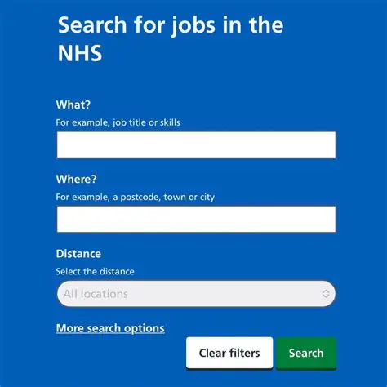
I have researched some information on healthcare assistants and looked for healthcare assistant job adverts on the NHS Job website. Once I have read through this advert it will make me understand what I need for this job e.g. qualifications and experience. This will help me find what my strengths and weaknesses are and will also help me find exactly what I need to improve about myself, and this will then get me ready to work in an environment being a Healthcare assistant.
Job title: Healthcare Assistant.
Employer: Avery Healthcare Group Ltd
Location: Avery Healthcare , Winson Green , B18 4BJ , United kingdom
Salary: £12.72 an hour
Closing date: 05 November 2026
Source: https://www.jobs.nhs.uk/candidate/jobadvert/L0034-26-4342?searchFormType=main&keyword=healthcare%20Assistants&location=Birmingham&language=en&country=GB-ENG&page=2&sort=publicationDateDesc
The reason I chose this specific job is because it will help me further on with my experience. They are looking for someone who will have a positive impact on their residents, and I feel like I am just the right person who can do that.

Slide 5
My Strength
My Weakness
Kind and Respectful
Effective Communication
Patience
Observation skills
Dealing with emotions
Being available to everyone
Gaining practical skills
One weakness of mines is being available to everyone and trying to give care and time to more than one person at a time as I'm scared to hurt someone or make them feel down and this wouldn’t be good in a care home as it could put me under stress and also upset my residents because I can't keep up with their care.
Another weakness is dealing with emotions I have a big problem with this as I find it hard to deal with emotions and this could be a bad thing for me when working in a care home because if a resident is coming to me with their problems and they see me cry over their issues or being upset with them makes them not feel secure or better.
One on my strengths is effective communication I feel like I am very confident in speaking to new people and getting to know them and speaking about personal things and comforting a person , in a health care home it is important to show communication with every resident and make them feel as comfortable with you as possible e.g. someone who is feeling down could come and speak to me about their problems and I will know how to comfort them.

Slide 6
Opportunities
Threats
Do an extra health and social course
Read healthcare books
Do some healthcare volunteering
Stressful busy environment
Competition for jobs
Low pay and financial stress
There are many opportunities linked to my career, but a very good opportunity could be doing an extra health and social care course to grow my knowledge. This way I can learn more new information and apply it to my job which will help me a lot.
Another opportunity could be to do some healthcare volunteering this will give me some experience into what working as a healthcare assistant could be like and get me prepared for it.
A threats that could come with this career could be a stressful busy environment work could get very busy with every patient needing something at once which could be stressful and stress you out physically and emotionally but I can overcome this by making a schedule and going to one person at a time and not giving the chance to put myself in a stressful situation this will build my thinking skills.

Slide 7
Conclusion
In conclusion this SWOT analysis has really helped me in identifying my strengths and weaknesses and what I can to better these. My strengths help me show kindness and be respectful whereas my weaknesses are something I can work on and improve. Doing extra training can help me build more knowledge about going into the job. My main goal is to become independent and responsible as a healthcare professional. Thank you for listening.
https://www.jobs.nhs.uk/candidate/jobadvert/L0034-26-4342?searchFormType=main&keyword=healthcare%20Assistants&location=Birmingham&language=en&country=GB-ENG&page=2&sort=publicationDateDesc
https://www.skillsforcare.org.uk/Careers-in-care/Job-roles/Roles/Care-worker.aspx
https://www.healthcareers.nhs.uk/explore-roles/healthcare-support-worker/roles-healthcare-support-worker/healthcare-assistant

