Slide 1
ECAY4002
Introduction to Advocacy
Phillip Morgan
2017

Slide 2
Participatory Frameworks
Arnstein’s Ladder of Participation (1969)
Hart’s Ladder of Participation (1992)

Slide 3
Arnstein’s Ladder of Participation
Citizen Control
Delegated Power
Partnership
Placation
Consultation
Informing
Therapy
Manipulation
(Arnstein, 2006)

Slide 4
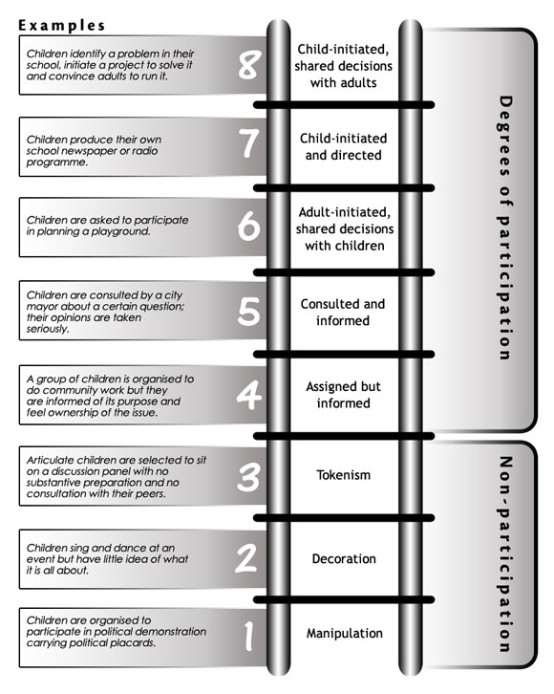
Various representations of it’s application
From children and young people to
Adult care
Elderly care
Mental Health
Activity:
Consider how this ladder might be applied in a setting of your choice, then discuss within your group how these approaches might be used and why they might be necessary within a given context.

Slide 5
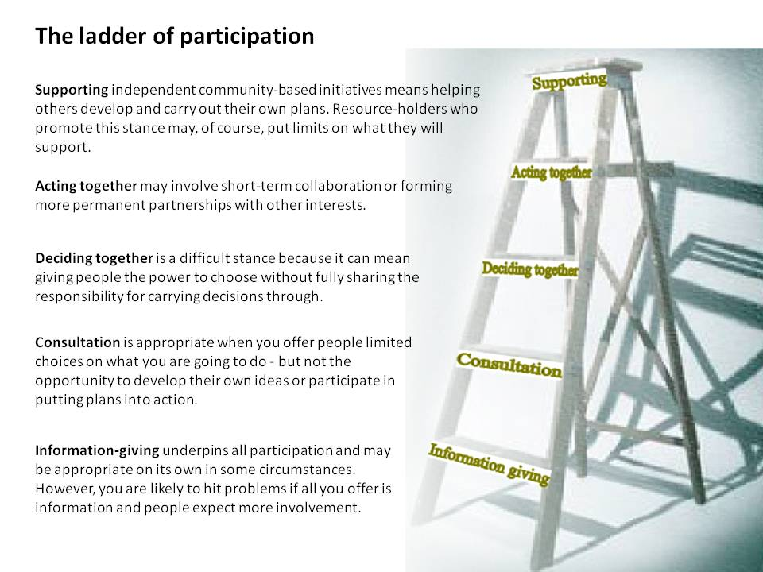
Another example

Slide 6
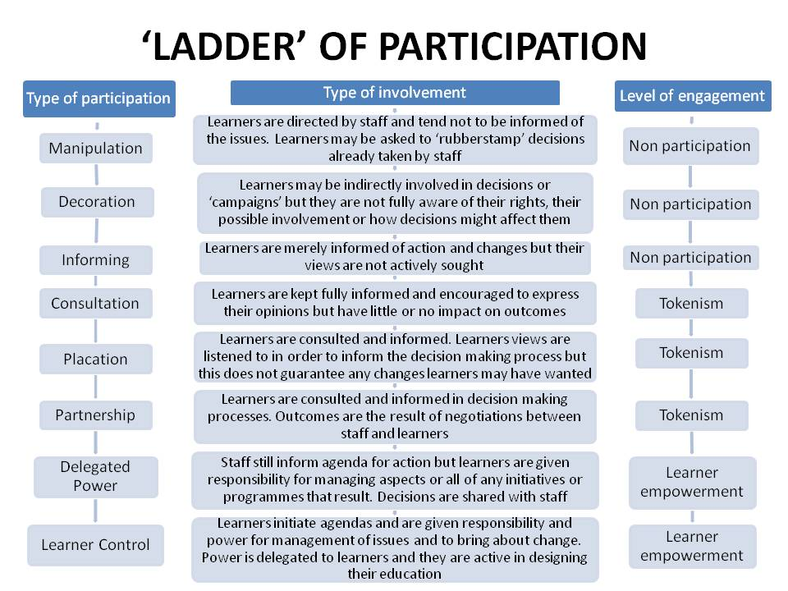
Further explanation

Slide 7
UNICEF: Roger Hart
https://www.unicef-irc.org/publications/pdf/childrens_participation.pdf

Slide 8
Participation of children
Useful web-links
http://www.pupilvoicewales.org.uk/english/secondary/about-us/uncrc/
http://gov.wales/statistics-and-research/children-young-peoples-participation/?lang=en
http://www.childrensrightswales.org.uk/participation.aspx
http://www.unicef.org.uk/UNICEFs-Work/UN-Convention/

Slide 9
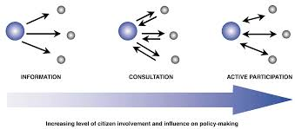

Slide 10
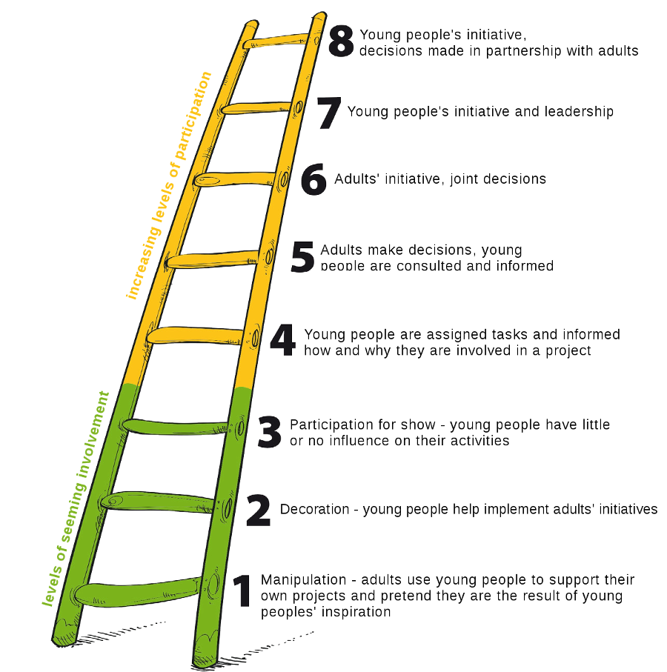
How to engage active participation of Young People Model
(Hart, 1992)

Slide 11
References
Arnstein, R (1969) Available at http://lithgow-schmidt.dk/sherry-arnstein/ladder-of-citizen-participation.html Accessed on 28/09/16
Hart, R (1992) UNICEF, A demonstration by school children in Peru for immunization
Children’s participation: from tokenism to citizenship. Available at https://www.unicef-irc.org/publications/pdf/childrens_participation.pdf Accessed on 28/09/16
Google Images (2016) Available at https://www.google.co.uk/search?q=Arnstein%27s+ladder+of+participation&client=firefox-b-ab&source=lnms&tbm=isch&sa=X&ved=0ahUKEwjz0Lr997HPAhWmF8AKHdt6A0oQ_AUICCgB&biw=1280&bih=915#imgrc=yR8DZt5cJP4x2M%3A Accessed on 28/09/16

