Slide 1
LCBB5010
Management Accounting for Managers
Week 5
Budgeting

Slide 2
Learning Outcomes; by the end of this session you should be able to:
Understand why organizations budget and the processes they use to create budgets
Distinguish between systems and types of budgets
Prepare sales and production budget
Appreciate and activity-based budgeting approach
Consider some criticisms of budgeting as a performance management system
McGraw-Hill Education | Seal & Rohde Management Accounting 6th edition © 2018

Slide 3
What is a Budget?
A budget is a detailed plan for the acquisition and use of financial and other resources over a specified time period.
The act of preparing a budget is called budgeting.
Master Budget
The master budget represents a comprehensive expression of management’s plans for the future and how these plans are to be accomplished
It generally culminates in a cash budget, a budgeted statement of profit or loss, and a budgeted statement of financial position.

Slide 4
﻿Why Budget?
For example, a manufacturing company needs to plan their material and labour requirements for the coming year. In order to do this, they will have to forecast their expected sales units for the year i.e., a sales budget.
Then they will be in position to budget their production units for the year i.e., a production budget. Once they have budgeted how many units to produce, they are able to estimate how much material and how much labour they will require i.e., a materials usage budget and a labour budget.

Slide 5
The Basic Framework of Budgeting
Detail
Budget
Detail
Budget
Materials
Detail
Budget
Production
Master
Budget
Summary of
a company’s
plans.
Sales

Slide 6
Planning and Control
Control – Involves the steps taken by management that attempt to ensure the objectives are attained.
Investigating causes for variances.
Planning – Involves developing objectives and preparing various budgets to achieve these objectives.

Slide 7
Advantages of Budgeting
Define goal
and objectives
Communicating
plans
Think about and
plan for the future
Advantages
Coordinate
activities
Means of allocating
resources
Uncover potential
bottlenecks

Slide 8
Responsibility Accounting
Managers should be held responsible for those items – and only those items – that the manager can control to a significant extent.
Any Examples of items within the control of production managers?

Slide 9
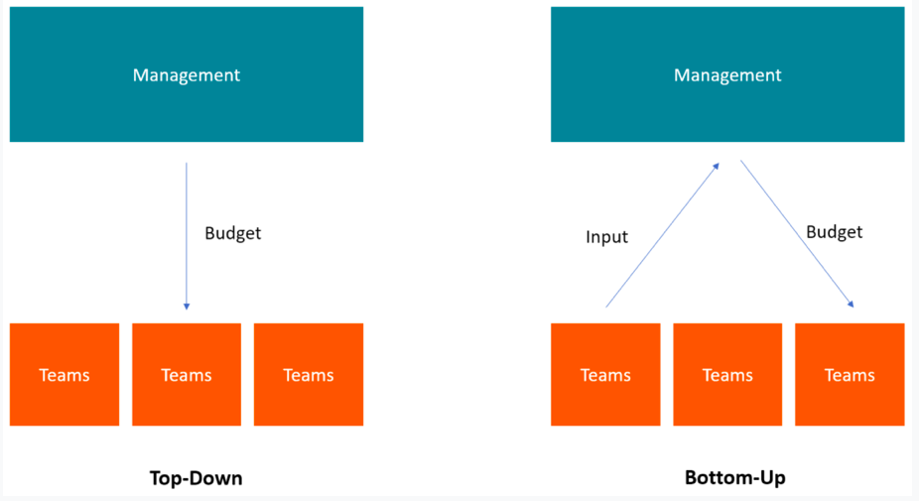
Budgeting Systems
CFA.com

Slide 10
Budgeting Systems
Top – down budgeting: it refers to a budgeting method where senior management prepare a high-level budget for the company. It’s prepared based on the company’s objectives and then passes it on to department managers for implementation.
Benefits | Demerits
Doesn’t allow for slack | Demotivating
Gives lower mgt time to focus on other areas of the business | May not be accurate
Quicker to prepare | Difficult in meeting head office targets

Slide 11
Budgeting Systems
Participative budgeting (also known as Bottom – up budgeting)
The departmental heads/managers prepare their budget based on present information and past experiences and present it to top management for approval. They consider margin pressures and external market conditions to make budget more realistic and attainable.
Benefits | Demerits
Motivating | Distracting operational managers from core business activities
Use of accurate information | Time consuming
No opportunity to blame others | Allows for slack
Benefits changing environment | Goal incongruent: may not be in the interest of the company

Slide 12
Budgeting Styles
Static or fixed Budget: This refers to the master budget which is prepared at the beginning of the accounting year
Flexible Budget: This incorporates changes due to increase or decrease in sales and production volume. A range of production or sales levels are proposed at the beginning of the year to aid flexibility. 10,000 20,000 30,000
Flexed Budget: This is prepared at the end of the year in order to compare actual activity level to standard budgeted activity levels.

Slide 13
Flexible Budgets
Merits | Demerits
Prevents overspending: As economic conditions change; your budgets reflects these changes with either increases or decreases | It can be time consuming to produce especially when most of the costs are fixed.
React to market opportunities: If market conditions improve/worsen, you can adjust your budgets to meet increased or decreased demand | Difficulty in estimating tax burden due to range of activity levels
Ability to adjust cost margins which aid efficient decision making on pricing. | Difficult to disentangle mixed costs into fixed and variable elements e.g. for labour
Relies on up-to-date information by assessing managers performance based on events within their control

Slide 14
Static Budgets
Merits | Demerits
It is easy to prepare and implement | It can’t react quickly to changes in market conditions
It is not time consuming | Doesn’t reflect current state of costs and activity levels within the business
It provides the basic data used in conducting variance analysis | May lead management to making wrong decision if up-to-date information isn't used
It promotes a culture of strict adherence to the “budget” | May assess managers performance using activities which are outside their control

Slide 15
Types of Budgeting
Incremental Budgeting: This budgeting approach entails periodic increases e.g.; NHS increases annual budget by 0.5%
Rolling Budgeting: This budgeting approach is updated frequently either monthly or quarterly. (Not prepared at a stretch)
Zero based Budgeting: This budgeting approach requires a new budget to be prepared every year rather than just updating that of the previous year, e.g., WPP

Slide 16
Choosing the Budget Period: Rolling Budget
Continuous or
Perpetual Budget
1999
2000
2001
2002
This budget is usually a twelve-month
budget that rolls forward one month
as the current month is completed.

Slide 17
The Budget Committee
A standing committee responsible for
  Overall policy matters relating to the budget
  Co-ordinating the preparation of the budget
  A matter of Human Relations
A budget must have complete acceptance and support of the persons who occupy key management positions.
Top management should not use budgets to find someone to blame for a problem.
How challenging should budget targets be? They should be ambitious but realistic.

Slide 18
The Master Budget
Sales
Budget
Ending
inventory
Budget
Selling and
Administrative
Budget
Production
Budget
Direct
Materials
Budget
Direct
Labour
Budget
Manufacturing
Overhead
Budget
Cash
Budget
Accounting and finance updates us on
Break even points and Sales take it
from there
Budgeted Financial Statements

Slide 19
Sales Budget
The sales budget is the starting point in preparing the master budget, a detailed
schedule showing expected sales for the coming periods expressed in units and pounds.
Budgeting Example
Royal Company is preparing budgets for the quarter ending June 30.
Budgeted sales for the next five months are:
  April 20,000 units
  May 50,000 units
  June 30,000 units
  July 25,000 units
  August 15,000 units.
The selling price is £10 per unit.

Slide 20
The Sales Budget

Slide 21
The Sales Budget

Slide 22
The Production Budget
Sales
Budget
Production
Budget
This is the heart of
the business
Completed
Production must be adequate to meet budgeted
sales and provide for sufficient ending inventory for the next period.

Slide 23
The Production Budget
Royal Company wants ending inventory to be equal to 20% of the following month’s budgeted sales in units.
On March 31, 4,000 units were on hand.
    Let’s prepare the production budget.

Slide 24
The Production Budget
Budgeted sales 50,000
Desired per cent 20%
Desired inventory 10,000

Slide 25
The Production Budget
March 31
ending inventory

Slide 26
The Production Budget
20% X 30000 (June budgeted sales) =6000

Slide 27
The Production Budget
They had $10,000 worth of goods sitting in their inventory at the end of April
July = 25000

Slide 28
The Production Budget
20% x 25000
July budgeted
Sales (slide 19)
Initial inventory

Slide 29
The Direct Labour Budget
The direct labour budget is also developed from the production budget.
Direct labour requirements must be computed so that the company will know whether sufficient labour time is available to meet production needs. This is key!!!

Slide 30
The Direct Labour Budget
At Royal, each unit of product requires 0.05 hours of direct labour. (3 minutes)
The Company has a‘no layoff’policy so all employees will be paid for 40 hours of work each week.
In exchange for the‘no layoff’policy, workers agreed to a wage rate of £10 per hour regardless of the hours worked (no overtime pay).
For the next three months, the direct labour workforce will be paid for a minimum of 1,500 hours per month.
Let’s prepare the direct labour budget.

Slide 31
The Direct Labour Budget
From production
Budget – slide 28

Slide 32
The Direct Labour Budget
26,000 x 0.05

Slide 33
The Direct Labour Budget
Higher of labour hours required
or labour hours guaranteed.
Notes:
In April and May, they have actual labour hours of 1,300 and 1,450 respectively, however they guaranteed that no matter what happens they would always pay workers for 40 hours per month even if they don’t work up to those hours.

Slide 34
The Direct Labour Budget
£53,000
This goes
into the
master
budget
15,000 23,000 15,000 53,000

Slide 35
Activity-Based Budgeting
It is unlikely that all variable overhead in a complex organization is driven by a single factor.
Activity-based costing provides a way of recognizing a variety of overhead cost drivers and thereby increasing the accuracy of the costing system.

Slide 36
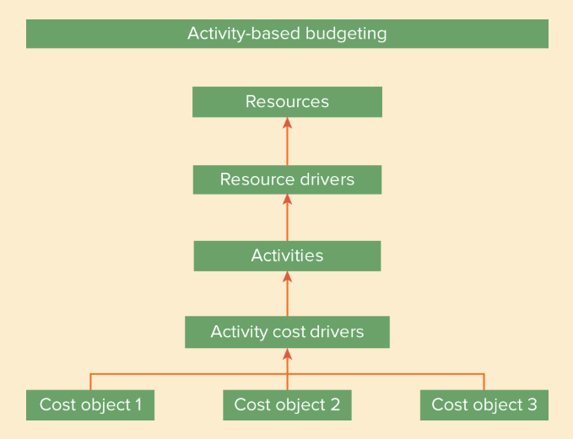
Activity-Based Budgeting
Exhibit 11.4 Activity-based budgeting

Slide 37
Some Criticisms of Budgeting as a Performance Management System
It is too time consuming.
It tends to focus on cost control rather than value creation.
It tends to be top down.
It encourages gaming and opportunism.
It reinforces departmental barriers.
It hinders knowledge sharing.
It makes people feel undervalued.

Slide 38
Remedies?
With an increase in the importance of intellectual capital relative to financial capital companies need to adopt a network rather than a hierarchical, departmental structure.
A network model may still use budgets for cash forecasting but not for cost control.
The aim is to avoid ‘actual versus budget’ reports and concentrate on relative performance.
Need other forms of management control – benchmarking and a mix of financial and non-financial measures (balanced scorecard).

Slide 39
Reform or Abandon Budgeting
One issue concerns the question of predictability.
The other issue concerns organizational and
time-frame problems

Slide 40
References
Rhode, S. and Garrison, N. (2019) Management Accounting. Sixth edition. London, England: McGraw Hill

