Slide 1

Week 1
Professional Career Development (BMSW4012)

Slide 2
Learning Objectives
By the end of this session, students will be able to:
Describe the purpose and structure of the Professional Career Development module, including assessment requirements and expectations.
Explain what reflective practice is and why it is important for professional and career development.
Identify key stages, experiences, or turning points in their own career journey to date.
Apply the early stages of a reflective model (e.g. description and feelings) to their own career experiences.
Begin to articulate how reflective practice will support the completion of Assignment Part 1.

Slide 3
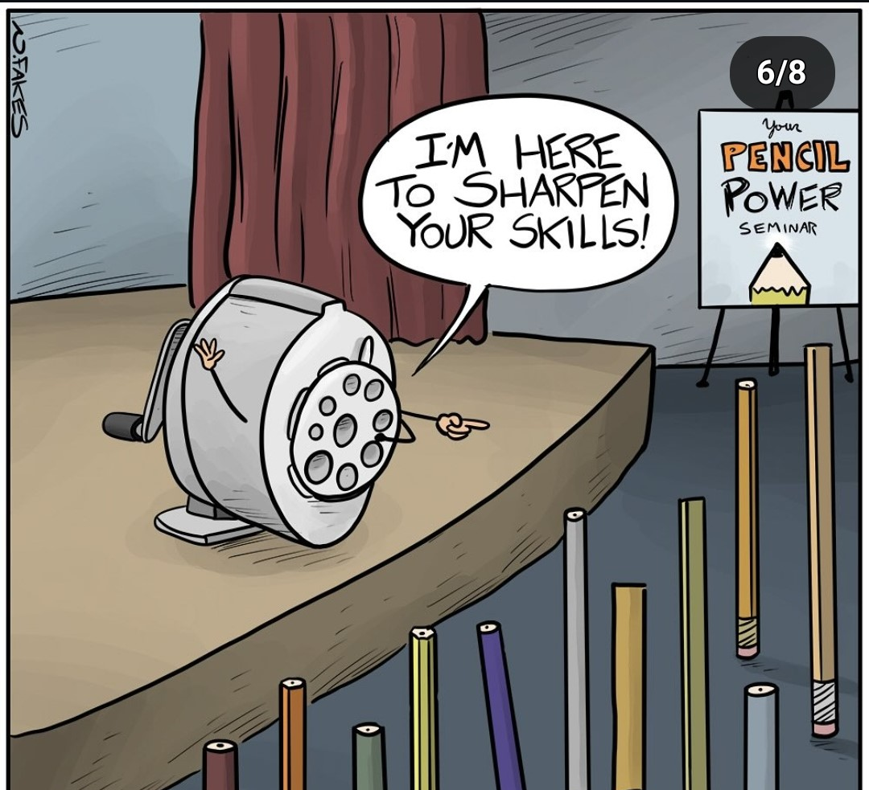
Meet your Lecturer
What expectations do you for this Module?

Slide 4

Introduce your colleague to us:
1. What is their name?
2. Where are they from?
3. What is a curious fact about them?
Notes:
Pair them up with people they do not know/may not be familiar with. This is important as they were separate classes last term and will need to build a new safe learning environment together. For most pair/group work, choose the groups to ensure a good group dynamic.

Slide 5
Professional Standards
Respectful and balanced discussions relevant to the Module topics.
Engagement and participation in all class activities.
Avoid using your phone in class, if you need to use your phone for an emergency - please leave the class to avoid disruption to the learning environment.
Make sure you bring pen and paper to take notes as you will be needing your notes to help you.
Punctuality will be closely monitored and it will be noted if you are late or leave early. This can impact your attendance rate and the exam board decision at the end of term.
In the classroom the default language is English no matter what is being discussed and who is involved, this is to ensure respect amongst colleagues and that we can all be involved in the discussion.

Slide 6
Professional Standards
If you are likely to be late to class please try to email your Lecturer as soon as possible to notify them.
Always use your student email to communicate with the University, emails sent via your personal email will be ignored for security purposes.
No smoking/vaping in the building.
When the class is coming to a close please take all your rubbish with you.
You are welcome to eat/drink within the class providing you are not disrupting others.

Slide 7


The 5 pillars of success
Attend lectures
Take notes
Ask questions
Listen carefully
Submit drafts
Notes:
On this slide it is just to guide them through simple steps that they can use to increase their chances of success, remind them that academia is much more than just turning up and submitting assignments when they are due

Slide 8



In your opinion what is Professional Career Development?
Notes:
Seek answers from them and then discuss the next slide

Slide 9

Career development is the process of focusing learning activities (including work experience) towards preferred career outcomes. Career development may also include development of career competencies. Professional development combines personal development with career development. (Careersmart.org.uk)

Slide 10
Why is it important?
Skill enhancement
Career advancement
Increased job satisfaction
Adaptability
Networking
Personal growth
Leadership development
Better personal brand

Slide 11

Group discussion
Notes:
Try to gear this discussion towards their academic future when possible, what skills they think they need to develop to land that dream job or that own business that they want to start

Slide 12
Introduction to Module & Assignments
Module code and name – Professional Career Development/BMSW4012
Marks are out of 100, to pass the Module you must have a minimum of 40% mark this is calculated based on both assignments for example: 40% assignment 1 + 40% assignment 2 = 80% divided by 2 = 40% final Module mark.
Working hours are:
Monday – Thursday: 8:30am to 5pm
Fridays: 8:30am to 4:30pm

Slide 13
Let’s take a look at the Module Handbook together
Notes:
Go through the Module Handbook with them, noting the assignments, deadlines, marking criteria, marks available.

Slide 14
Assignment 1 & Submission Deadlines
Part 1 – 1500 Reflective Essay
Deadline: 27th of February 23.59.
Part 2 - Job Interview Practical Task
Written Materials to be submitted by 23rd of March 2026 @ 9AM.
Interviews conducted week commencing 23rd of March 2026.

Slide 15

Refresher:
Reflective Practice

Slide 16
What is Reflective Practice?
Reflective practice is the ability to reflect on one's actions so as to engage in a process of continuous learning. - Donald Schon
What is Reflection–in-action?
What is Reflection-on-action?
When may you use these?

Slide 17
What do you remember about Gibbs Reflective Cycle?
Notes:
https://youtu.be/vGyjF9Ngd8Y?si=EJd5msB5UsKHnSCc

Slide 18
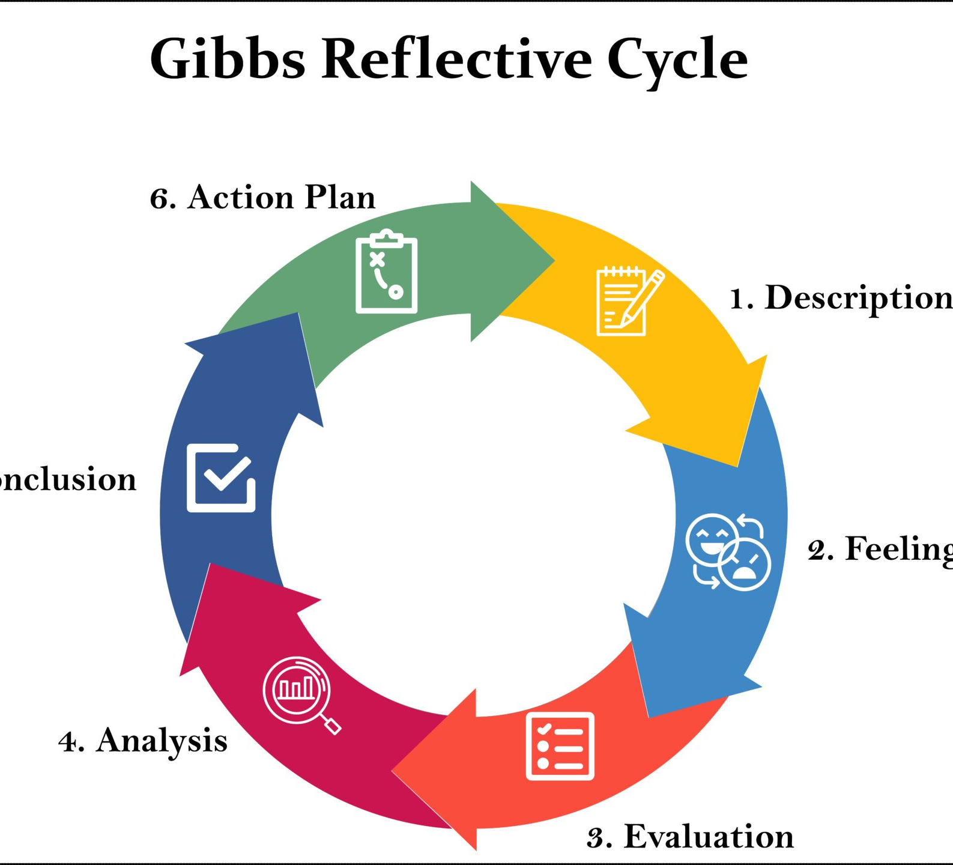
Gibbs Reflective Cycle
Notes:
https://youtu.be/vGyjF9Ngd8Y?si=EJd5msB5UsKHnSCc

Slide 19

Let’s Reflect!
What has your career journey looked like so far?
(This may include education, jobs, voluntary work, caring responsibilities, gaps, or changes in direction.)
Identify one or two key moments that stand out to you.
(For example: starting a course, leaving a job, a setback, a success, or a decision you struggled with.)
Notes:
Get them to get out a notepad and a pen or their laptops, tell them this activity is going to help them with Assignment 1 and get them to complete all the questions, talk then through the questions, giving examples and encouraging them to dig deep.

Slide 20
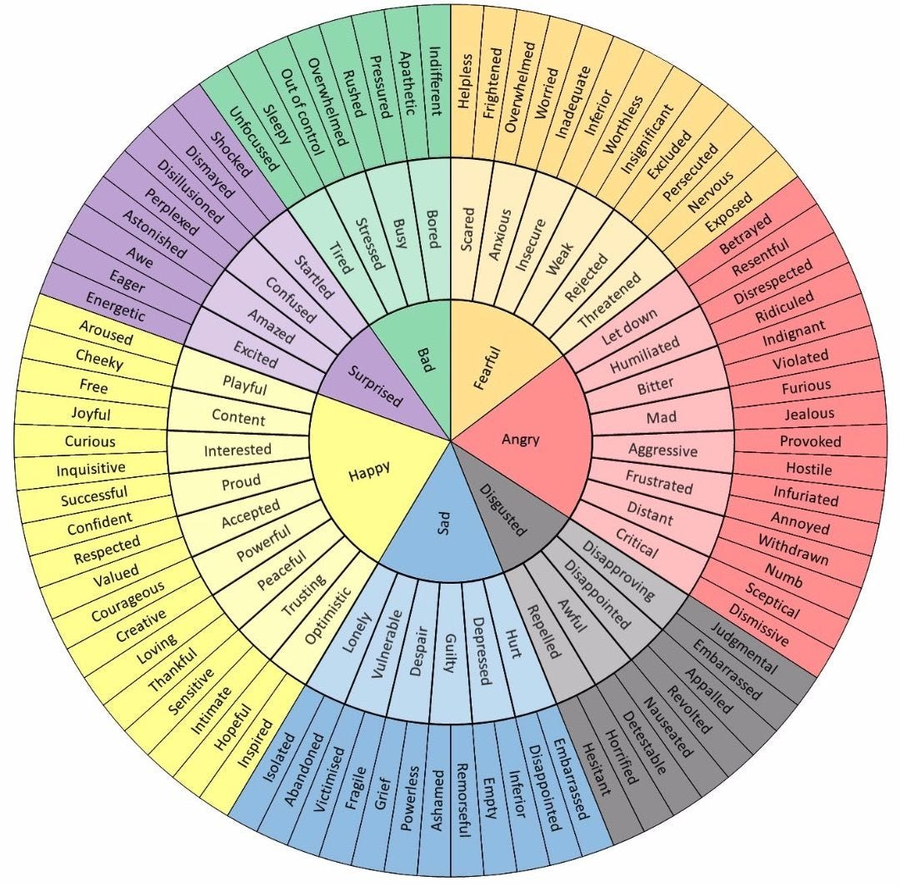
Let’s Reflect!
How did you feel about your career at these points?(For example: confident, uncertain, motivated, stuck, proud, anxious.)
How do you feel now, at the start of this module, about your future career or progression?

Slide 21

Let’s Reflect!
What do you hope this module will help you improve or understand about yourself?
Which areas of your career development do you think you may need to work on most? (For example: confidence, clarity of direction, employability skills, planning.)

Slide 22

Keep your notes safe, they will help you complete Part 1 of your Assignment.

Slide 23
Learning Objectives
By the end of this session, students will be able to:
Describe the purpose and structure of the Professional Career Development module, including assessment requirements and expectations.
Explain what reflective practice is and why it is important for professional and career development.
Identify key stages, experiences, or turning points in their own career journey to date.
Apply the early stages of a reflective model (e.g. description and feelings) to their own career experiences.
Begin to articulate how reflective practice will support the completion of Assignment Part 1.

Slide 24
Homework
Read the full Module handbook available on Moodle.
Familiarise yourself with the requirements for the Part 1 of your Assignment.
Review the Module Reading List.
If you have any questions email your Lecturer for assistance.

Slide 25
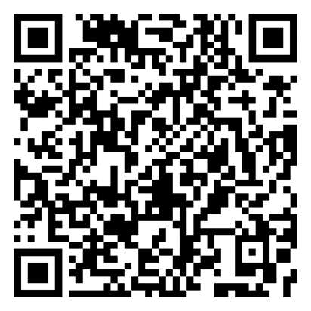
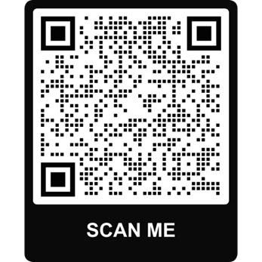
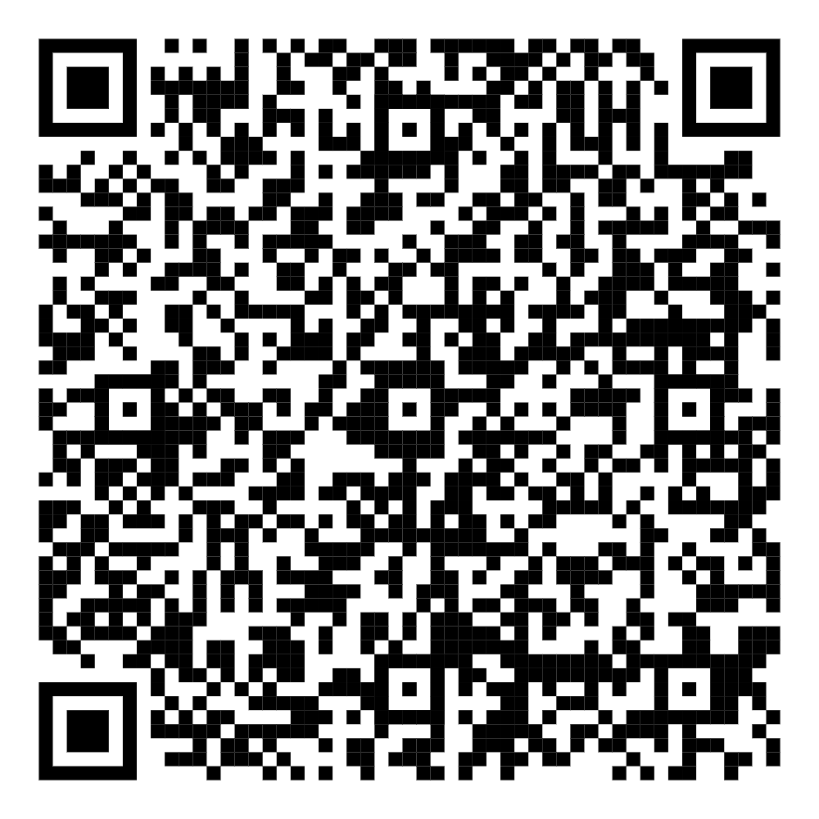
Useful links
Study Skills support
To book an online appointment email:
studyskillsdistance@uwtsd.ac.uk
Giving a brief outline of support you require and a suitable day and time
Wellbeing support
Money support

