Slide 1
An analysis of the extent to which Euripides’ characters Electra and Helen have been perceived as ‘masculine’
Dissertation Presentation
Elizabeth Alice Ann Cawdell
1602192

Slide 2
Chapter One
This presentation will be focusing on the first chapter of the dissertation: ‘The Athenian Woman and Theory’.
This is the point of research that has been reached so far.
This chapter focuses on the theoretical approach of the research and defining the terms ‘masculine’ and ‘feminine’ within a 5th century bc context.
This chapter will also give a description of a traditional Athenian woman.

Slide 3
How does this fit into the wider dissertation?
This is the opening chapter of the dissertation.
Before it is possible to focus on Helen and Electra in a close reading of the texts, there needs to be an explanation of what is meant by describing them as ’masculine’ and ‘feminine’.

Slide 4
The life of a 5th century BC Athenian woman
“The effect of urbanization [within the 5th century] upon women was to have their activities moved indoors and to make their labor less visible and hence less valued.” – Pomeroy. 1975: 71
”They concerned themselves with the care of young children, the nursing of sick slaves, the fabrication of clothing, and the preparation of food” – Pomeroy. 1975: 72
Wealthier women would take on a more managerial role within the household, and according to Xenophon, “the wise husband will teach this science to his young bride” – Pomeroy. 1975: 72; Xenophon. Oeconomicus. 9-10.1; 7.35-6

Slide 5
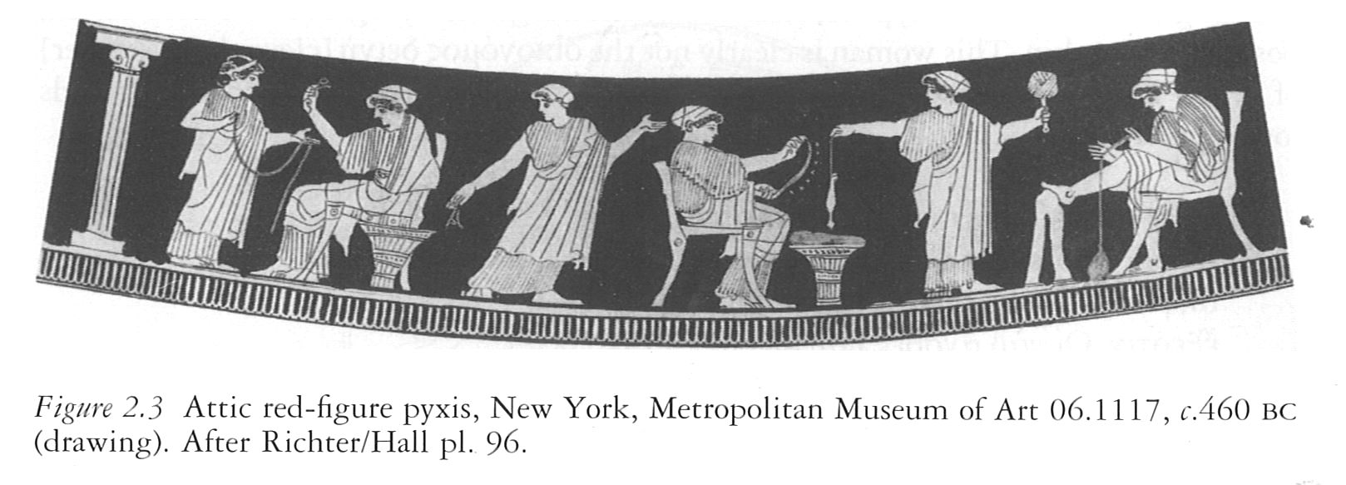
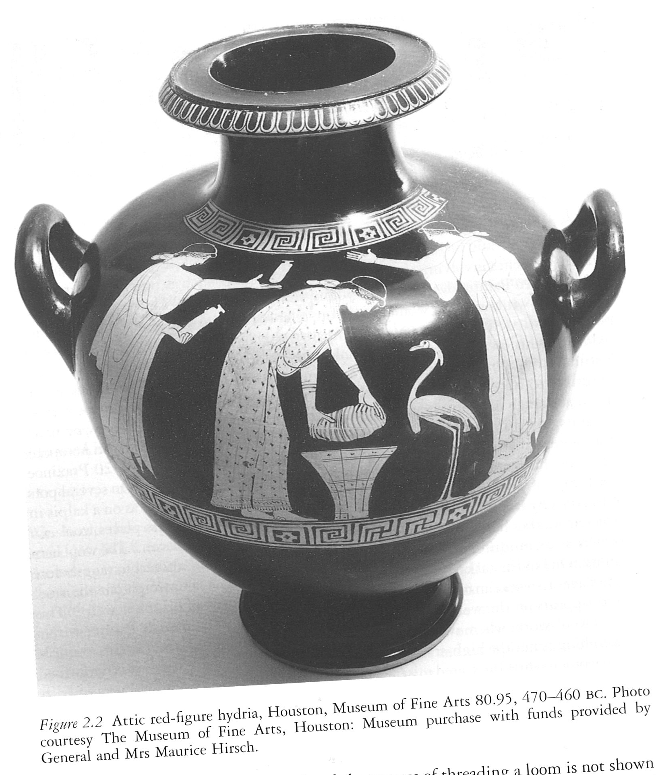
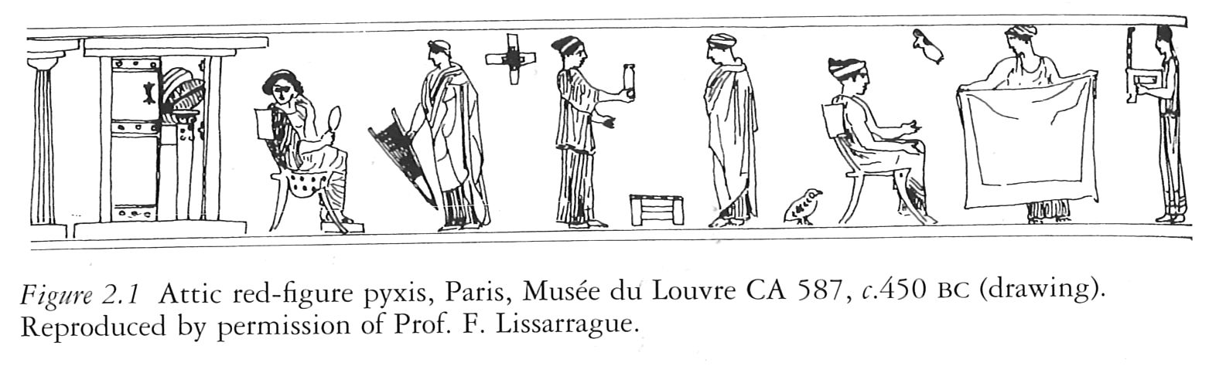

Slide 6
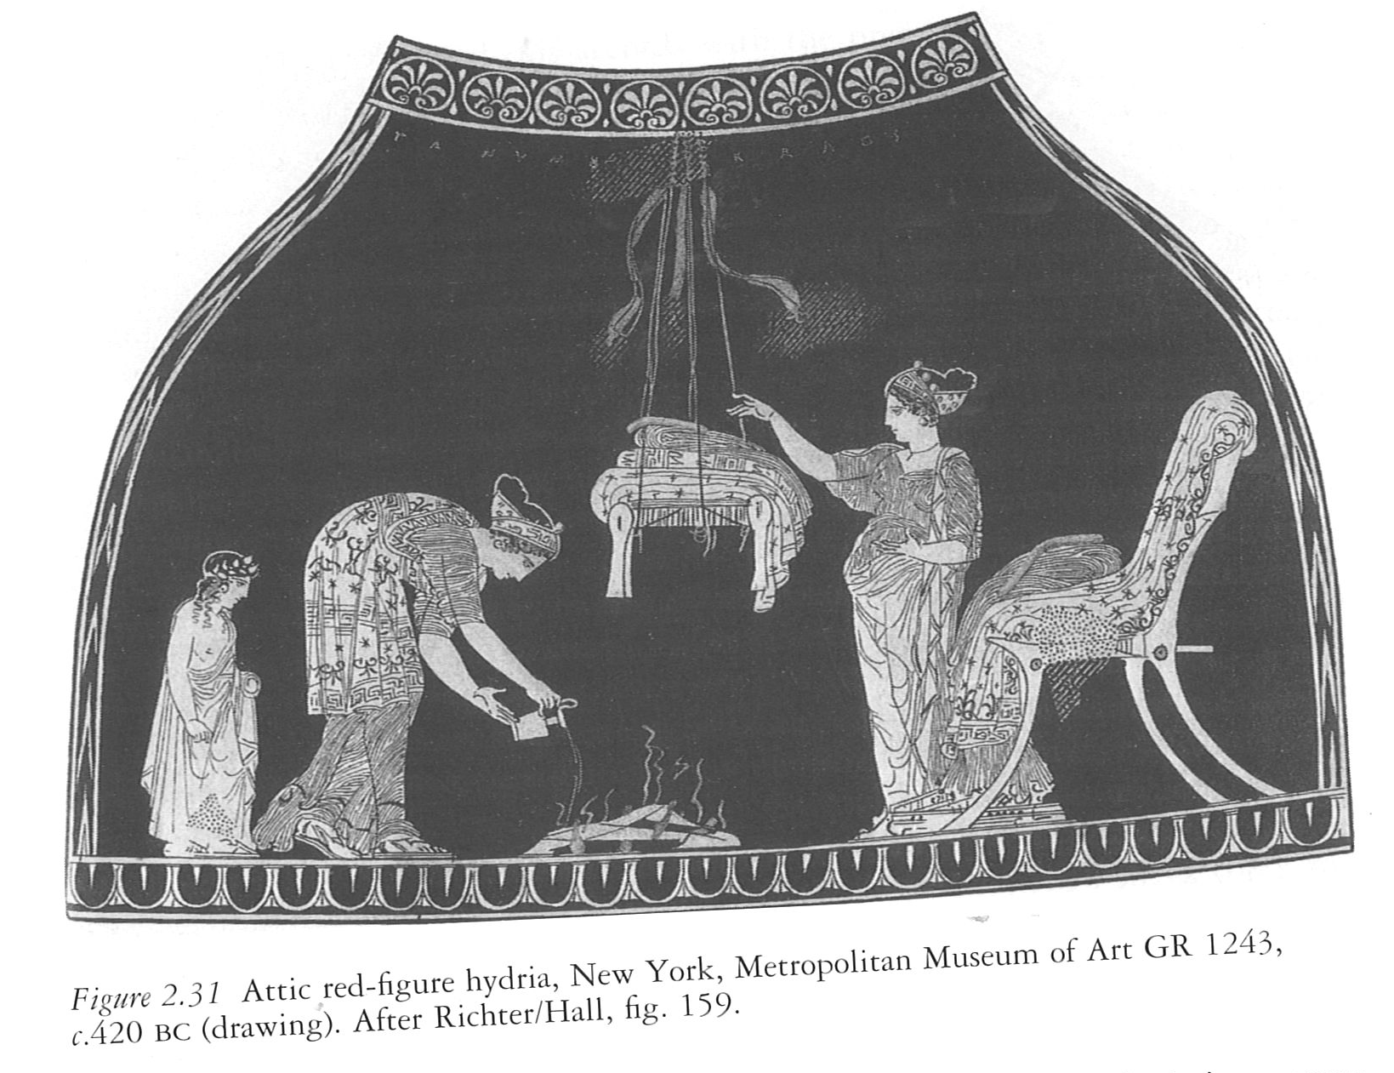
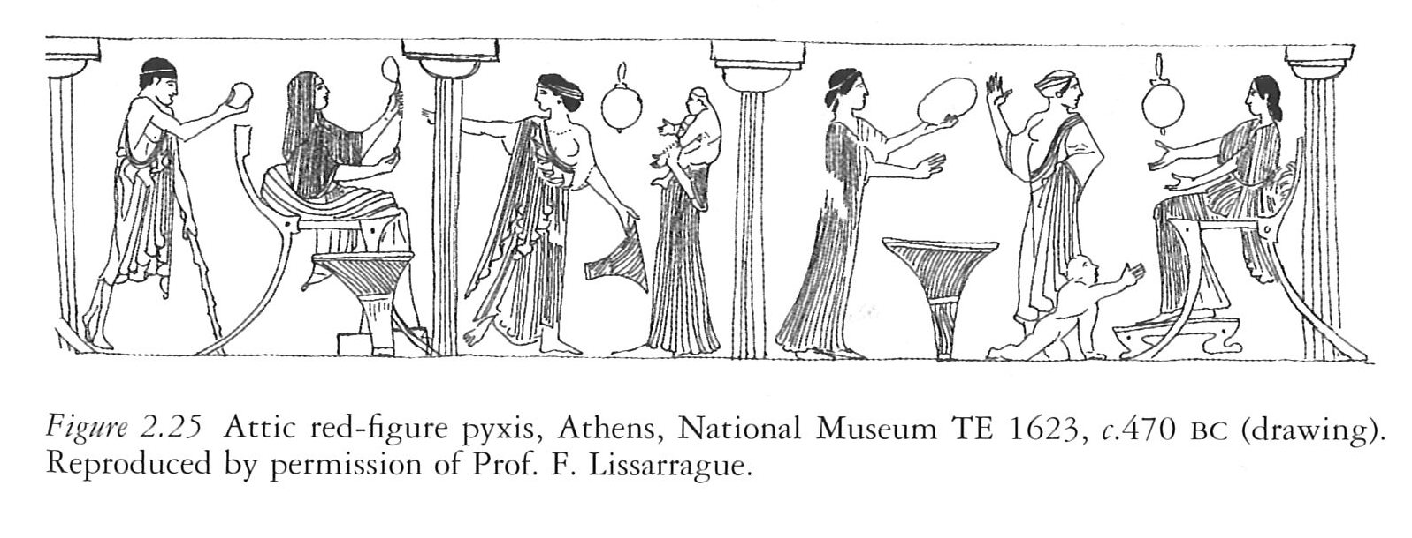
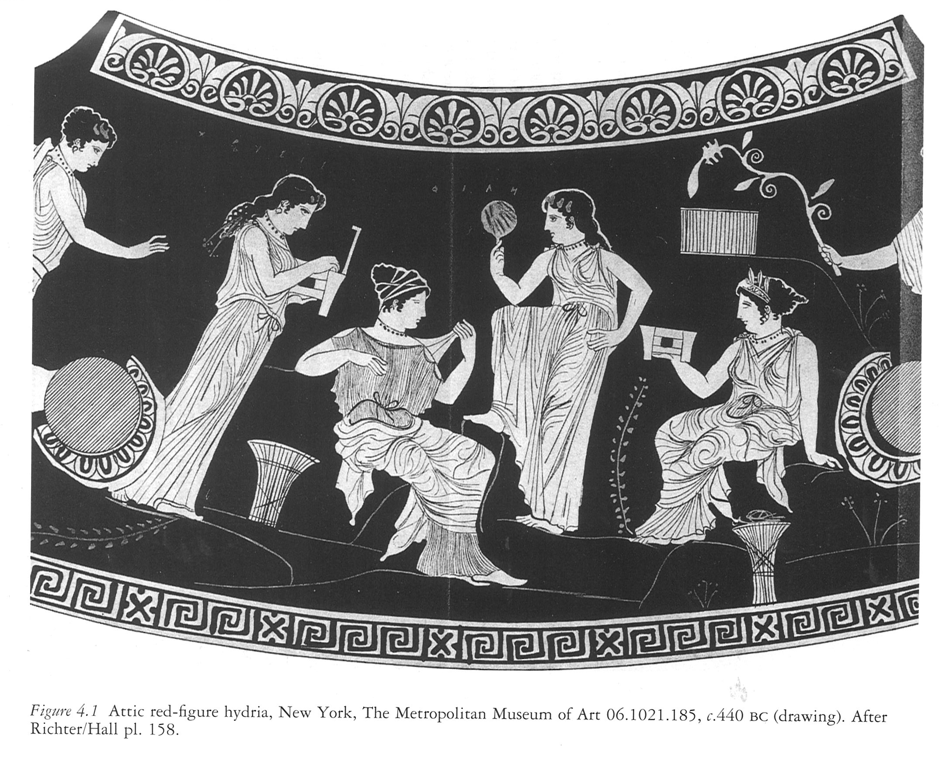
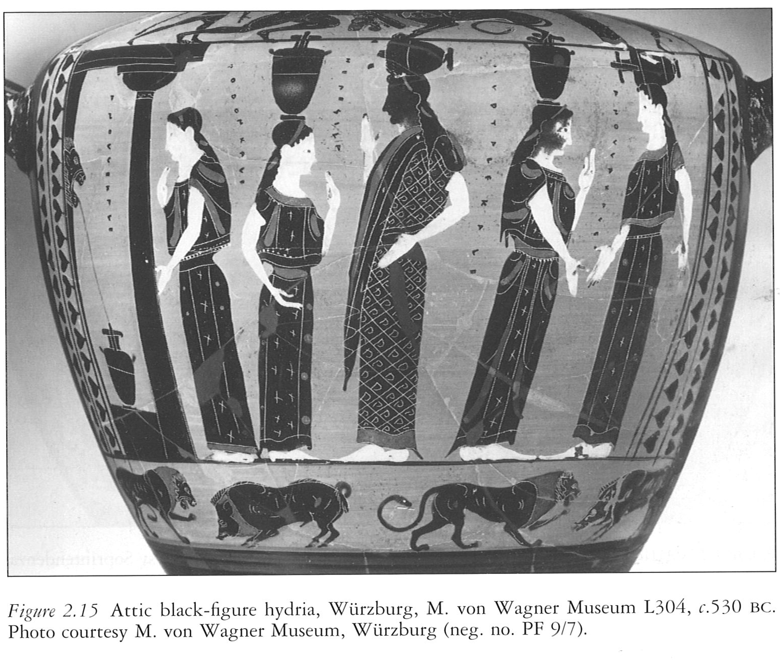

Slide 7
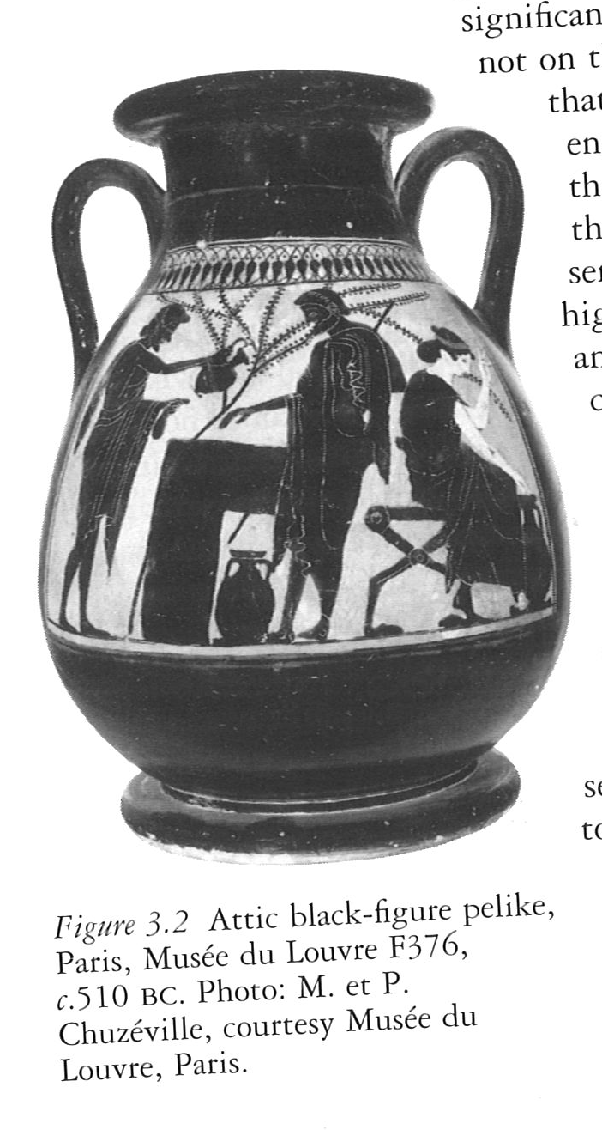


Slide 8
Theoretical Approach and how it is applied to a 5th century BC context
The theories that will be used throughout this research will be gender theory, feminist theory and performance theory.
Using contemporary theories such as feminism, gender and performance raise difficulties in the sense that they have not existed until more recently, and would not have been thought about within the ancient world.
Justification of using these theories whilst researching and analysing.

Slide 9
Performance Theory
This is being used as a result of both texts studied being plays.
The female characters in these tragedies would originally have been performed by male actors.
The plays were written by a man. (so the female perspective was actually a male view on the female perspective)
Performed to men. Women were not present at the productions. – Henderson. 1991
Study of plays, therefore not completely comparable to Athenian women described earlier.

Slide 10
Feminist Theory
This is being used as a result of the in-depth analysis of the female characters within the plays.
“The feminine may be defined in terms of the absence of masculine characteristics” – Morley. 2004: 95
Difficulties: texts mainly focus on elite women, and most of the information available on women in ancient antiquity is written from an elite man’s perspective. – Morley. 2004: 90)
Feminist readings have the risk of containing prejudices and bias from the writer

Slide 11
Gender Theory
This is being used because of the close analysis of what is masculine and feminine.
“Male gender identity was fragile since masculinity was not founded on the possession of a male body, but on the aggressive performance of masculinity in everyday life.” – Mottier. 2008: 7
“’Masculinity’ is not a stable identity founded on a physical reality, but a role, a performance, something that is constantly shifting and negotiated.” – Morley. 2004: 98

Slide 12
What is meant by ‘Masculine’?
Dictionary definition: “having qualities or appearance traditionally associated with men”
Mottier: based on actions rather than the possession of a male body.
Actions were dominant in all social and private roles, aggressive.

Slide 13
What is meant by ‘Feminine’?
Dictionary definition: “having qualities or an appearance traditionally associated with women, especially delicacy and prettiness”
Opposite to masculine.
Actions were passive, and domesticated.
Women were seen passive within society despite their active role in managing the household.

Slide 14
What are the next steps?
From this a closer more targeted reading of the translated texts of Electra and Helen by Euripides will take place so a discussion of the behavior of the women and how they can be perceived as masculine can take place.
More than one translation of each text will be looked at, the times in which they were translated will be examined and whether this has any effect on the language used.

Slide 15
What is the purpose of this research and why is it relevant?
The purpose of this research is to provide an insight into Euripidean Greek tragedy.
It is relevant for those interested in Greek tragedy as a genre.
Produces a new outlook and viewpoint of the characters studied.
Gives an insight into lesser known and studied tragedies.
To apply gender, feminist and performance theory to these plays in order to further analyse and discuss.

Slide 16
bibliography
Ancient:
  Xenophon, Oeconomicus. E. C. Marchant (trans.). 1923. Cambridge: Harvard University Press
Modern:
  Beard, M. 1993. ‘The Classical Woman’, History Today. 43, pp. 29-36
  Cawthorn, K. 2008. Becoming Female: The Male Body in Greek Tragedy. London: Bloomsbury
  Henderson, J. 1991. ‘Women and the Athenian Dramatic Festivals’, in Transactions of the American Philological Association. 121, pp. 133-147
  McHardy, F., and Marshall, E. 2004. Women’s Influence on Classical Civilisation. London: Routledge
  Mottier, V. 2008. Sexuality: A Very Short Introduction. Oxford: Oxford University Press
  Morley, N. 2004. Theories, Models and Concepts in Ancient History. Oxon: Routledge
  Pomeroy, S. B. 1975. Goddesses, Whores, Wives and Slaves. New York: Schocken Books

Slide 17
Images
Lewis, S. 2002. The Athenian Woman: An Iconographic Handbook. London: Routledge
  Fig. 2.1, p.63 – Attic red-figure pyxis, c. 450 BC (drawing)
  Fig. 2.2, p.64 – Attic red-figure hydria, 460-70 BC
  Fig. 2.3, p. 65 – Attic red-figure pyxis, c. 460 BC
  Fig. 2.15, p. 73 – Attic black-figure hydria, c. 530 BC
  Fig. 2.25, p. 81 – Attic red-figure pyxis, c. 470 BC (drawing)
  Fig. 2.31, p. 88 – Attic red-figure hydria, c. 420 BC
  Fig. 3.2, p. 92 – Attic black-figure pelike, c. 510 BC
  Fig 3.4, p. 94 – Attic red-figure cup, c. 480 BC
  Fig 4.1, p. 131 – Attic red-figure hydra, c. 440 BC

Slide 18
Questions?

