Slide 1
Certificate of Higher Education in Employability Skills
Problem Solving and Innovation (BMSW4014)
Jaliya de Silva/Arpu Kumar

Slide 2
Agenda
Assessment 2 – Due 05/12/25
PESTLE analysis.
Stakeholder analysis.
Problem of the week

Slide 3
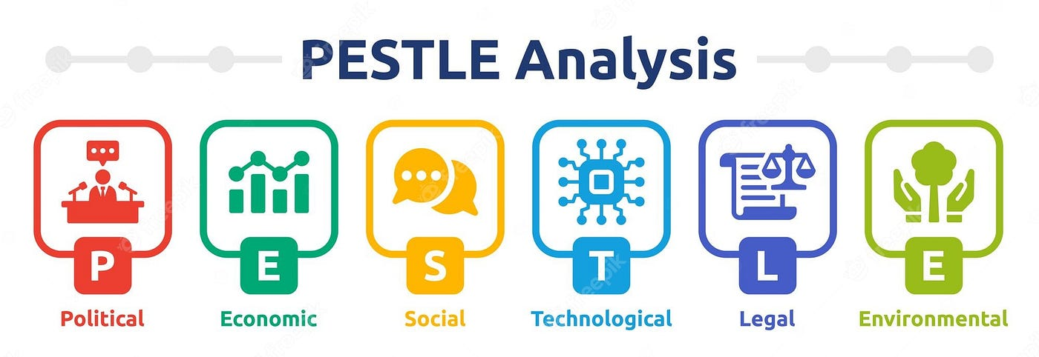
What is PESTLE?
PESTLE analysis is a strategic tool used to evaluate the external factors that can impact an organisation's performance and decision-making.
It stands for Political, Economic, Social, Technological, Legal, and Environmental factors.

Slide 4

Political Factors
Government policies, regulations, and stability
Tax policies and trade regulations
Political ideologies and trends
Foreign trade policies and relations
Notes:
Political Factors
Understanding political factors like government policies, regulations, and stability helps organizations frame business policies and strategies that comply with the political environment.
Analysing political trends and ideologies guides decisions related to market entry, expansion, or exit strategies in different regions or countries.
What current factors are impacting organisations in general?

Slide 5

Economic Factors
Economic growth rates and trends
Interest rates and inflation
Unemployment rates and labour costs
Disposable income and consumer spending patterns
Exchange rates and currency stability
Notes:
Evaluating economic conditions like GDP, employment rates, inflation, and interest rates facilitates decisions regarding demand, supply, pricing, and cost management strategies.
Assessing labour costs, exchange rates, and economic policies supports decisions on resource allocation, outsourcing, and international trade strategies
What current factors are impacting organisations in general?

Slide 6

Social Factors
Cultural trends and demographics
Population growth and age distribution
Lifestyle changes and attitudes
Education levels and ethical concerns
Notes:
Understanding consumer behaviour, preferences, values, and cultural trends aids in developing effective marketing strategies, product positioning, and enhancing customer satisfaction.
Analysing demographic shifts and lifestyle changes guides decisions related to product development, target market selection, and distribution channels.
What current factors are impacting organisations in general?

Slide 7

Technological Factors
Technological innovations and advancements
Access to emerging technologies
Rate of technological obsolescence
Government spending on research and development
Notes:
Studying technological advancements, research and development trends, and automation opportunities supports decisions on process improvements, cost optimisation, and competitive positioning.
Assessing access to emerging technologies and digital transformation guides decisions on technology adoption, innovation strategies, and resource allocation for technological capabilities
What current factors are impacting organisations in general?

Slide 8

Legal Factors
Employment laws and regulations
Consumer protection and safety regulations
Intellectual property rights and copyright laws
Environmental and trade regulations
Notes:
Analysing legal factors like corporate laws, labour laws, and consumer protection regulations ensures compliance and guides decisions related to operational strategies, risk management, and legal obligations
What current factors are impacting organisations in general?

Slide 9

Environmental Factors
Climate change and weather patterns
Renewable energy and sustainability concerns
Waste management and pollution levels
Attitudes towards green products and practices
Notes:
Evaluating environmental factors like climate change, ecological concerns, and natural resource scarcity supports decisions on sustainable business practices, eco-friendly product development, and corporate social responsibility initiatives
What current factors are impacting organisations in general?

Slide 10
Why use it?
PESTLE analysis helps organisations identify potential opportunities and threats in their external environment.
It aids in strategic planning, risk management, and decision making processes by providing a comprehensive understanding of the macro-environmental factors that can impact business operations and performance.
By conducting a comprehensive PESTLE analysis, organisations can identify potential opportunities and threats, mitigate risks, and make informed strategic decisions that align with their objectives and the external environment.
Notes:
What is a macro-environment?

Slide 11
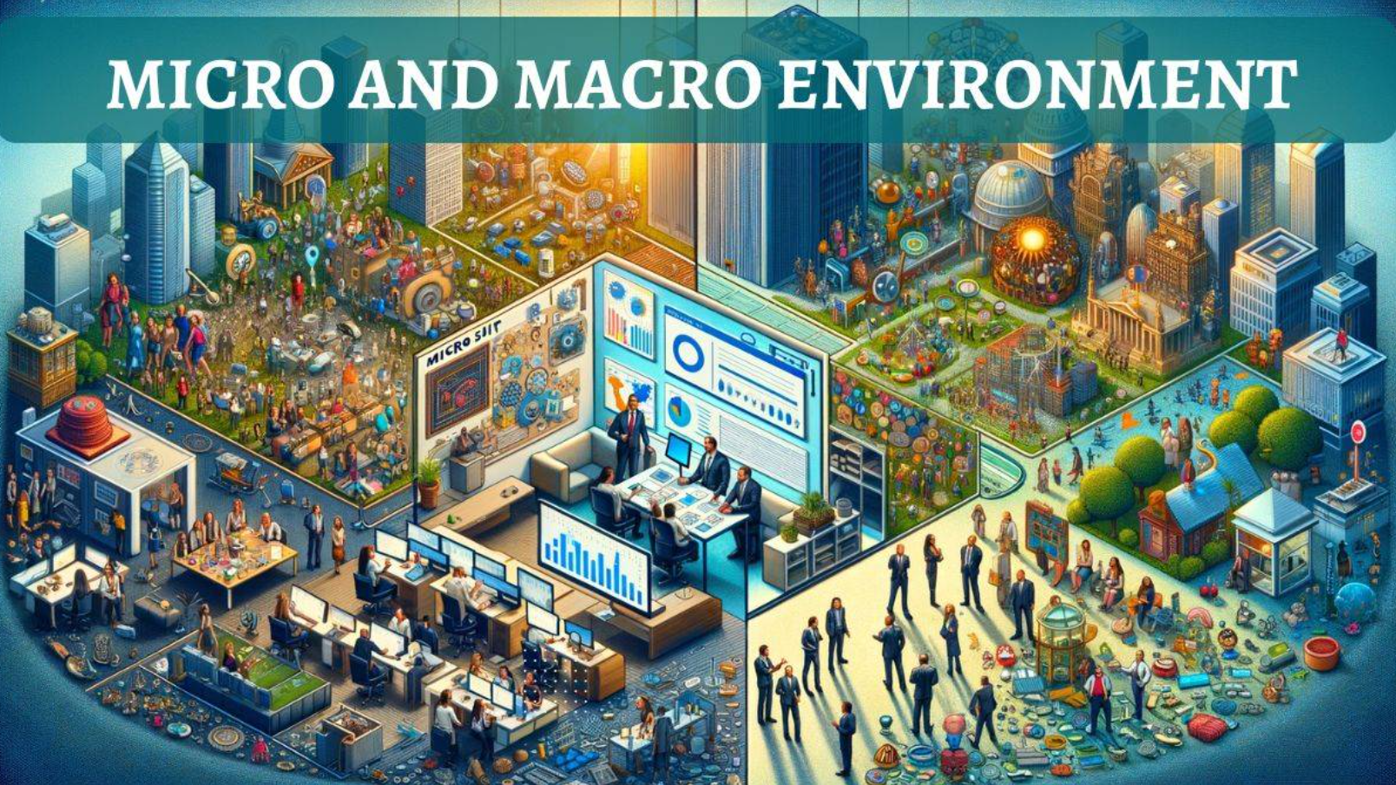
Macro-environment
What is the difference between micro-environment and macro-environment?
Notes:
Micro-environment - Immediate factors impacting a business (customers, suppliers, competitors)
Macro-environment - External forces shaping the industry (economy, technology, social trends).
Example: Imagine a clothing boutique operating in a local market. Its micro environment would include loyal customers who provide direct feedback, local suppliers who provide fabrics and accessories, and nearby competitors. These elements directly affect the boutique’s day-to-day operations and customer relationships. These internal factors are part of micro environment.
However, the macro environment also plays a pivotal role. For instance, economic factors like rising inflation or changing consumer behavior can impact the boutique’s sales and profitability. Technological advancements, such as the rise of online shopping platforms, can alter the industry landscape and consumer preferences. Furthermore, social factors like changing fashion trends or sustainability concerns can shape customer demands. All these external factors are part of the macro environment.
Aggarwal, C. (2024) Difference between Micro Environment and Macro Environment. Available at: Difference between Micro Environment and Macro Environment - Shiksha Online (Accessed: 10 June 2024)

Slide 12
Example of PESTLE in action
Tesco
British Airways
Notes:
These examples illustrate how PESTLE analysis enables companies to proactively identify potential threats and opportunities arising from the external environment, and develop strategies to mitigate risks and capitalise on favourable conditions.

Slide 13
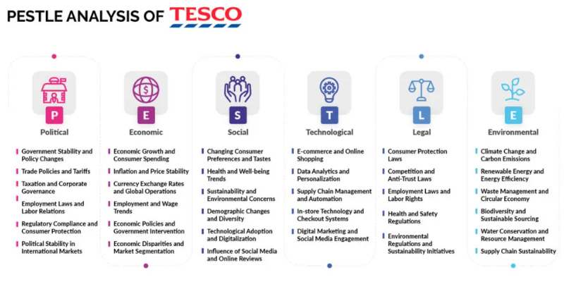
Notes:
Pereira (2023) Tesco PESTLE Analysis (2024)

Slide 14

Political
Brexit
Government policies
Geopolitical stability
Compliance with regulations
Government support
Economic
Fluctuations in fuel prices
Exchange rates
Interest rates
Inflation
Highly competitive industry
Social
Growing middle class in developing economies
Changing attitudes towards climate change
Customer perception of the airline
Technological
Investments in mobile apps and digital tech
Data analytics and AI
Automation and robotics
Legal
Food safety regulations and consumer protection
Data protection laws – GDPR
Competition laws
Environmental
Pressure to reduce carbon emissions
Climate change impacting weather patterns
Growing customer demand for eco-friendly travel options
Notes:
Political Factors
Brexit has introduced complexities regarding air travel agreements, regulations, and market access between the UK and EU
Government policies like travel restrictions, open skies agreements, and air passenger duty impact flight routes and operational costs.
Geopolitical stability in key markets affects air travel demand and operational routes
Compliance with strict aviation regulations set by UK and international authorities is crucial
Government support during economic challenges, like the COVID-19 pandemic, can provide financial aid but may come with conditions
Economic Factors
Fluctuations in fuel prices directly affect operational costs and profit margins
Global economic conditions influence consumer travel behaviour and ticket sales
Exchange rate fluctuations impact international ticket prices and profitability when converting foreign revenues to GBP
Interest rates affect consumer borrowing and spending on travel
Inflation can increase operational costs, potentially leading to higher fares
The airline industry is highly competitive, with both legacy carriers and low-cost airlines vying for market share
Social Factors
Growing middle class in developing economies is creating new demand for air travel
Travelers are increasingly seeking unique and enriching experiences over traditional vacations
Changing attitudes towards climate change and sustainability are influencing consumer choices and airline operations
British Airways' perception has shifted from a high-cost carrier to a more affordable option, appealing to a broader demographic
Technological Factors
Investments in e-commerce, mobile apps, and digital technologies enhance operational efficiency and customer experience
Data analytics and AI are being leveraged for personalised marketing and inventory management
Automation and robotics are transforming supply chain and warehouse operations
Legal Factors
Compliance with food safety regulations, labour laws, and consumer protection legislation is crucial
Data protection and privacy laws like GDPR impact how customer data is handled
Competition laws and antitrust regulations influence market practices and expansion strategies
Environmental Factors
Airlines face pressure to reduce carbon emissions and adopt more sustainable practices
Climate change impacts on weather patterns can affect flight operations and schedules.
Growing consumer demand for eco-friendly travel options influences airline strategies and operations.
This PESTLE analysis highlights the complex external environment British Airways operates in, with various challenges and opportunities across political, economic, social, technological, legal, and environmental dimensions.

Slide 15
Group activity
Complete a PESTLE analysis on a retailer of your choice.
Notes:
Allow 20 minutes for this.

Slide 16
Break

Slide 17
Stakeholder Theory
What is a Stakeholder?
“…any group or individual who can affect or is affected by the achievement of an organisation’s objectives” (Freeman, 1984).
There may be conflict between the expectations of different groups of stakeholders.
In contrast, Friedman’s Shareholder Theory (1970) proposes the only stakeholders a company should consider are its shareholders.
Notes:
Edward Freeman’s stakeholder theory holds that a company’s stakeholders include just about anyone affected by the company and its workings.
That view is in opposition to the long-held shareholder theory proposed by economist Milton Friedman that in capitalism, the only stakeholders a company should care about are its shareholders - and thus, its bottom line. Friedman’s view is that companies are compelled to make a profit, to satisfy their shareholders, and to continue positive growth.

Slide 18
Opposing Views
Traditional view
  Adam Smith’s The Wealth of Nations (1776) provided the basis for capitalism by focusing on specialisation and factors of production.
  The general assumption is that organisations seek to maximise profit for their shareholders.
Alternative view
  The alternative theory is that organisations seek to serve the interests of all its shareholders and owners.
  Freeman (1984) defined stakeholder as being individuals or groups that affect or are affected by the achievement of an organisation’s objective.

Slide 19
Definitions
Stakeholders
  Those who are affected by and affect the actions of a firm.
  These can be identified as internal or external stakeholders
Primary Stakeholders
  Those who have a formal, official or contractual relationship with a firm. For example, stockholders, strategic customers, employees, communities, governmental agencies.
Secondary Stakeholders
  All other stakeholders. For example, environmentalists, media, trade associations.
Notes:
.

Slide 20
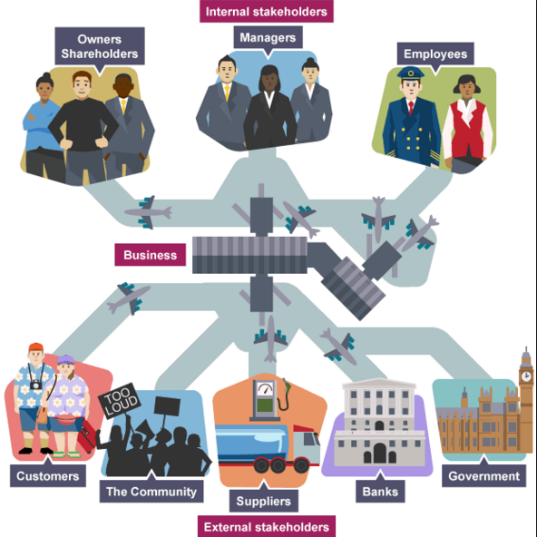
Notes:
Internal Stakeholders
Internal stakeholders are intimately associated to the organisation and their objectives are likely to have a strong influence on how it is run.
The main two examples of internal stakeholders are:
Employees
Management
Connected Stakeholders
Connected stakeholders can be viewed as having a contractual relationship with the organisation.
The objective of satisfying the shareholders needs to be fulfilled, however, customers and finance objectives must be met if the company is to succeed.
Some examples of connected stakeholders may include:
Shareholders – interested in shareholders’ wealth measured by profitability, P/E ratios, market capitalisation
Response risk if interests are not recognised
Sell shares (e.g. to predator) or vote against management (e.g. at AGM)
Customers – interested in the company’s products
Response risk if interests are not recognised
Buy elsewhere
Damage reputation (e.g. bad publicity)
Legal action
Suppliers – interested in building long term relationship, on time payment of goods and profitable sales
Response risk if interests are not recognised
Refusal of credit
Stop supplying
Legal action (e.g. for unpaid debts)
Finance providers - like banks interested in loan security
Response risk if interests are not recognised
Denial of credit
Higher interest charges
External Stakeholders
External stakeholders have quite diverse objectives and have varying ability to ensure that the organisation meets its objectives.
Some examples of external stakeholders may include:
Non-governmental organisations
Interests to defend
Human rights
Response risk if interests are not recognised
Legal action
Environmental pressure groups
Interests to defend
Protecting the environment
Human rights
Response risk if interests are not recognised
Publicity
Direct action
Sabotage
Pressure on government
Government and regulatory agencies – interested in tax, compliance with legislation and employment opportunities
Response risk if interests are not recognised
Tax increases
Regulation
Legal action
Tariffs
Trade unions – interested in protecting their members.
Response risk if interests are not recognised
Legal action
Direct action

Slide 21
Effective Stakeholder Management
Five core questions an organisation should consider:
  Who are our stakeholders?
  What impact do they/can they have on the organisation (increase profit, improve customer satisfaction, damage the brand/organisation name).
  What opportunities or threats do stakeholders bring?
  What responsibilities do they have to the stakeholder (economic, legal, ethical).
  What strategies or actions should an organisation follow to ensure they manage stakeholders expectations?

Slide 22
Stakeholder Analysis Model
Mendelow (1991) proposed a model that ranks stakeholder according to power and interest.
Benefits of stakeholder analysis:
  Enables you to prioritise stakeholders
  Helps to explain the project to others
  Helps keep the project team and stakeholders engaged
  Quick and easy to create
  Can easily adapt it throughout the project

Slide 23
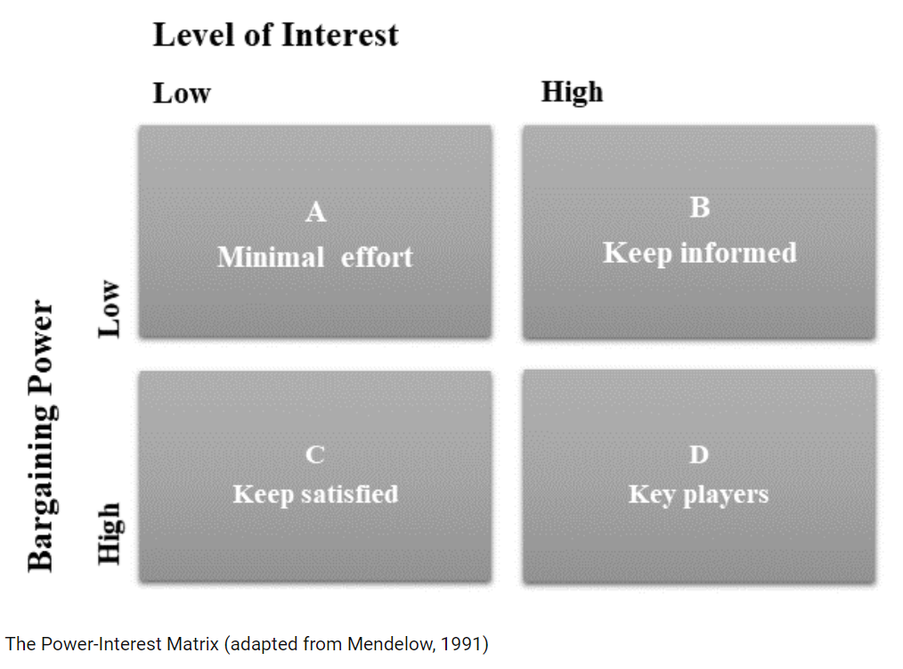
Mendelow Stakeholder Matrix
Notes:
The stakeholder matrix is a simple graphical representation of a stakeholder analysis. It has two axes, with the chart divided into four areas. The position of each stakeholder on the matrix allows the project manager to identify high priority, important stakeholders for the project and those who might be less engaged and have less of an impact. The two axes of the matrix include:
Interest: This is the x-axis (the horizontal axis) of the chart and identifies the level of interest each stakeholder is likely to have in the project. A stakeholder with a prime interest in the project is towards the right-hand end of the interest axis, while those with low interest would be towards the left-hand side of the chart.
Power: This is the y-axis (the vertical axis) of the chart which illustrates how much power each stakeholder has to affect the project. The higher the power of the stakeholder, the higher their placement on the power axis, while stakeholders with little or no power to influence the project are towards the bottom of the axis.
Plotting the stakeholders on the chart creates four specific areas of the matrix, which help the project manager to organise and prioritise the roles of stakeholders in the project.

Slide 24
Categories of the Matrix
A. Minimal effort – Low power, low interest
B. Keep informed - Low power, high interest
C. Keep satisfied - High power, low interest
D. Key players – High power, high interest
Notes:
Low power, low interest
Low power, low-interest stakeholders are unlikely to be much of a priority for the project. They may need monitoring as the project progresses in case the situation changes. These stakeholders might be employees or outside consultants working on the project, including administrative staff or colleagues involved in manual work.
Low power, high interest
Low power, high-interest stakeholders might have heavy involvement in the project. Alternatively, the project may affect them significantly, but they may have little power over the project's direction. Project teams would typically keep these stakeholders up-to-date on developments in the project, even if they're unable to influence the outcome of those developments.
High power, low interest
Stakeholders with high power but low interest might be less likely to have a direct role in the project. They would, though, be likely to have some power over its eventual success or failure. High power, low interest stakeholders may be important to keep happy and you might wish to update them on the project, even if they're not directly interested in it. An example of a high power, low interest stakeholder might be a company director or CEO, who doesn't take part in the daily work of the project but still has significant power over it.
High power, high interest
These stakeholders are likely to play a key role in the project. Each stakeholder in this category probably requires close management and involvement in every stage of the project. High power, high interest stakeholders might be the head of the department running the project or a direct supervisor or manager of the project management team. These stakeholders oversee the direction of the project and have a vested interest in ensuring the project is a success.

Slide 25
Problem of the Week
Green University is a medium-sized institution with approximately 10,000 students and 1,500 faculty and staff members. The university prides itself on its commitment to sustainability and environmental responsibility. However, the current recycling program on campus is outdated and inefficient, resulting in a significant amount of recyclable materials ending up in landfill.
The university's administration has decided to implement a comprehensive new recycling program to address this issue. The program aims to increase recycling rates, reduce waste, and promote a more sustainable campus environment.
Identify the potential stakeholders involved in implementing the new campus recycling program and assess their levels of interest and influence using Mendelow's Stakeholder Matrix.
Notes:
Additional case study word document on Moodle.
Allow 20-30 minutes.

Slide 26
Any questions?
Recap quiz next week to test your knowledge!

