Slide 1
Contribution Made by
HRM/HRD and Ethics
Lecturer: Deborah Rees deborah.rees@ustsd.ac.uk
Leading, Managing & Developing People:
Week 5

Slide 2
Module Aims and Learning Outcomes
Review and critically evaluate major contemporary research and debates in the fields of human resource management (HRM) and human resource development (HRD).
Evaluate major theories relating to motivation, commitment and engagement at work and how these are put into practice by organisations.
Debate and critically evaluate the characteristics of effective leadership and the methods used to develop leaders in organisations.
Contribute to the promotion of flexible working and effective change management in organisations.
Critically discuss the aims and objectives of the HRM and HRD function in organisations and how these are met in practice.
Assess the contribution made by HRM and HRD specialists in different types of organisation.
Promote professionalism and an ethical approach to HRM and HRD practice in organisations.
Major debates about professionalism and ethics in organisations; common ethical dilemmas faced by managers and ways of resolving these; equity and fair-dealing; managing within the expectations of the law.

Slide 3
Aims and Contribution of HR
“HR Suffers from reputational deficit” Timms (2018).
“HR stands at an inflection point …… human resources are their (business’) greatest resource” Timms (2018).
Notes:
Timms, P. (2018) Transformational HR How Human Resources Can Create Value and Impact Business Strategy. London: Kogan Page Limited.

Slide 4
Aims and Contribution of HR
Major contemporary developments in HRM and HRD practice in larger private sector companies
Small and medium-sized enterprises
Public sector organisations
Voluntary sector organisations and international corporations.

Slide 5
Aims and Contribution of HR
Major contemporary developments in HRM and HRD practice in larger private sector companies
Investment in technology and HR Analytics – evidence based decision making shaped by people science.
Shift in focus from ‘Human Resources’ to ‘People Services’ function in a bid to shift people to the centre of the business’ focus.
Move from annual appraisals to more frequent development conversations / real-time coaching guidance on live issues.
HR / People Services recruiting candidates with operational experience as opposed to traditional HR backgrounds (Google, Microsoft, Kelly Services etc).
Total Rewards packages being crafted to attract the best talent in light of existing skills shortages
Agile HR to support agile businesses
Employee monitoring ramping up (“Humanyze” from Billion Dollar Question).

Slide 6
Aims and Contribution of HR
Small and medium-sized enterprises
Lagging behind with technological investment for the most part.
Grappling to equip their businesses to deal with IR36 implications and Good Work Plan legislative changes.
Being usurped by large global entities such as Amazon – culminating in downsizing initiatives.
Ill-prepared for the 4th Industrial Revolution.
Ill-prepared for BREXIT.
Encouraging a unitarist approach to employee relations
Notes:
See IR36 Document and Good Work Plan Guidance – both on Moodle.
SME statistics

Slide 7
Aims and Contribution of HR
Public sector organisations
Maintaining TU and Employee Relations
Trying to retain and motivate employees against a backdrop of discontent following a decade of austerity measures since the financial crisis. ……
Pay mechanisms have failed to keep up with private sector rises.
Proposed strikes across Universities
NHS at breaking point
Police failing to meet targets
Ambulance Services failing to meet targets.

Slide 8
Aims and Contribution of HR
Voluntary sector organisations
Trying to do more with less
Supporting employees working in emotionally stressful services
Grappling with high turnover (students and part-time employees occupy a larger percentage of jobs)

Slide 9
Aims and Contribution of HR
International corporations.
Harmonising terms, conditions and work practices internationally.
Preparing for BREXIT ramifications.
Facing a deeper impact from Coronovirus
Leading the way with technological developments
Environmental and ethical agendas

Slide 10
Improving HR Services at the Royal Bolton Hospital (2011)
Define the mission
Set the objectives
Conduct an internal and external SWOT
Analyse existing strategies and do a gap analysis
Define distinctive capabilities of the org
Define strategic issues
Determine corporate and functional strategies to achieve these goals
Prepare an integrated strategy plan for implementing strategies
Implement
Monitor implementation
Notes:
Armstrong, M. (2016) Armstrong’s Handbook of Strategic Human Resource Management. 6th e.d. London: Kogan Page.
Page 20.

Slide 11
Strategic Human Resource Management Concepts
Resource based view (RBV)
Strategic fit
Best practice approach
Best fit approach
Vertical and Horizontal (‘bundling’) Integration
Notes:
Armstrong, M. (2016) Armstrong’s Handbook of Strategic Human Resource Management. 6th e.d. London: Kogan Page.
Pages 36 to 47

Slide 12
Integrating business and HR strategy – Vertical Fit
It is not enough to simply list a set of strategic priorities. It is also necessary to see that they are integrated with the business strategy, a key requirement of strategic HRM. In doing this, account should be taken of the fact that strategies for change have also to be integrated with changes in the external and internal environments. ‘Fit’ may exist at a point in time but circumstances with change and ‘fit’ no longer exists’. An excessive pursuit of ‘fit’ with the status quo will inhibit the flexibility of approach which is essential in turbulent conditions.
Notes:
Armstrong, M. (2016) Armstrong’s Handbook of Strategic Human Resource Management. 6th e.d. London: Kogan Page.
Page 77.
What contemporary approaches counter this? The Emergent Strategy of Google and Netlix.

Slide 13
Integrating business and HR strategy – Horizontal Fit or ‘Bundling’
Horizontal integration or ‘fit’ takes place when the various HRM strategies cohere and are mutually supporting. It can be attained by the process of ‘bundling’ which is carried out by:
1. identifying appropriate HR approaches,
2. assessing how the items in the bundle can be linked together so that they become mutually reinforcing;
3. Drawing up programmes for the development of these practices, paying particular attention to the links between them
Notes:
Armstrong, M. (2016) Armstrong’s Handbook of Strategic Human Resource Management. 6th e.d. London: Kogan Page.
Page 78.
What contemporary approaches counter this? The Emergent Strategy of Google and Netlix.

Slide 14
Rhetoric v Reality – The ‘Say-Do’ Gap
Gratton et al (1999) noted ‘the disjunction between rhetoric and reality in the area of human resource management, between HRM theory and HRM practice, between what the HR function says it is doing and how that practice is perceived by employees, and between what the senior management believes to be the role of the HR function, and the role it actually plays’.
Notes:
Armstrong, M. (2016) Armstrong’s Handbook of Strategic Human Resource Management. 6th e.d. London: Kogan Page.
Page 85.
MacLeod talks about the say-do gap in his “Engage for Success” report in 2009. Lucy Adams talks extensively about the short-falls of HR, and the façade between what the policies say and what goes on in reality.
What contemporary approaches counter this? The Emergent Strategy of Google and Netlix.

Slide 15
CIPD (2013) Hackathon – Enemies of Adaptability
Hierarchy
Fear
Decision bias
Habit
Centalization
Inflexible business practices
Rigid structures
Skills deficit
Short-term thinking
Insufficient experimentation
Lack of diversity
A paucity of purpose
Notes:
Timms, P. (2018) Transformational HR How Human Resources Can Create Value and Impact Business Strategy. London: Kogan Page Limited.
Page 128
Paucity – in small supply / lacking

Slide 16
CIPD (2013) Hackathon – Design Principals of Adaptable Organisations
Experimentation and learning
Purpose and meaning
Creativity
Transparency and openness
Diversity
Peer collaboration
Autonomy and trust
Flexibility
Natural leadership and meritocracy
Notes:
Timms, P. (2018) Transformational HR How Human Resources Can Create Value and Impact Business Strategy. London: Kogan Page Limited.
Page 128

Slide 17
Factors that contribute to this gap
Tendency for employees in diverse orgs to only accept initiatives they perceive to be relevant to their own areas
Tendency of long serving employees to cling to the status quo
Complex or ambiguous initiatives may not be understood by employees
It is more difficult to gain acceptance of non-routine initiatives
Employees will be hostile to initiatives if they are believed to be in conflict with the orgs’ identity – e.g downsizing in culture of job for life
Initiative seen as a threat
Inconsistencies with strategies and values
Extent to which SMT is trusted
Perceived fairness of the initiative
Extent to which existing processes could help to imbed the initiative
Bureaucratic culture which leads to inertia
Failure to understand the strategic needs of the business
Inadequate assessment of environmental and cultural factors
Development of ill-conceived / unmanageable / irrelevant initiatives
Failure to involve stakeholders in the strategy.
Notes:
Armstrong, M. (2016) Armstrong’s Handbook of Strategic Human Resource Management. 6th e.d. London: Kogan Page.
Page 85.
Triangulate – the Importance of the say – do gap is mentioned in McLeod’s Engage for Success Report, and Lucy Adams’ book supports the above too.
What contemporary approaches counter this? The Emergent Strategy of Google and Netlix.

Slide 18
Ensuring Effective Delivery of HR Strategy
Formulate effective strategies
Involve stakeholders
Communicate
Build skills
Monitor and Educate
Manage Change
Notes:
Armstrong, M. (2016) Armstrong’s Handbook of Strategic Human Resource Management. 6th e.d. London: Kogan Page.
Page 86.
Triangulate – the Importance of the say – do gap is mentioned in McLeod’s Engage for Success Report, and Lucy Adams’ book supports the above too.
What contemporary approaches counter this? The Emergent Strategy of Google and Netlix.

Slide 19
Human Capital Strategy
Determine the impact of people on the business and determine their contribution to value
Determine that HR practices produce value for money in terms of ROI (Return on Investment)
Provide guidance on future HR and business strategy
Provide data that will inform strategies and practices designed to improve the effectiveness of people management in the organisation
Notes:
Armstrong, M. (2016) Armstrong’s Handbook of Strategic Human Resource Management. 6th e.d. London: Kogan Page.
Page 106
Triangulate – the Importance of the say – do gap is mentioned in McLeod’s Engage for Success Report, and Lucy Adams’ book supports the above too.
What contemporary approaches counter this? The Emergent Strategy of Google and Netlix.

Slide 20
High Performance Work Systems
A high performance work system (HPWS) has been defined by Becker and Huselid (1998) as: ‘An internally consistent and coherent HRM system that is focused on solving operational problems and implementing the firm’s competitive strategy’.
They suggested that such a system is the key to the acquisition, motivation and development of the underlying intellectual assets that can be a source of sustained competitive advantage.
Notes:
Armstrong, M. (2016) Armstrong’s Handbook of Strategic Human Resource Management. 6th e.d. London: Kogan Page.
Page 139

Slide 21
Basic Features of a HPWS
Shih, Chiang and Hsu (2005)
Job infrastructure – workplace arrangements that equip workers with the proper abilities to do their jobs, provide them with the means to do their jobs and give them motivation to do their jobs.
Training programmes – to enhance employee skills: investment in increasing employee skills knowledge and ability.
Information sharing and worker involvement mechanisms – to understand the available alternatives and make correct decisions.
Compensation and promotion opportunities that provide motivation – to encourage skilled employees to engage in effective discretionary decision making in a variety of environmental contingencies.
Notes:
Armstrong, M. (2016) Armstrong’s Handbook of Strategic Human Resource Management. 6th e.d. London: Kogan Page.
Page 139
How does this compare with more recent thinking?? – Dan Pink TED talk, Rachel Goyette TED Talk, Patty McCord TED Talk , Simon Sinek TED Talk

Slide 22
Agile Working
Agile working is an approach to running a business that enables it to respond rapidly to change, new demands and increasing complexity.
A report by the Economic Intelligence Unit (2009) stated the characteristics of an ‘agile’ business were a high performance culture, flexibility of management practices and resources, and organisational structures that support collaboration, rapid decision making and execution.
Nearly 90% of senior execs at the EIU believe that organisational agility (ability to anticipate and address the forces affecting the business) is crucial for business success.
Notes:
Armstrong, M. (2016) Armstrong’s Handbook of Strategic Human Resource Management. 6th e.d. London: Kogan Page.
Page 144
How does this compare with more recent thinking?? – Dan Pink TED talk, Rachel Goyette TED Talk, Patty McCord TED Talk , Simon Sinek TED Talk

Slide 23
Aims and Contribution of HR
Major contemporary developments in HRM and HRD practice in larger private sector companies
“We can learn a lot from the world of agile and creative start-ups, by the moves to more liberated structures of so called democratized work places which put people at the heart of business thinking” Cheese (2018)
Notes:
Cited by Peter Cheese in the Foreword of:
Timms, P. (2018) Transformational HR How Human Resources Can Create Value and Impact Business Strategy. London: Kogan Page Limited.

Slide 24
Being an HRM professional (1)
Is HRM a profession? What does it mean to be a professional?
    Being a member of the CIPD and ‘acting as a professional’ entails far more than passing exams, as indicated in the CIPD Code of Professional Conduct (2015).
    It requires a commitment to update professional knowledge, uphold legal thresholds and behave with integrity at all times. In addition, CIPD members are required to ‘challenge others if they suspect unlawful or unethical conduct or behaviour’ (para 4.2).

Slide 25
Being an HRM professional (2)
    No exceptions to positive professional behaviour in all aspects of working life. Those embracing such standards may use them as a frame for professional identity, where the standards become part of their working self (Brown 2015).

Slide 26
Importance of codes of conduct
Codes may be professional (e.g. CIPD), applied to a whole sector or related to an individual organisation.
Codes signal to the outside world the standards of behaviour required.
    Professional codes help individual members to deal with competing short-term influences at work.
    Codes may seem to be based on duty-based ethics, but can also be seen as the distillation of years of experience of consequences.
    Codes provide a system of overt regulation whereby complaints can be received and sanctions given.

Slide 27
Aims and Contribution of HR
“We are seeing…..the move away from standard or ‘best’ practice to innovating and understanding what is best fit for the context we are in” Cheese (2018)
Notes:
Cited by Peter Cheese in the Foreword of:
Timms, P. (2018) Transformational HR How Human Resources Can Create Value and Impact Business Strategy. London: Kogan Page Limited.
Perry Timms Handout on moving from 3 legged stool, to 4 zones of HR.

Slide 28
Aims and Contribution of HR
“A key principal that guides organisations who put people at the heart of business is the understanding and support of wellbeing. With stress, engagement and many other modern work trends not headed in the right direction , wellbeing must be a central principal for what we do – the duty of care we have to our employees, and how by so doing we help them to be more productive and effective”. Cheese (2018)
Notes:
Cited by Peter Cheese in the Foreword of:
Timms, P. (2018) Transformational HR How Human Resources Can Create Value and Impact Business Strategy. London: Kogan Page Limited.
Perry Timms Handout on moving from 3 legged stool, to 4 zones of HR.

Slide 29
Ethics Content
Major debates about professionalism and ethics in organisations
Common ethical dilemmas faced by managers and ways of resolving these
Equity and fair-dealing; managing within the expectations of the law.

Slide 30
Ethics and HRM
What’s different about human resources?
    Can human resources be treated in the same way as an organisation’s other resources?
Human resources aren’t actually owned by the organisation: the arrangement is voluntary on both sides.
The employment relationship is usually continuing, for mutually beneficial reasons.
    Employers usually have more power than employees, leading to protective laws, etc.
Above all, human beings are special, with rights that inanimate resources do not have.
Notes:
Remember, if the psychological contract is out of balance, the employee can and will withdraw their discretionary effort.

Slide 31
Three approaches to ethics
Ethics as duties: actions that are good or bad in their own right (also entails rights and/or principles)
Ethics as consequences: goodness or badness depends on what happens as a result
Ethics as virtues: desirable qualities or character traits exhibited by good people
All three approaches have practical implications for ethical HRM.

Slide 32
Ethics and businesses
Moral theories developed for individuals
Organisations (e.g. businesses) are not the same as individuals. However,
  organisations do act with intent, and may exert a lot of power
  organisations are groups of people, with their own values
Being clear about the purpose of an organisation helps to define good and bad acts by that organisation

Slide 33
The business purpose (1)
  What are businesses for?
    Making as much money as possible for the shareholders (in competition with other businesses and subject to the law)
    Taking account of and balancing a broader range of stakeholder interests; acknowledging a wider corporate social responsibility (CSR) than just selling products and services at a profit.
Notes:
Remember the Capitalism in Crisis Article.
Remember the Deloitte’s Human Capital Trends report talking about “Social Enterprising Organisatons”
The Global Threats Report talks about the BIG problems the world faces today and David Clutterbuck and Peter Hawkins in their (2020) Masterclass talk about the solution to this being team work – working to solve these big problems together – huge emphasis is now placed on ‘team literacy’ skills for people managers.

Slide 34
The business purpose (2)
  What are the implications for ethical HRM?
    Shareholder-oriented firms need to attract and keep the best people and so have an incentive to pay well and offer good conditions of service.
  It should also be remembered that employees are an important stakeholder group. Greenwood and Freeman (2011) argue that stakeholder theory offers the potential to open up an analysis of HRM to a more pluralistic and pragmatic approach to ethics.
Notes:
Insert David Clutterbuck Slide on enhanced stakeholder map

Slide 35
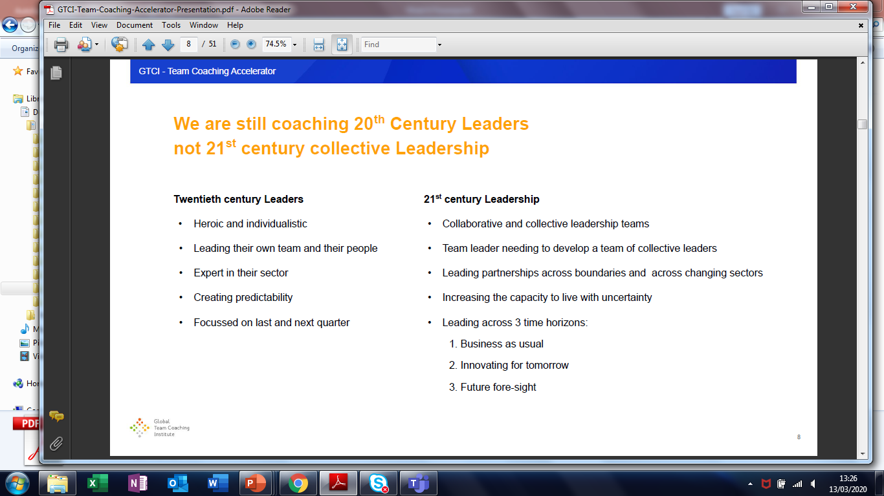
Notes:
David Clutterbuck and Peter Hawkins (2020) - Masterclass

Slide 36
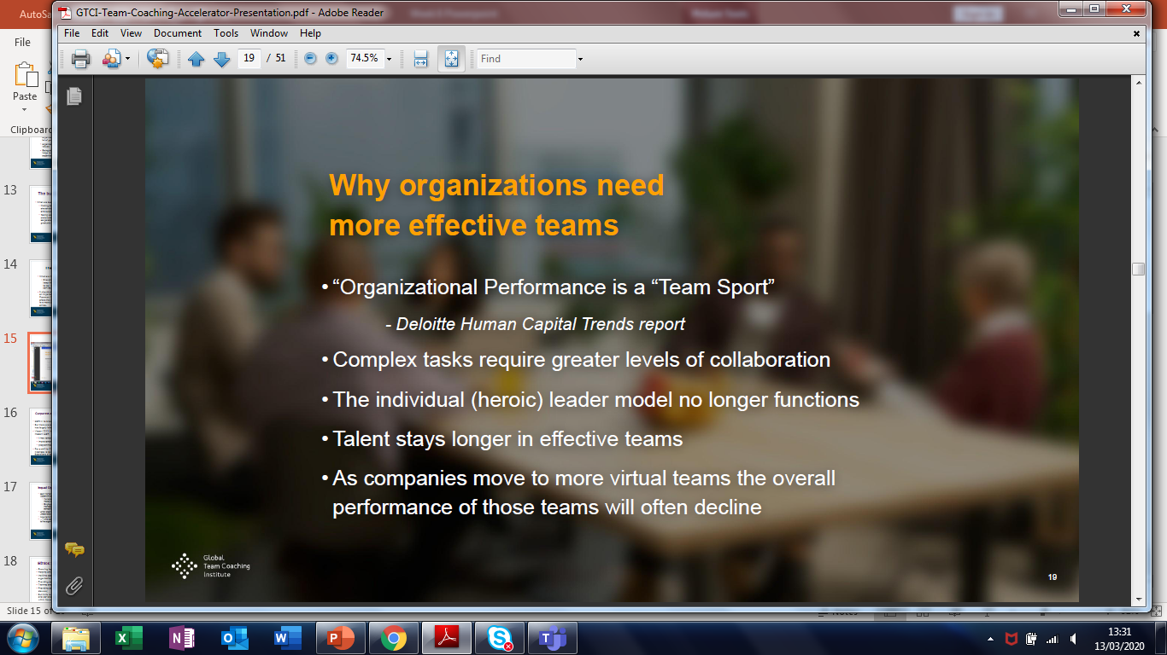
Notes:
David Clutterbuck and Peter Hawkins (2020) - Masterclass

Slide 37
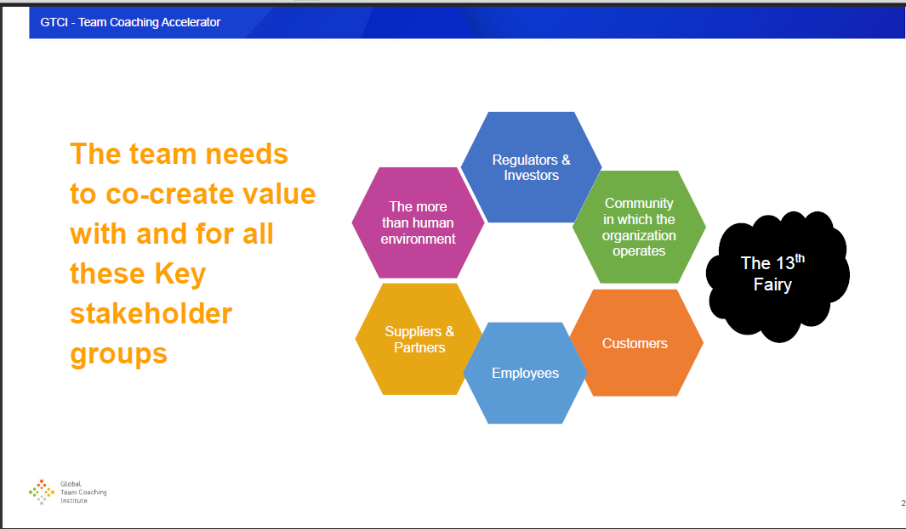
Notes:
David Clutterbuck and Peter Hawkins (2020) – Masterclass
Note this vision of stakeholders is broader than the usual employees/orgs/customers – there is more emphasis on stakeholder analysis in 2020

Slide 38
Corporate sustainability and responsibility
CSR in its broader sense is now accepted business strategy.
But there are criticisms from those who believe voluntary CSR has largely failed to deliver on its promise.
Visser (2012) identifies what he calls the ‘triple curse of modern CSR’
  it has remained largely peripheral to business operations
  improvements made have only been incremental
  programmes are frequently uneconomic.
For a shift to CSR 2.0 to be effective it needs sustainability practices to be embedded and integrated into the core operations of companies.

Slide 39
Social Enterprising Organisations – A Step Forwards From CSR
Deloitte Human Capital Trends Report (2019)
Capitalism in Crisis Article (2020)
World Economic Forum – Global Threats Report (2020)
Coronovirus outbreak is likely to propel ‘Social Enterprising Organisations’ further up the international CEO’s Agenda

Slide 40
Equal Opportunities (EO) and ethics
Duty-/rights-based and consequentialist justifications for Equal Opportunities:
  Humans have a right to be treated as individuals and not merely as members of groups.
  Employers who are prejudiced in their recruitment are denying themselves access to part of the labour market and may suffer competitive damage.
Unfair discrimination in employment is also often illegal (as well as undesirable or inadvisable).
Arguments for and against ‘positive’ discrimination continue . . .
. . . while advocates of ‘diversity management’ stress the benefits to the organisation in terms of innovation and resilience.

Slide 41
Ethics: the role of HR
Ensuring legal compliance – a major responsibility
Helping employers compete for the best talent
Instilling good professional practice throughout the organisation
Providing advice and guidance for individuals
Training and briefing, fostering ethical conduct
Providing confidential feedback channels (e.g. for whistle-blowers)
But limits to what HR can effect. Need for collaboration and (co-)creating policies in order to embed ethical values within the organisation.
Notes:
What others can you think of?

Slide 42
HR and ethical stewardship
HR professionals have a significant role to play in setting and maintaining ethical standards in organisations.
Ethics has to be seen as the responsibility of all:
  Ethics is not just about employees – customers, suppliers and other contacts also have ethical expectations.
  Major ethical problems may originate in work carried out at a junior level, way beyond the view of HR managers.
  If ‘ethics’ is seen as someone else’s responsibility, the organisation will fail to learn and develop fully.

Slide 43
Ethics in the Spotlight
Primark (and others) sweatshop scandal (2008)
Banks in the run up to the Financial Crisis of (2008/9)
TISC Clause in the Slavery Act (2015)
#metoo campaign goes viral (2017)
Sports Direct (2018)
“Humanez” in the U.S, employee monitoring (2018)
Amazon (2018) for working conditions
Good Work Plan (2018) – Legislation (2020)
AI being written by white males leading to prejudice David Clutterbuck article (2019)
Airline fuel emissions (2019)
Universities balloted to strike over pay (2019)
Airline expansion lobbying (2020)
Amazon (2020) ‘spying’ via Alexa
CEO Pay - ongoing
Notes:
TISC – Transparency in Supply Chains

Slide 44
Any Questions?
Next Week:
Finish off any outstanding content
Go through the exam requirements
Student-led exam preparation session

