Slide 1
BMST4004
Tendon and Ligament Healing

Slide 2


Learning Outcomes
Describe types of tendon and ligament injury
Discuss tendon and ligament healing including
timescales and timeframes that facilitate appropriate
healing
Discuss their tolerances to loading

Slide 3
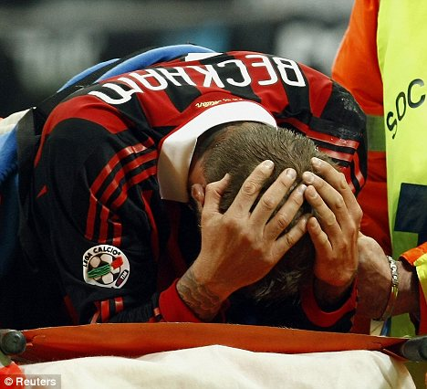
Tendon and Ligament Mechanics

Slide 4
Tendon and Ligament Alignment
Wavy
Patella Tendon

Slide 5
Ligament
Attach Bone to Bone
Can get sprained
3 Grades
- Grade I (Pain no laxity)
- Grade 2 (Pain & laxity)
- Grade 3 (No Pain & lax+++)

Slide 6
Ligament Damage and Failure
950 N (95Kg) = 6.05 mm
880 N (88Kg) = 5.04 mm

Slide 7
Ligament Failure
Speed of force determines where
the ligament fails
- High speed: Bone ligament
interface
- Low speed: Mid-belly (core or
ligament)

Slide 8
Use v Disuse
Ligaments:
- Increased structural strength and stiffness
- ADL enough to maintain 80-90% potential
strength/mechanical potential (Frank, 1996).
- Exercise increases ligament strength and stiffness by up to an additional 10-20%

Slide 9
Ligament Healing
Ligaments:
- When ligament tears, frayed stump ends are present
- Ligament undergoes inflammatory process
- Ligament stumps become surrounded by fluid, causing ends to become friable (easily crumbled)
- Vascular permeability increases and permits normal inflammatory products to invade
- Erythrocytes invade gap between stump ends

Slide 10
Ligament Healing
Time | Activity
< 6hrs | Injury site fill with erythrocytes, leukocytes and lymphocytes. Ligament stumps become progressively more friable with the accumulation of serous fluids in the area
24/24 | Monocytes and macrophages infiltrate the area . Fibroblasts begin to appear and become significant in number
48-72/24 | Fibroblast produce the extracellular matrix
1-2/52 | Fibrocytes and macrophages are numerous Random collagen fibres and abundant ground substance are seen. Fragile vascular granulation is seen Extracellular matrix continues to be synthesised by fibroblasts Macrophages, mast cells and fibroblasts continue to predominate. Vascular buds appear in the wound to communicate with existing capillaries Elastin is seen

Slide 11
Ligament Healing
Time | Activity
2/7 to 6/52 | Proliferation phase occurs Cellular and matrix structures replace the blood clot formed during inflammation
6/52 to 12/12 | Macrophages and fibroblasts diminish
< 12/12 | Collagen concentration stabilises with type I collagen replacing type III Collagen cross link increase in number Ligament becomes more normal
40-50/52 | Near normal tensile strength restored

Slide 12
Ligament Immobilisation
Ligaments:
- Major deterioration in first few weeks
- Ligament cells produce inferior quality ligament material
- Structural weakening at ligament complex
- Osteoclast at bone-ligament that decreases the strength of insertional bone (concurrently)

Slide 13
Tendons
Types of Tendon Issue:
- Strain (partial or rupture)
- Tendinopathy (Overuse)

Slide 14
Tendons
USE v DISUSE:
- Few good studies available
- Increased number and size of collagen fibrils
- Increased cross-sectional area
- Exercise leads to increased collagen synthesis in growing tendons (Curwin et al,1988)
- Exercise leads to increased number of fibroblasts in tendons (Zamora & Marini,1988)

Slide 15
Acute Tendon Healing
Time | Activity
0-3/7 | Cells that originate from extrinsic peri-tendinous tissue and from intrinsic tissue from the epitenon and endotenon are active
5/7 | Wound gap is filled by phagocytes
1/52 | Collagen synthesis is initiated , new collagen fibres placed in random and disorganised orientation
10/7 | Collagen synthesis peaks
3/52 | Endotenon provides significant fibroblast proliferation at the site. Significant revascularisation occurs. Synovial sheath is rebuilt: smooth gliding surface develops. Fibroblasts also start to become orientated in line with tendon axis
4/52 | Fibroblasts predominate in the healing area. Collagen content increases. Collagen fully orientated with tendon axis
Daniel Martin
MSc BSc MHCPC MCSP MAACP

Slide 16
Acute Tendon Healing
Time | Activity
5/52 | Collagen synthesis is complete
6/52 | Fibroblasts that have proliferated endotenon are the primary cells: simultaneously synthesising collagen whilst contributing to collagen re-absorption
2/12 | Collagen is mature and re-aligned along the tendons axis
4/12 | Fibroblasts have reverted to tenocytes , Type III collagen has been replaced by Type I Maturation is complete
40-50/52 | Strength is 85-95% normal
Daniel Martin
MSc BSc MHCPC MCSP MAACP

Slide 17
Tendon Terminology
Tendinopathy – condition associated with the tendon
Tendinosis - degenerative
Tendinitis - inflammatory
Tenosynovitis – inflammation of the synovium around the tendon

Slide 18
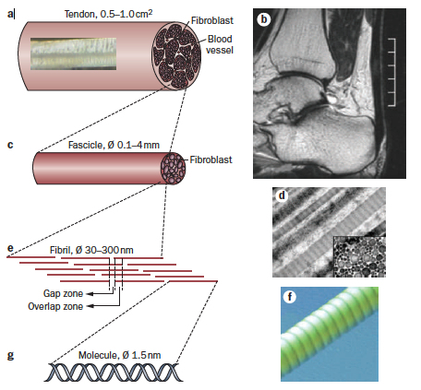
Tendon Structure

Slide 19
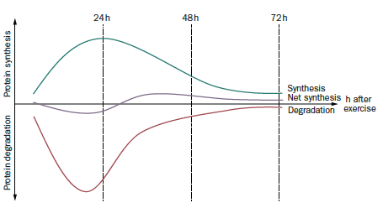
Tendon Concepts - Normal

Slide 20
Tendon Concepts - Abnormal
Reactive tendon
Tendon dysrepair
Degenerative tendinopathy

Slide 21
Tendon Concepts – Reactive tendinopathy
Non inflammatory
Acute Tensile/ Compressive Force
Localised thickening at point of stress
Increase CSA in response to load
Normal tendon increases stiffness not CSA
Able to return to normal state after deloading
Increased cytoplasmic organelles for protein production
Large proteoglycans
Matrix changes due to water uptake
Collagen integrity maintained
No neurovascular changes
Minutes – few days

Slide 22
Tendon Concepts – Dysrepair tendinopathy
Attempt at tendon healing
Similar to reactive tendinopathy but with
increased cell breakdown
Increased cells numbers (Chrondrocytes and
Myofibroblasts)
Separation of collagen and disorganisation of
matrix
Increased ground substance
Some may increase in neovascularization and
neurals

Slide 23
Tendon Concepts – Degenerative tendinopathy
Areas of cell death
Areas of acellularity (non cellular)
Large areas of disordered matrix filled with vessels, matrix breakdown products and little collagen
Considerable heterogeneity of the matrix
Islands of degenerative pathology
Interspersed with other areas of pathology and normal
` tendon
97% Achilles tendons that rupture are degenerative

Slide 24
Clinical Concepts
– Where are they
Subjective Ax is Key
Duration of symptoms
Age factor
Single bout or repeated
Investigations - ultrasound/MRI? Doppler?
Questionnaires
Objective Markers? (Squeeze/SL Calf Raise)

