Slide 1
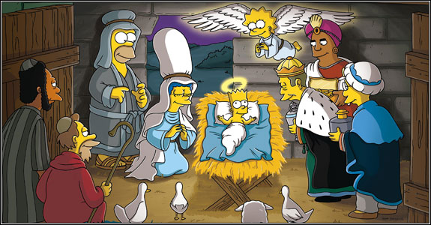
Spirituality in your everyday
Media and religion

Slide 2
Look at the images on the next slide they show a variety of different adverts. Your task is to detect whether there is a theme running through the images and what they show.

Slide 3
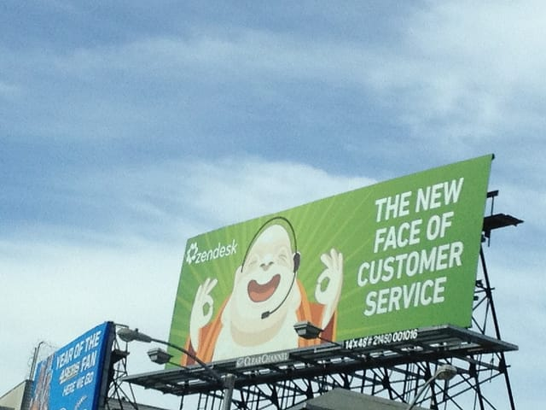


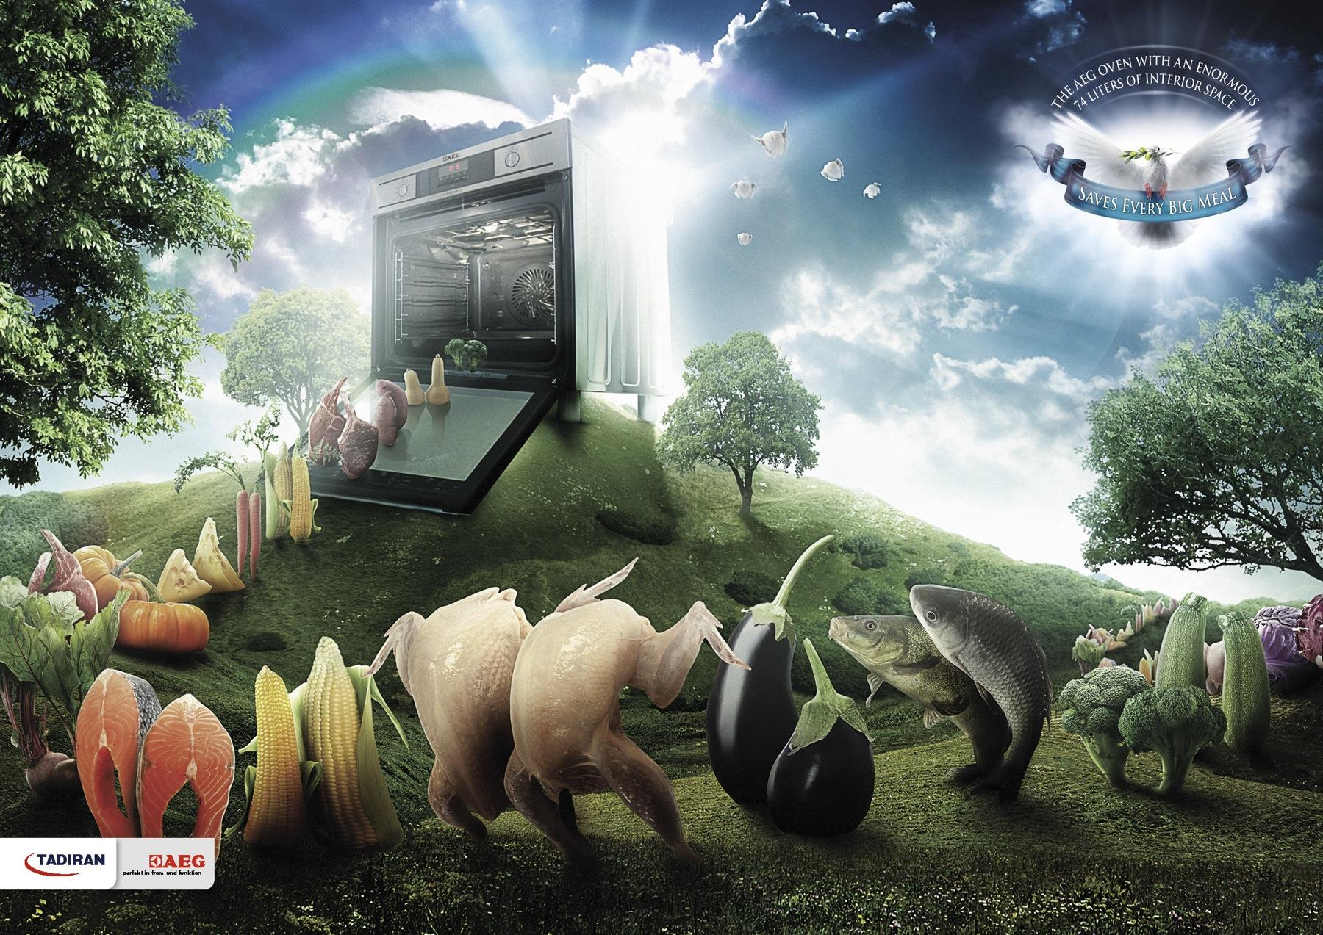


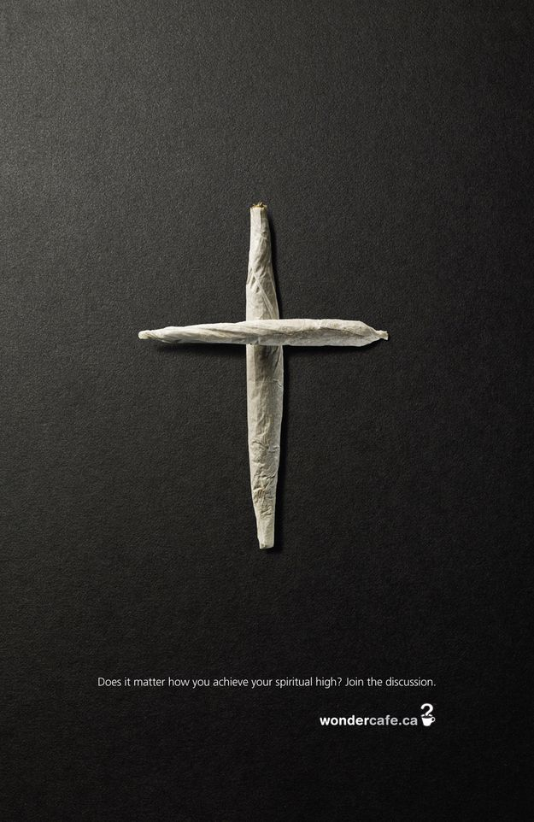
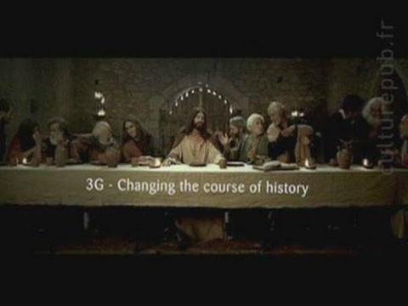

Slide 4
Objectives
Learn a definition of pop culture
Understand how religion fits into pop culture
Understand the effects that religion plays within the media

Slide 5
So what is Pop Culture?
Popular culture (or "pop culture") refers in general to the traditions and material culture of a particular society.
In the modern West, pop culture refers to cultural products such as music, art, literature, fashion, dance, film, cyberculture, television, and radio that are consumed by the majority of a society's population.
Popular culture is those types of media that have mass accessibility and appeal.

Slide 6
Can you think of religion in any examples of pop culture that are not adverts?
Create a spider diagram of other examples
Pop culture

Slide 7

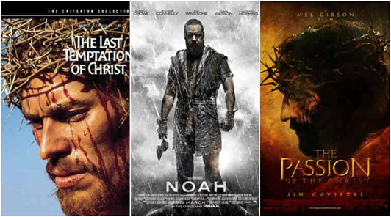
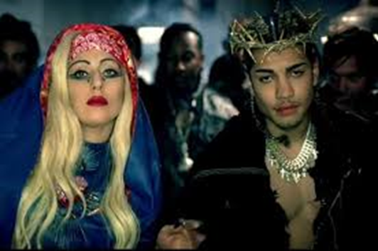
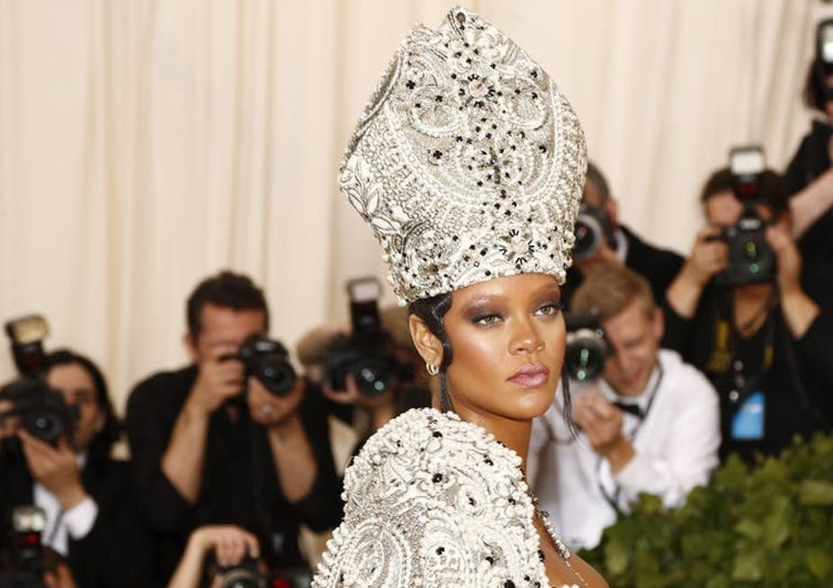
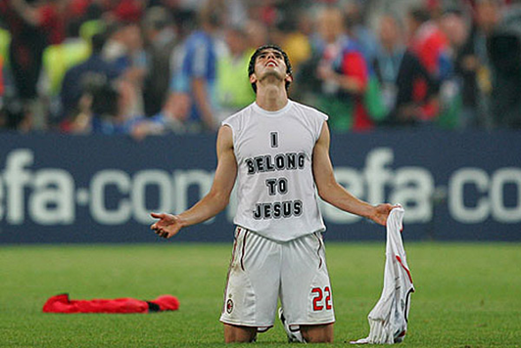
Examples
Film
Television
Sport
Music
Fashion

Slide 8
Watch the following video:
https://youtu.be/It4CDeqBXmU
Whilst watching this video, I want you to see if you can pick up on points that display religion negatively AND any points that display religion positively

Slide 9
Benefits and negatives of how the media portrays religion
Negatives | Positives
Often ridicules Shows religion as being dangerous – cult like Suggests followers are crazy Changes the story to fit the narrative that adverts/films etc are trying to show Exploitation | Promotes religion Can often show positives aspects of religious belief Information Creative – met gala

Slide 10
So what have we learnt today?

