Slide 1
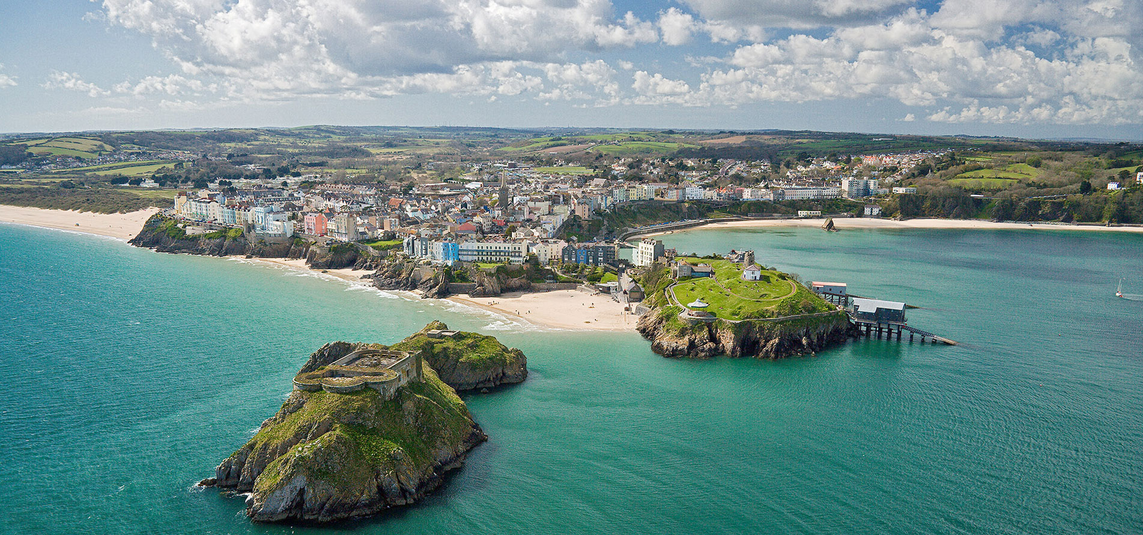

IRONMAN WALES 2020
BID PITCH
By Megan Smith, Sonny Hawkins and Amy Graham

Slide 2
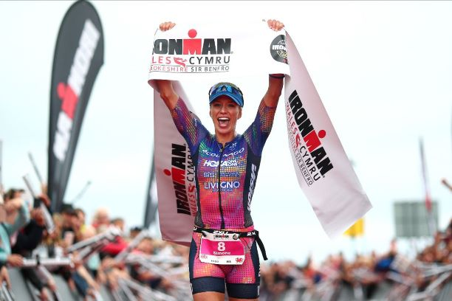
INTRODUCTION

Slide 3
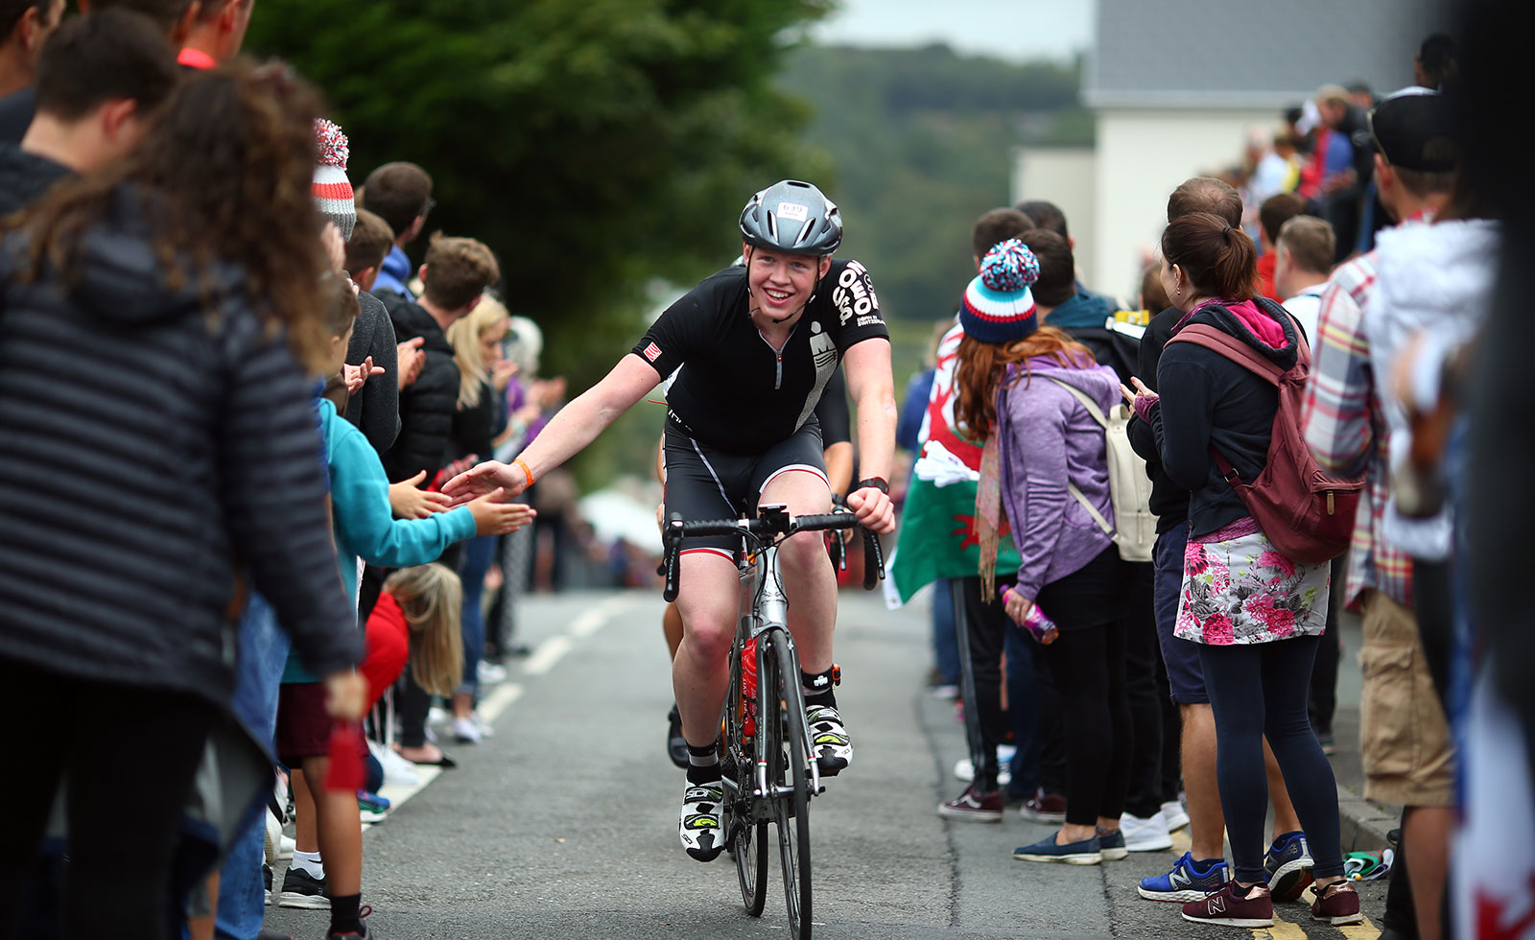
EVENT OBJECTIVES
To fulfil the overall aim of community engagement
To promote the 10 year anniversary of Ironman Wales
To show gratitude to the volunteers in the local community
OBJECTIVES

Slide 4


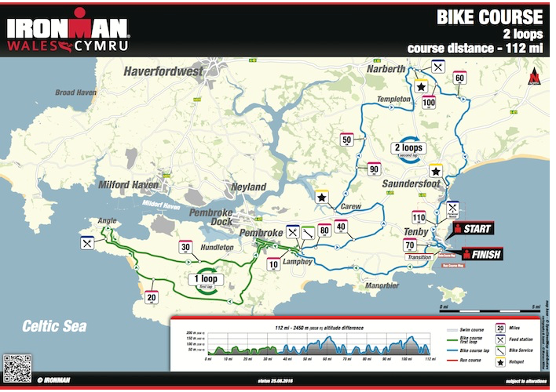

Pre Planning
Study Ironman bike and cycle course
Compare this with local maps
Look at time allocations for hubs and review
Original number of locations reviewed and reduced due to time limitations and costs for hub events
Locate suitable venues within locations to hold hub
Final hub locations

Slide 5
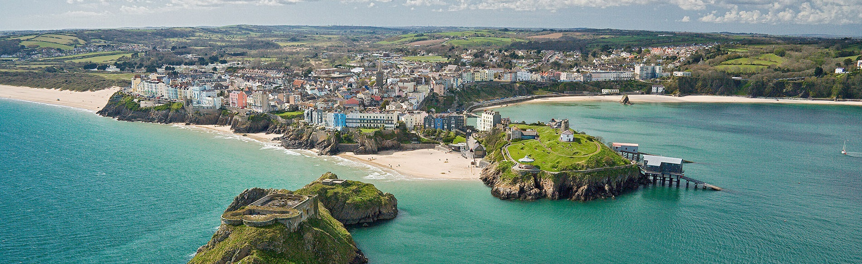
Set –up
Hub Set-up
Rugby club
Timetable for Hub Set up:
For setting up hubs at all destinations:
10.00 a.m. arrival and set up of bouncy castle and face painting station
12.00 p.m. start of hub
16.00 p.m. hub closes and take down commences.
This timetable will apply to all hubs on the route.
9.00 a.m. Set up room with Ironman themed décor and banner.
11.00 a.m. Food Vans scheduled to arrive and set u
11.15 a.m. Photo booth arrive and set up
11.30 a.m. Cake schedule arrive at the Rugby club
12.00 p.m. Doors open to receive first volunteer guests.
Throughout the day volunteers can arrive at their leisure to enjoy entertainment and food
8..30 p.m. Food vans and photo booth vacate premises and take down commences, to be out of club by 9.30 p.m.

Slide 6
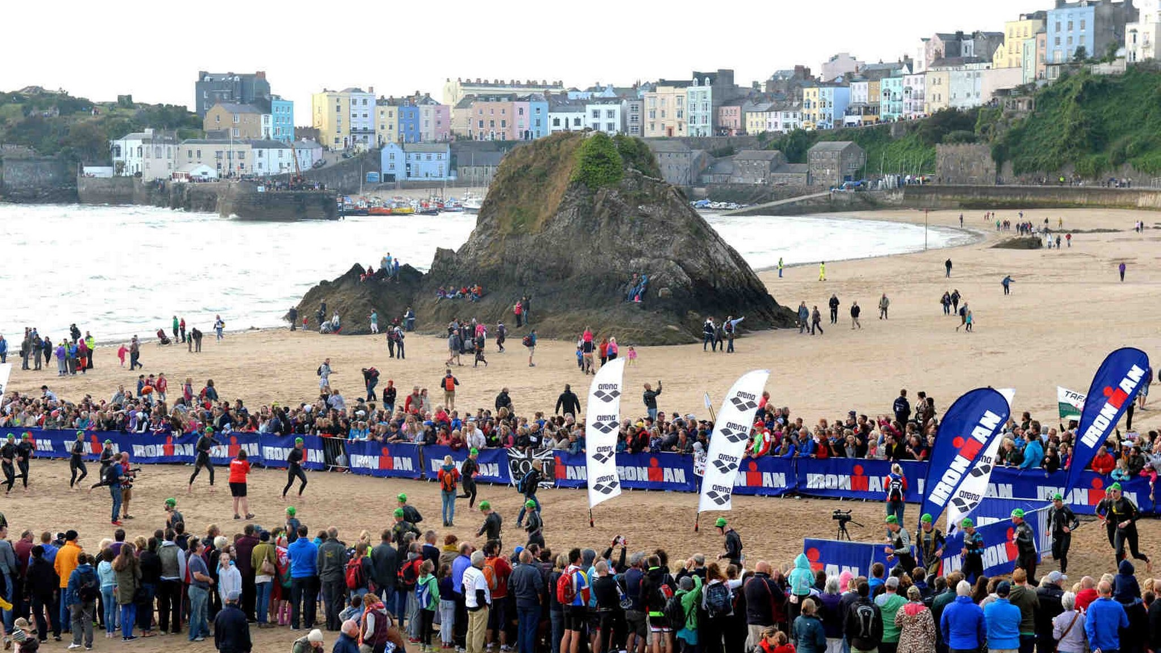
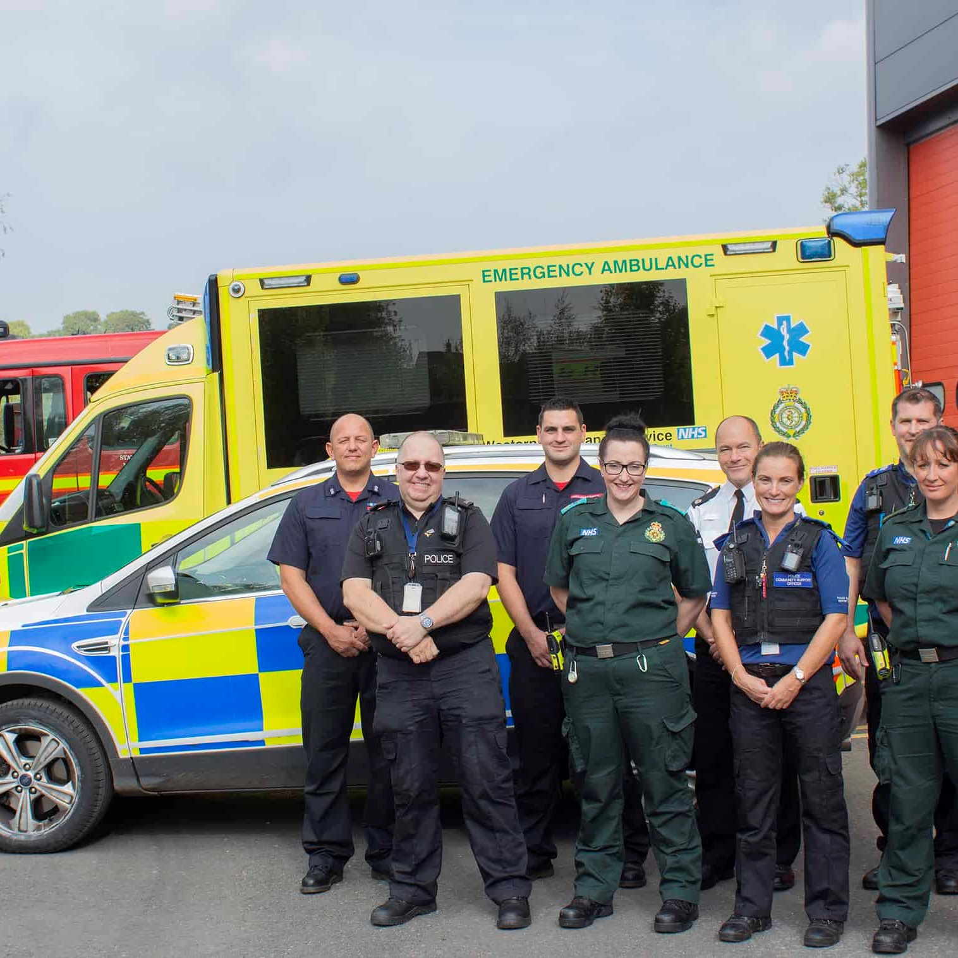
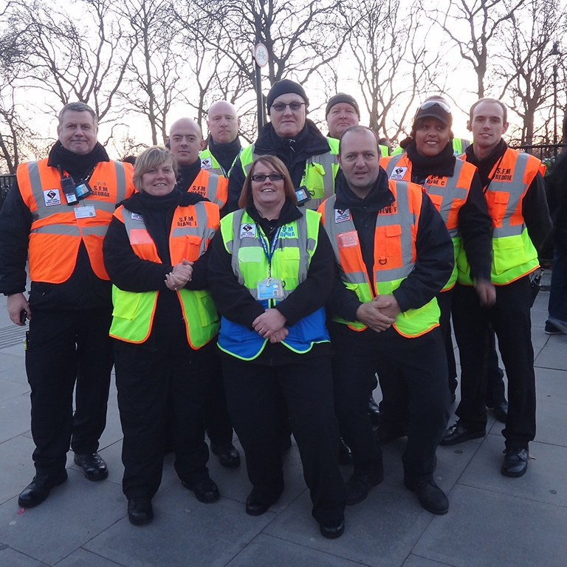

THE TEAM
Stewards
Local Businesses
Local Authorities

Slide 7
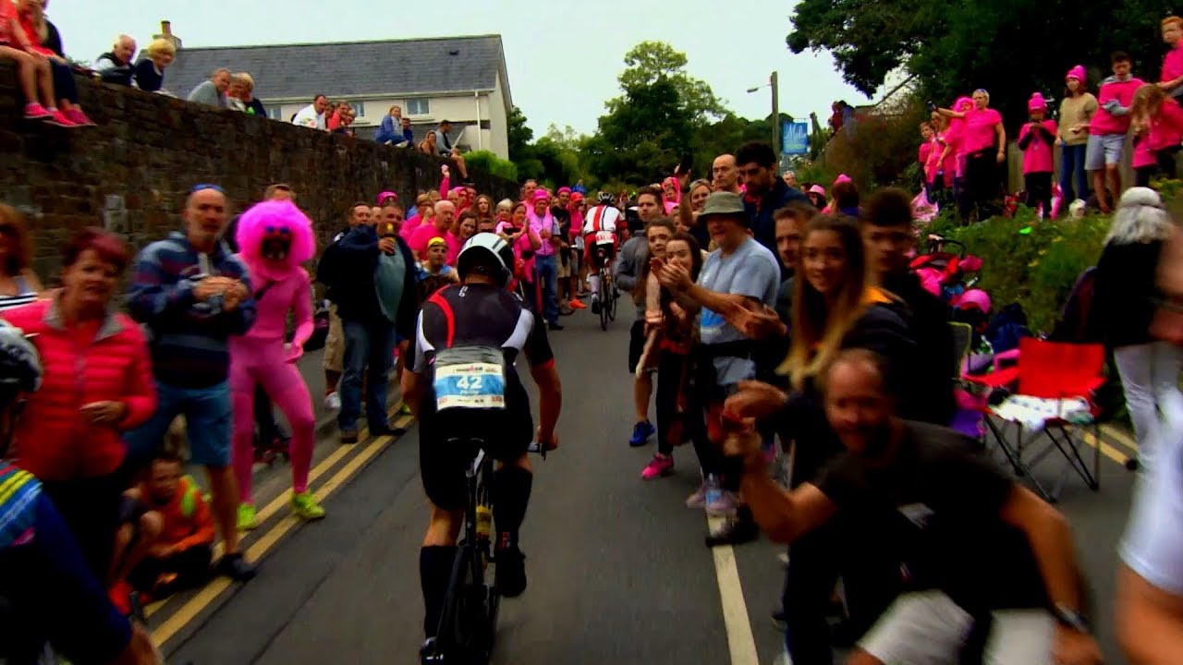
COMMUNITY
Social participation is key in the communities for the development of tourism products (Jamal and Getz, 1995)
Social, cultural, economic and environmental development (Laura Hemmings, 2018)
Create an atmosphere and high spirit at the hubs and event
Increase in footfall numbers

Slide 8

Catering
Modern food vans to provide food to cater to all preferences - £500 per van
Food voucher when registering as a volunteer
Celebration cakes to say thank you - £80 per cake

Slide 9

ENTERTAINMENT
Entertainment will be provided between 12-8pm
Bouncy castle at the rugby club and hubs - £100 per bouncy castle, per day
Photo booth entertainment provided by Pic & Mix – family run business
Face painting by university volunteers

Slide 10
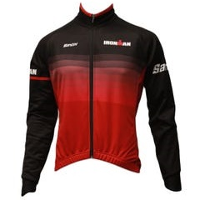


GIFTS
UWTSD accessories
Food Vouchers
Ironman Kit

Slide 11

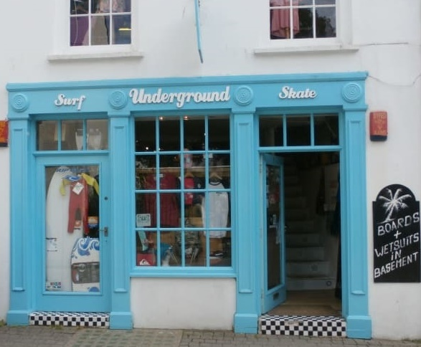
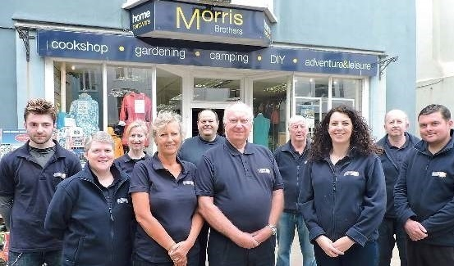
SPONSORS
Decathlon Sports Shop/Sports Clothing Tenby
Llewellyn Sports – Sporting Goods, Tenby
Kit Bag – Sporting Goods, Tenby
Morris Bros. Tenby – Outdoor Gear, Tenby
Brobike Cycle Shop, Tenby
Underground Surf Shop, Tenby
Tenby Cycles
Surf Centre – Sporting Goods, Tenby

Slide 12




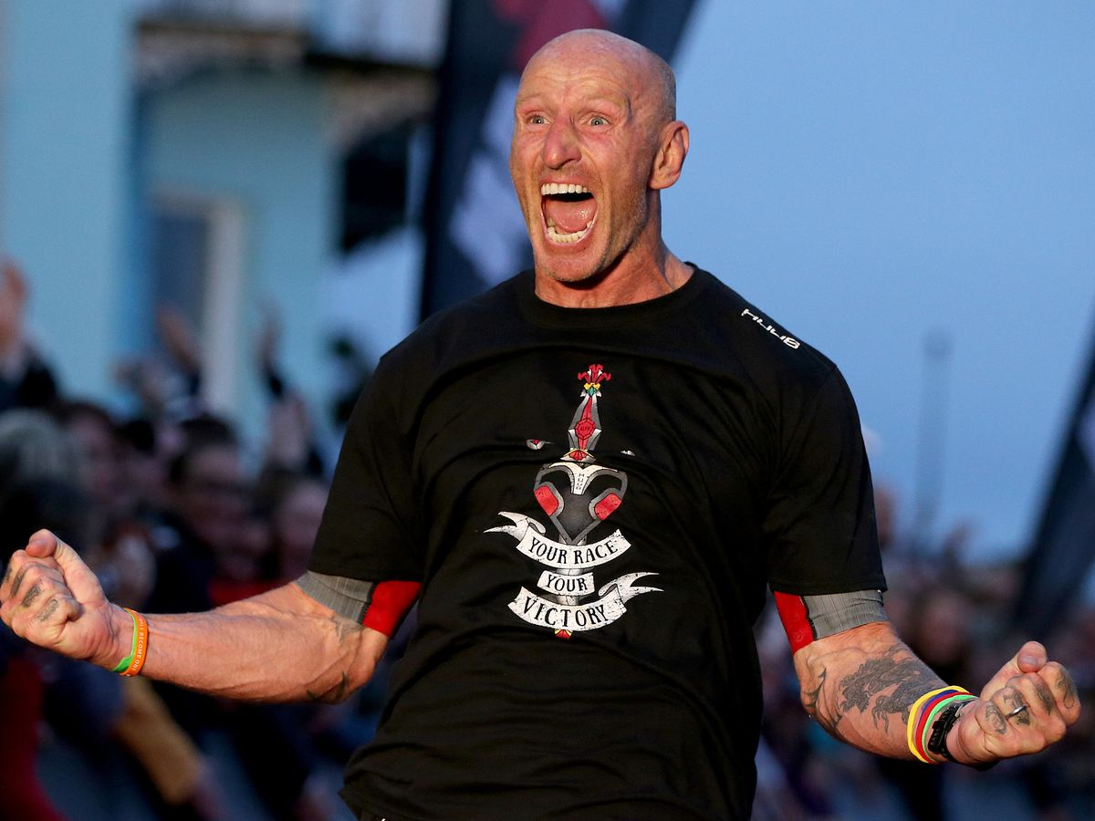


MARKETING
SOCIAL MEDIA
WEBSITE
CELEBRITY VLOGS
SCHOOL/LOCAL CLUBS

Slide 13

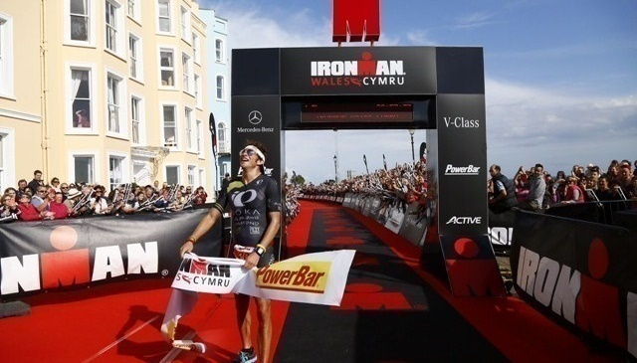


BRANDING

Slide 14




Slide 15
Finances
Items | Price
Food vans x 4 | £2000
Bouncy castle x 5 | £500
Cake x 5 | £400
Pic & Mix | £200
Rugby club | £0.00
Total | £3100

Slide 16

REQUIRED FUNDING
Entertainment
Catering
£2400

Slide 17
THANK YOU!

