Slide 1

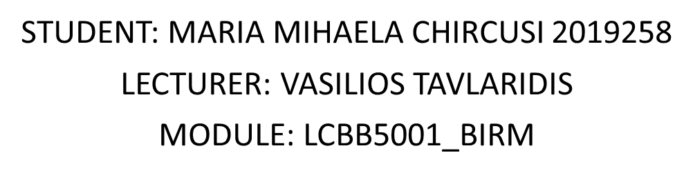

Slide 2
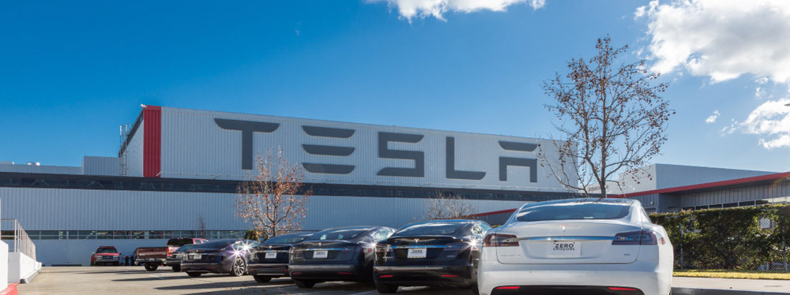
About Tesla
Tesla,Inc.is an American company that designs, manufactures, and sells electric cars.
Was co-founded in 2003 by 2 engineers(Martin Eberhard.and Marc Tarpenning).
In 2004 Elon Musk join the company by investing 6.5 million USD.
Has the headquarters in Austin ,Texas.

Slide 3
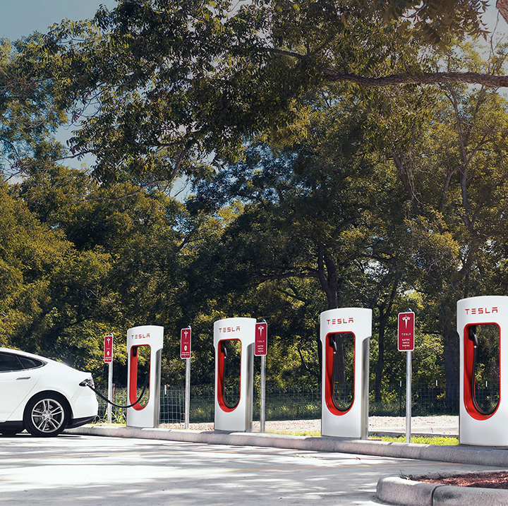
Product and Services
Products:
electric cars,solar panels,solar roofs, accessories.
Services:
vehicle servicing;
charging insurance;
software updates.

Slide 4
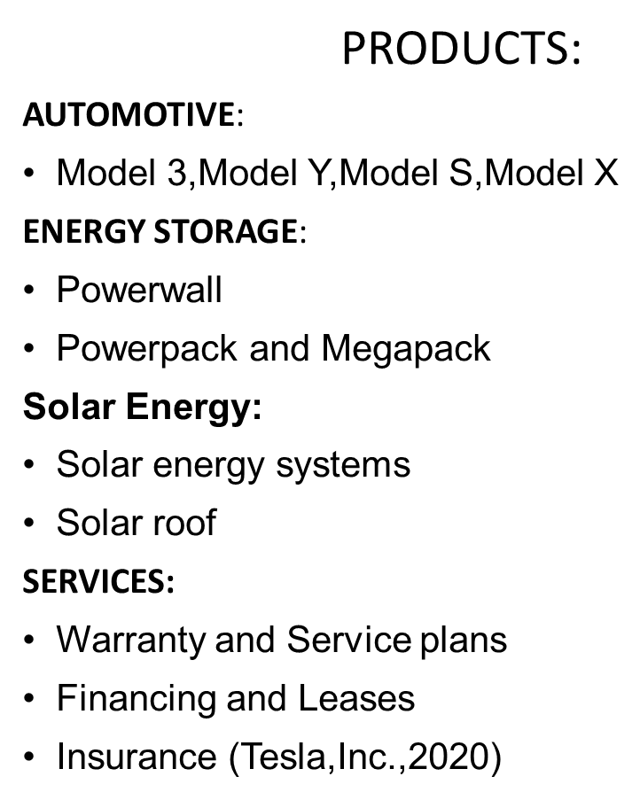
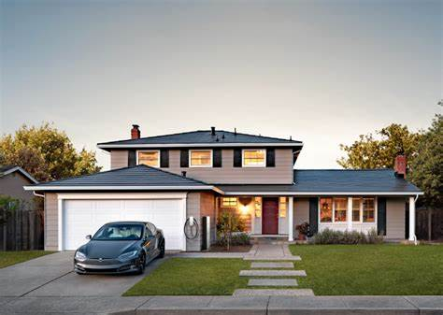
Marketing mix

Slide 5
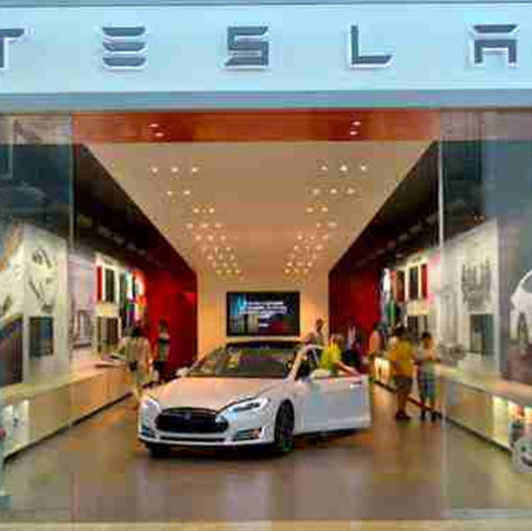
Marketing mix
PLACE/DISTRIBUTION:
Tesla is not selling through franchised dealerships
Sells through own galleries and online platforms
Company-owned service centers
Large range of changing station
Tesla has around 130 stores and exhibitions in the U. S., as well as stores and gallery in 34 other countries, as of September 2020.
Tesla’s largest market is in the USA
Germany now accounts for one in every four Tesla sales, with 26,000 vehicles delivered in 2021

Slide 6
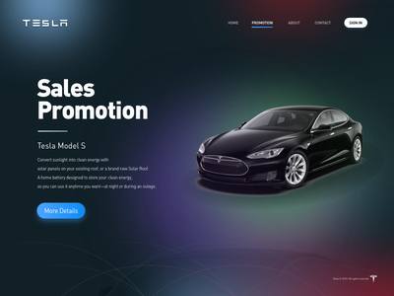
Marketing mix
PROMOTION:
Marketing with word - of - mouth (most significant)
Selling to individuals
Public relations
Promotional sales
Advertising that is delivered directly to the consumer

Slide 7
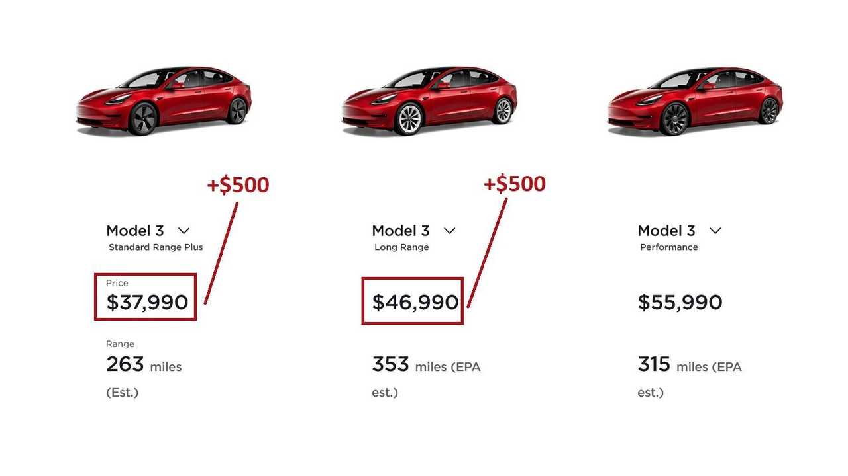
Marketing mix
PRICE:
Pricing approach for market entry:
1.premium
2.skimming
Currently, the pricing plan is as follows:
1.affordable luxury;
2.affordable ( mainstream market)
3.geographical

Slide 8
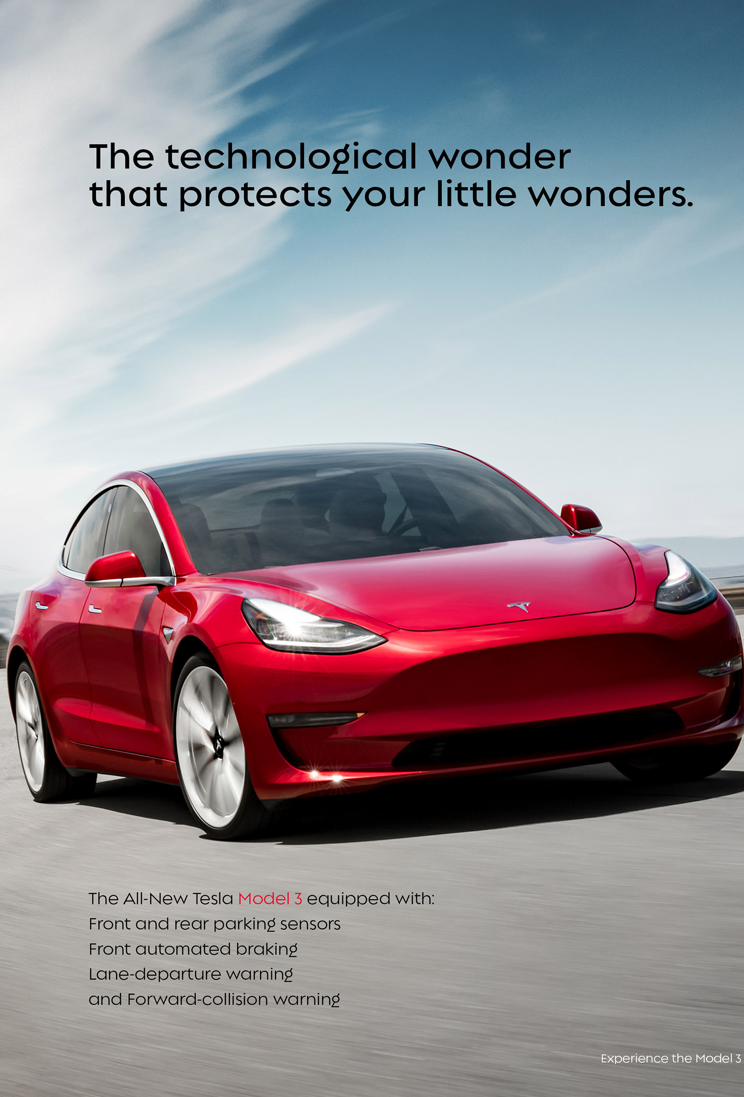
TARGET MARKET
Tesla Inc.'s current target market is customers looking for high-end, environmentally friendly automobiles.
Primary target:
30-60 years old
people with greater income looking for luxury cars.
environment-friendliness
Secondary target:
18-30 years old
middle class young professionals.

Slide 9
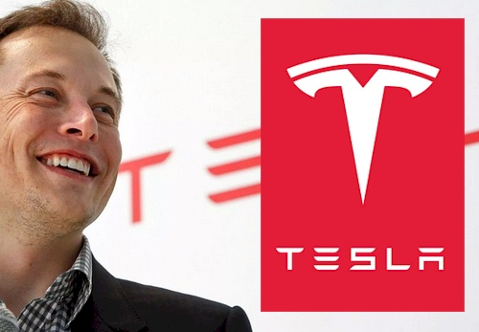
Marketing strategies
Tesla has taken a very different approach to marketing than its automotive competitors, allowing it to stand out.
Tesla's marketing strategy and image are heavily influenced by its CEO's activities.
Musk’s international reputation, both favorable and unfavorable, has a big impact on the business.

Slide 10
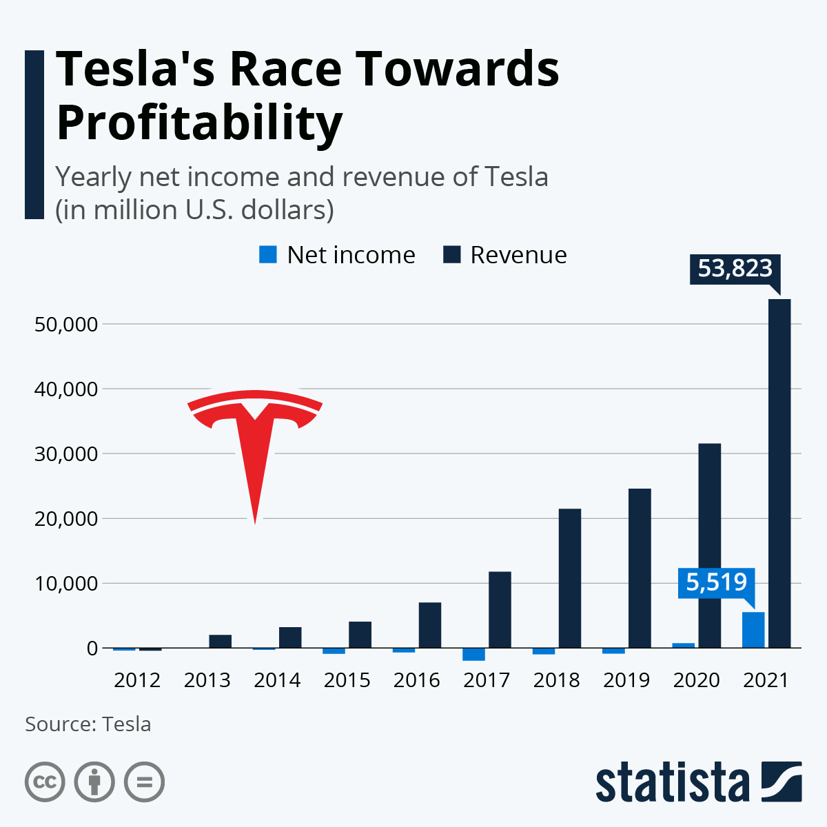
Profitability for 12 months
For the first time in 2020, Elon Musk's company generated a profit rather than a loss. This indicated a rise in global interest in battery electric vehicle adoption.
Tesla was able to achieve a 25% gross profit margin thanks to a drop in price per model and a fantastic year on the stock market.

Slide 11
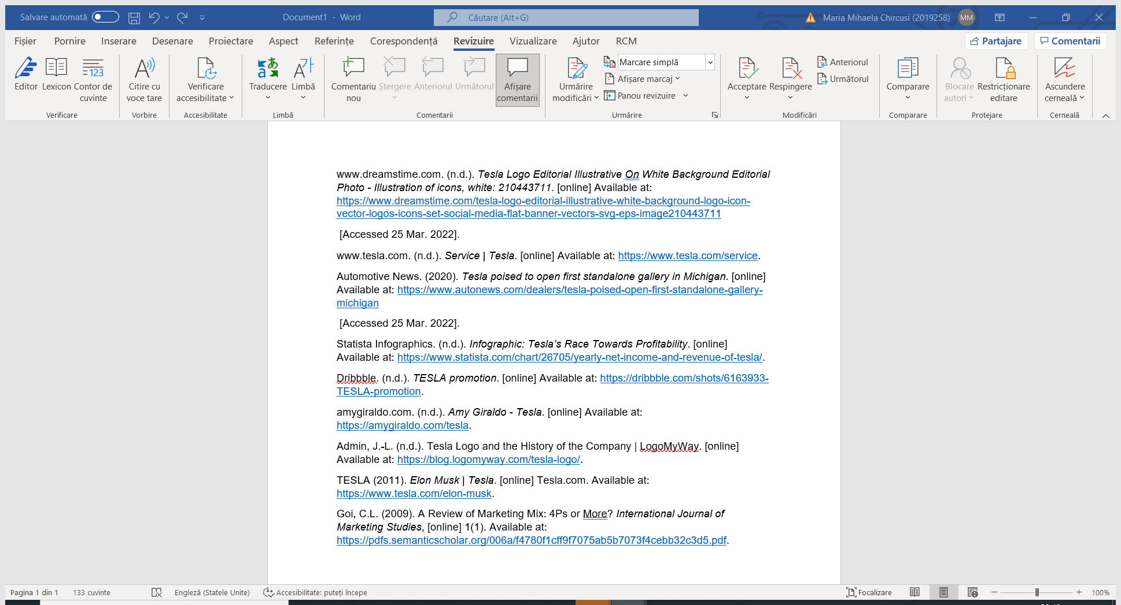
Reference list

Slide 12


