Slide 1
Describe specific examples from Youth Work practice where youth work skills, tools and approaches are used to build meaningful relationships with young people and others
Danielle Fender
Notes:
Introduce self and briefly explain what the presentation will be looking at. Approx 10 minutes long, and opportunity for questions at the end.

Slide 2

Introduction
To look at the links between good youth work practice and how these help to build positive and meaningful relationships with young people.
Notes:
During this presentation we will be looking at examples of good youth work practice, tools and approaches that help to build meaningful relationships between youth workers and young people. I will also be making links to theory and my own personal experiences/ examples when practicing youth work.

Slide 3
What are some examples of good youth work practice.
. Providing opportunities that involve young people in the planning and delivery of activities.
. Creating a welcoming, safe and inclusive environment that young people can feel a sense of belonging.
. Building trusting and meaningful relationships.
. Providing advocacy support
. Empowering young people
Notes:
We can do this by being youth lead, and working with young people on what is important to them what support they need.
Important that young people feel safe and that they can be themselves, providing a space where they can take ownership off, a hall/ rooms etc.
Providing opportunities for young people to make positive relationships with both staff and their peers. We can do this on a one to one basis, or by working together in group activities.
By ensuring that young people have a voice, are heard and respected. Youth workers can also encourage young people to become more confident in their decision making, by providing them with opportunities to build confidence in themselves through participative working.
Making sure their ideas are listened to and acted on, youth workers can also take on a mentoring role where they provide support and guidance in helping young people to achieve their personal goals.

Slide 4
What skills can be used to promote and build relationships.
. Empathy
. Active listening
. Communication
.Team work
.Decision making
Notes:
The ability to understand and be able to acknowledge the struggles that Young people may experience
Remain present, pay attention to what is being said, no distractions
Strong communication both verbally and written is vital when trying to build relationships with others.
Helps us to learn from others, which is an important skill when working with young people. Encourages working together which is a strong foundation when building relationships with others.
Listening to others, making compromises, seeing things from other people's point of view, build trust in others when you then go along with a decision made by someone else.

Slide 5
We never educate directly, but indirectly by means of the environment. Whether we permit chance environments to do the work, or wether we design environments for the purpose, makes a great deal of difference.
(Dewey,1916:16)
Notes:
This is a little quote that I feel sums up the way in which youth workers carry out their work with young people.

Slide 6
Group work.. Why is it effective?
. Learn from each other
. Helps to form friendships
. Build communication skills
.Enhance problem solving skills
Notes:
As youth workers, our aim is to help young people learn in a way that works for them, and to encourage them to see other people’s point of views/ see things from a different perspective, and to learn from each other.
. By creating a group you are also hopefully creating the start of friendships. Young people who maybe wouldn’t normally interact with each other are then given that opportunity to do so.
Working in a group will help build communication skills/ including listening skills for both the facilitator and participants.
. when young people work collectively together in a group session it gives them the opportunity to problem solve and brainstorm together.

Slide 7
Role of the facilitator/ youth worker
.To be well prepared
.To be approachable
.To provide structure
.To be a strong/ confident communicator
.To manage conflict
.To keep the group focused
Notes:
As youth workers our role usually sees us being the main Facilitator when it comes to group work Especially when groups are going through the first stages of group development. According to Tuckman’s theory groups go through 5 stages of development, these are Forming, Storming, Norming, Performing, and Adjourning. During the forming stage the group will more than likely rely on us the youth workers to be the facilitator, where we need to ensure that we are taking on the responsibility and being able to take a active role in the facilitation.

Slide 8
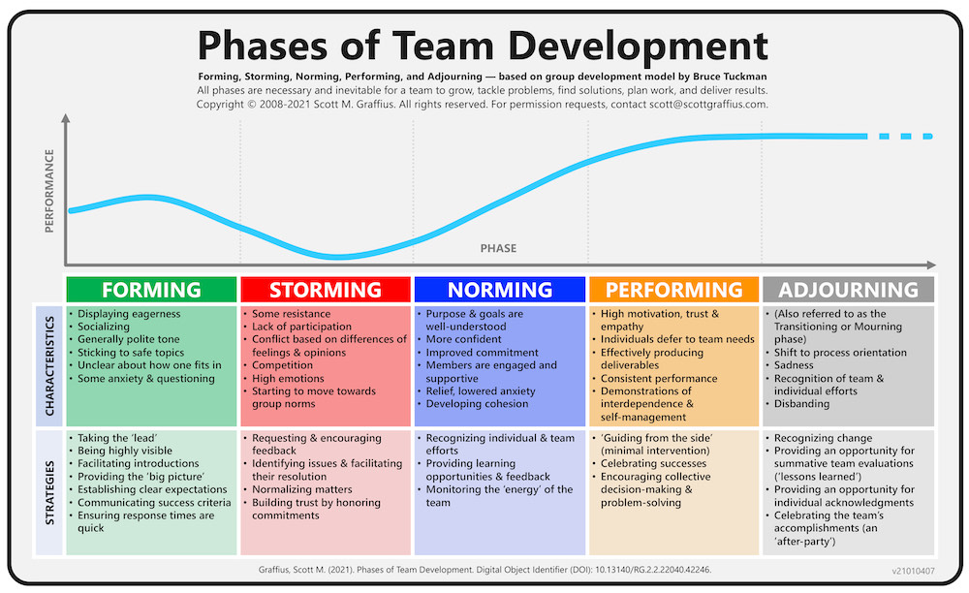
https://www.scottgraffius.com/blog/files/tag-five-phases-of-team-development.html
Notes:
According to Tuckman’s theory, as the group goes through the 5 stages, the facilitator will often change as the group dynamics change. By working in a group young people are building relationships and showing their own personalities and naturally becoming their own facilitators. The middle stages is where conflicts and arguments may arise. Young people may become over confident or be fighting to be “ the top dog” It’s likely that the group will still need the intervention of the facliitator. At the end of the group session or at stage 5 it is hoped that the group has been able to reach their goal, form friendships, become better communicators and feel a sense of achievement from being able to work with each other to reach the end goal.

Slide 9
Conclusion
Group work is a vital tool that helps promote a range of skills between young people.
Young people are often more confident, have gained new skills, and in the right group conditions have taken away life skills that would help them in later life.
Notes:
When we use group work as a way in which we get young people to build relationships, we can be assured that if facilitated correctly they will go through the 5 stages of group development, with the hope being that at stage 5, and after the task in hand, they have learnt how to work alongside each other, work positively and respectfully, and have learnt things from others. I feel that in my practice group work has been one of the major successes when it comes to relationship building, and the young people have benefitted from this in a positive manner, and is my go to when I am trying to build on relationships or manage conflict in my youth club.

Slide 10
References
https://bokcenter.harvard.edu/group-work#:~:text=Some%20reasons%20to%20ask%20students%20to%20work%20in%20groups&text=Small%20groups%20are%20good%20for,or%20complex%20for%20an%20individual(acsessed on 18.10.24)
https://www.wcupa.edu/coral/tuckmanStagesGroupDelvelopment.aspx#:~:text=These%20stages%20are%20commonly%20known,more%20collaborative%20or%20shared%20leadership. (accessed on 20.10.24)
https://www.scottgraffius.com/blog/files/tag-five-phases-of-team-development.html ( Image accessed on 21.10.24)
Dewey.J.(1916)Democracy and Education. New york:macmillan
Youth work in Wales: Principles and purposes

