Slide 1

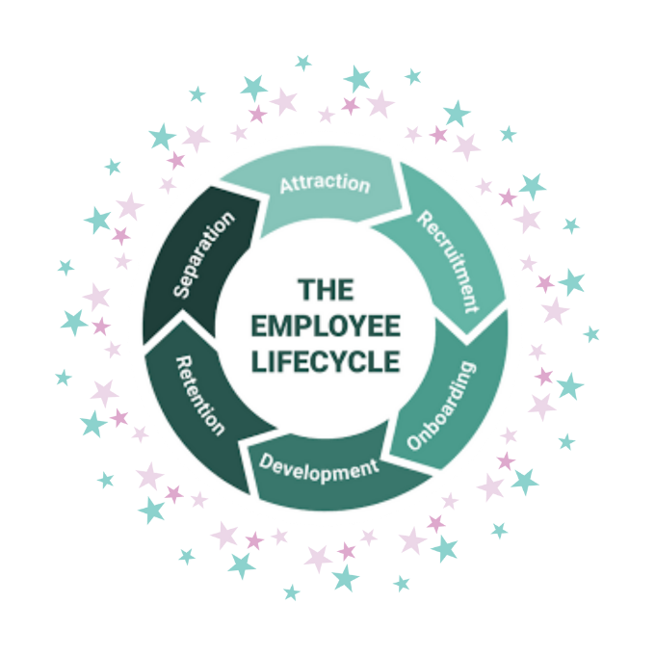
HILTON HOTEL
THE EMPLOYEE LIFECYCLE
PERSONNEL RESOURCING AND DEVELOPMENT BMIH4010
BY: SALVADOR PUMA

Slide 2
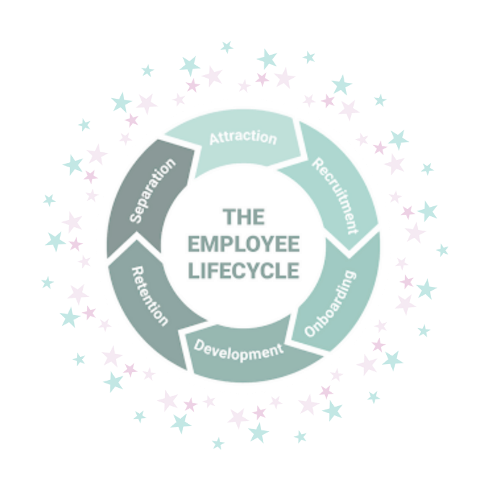
INTRODUCTION
The employee life cycle is a framework that illustrates the various stages an employee goes through within an organization.(Schultz, 2021) It captures the entire experience an employee has from joining to leaving the company. While some large organizations may not fully appreciate the importance of employee engagement, it plays a crucial role in the employee lifecycle and can significantly leverage the talent within a company’s workforce. Employee engagement refers to the emotional and mental connection employees form with their work, their colleagues, and the organization itself.
HILTON

Slide 3
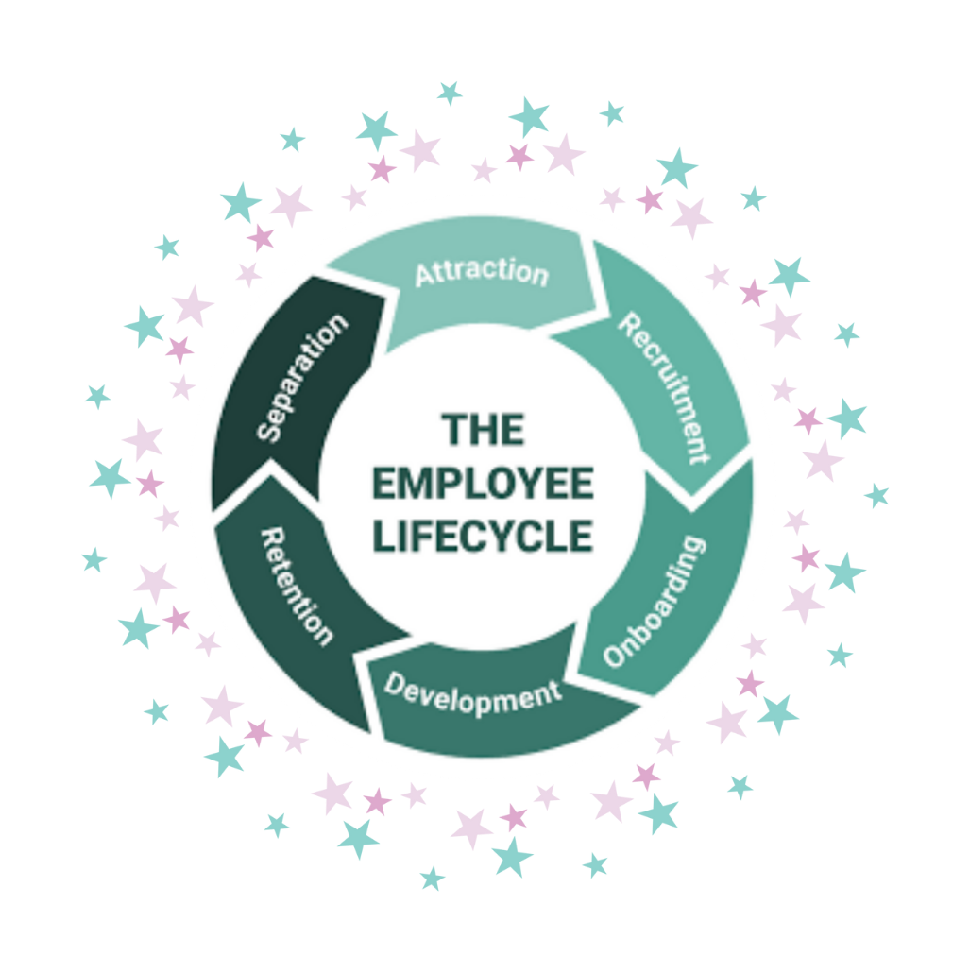
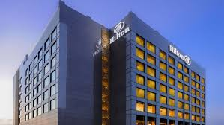
ATTRACTION
RECRUITMENT
  CORPORATE CULTURE
  HIRING PROCESSES
SEPERATION
ONBOARDING
  DEPARTING
  WELCOMING
RETENTION
  ENCOURAGING
DEVELOPMENT
  CAREER GOALS
(Kraneis, 2022)

Slide 4

ATTRACTION
Attraction is the initial phase where potential employees are introduced to an employer's brand. Drawing talent to Hilton is effortless the hotel’s global reputation is unparalleled, and whenever a position becomes available, top-tier candidates are eager to apply.
Candidates who demonstrate a passion for delivering exceptional experiences and proven track record of integrity, collaboration, and achieving results, is all in line with what the Hilton values are, ensuring candidates are a great fit for Hilton, and that Hilton is a great fit for you.
(Connery, 2022)

Slide 5

RECRUITMENT
Recruitment is the next phase in the cycle, marking the transition of an individual from an applicant to a fully employed member of the team. The way a prospective employee is treated during this process significantly impacts their perception of the company. At Hilton, the HR department manages recruitment and selection for Hilton Hotels. This process includes interviews, psychometric testing, and an overall evaluation of the candidate. Additionally, the recruitment process at the hotel incorporates group activities, role-playing, and tray exercises, all conducted through thoughtful management decisions. Employees are selected based on their ability to align with the hotel's culture and values.
(Connery, 2022)

Slide 6

ONBOARDING
The third step in the cycle is onboarding, which focuses on helping new employees understand and integrate into the organization's culture. This phase is crucial for making them feel welcomed and comfortable, allowing them to envision their potential within the company. When done effectively, onboarding boosts a recruit's confidence in their ability to make a meaningful impact. At Hilton, the company culture is structured around various departments, each responsible for specific tasks. During recruitment, new hires undergo active training to meet the expectations of their respective departments. These techniques are key to ensuring high levels of customer satisfaction at the hotel.
(Connery, 2022)

Slide 7

DEVELOPMENT
Career development is key to helping employees advance through various initiatives. Organizations must explore strategic methods to unlock their workforce's potential. Eventually, the employee lifecycle concludes with separation, where employees may leave for different reasons. Reflection is crucial during this phase, and a solid offboarding process can help identify areas for improvement.
Organizations have internal policies to ensure smooth transitions when an employee leaves, and feedback suggests that these procedures are straightforward and not burdensome.
(Kraneis, 2022)

Slide 8

RETENTION
Retention comes next a step in the employee life cycle, focusing on keeping top talent within the company.This stage is critical because, over time, there is a risk that employees may be taken for granted. Addressing key factors like rewards and recognition is essential to ensure employees understand how to achieve their goals. As a globally operating hotel brand, every Hilton branch strives to be the best. Hilton has an internal awards and recognition program that celebrates its top talent, making it an effective strategy for retaining employees and keeping high performers engaged.
(Rosett and Hagerty, 2021)

Slide 9

SEPARATION
When an employee leaves a Hilton hotel, they must follow these steps for a smooth transition:
Resignation: Submit a formal resignation letter with the required notice period.
Paperwork: Complete exit forms, including final pay and benefits details.
Return Property: Return company items like keys, uniforms, and equipment.
Finalize Pay: Settle any outstanding financial matters, including final pay and unused vacation days.
Adhere to Policies: Follow Hilton's departure policies, including confidentiality agreements.
These steps ensure the departure aligns with Hilton's procedures.
(Rosett and Hagerty, 2021)
.

Slide 10
THANK YOU

Slide 11
REFERENCE
Friedman, A. (2011) Continuing professional development: Lifelong learning of millions. 1st edition. ISBN Taylor & Francis Group.
Kanner, G. (2024) An Inside Look at Our Job Application & Hiring Processes, 7th September Available at: https://life.marriott.com/blog/hiring-process/#open-jobs (Accessed: 4th February 2025).
Hilton (2022) OUR CULTURE BUSINESS OF PEOPLE SERVING PEOPLE.
Available at: https://jobs.hilton.com/us/en/culture (Accessed: 8th February 2025).
Hilton (2022) OUR CULTURE A BUSINESS OF PEOPLE SERVING PEOPLE.
Available at: https://jobs.hilton.com/us/en/benefits (Accessed: 11th February 2025).
Hilton (2022) OUR CULTURE A BUSINESS OF PEOPLE SERVING PEOPLE.
Available at: https://jobs.hilton.com/us/en/inclusion-talent (Accessed: 11thFebruary 2025)
Hilton (2022) CAREER PATHSWORK YOU’LL LOVE. Available at: https://jobs.hilton.com/latam/en/career-paths (Accessed: 5th February 2025)
Taylor, S and Woodhams, C. (2022) Studying Human Resource Management: A guide to the study, context and practice of HR. Third Edition: Konan Page.
Segundo, I. (2023) What Does a First Day at Marriott Look Like? 16th October. Available at: https://life.marriott.com/blog/first-day/ (Accessed: 14th February 20025).
Marchington, M, Wilkinson, A., Donnelly, R. and Kynighow, A. (2021) Human resource management at work. 7th ed. London: Chartered Institute of Personnel and Development. Great Britain and the United States: Kogan Page Limited.
Mas Vale Saber (2023). Marriott Vacations Worldwide - Recruitment Testimonial. Available at: https://www.youtube.com/watch?v=5iQ2yrFT4t4 (Accessed 12th March 2025).

