Slide 1


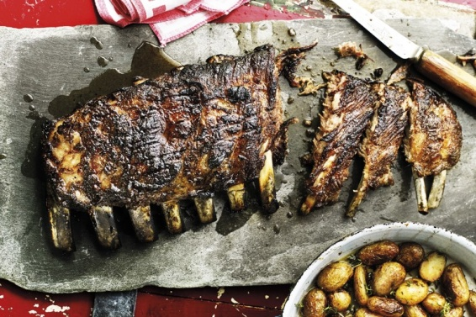
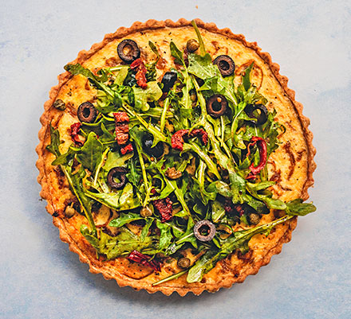


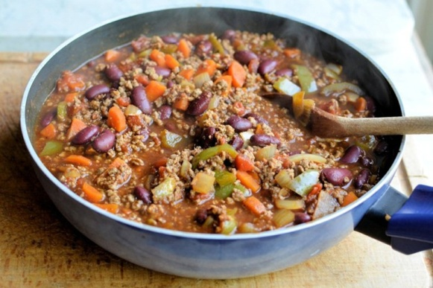
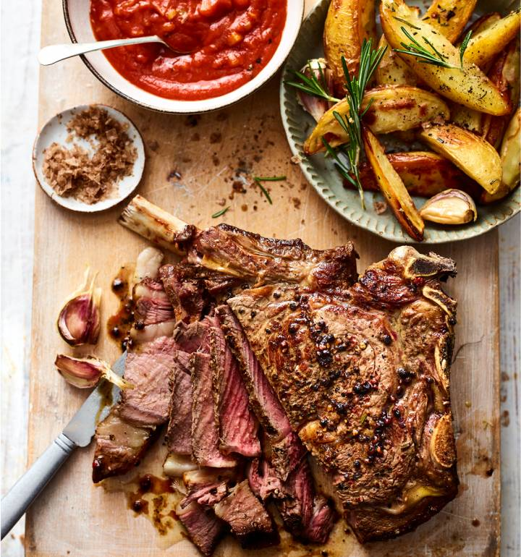


Food Beverage Operations, Module: BMIH4002
Student Name: Catalin Pocolin
ID: 2117502
Lecturer’s name: Ffion Cumperpatch
Hotel Trinity
Quality you can taste
Roasted and grilled pork ribs with quince glaze
Potted shrimp tart with shaved rainbow beet salad
Price: 25.50
Calories: 480 KCAL (Fat 45gm)
Allergens: quince paste
Availability: 07.30am-11.45am
Price: 17.50
Calories: 370 KCAL (Fat 15gm)
Allergens: Shrimp
Availability: 07.30am-11.45am
Low-calorie smoky chili with vegetables and beans
Special Dish
Salt and pepper rib of beef with Bloody Mary sauce and roast potato wedges
Price: 17.50
Calories: 410 KCAL (Fat 10gm)
Allergens: Beans
Availability: 07.30am- 10.00 pm
Price: 26.50
Calories: 595 KCAL (Fat 11gm)
Allergens: Beef
Availability: 05.00pm-10.00pm
Live Music Show at Dinner
Home Delivery Available:
Uber Eats, Hungry house, Zomato
Payment Method
Hotel Trinity, Coast on Swansea, South Wales
References
Restaurant menu | LearnEnglish Kids (n.d.) Restaurant Menu | LearnEnglish Kids [Online]. Restaurant menu | LearnEnglish Kids. Available from: <https://learnenglishkids.britishcouncil.org/writing-practice/restaurant-menu> [Accessed 7 November 2022].
Diemer, S., (2016). Recipes and food discourse in English–a historical menu. Culinary linguistics: The chef’s special.

