Slide 1
Presentation Date:18-12-2025
Title: Digital Forensic Investigation Name:Deep trivedi

Slide 2
Presentation Overview
Introduction and Background
Objective of Investigation
Evidence Acquisition
Communication Logs Analysis
Email Analysis
Call Log Analysis
Timeline Reconstruction
Suspect Profiling
Forensic Tools and Methodology
Findings
Conclusion and Recommendations
References

Slide 3
Introduction and Background
This investigation focuses on alleged spying by the corporate side in Quantum Tech, a leading AI company. The firm discovered that its private patent database was obtained without permission. The patent, QT AI-2025 provides a revolutionary AI chip with huge commercial potential. The main suspect is Emma is an engineer from Quantum Tech, is believed to have snatched the patent file. It is believed that she transferred them at NexGen Circuits through an intermediary, Joe, with Norman who is a buyer from NexGen as well, being part of the transaction. This talk aims at revealing the motives of each suspect on the basis of the evidence available on digital [1].

Slide 4
Objective of Investigation
The aim of this probe is to employ digital tools for forensic analysis to prove or deny the allegations that patent theft has occurred. The investigation will examine communications as well as the device's data to determine an exact timeline, and connect the suspects. Through the analysis of data taken from diverse gadgets (smartphones as well as USBs) as well as digital communication (WhatsApp and emails, Instagram, and emails) The investigation will reveal the method by which Emma, Joe, and Norman took over the theft of QT-AI-2025 patent, and also their role in the plot [6].

Slide 5
Evidence Acquisition
The gadgets involved in this investigation are:
  jOE's Samsung Galaxy A13 - the main suspect's phone, which contains crucial information and communications [5].
  Norman's mobile phone is believed to have details relating to the acquisition and the transfer of the patent stolen [9].
  Emma's phone - the intermediary's phone, whose messages may reveal the manner in which the theft of the patent [8].
  Forensic instruments like Cellebrite UFED are used to collect information from these devices, making sure that evidence is secure by ensuring secure handling and a correct chains of custody [2].

Slide 6
Communication Logs Analysis
The analysis of the logs of communication particularly WhatsApp as well as Instagram's DMs gave insight into interactions between suspects [2].
Emma Joe and Joe often communicated regarding the transfer of the patents that were stolen. The messages also included discussions on the security of file transfers as well as secure meetings arrangements as well as payment negotiation [3].
Emma and Norman utilized encrypted channels to conclude their deal and confirm that the patent was sold [2].
These communication, particularly payments and file transfer crucial in proving that the patent was stolen [4].

Slide 7
Email Analysis
  Emails played an essential part in establishing the theft. The most important emails among Emma and Norman included attachments of documents stolen from the patent and also details concerning the purchase. The correspondence confirmed the fact that Norman knew about the stealing and willing to purchase the patent stolen. In addition, emails involving Vanessa (R&D Director for R&D at NexGen Circuits) indicated her involvement in the deal and suggested that she was a part of the corporate spying. After analyzing the emails, we could determine the timing as well as the motivation behind the theft could be determined [8].

Slide 8
Call Log Analysis
Analysis of the call's logs revealed more insight on the co-ordination between the suspects [1].
Emma and Joe received multiple phone calls, many of which were about the planning of the theft's execution such as file transfer information as well as possible arrangements for a meeting [3].
Emma and Norman talked about the details of the sale of patents in negotiations over the price, as well as concurring about how the documents will be handed over [5].
Joe and Norman spoke to complete the sale, which revealed Joe's role as a mediator in the transaction. These conversations confirmed the intentions of the criminals as well as the timeframe for the execution of crime. [9]

Slide 9
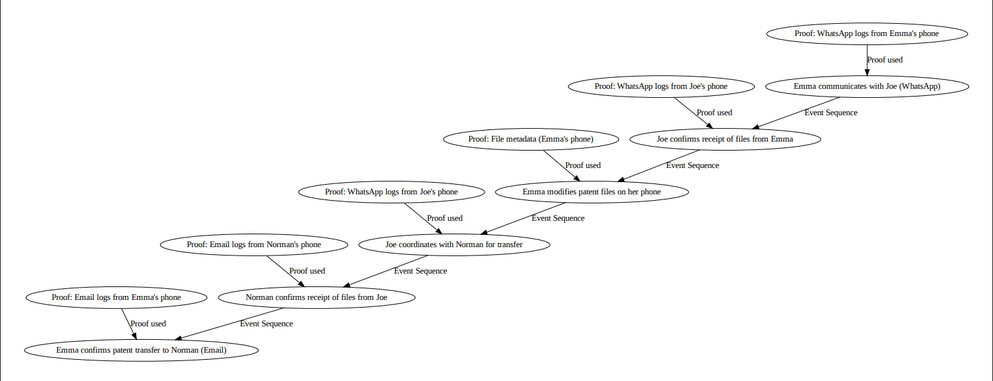
Timeline Reconstruction
A reconstruction of the timeline was made using the communications and call logs [5].
Initiative Contact initial contact between Emma Joe and Joe was the first sign of the scheme to take over the patent [1].
Coordinating between Emma Joe and Emma Joe via emails, they affirmed the facts of the theft and arranged for the transfer of the files to Norman [2].
Patent Transfer Emails with hyperlinks or attachments proved that the files stolen were transferred [6].
Settlement of Payments: The payments were confirmed by email and WhatsApp to mark the completion of the fraudulent payment [7].
This timeline provides a clearer picture of the sequence of events, and also highlighted the co-ordination and execution of the murder [6].

Slide 10
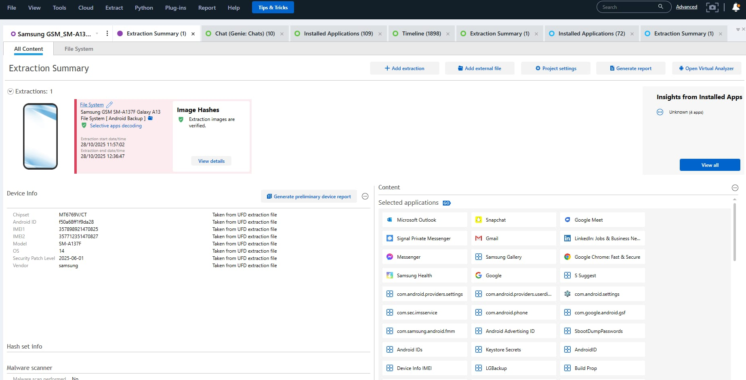
Suspect Profiling
Joe(Perpetrator): Emma is an engineer who has privilege access to the QT AI-2025 patent, was the primary part in the theft. The way she communicated between Joe and Norman revealed her participation in the planning as well as implementation of the theft [5].
Emma (Intermediary): Joe was a mediator that assisted in the transfer of stolen information in between Emma Norman and Emma Norman. Logs of conversations and calls indicated that he was aware of the illicit nature of the exchange [7].
Norman (Buyer): Norman is a purchaser at NexGen Circuits, was the person who was supposed to receive the patent stolen. His conversations to Emma and Joe proved that he was part of the illicit purchase by sending emails outlining how he paid for the patent [6].

Slide 11
Forensic Tools and Methodology
The tool Cellebrite UFED was utilized to retrieve the data of mobile phones, which ensures an uninvolved and safe process [5].
Image Acquisition Cellebrite permitted the production of forensic images of devices, which ensured that there was no alteration of data in the process of extraction [4].
Data Integrity: The hash values (MD5 and the SHA-1) were computed in order to make sure that data integrity was not compromised [8].
File Extraction Cellebrite has recovered deleted messages emails and even files, and revealed crucial evidence of the transfer of patent.
Notes:
Gantt chart

Slide 12
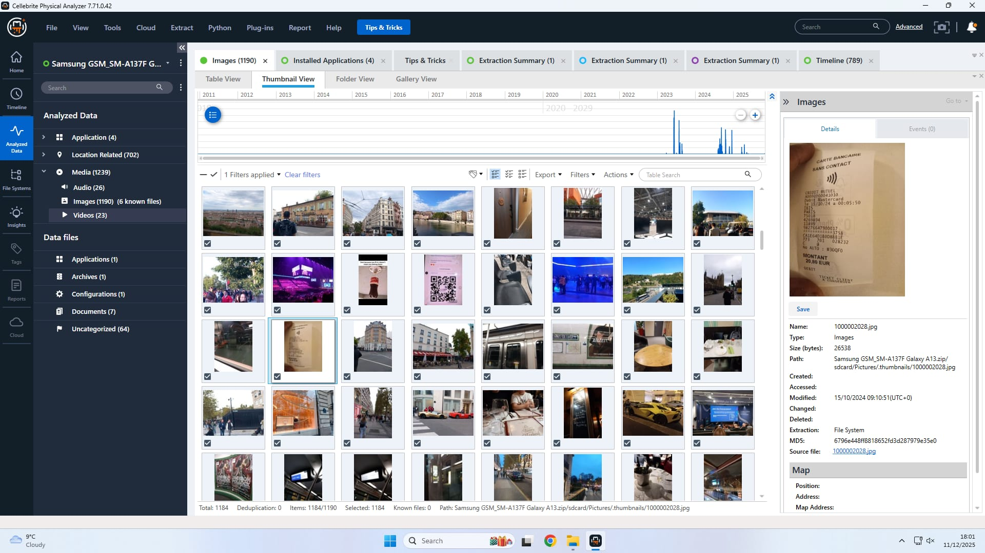
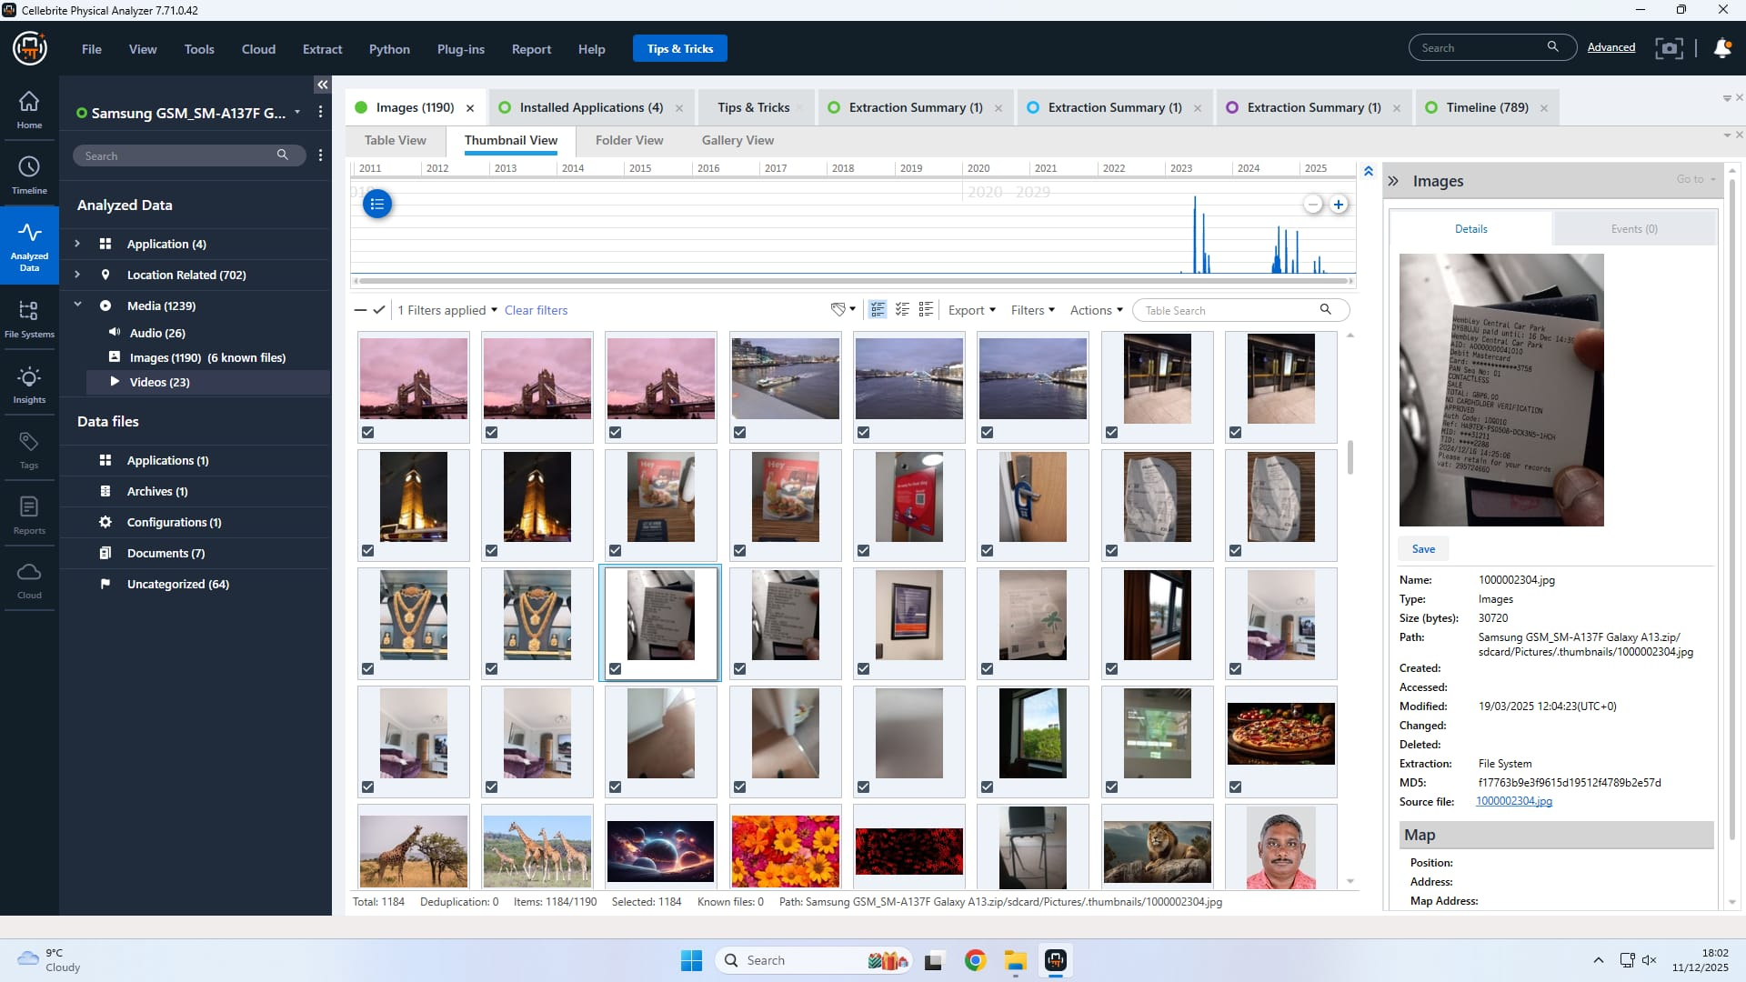
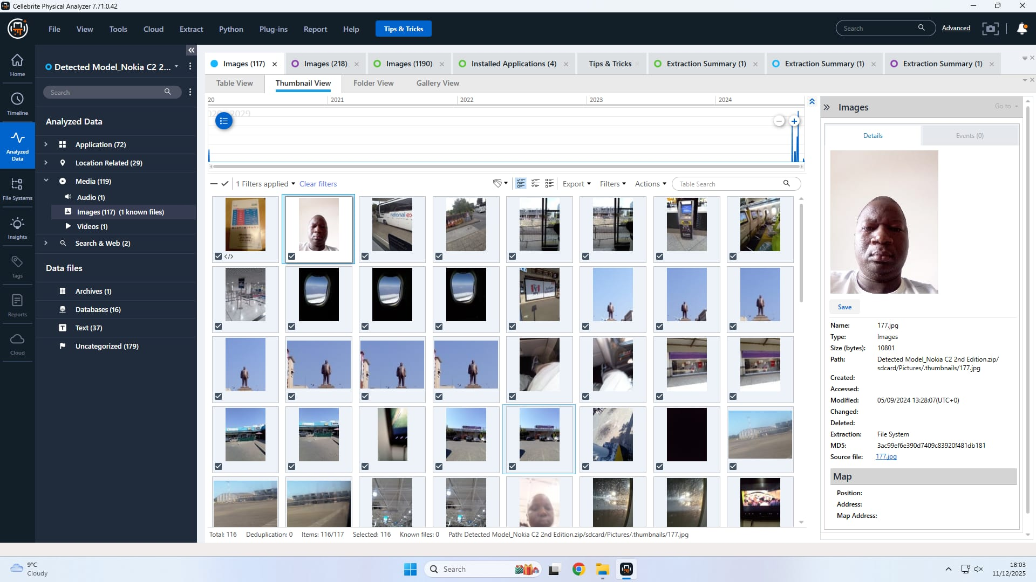
Findings
The investigation has confirmed the involvement of the suspects [6].
  Joe was discovered to have snatched the QT-AI-2025 patent documents, along with a letter that confirmed her intentions to offer for sale [4].
  Emma was the intermediary in the transaction, helping to facilitate it in between Norman and Joe[1].
  Norman was discovered to be the one who bought the stolen patent. He was also found to have email and call logs that confirmed his involvement in the robbery.
  The time-line and logs of communication provide clear proof of the plot, showing that the crime was planned as well as executed. The financial loss was resolved through these digital transactions [5].

Slide 13
Findings
Event | Timestamp | Phone Model Checked | Proof Used | Interpretation
Joe communicates with Emma (WhatsApp) | 2025-10-28 10:00 | Samsung SM-A137F Galaxy (Joe) | WhatsApp logs from Joe's phone | Emma contacts Joe about the patent deal.
Emma confirms receipt of files from Joe | 2025-10-28 11:00 | Emma's Smartphone | WhatsApp logs from Emma's phone | Emma confirms that he has received the files from Joe and is preparing for transfer to Norman.
Emma modifies patent files on her phone | 2025-10-28 12:00 | Emma’s Phone | File metadata Joe's phone | Emma modifies the patent files on her phone, preparing them for illegal transfer.
Emma coordinates with Norman for transfer | 2025-10-28 13:00 | Joe's Smartphone | WhatsApp logs from Joe's phone | Emma coordinates the transfer with Norman, confirming the meeting details.
Norman confirms receipt of files from Joe | 2025-10-28 14:00 | Nokia C2 2nd Edition (Norman) | Email logs from Norman's phone | Norman receives the stolen patent files from Joe and confirms the acquisition.
Joe confirms patent transfer to Norman (Email) | 2025-10-28 15:00 | Samsung SM-A137F Galaxy (Joe) | Email logs from Joe's phone | Joe confirms that the patent transfer has been completed and payment will follow.

Slide 14
Conclusion and Recommendations
Conclusion:
This case reveals the fact that Emma, Joe, and Norman were associated with the piracy of the QT-AI-2025 patent from Quantum Tech. The evidence gathered from logs of communications as well as emails and phone evidence proved their participation as well as their actions during the corporate spying. The patent stolen was taken over by Quantum Tech to NexGen Circuits and was facilitated with the help of Emma as well as Joe [1].
Recommendations:
  Legal action: Quantum Tech should pursue the criminal prosecution of all people of involvement [2].
  Security Enhancements Quantum Tech must implement stricter security protocols as well as access control to safeguard the value of intellectual property [5].
  Additional Investigation The law enforcement agencies should broaden the scope of their investigation to encompass the possibility of involvement by other people or businesses involved in stealing the patent [6].

Slide 15
References
[1] Cellebrite, “UFED Physical Analyzer 7.73.0.162: User Guide,” Cellebrite USA, 2020.
[2] Casey, E., Digital Evidence and Computer Crime: Forensic Science, Computers, and the Internet, 3rd ed. Academic Press, 2011.
[3] Carrier, B., and E. Spafford, Risks of Key Recovery in the Digital Forensics Process, 2nd ed. ACM Press, 2003.
[4] Farrell, R., and G. McGrew, “Practical mobile forensics,” Forensic Sci. Int., vol. 240, pp. 1–8, 2014.
[5] Finkel, H., “The role of communication logs in mobile device forensics,” J. Forensic Sci., vol. 54, no. 6, pp. 1264–1271, 2009.
[6] Garfinkel, S., “Digital forensics research: The next 10 years,” Int. J. Digital Forensics & Incident Analysis, vol. 1, no. 2, pp. 2–12, 2010.
[7] Kuhn, G., “Digital forensics: The role of digital evidence in law enforcement,” J. Digital Forensics, vol. 1, no. 1, pp. 20–28, 2005.
[8] Boehm, M., and K. Boehm, “The impact of file system structures in forensic investigations,” J. Digit. Forensics, Security and Law, vol. 2, no. 4, pp. 57–65, 2007.
[9] Bunting, S., “A comprehensive look at the role of file system analysis in data retrieval for forensics,” Int. J. Digital Evidence, vol. 7, no. 4, pp. 15–25, 2016.

