Slide 1
Key skills for becoming a future manager
Student Name: Daniela Rusu
Student ID: 2133710
Module: Academic And Employability Skills
Module Code: BMSW4001
Lecturer: Sukhpreet Grewal

Slide 2
Key skills for becoming a future manager
A competent manager does more than just supervise employees, projects, and results. Successful managers build a skill set that helps others to lead teams successfully.
Key points of presentation:
1 Skills that I already have
2 Skills that I have to improve for my future job
3 How I use SWOT analyses on my job

Slide 3
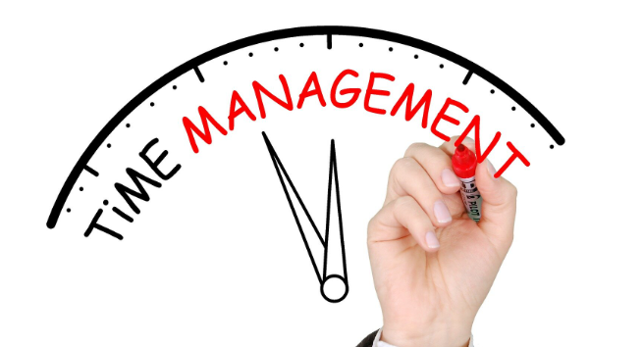
1 Skills that I already have and use on my actual job:
1 Time management-
using my time efficient, I am achieving my goals easier and faster,
important to help me prioritise better and increase productivity.
also reduce the day-by-day stress
helps me to work smarter, not harder
when I manage my time well, allows me to have a better control of my day

Slide 4

Actual Skills(cont.):
2 Communication –is a key skill that I use with my colleagues and customers.
will enhance a company’s productivity and efficiency
help to prevent the wastage of precious time and resources (Cole, 2019)
A clearer understanding of customer needs

Slide 5

Actual Skills(cont.):
3 Punctuality- is the ability to be prompt, attend appointments on time and submit your assignments by the deadline (Crews and May, 2016)
requires forward preparation and making arrangements to guarantee that you can complete your duties on time.
No matter where my job is, it's crucial to constantly arrive at work on time.

Slide 6
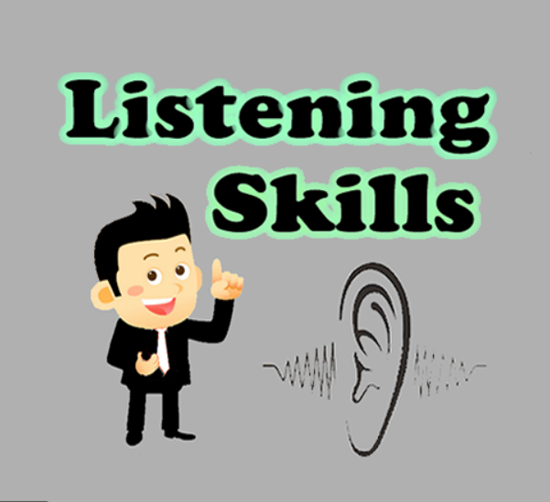
Actual Skills(cont.):
4 Listening skills- Your ability to listen has a big impact on how productive you are at work and how well you get along with other people.
Active listening will provide some advantages, per example:
helps me to understand critical information better,
involves listening with all senses
improved self-esteem and confidence

Slide 7


2 Skills that I have to improve for my future job:
Self-management- is about planning for the future, owning your present, and being conscientious about what you do - as well as learning how to do it better the next time (Patnaik, 2021).
Improving my self management I will manage my behaviour, thoughts, and emotions in a conscious and productive way.
Problem-solving- is the process of finding solution to eliminate impediments to reaching an objective (Prasad, 2021).
Improving this skill, will help me to define the problem, generate alternative solutions, evaluate and select an alternative.

Slide 8
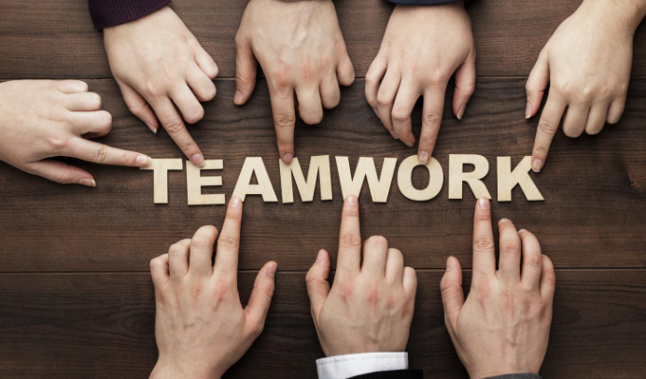
2 Skills that I have to improve for my future job(cont.):
Teamwork- improving my teamwork skills will enable to:
work harmoniously with other colleagues,
It can increase my hiring chances
It can help me to solve conflicts(Payne, 2000)

Slide 9
3 How I use SWOT(strengths, weaknesses, opportunities and threats) analyses on my job when I have to make some important decisions.
As an example, when I have to change the beauty salon to a new location:
Strengths-well trained team -high traffic location -discounted prices for customers -quality services | Weaknesses-lack of team training -inventory -wrong location - no parking spaces for customers
Opportunities-new styling methods -introducing new products -bringing new brands -attracting new clients | Threats-competitive saloons from new location -ending active promotions -losing the main customers -transport network from the new location

Slide 10
References:
Crews, T., B., and May, K.,B. (2016). Digital Media: Concepts and Applications. 4th Edition. Boston: Cengage Learning
Cole, S. (2019). Communication Skills Training: 2 in 1: How to Handle Difficult Conversations, Improve Your Persuasion Skills, And Become a Master at Public Speaking. Roland Bind
Payne, M. (2000). Teamwork in Multiprofessional Care. Michigan: Lyceum Books
Patnaik, S. (2021). Self-Management: For Individual and Organizational Success. Partridge Publishing
Prasad, M. (2021). Problem-Solving Sociology: A Guide for Students. New York: Oxford University Press

