Slide 1
Module Name : Electronics I
Module Code : ACDB5002
Lecture : 2
Topic : PN Junction & Zener Diodes
Lecture By,
Mrs. Jenifer Prince Devaraj,
Lecturer - Embedded Electronics,
Faculty of Applied Computing,
UWTSD
Email:j.prince-devaraj@uwtsd.ac.uk

Slide 2
PN Junction & Zener Diodes
Learning Outcome:
At the end of this lecture, the students can be able to understand the concepts of
Power Supply Blocks.
  PN junction
  PN junction diode
  Zener Diode

Slide 3
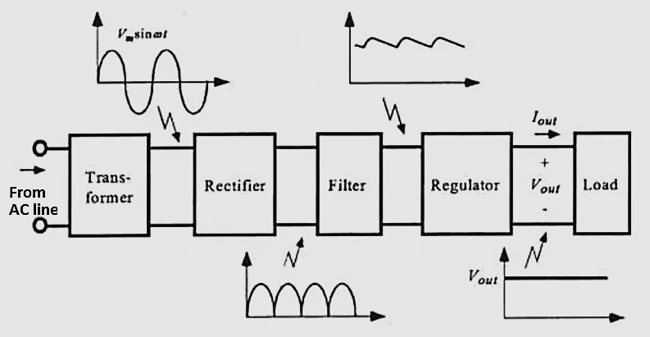
PN Junction & Zener Diodes
Basic Blocks of Power Supply

Slide 4
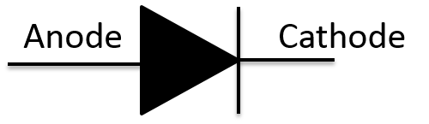
PN junction
PN Junction & Zener Diodes
A junction formed between a sample of P type semiconductor and N type semiconductor is known as PN junction (or) Junction diode.
It has two electrodes
P region named as Anode
N region Named as Cathode

Slide 5
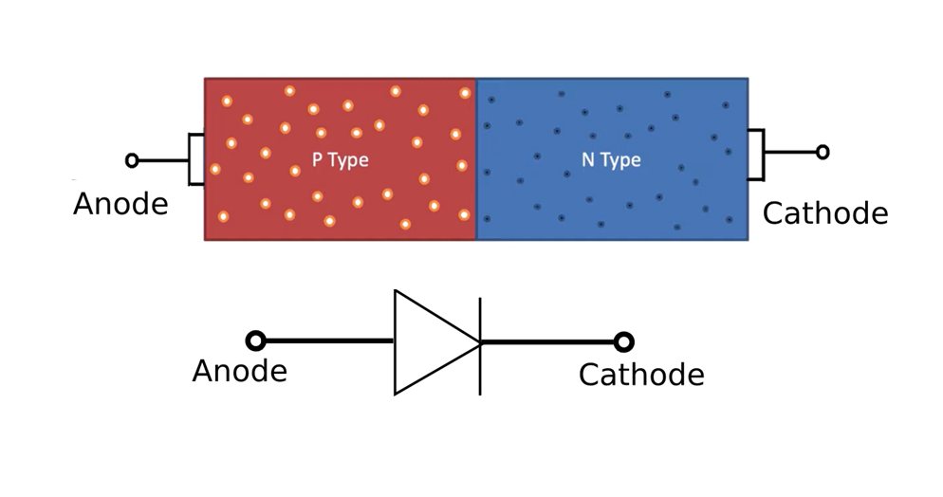
PN - junction
PN Junction & Zener Diodes

Slide 6
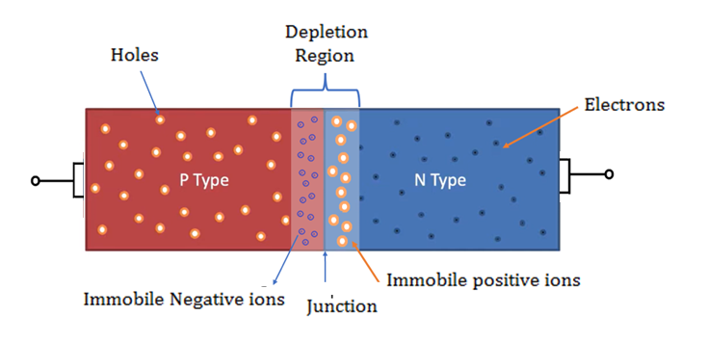
PN junction – Open circuited
PN Junction & Zener Diodes
When no supply is given to the PN junction diode.

Slide 7
There are two forces regulating the PN junction:
PN Junction & Zener Diodes
Drift current
– Conduction of current happens due to drifting of majority charge particles.
Diffusion current
– conduction of current due to minority charge particles.

Slide 8
PN junction – Biasing
PN Junction & Zener Diodes
Voltage can be applied in PN junction diode in two ways to control the width of the depletion region. They are
Forward biasing
Reverse Biasing
When an external voltage is applied to the PN junction in such a way that it cancels the potential barrier and permits the current flow, it is called Biasing

Slide 9
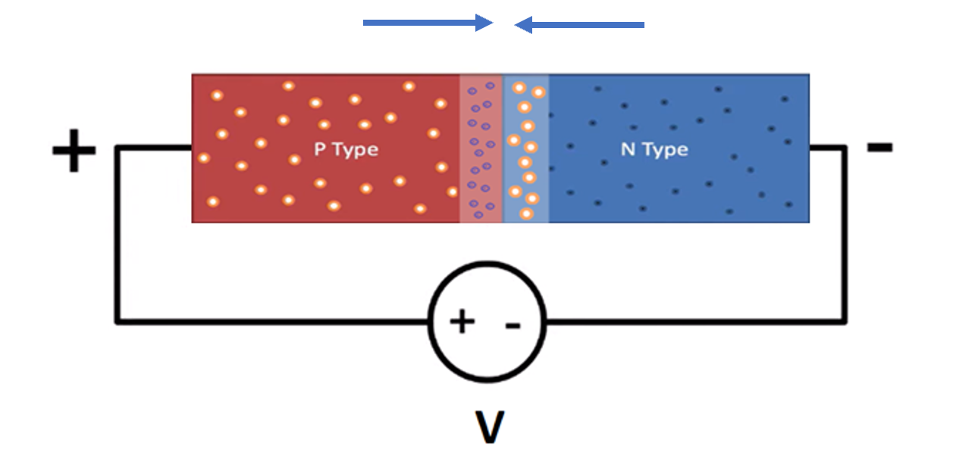
PN junction – Forward biased
PN Junction & Zener Diodes
In Forward Bias condition, we work with drift and prevent diffusion
Hence, Depletion Region Shrinks and conductivity increases

Slide 10
PN junction – Forward biased
PN Junction & Zener Diodes
Connecting, Positive of battery to P region and Negative of battery to N region is called Forward biasing.
This establishes an electric field opposite to potential barrier, So the potential barrier width decreases.
0.3V for Germanium and 0.7V for Silicon, is sufficient to eliminate the barrier potential, thus junction resistance becomes zero.

Slide 11
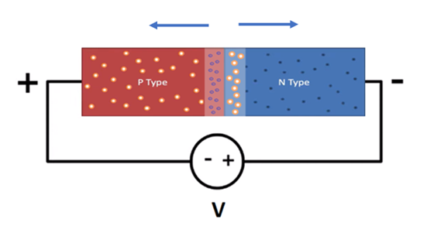
PN junction – Reverse biased
PN Junction & Zener Diodes
In Reverse Bias condition, we work with diffusion and prevent drift.
Hence, Depletion Region widens, and conductivity decreased

Slide 12
Diode Characteristics
PN Junction & Zener Diodes
PN – Junction Diode takes a certain amount of voltage in forward bias to collapse the depletion region and allow current flow.
This is the activation voltage and is generally ≈ 0.6V.
In reverse bias, the depletion region is expanded and current cannot flow.

Slide 13
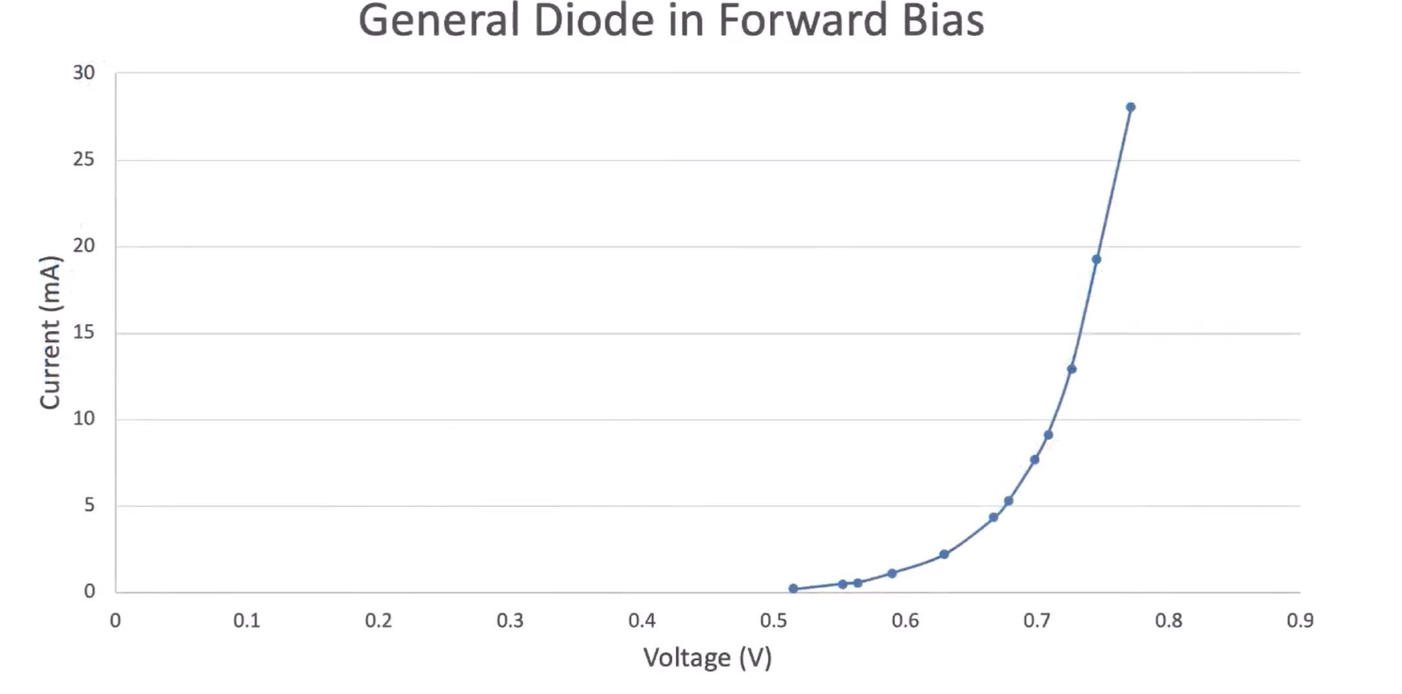
PN Junction & Zener Diodes

Slide 14
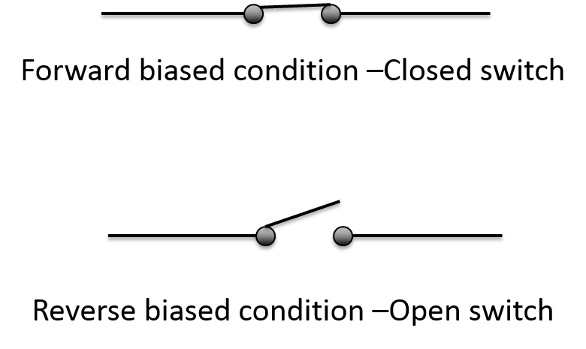
Diode resistance
PN Junction & Zener Diodes
Ideal diode has zero resistance in forward biased and infinite resistance in reverse biased condition.
Diode acts as a switch.

Slide 15
PN junction diode
PN Junction & Zener Diodes
Applications:
Used as switch.
Used in rectifier circuits.
Detector in RF circuits.

Slide 16
Zener diode
PN Junction & Zener Diodes
A Zener diode is a type of PN-junction diode that, allows current to flow not only from its anode to its cathode, but also in the reverse direction when it reaches the "Zener voltage".
Zener diodes have a highly doped PN junction.
Also, normal diodes are not designed to operate in the breakdown region, but Zener diodes can reliably operate in this region.

Slide 17
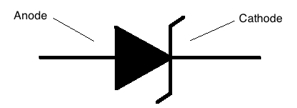
PN Junction & Zener Diodes
Zener effect:
Zener effect is a type of electrical breakdown.
It occurs in a reverse biased PN junction diode, where many free minority carriers suddenly increases the reverse current.
Diode which exhibits Zener effect is called Zener diode.

Slide 18
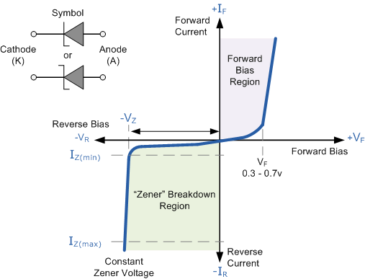
VI Characteristics of Zener diode
PN Junction & Zener Diodes

Slide 19
References
PN Junction & Zener Diodes
[1] P. Horowitz and W. Hill, The Art of Electronics, 3rd ed. Cambridge, UK: Cambridge University Press, 2015.
[2] "PN Junction Diode and Its Biasing Conditions," DDEScholar, [Online]. Available: https://ddescholar.acemap.info/field/2014194504.
[3] "PN Junction Diode Characteristics and Biasing," Electronics Tutorials, [Online]. Available: https://www.electronics-tutorials.ws/diode/diode_7.html.
[4] "P-N Junction Introduction," Physics and Radio Electronics, [Online]. Available: https://www.physics-and-radio-electronics.com/electronic-devices-and-circuits/semiconductor-diodes/p-n-junction-introduction.html.

Slide 20
Thank You

