Slide 1


Social Worker
Module : LCHS4009 Professional Development within Health and Social Care
Student Name: Nancy N Kamau
Student Number: 2524904
Lecturer Name: Arif Ahmed
A Personal SWOT Analysis

Slide 2

MY CHOSEN CAREER
Key Role Requirements:
Registered Social Worker with Social Work England and a Degree in Social Work.
Strong communication skills to develop effective relationships with children, families, colleagues and other agencies.
The ability to assess risk, identify needs and develop effective care plans through a Signs of Safety framework.
An ability to be resilient and to cope with a high and unpredictable workload in a Children and Families team.
A strong commitment to protecting and promoting the welfare of children and young people.
Role: Social Worker (Children and Families Team)
Employer: Dumfries and Galloway Council
Source: Live job advert from Forces Families Jobs (DGA13697), posted 10 October 2026.

Slide 3
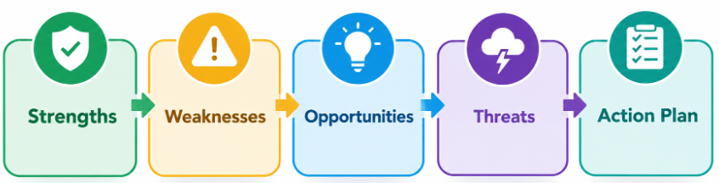
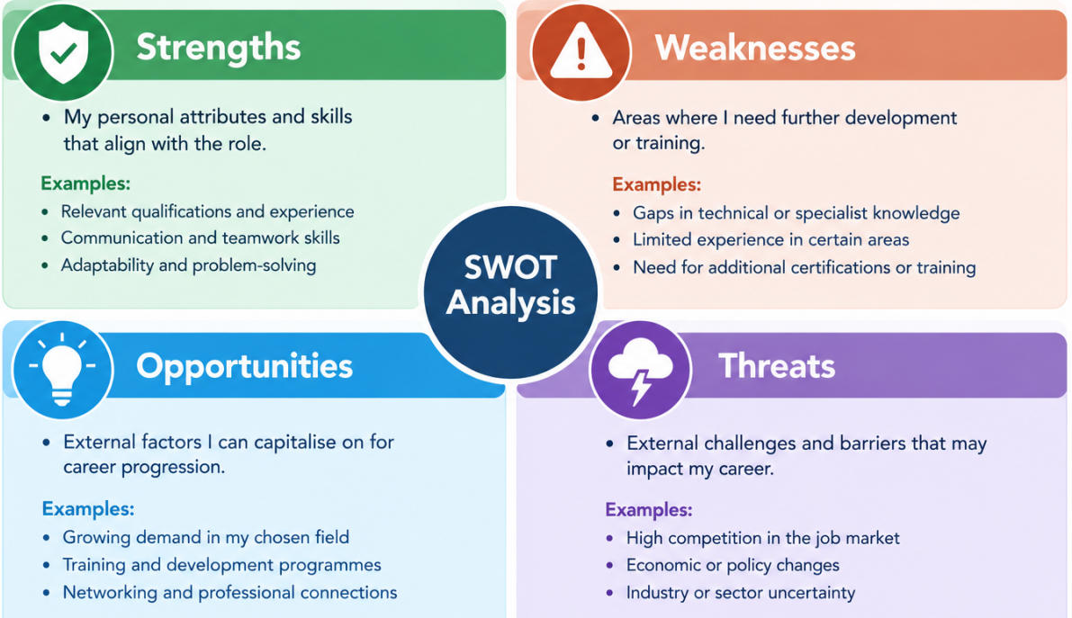
SWOT Analysis Overview
1. What is a SWOT Analysis?
SWOT is a strategic planning tool that assesses Strengths, Weaknesses, Opportunities, and Threats of a project or individual's career development. It has been extensively used in health and social care for the purposes of reflective practice and planning for professional development (Gopee, 2015).
2. Purpose of This Analysis
The framework helps me to critically explore my preparedness to work as a Children and Families Social Worker. It allows me to analyse the work within the context of the specific requirements of the job as stated in the Dumfries and Galloway Council advert (Dumfries and Galloway Council, 2026).
3. Application to My Career
This analysis will help me design an action plan that addresses my particular needs. This will show how I will be able to address my weaknesses through my strengths, reduce threats and maximise opportunities for development as a Social Worker (Social Work England, 2025).

Slide 4
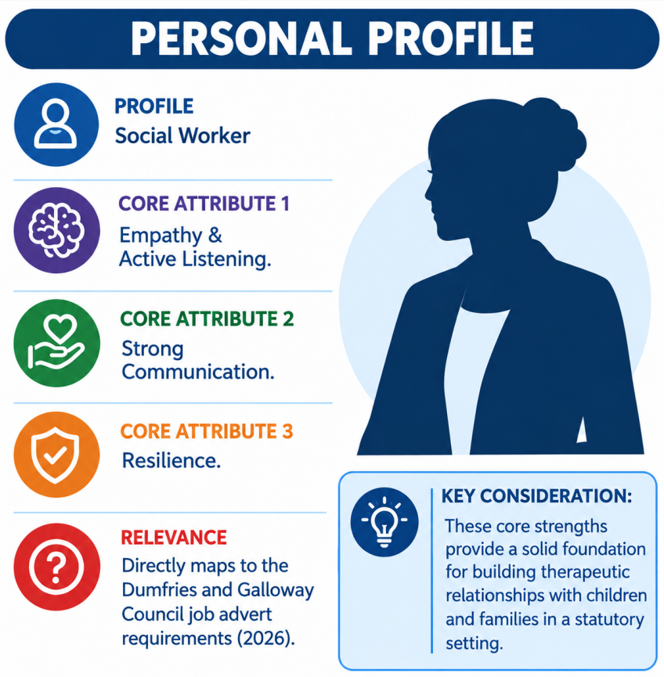
My Strengths
Core personal attributes aligned with the Children and Families Social Worker role.
1. Empathy and Active Listening
My skills in establishing trust and understanding different viewpoints. Practical Example: During my volunteer work at Sunrise care home, I established rapport with a service user who was troubled and listened to them without judgement, giving them the opportunity to talk about their difficulties.
2. Strong Communication
My verbal and written communication is clear and compassionate. Practical Example: Using different communication styles during university group projects and in part-time employment to communicate effectively; this is essential for multi-agency working and report writing.
3. Resilience
Ability to stay focused and composed when under stress. Practical Example: Completed multiple university deadlines and worked part-time, showing the ability to prioritise and work under pressure.
4. Alignment with Role Requirements
These are strengths that are directly relevant to the job advertisement requirement for "excellent communication skills" and the ability to "build effective relationships" with families. The advertisement specifically looks for someone who has the “energy and enthusiasm required to make a valuable contribution to the team” (Dumfries and Galloway Council, 2026).
5. Foundation for Professional Growth
Recognising these strengths gives me the ability to focus on using my strengths in a way that overcomes my weaknesses and reduces threats. I will apply my resilience to navigate the pressures of my role and my communication skills to fully participate in supervision and multi-disciplinary team working.

Slide 5
My Weakness
Safe and effective practice is dependent on self-awareness. Resilience is required in a statutory highpressure role (Dumfries and Galloway Council, 2026). The first step to handling constraints is to recognise them.
Areas for Development
Personal Barriers
Lack of direct statutory experience.
Theoretical knowledge only (e.g. Signs of Safety framework).
Gap: Lack of experience in legal environments with high pressure.
Job requirement: Safe risk assessment and care planning.
Excessive sensitivity: tendency to absorb others' distress.
Risk of burn-out: Professional boundaries need to be established.
Public speaking anxiety: Fear of speaking at public events such as court.
Impact: May limit ability to conduct multi-agency meetings and presenting evidence.

Slide 6
My Opportunity
External factors I can capitalise on to achieve professional growth. Directly aligned with the requirements of the Children and Families Social Worker role (Dumfries and Galloway Council, 2026).
The Opportunity
How I Will Utilise It (With My Strengths)
Student Placement (200 days): Opportunity for direct statutory work within a Children and Families team.
Specialist Training & CPD: Post-qualifying courses (e.g., Signs of Safety, Motivational Interviewing)
High demand for social workers: There are many positions for social workers in high need fields such as child protection.
Working with Multi-Disciplinary teams and membership in Professional Networks: BASW.
Seek out shadowing and complex cases during my placement to gain confidence and competence in my skills.
Emphasise Specialist training to develop my own personal empathy into systematic, professional skills (such as Motivational Interviewing).
Use Communication: Take advantage of the high need, targeting high points where my interpersonal skills can make an immediate difference.
Teamwork: Establish a professional support network and gain wisdom from experienced practitioners.

Slide 7
My Threats
External issues that I need to foresee and address to maintain my career in social work in the long term. There is evidence that the profession is currently experiencing high workload pressure and is experiencing shortages of staff which is affecting staff wellbeing (BASW, 2025). I need my internal strengths to overcome these external threats.
High Stress & Burnout
Negative Public Perception
76% report mental health crisis (BASW, 2025)
Mitigated by Resilience and Supervision
Media scrutiny and stereotypes
Mitigated by Empathy and Person-Centred Practice
Resource Constraints
Competitive Job Market
Limited funding and high caseloads
Mitigated by Resilience and Prioritisation
High competition for roles
Mitigated by Teamwork and Placement Experience

Slide 8
CONCLUSION
My SWOT analysis has been used to establish that my core strengths of empathy, communication, resilience, and teamwork are good match for the requirements of a Children and Families Social Worker (Dumfries and Galloway Council, 2026).
I have admitted that I am weak in certain aspects: limited statutory experience, over-sensitivity, and an inability to speak in public.
I have recognised external threats of burnout, negative public perception, resource limitations and competitive employment market.
My Action plan shows how I will leverage on my strengths to address my weaknesses, reduce my threats and take advantage of my opportunities in my career development.

Slide 9
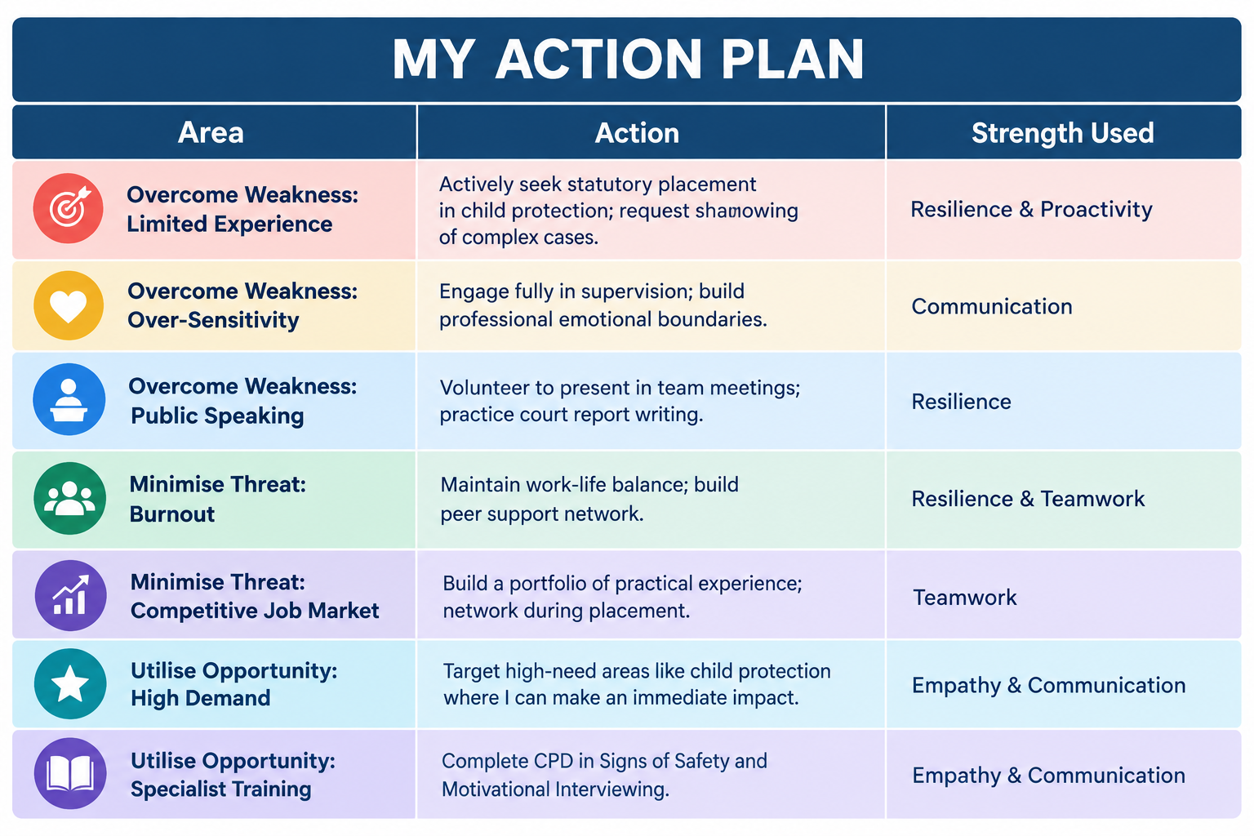
Action Plan

Slide 10
References
BASW (2025). BASW and Social Workers Union launch a major campaign to tackle poor working conditions in the profession. [online] Basw.co.uk. Available at: https://basw.co.uk/articles/basw-and-social-workers-union-launch-major-campaign-tackle-poor-working-conditions [Accessed 12 Oct. 2026].
Dumfries and Galloway Council (2026). Social worker - DGA13697 at Dumfries and Galloway Council in Dumfries | jobrapido.Com. [online] Jobrapido.com. Available at: https://uk.jobrapido.com/jobpreview/96126726056181760 [Accessed 12 Oct. 2026].
Gopee, N. (2015). Mentoring and Supervision in Healthcare. SAGE.
Social Work England (2025). CPD guidance. [online] Social Work England. Available at: https://www.socialworkengland.org.uk/cpd/cpd-guidance/ [Accessed 12 Oct. 2026].

Slide 11
THANK
YOU

