Slide 1
Knowledge and Belief
Prof Bettina E. Schmidt

Slide 2
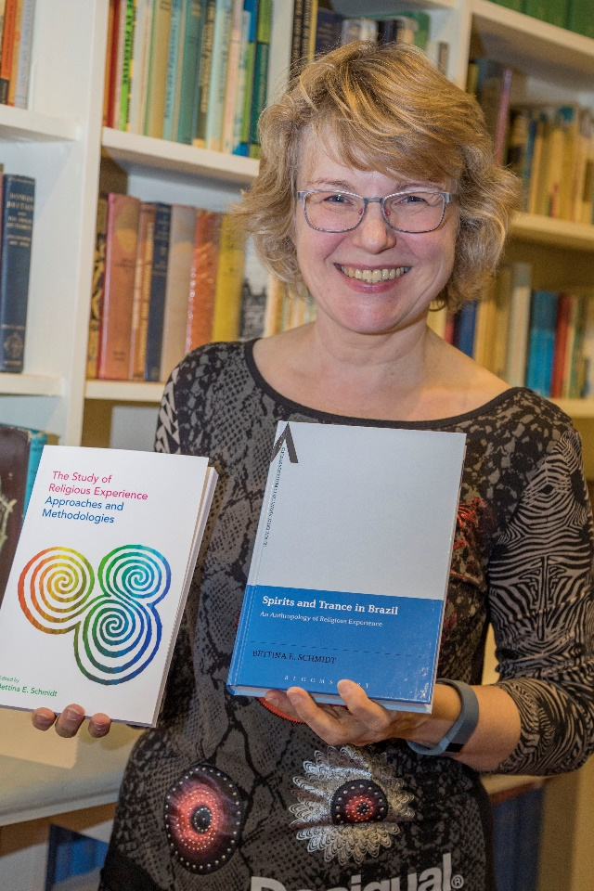
Welcome
Prof Bettina Schmidt
  Cultural anthropologist with focus on anthropology of religion
  Professor for study of religions
  Research on spirit possession, African derived religions in the Caribbean and Latin America (and more)

Slide 3
Part 1: Content of module
The module introduces students to the study of religions, culture and philosophy across periods and subjects.
Students will gain
  an awareness and introductory knowledge of the academic study of religion and philosophy
  an understanding and knowledge of disciplinary fields related to religion, culture and philosophy

Slide 4
Topics
Looking at specific religions such as Christianity, Buddhism, Islam and Sikhism
Looking at philosophical debates on belief and knowledge (including the debate about God from a philosophical angle)
Looking at selected areas such as belief in miracles and spirits

Slide 5
Weekly structure
Teaching material on Moodle
Each week: one core reading
-> importance of taking notes and prepare each week with reading!
a weekly live seminar via Teams

Slide 6
Assessments
an oral presentation about the first two chapters of Robert Crawford’s book What is Religion (30%)
2. a short essay (1500-2000 words) (70%)
Topic are listed on the Moodle page

Slide 7
Assessment 1: Review of Reading
Oral presentation (with or without slides) about the first two chapters of Robert Crawford’s book “What is religion” ('Can Religion be defined?' and 'How is Religion studied?’).
Concentrate on the critical engagement and close reading skills and make sure it is fully referenced.

Slide 8
Assignment 2: Essay
There are three topics on the Moodle page from which you can select your topic, according to your interest. (A fourth topic about Asian tradition can be added if required.)

Slide 9
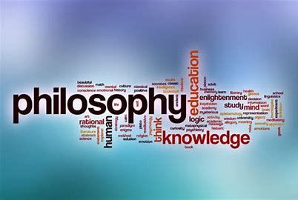
Part 2: Introduction to Knowledge and belief

Slide 10
Activities
Check the definitions of the words ‘Knowledge’ and ‘Belief’
Create a sentence with the verb ‘to know’ and ‘to believe’

Slide 11
Definition of Knowledge
facts, information, and skills acquired through experience or education; the theoretical or practical understanding of a subject
  Emphasis on factual accuracy but also link to experience or education

Slide 12
Knowledge according to the Cambridge Dictionary
understanding of or information about a subject that you get by experience or study, either known by one person or by people generally
the state of knowing about or being familiar with something

Slide 13
awareness, understanding, or information that has been obtained by experience or study, and that is either in a person’s mind or possessed by people generally
skill in, understanding of, or information about something, which a person gets by experience or study.
  (KNOWLEDGE | meaning in the Cambridge English Dictionary)

Slide 14
Definition of Belief
an acceptance that something exists or is true, especially one without proof
Belief in - trust, faith, or confidence in (someone or something)
  > something that does not need to be true

Slide 15
Belief according to the Cambridge Dictionary
the feeling of being certain that something exists or is true
  BELIEF | meaning in the Cambridge English Dictionary

Slide 16
Distinction between Knowledge and Belief
Knowledge based on facts
Experience
Education
Common knowledge
Belief in something that might not be true nor based on facts

Slide 17
Examples
Knowledge of English
I know how to speak Welsh a little bit
Belief in God
I believe in spirits

Slide 18
Activities
Check the definitions of the words ‘Knowledge’ and ‘Belief’
Create a sentence with the verb ‘to know’ and ‘to believe’

Slide 19
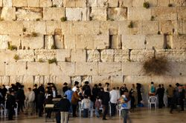
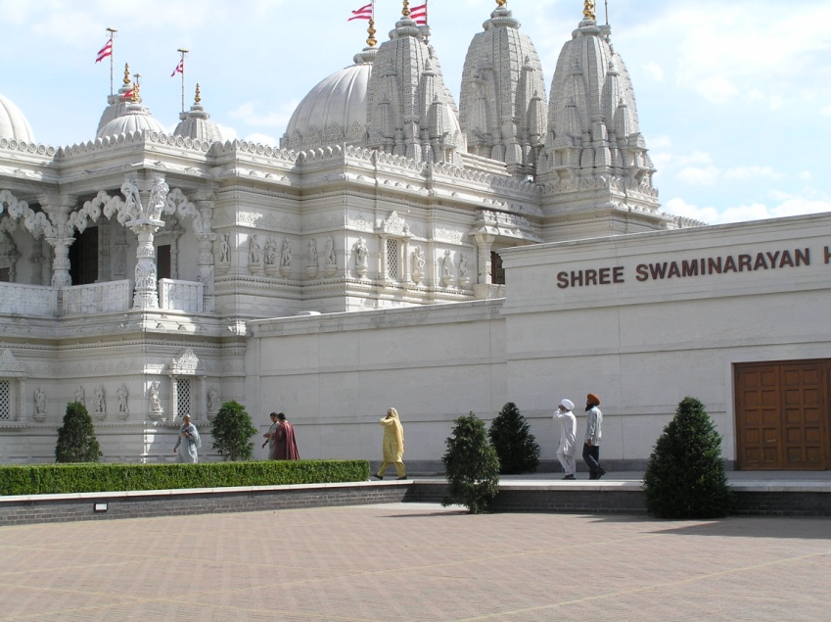
Part 3: What is Study of Religions?

Slide 20
Study of Religions
The study of religions as the study of human beings
The Study of Religions teaches the understanding of the religions in the world
We try to understand the worldviews of other people, their belief and practices, the way these people are structuring their world.

Slide 21
The study of religions integrates influences from different disciplines:
  theological, anthropological, and sociological approaches,
  but also psychology, art history, political theories, and philology

Slide 22
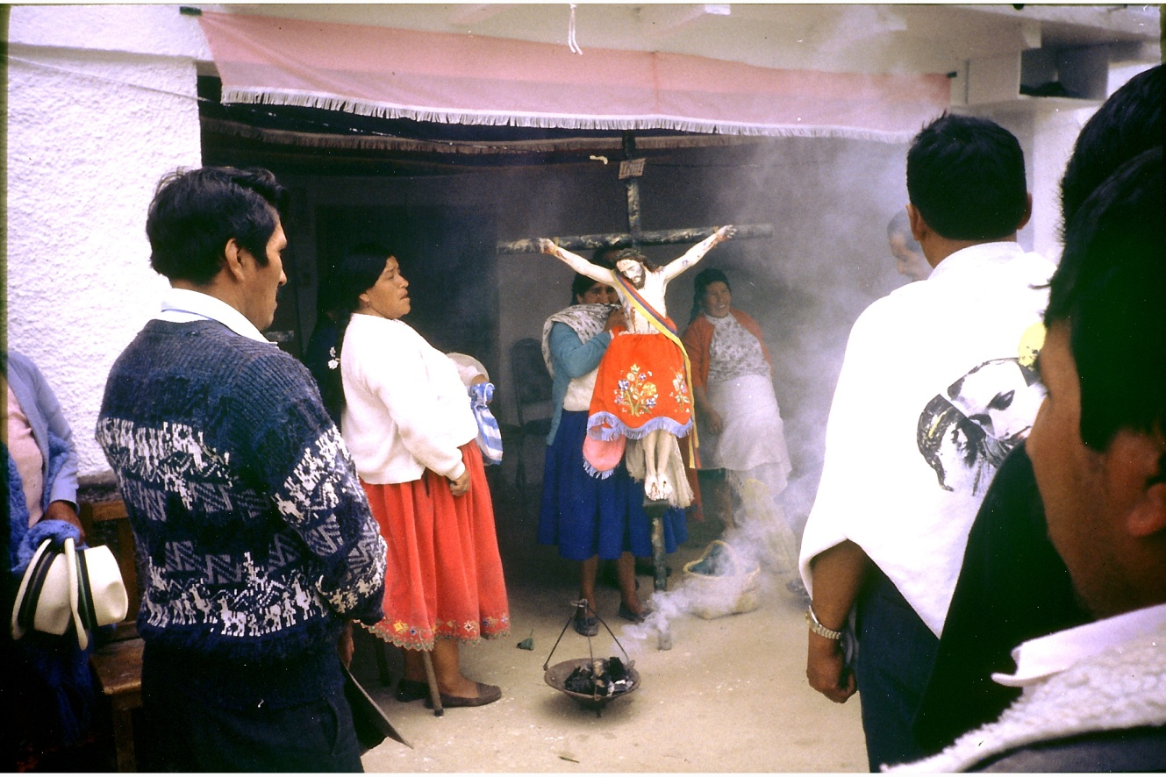
What is Religion?
Notes:
Ecuador 1996

Slide 23
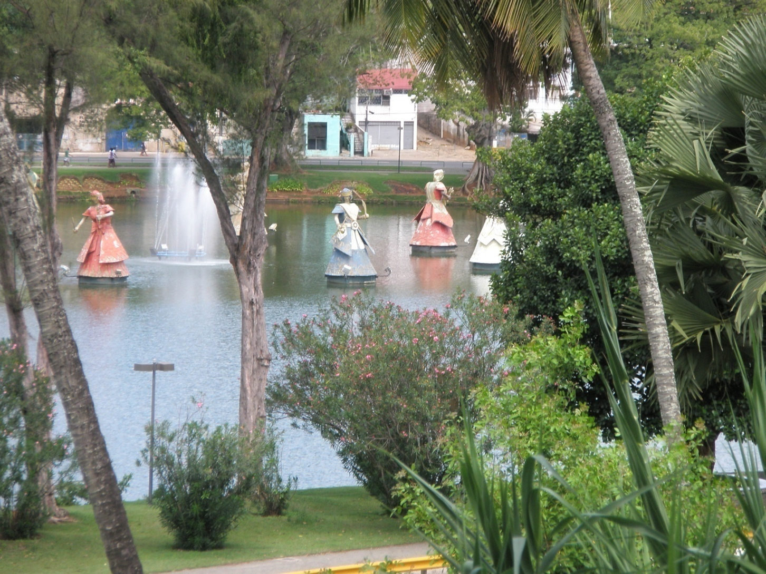
Religion is ..
one of the keywords of modern society used countless time but with very different meanings (Braun 2000, p. 4).

Slide 24
"I don’t want to call it a sacred site because your idea of something sacred and my idea of something sacred are a little bit different".
  Grant Bulltail, an Apsáalooke (Crow) elder speaking to school children about a prodigious landmark, Heart Mountain, Wyoming, 2003

Slide 25
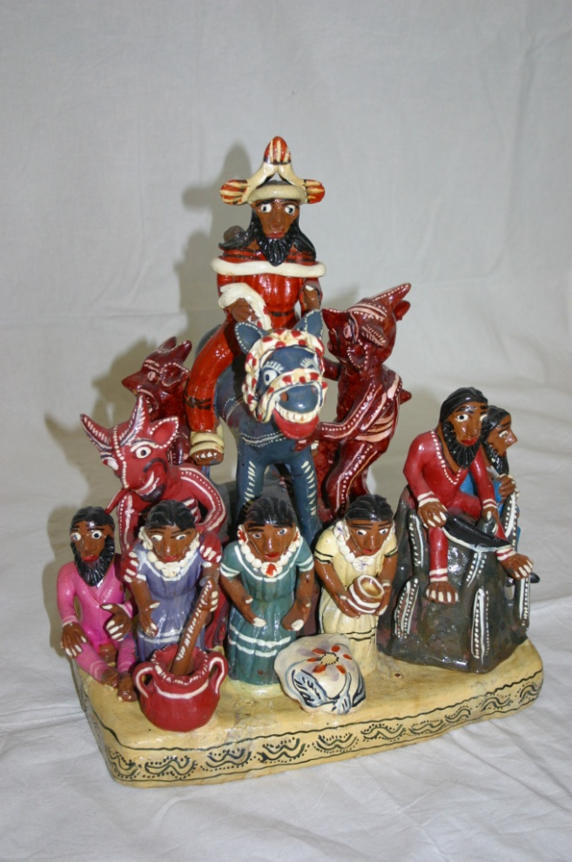
Dynamic religions
Religions constantly evolve and adapt
Religion is not a homogenous entity but should reflect what people do and believe in

Slide 26
Religion today
‘Religion is what religion does’ (Evans-Pritchard)
Instead of speaking of one form of Christianity, one form of Islam, one form of an indigenous religion, we should acknowledge the diversity of believes

Slide 27
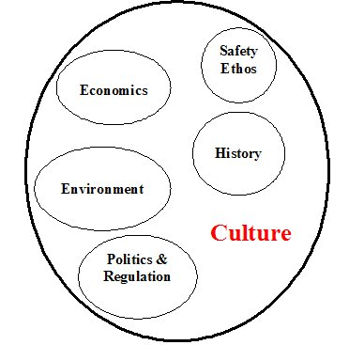
And religion is in the middle of all!

Slide 28
CORE READING
Crawford, R., What is Religion (London: Routledge, 2002).
  Available as e-book (access via the library catalogue)
  Task for the seminar: Read the Introduction and the second chapter How is religion studied?

