Slide 1
Glass Physical Web
Project Proposal
Dr Nik Whitehead
Associate professor, school of applied computing
University of wales trinity st david
Nicola.whitehead@uwtsd.ac.uk

Slide 2
What is the Physical Web?
Project Background
Aims & Objectives
Methodology
Expected Outcomes
Risks
Project Plan
Summary/Questions

Slide 3
What is the physical web?
Google project relating to the Internet of Things (IoT)
Aims to provide location-based information through Open Source technologies using Bluetooth Low Energy (BLE) beacons
First launched in October 2014 via GitHub as a response to Apple’s 2013 launch of the iBeacon technology
Uses Eddystone beacon profile (released July 2015)
In September 2016 the Minister for Skills & Science announced that the WAG wants Wales to become a leader in IoT technology
https://google.github.io/physical-web/
http://radar.oreilly.com/2015/04/googles-physical-web-vs-apples-ibeacon.html,

Slide 4
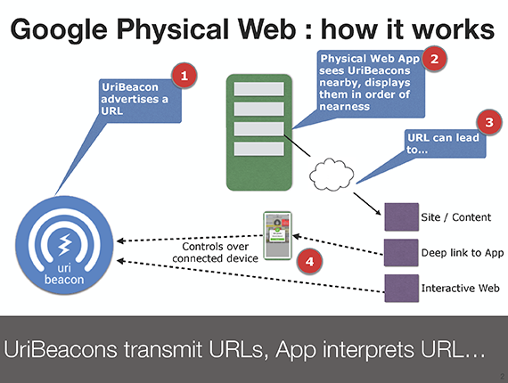
UriBeacons are available from multiple manufacturers from £12 each (retail) and last up to a year on a single CR 2032 Lithium cell
UriBeacons are detected using a specialised app or via a Chrome browser add-on
http://radar.oreilly.com/2015/04/googles-physical-web-vs-apples-ibeacon.html

Slide 5
Project Background
Swansea School of Art includes the historic Welsh School of Architectural Glass (founded in 1935)
Teaches practical skills in both architectural and decorative glass
Students have access to a set of workshops with specialised industrial machinery for cutting, heating, etching and treating glass
High-quality Health & Safety training is a legal requirement, and easy access to instruction manuals for these devices is essential
Currently paper copies of these are held in each workshop

Slide 6
Aims and Objectives
Aim: To investigate the use of Physical Web technology to provide users of the Glass Workshops with easily accessible Health & Safety materials
Objectives:
  To produce high-quality Health & Safety materials that can easily be accessed using mobile devices
  To use UriBeacons to point users towards those materials
  To record the usage of, and user responses to, such materials

Slide 7
Methodology
Bilingual multimedia H&S materials will be produced in collaboration with the Glass Support Staff and the Technology-Enhanced Learning Unit
These materials will be made available via a secure website using UriBeacons in each of four workshops
  Each workshop’s web page will contain text and video materials demonstrating the safe use of the equipment within the workshop
Access to the website will be logged in order to later evaluate the use of the system by workshop users
A user survey will gather subjective responses to the system

Slide 8
Expected Outcomes
This is a pilot study
It is expected that the final system will
Provide bi-lingual H&S information, including video demos, via users’ mobile phones/tablets
Provide the support staff with an easy-to-update method of maintaining H&S information
Reduce the workload on the support staff
Provide a baseline against which further projects can be measured

Slide 9
Risks
This is bleeding edge technology; some technical issues may arise
Potential users will require training in how to set up mobile phones/tablets in order to receive information from the beacons
  Posters and Moodle-based information will be used to inform potential users about the project
  Training workshops will be held to help users do the initial set-up
All of the materials may not be available before the project goes live (particularly the Welsh language materials)
  A subset of essential materials has already been identified and converted to appropriate forms in English

Slide 10
Project Plan
November 2016: Acquire and test beacons
December 2016: Develop essential text-based materials, liaise with TEL to organise creation of video-based materials
January 2017: Set up necessary web pages with essential materials
February 2017: Train users and open site for use
June 2017: Data analysis and publication
September 2017: Incorporate results into teaching for 2017/18

Slide 11
Summary
Aim to provide essential Health & Safety information in a new and accessible manner using Physical Web technologies
The project meets a need identified by support staff in the Glass department
Use of the system will be logged to investigate its effectiveness with a view to making it a major method of providing such information in future
The project also supports WAG aims in developing IoT skills in Wales

