Slide 1

Professional Services
BMGM5005
Week 8 - Managing Human Resources Globally
and Psychology Test for Work
Jemma Smith
International Gastronomy Management

Slide 2
Content
Factors that most strongly influence HRM in international markets.
Categories of international employees.
Four levels of global participation and the HRM issues faced within each level.
Hybrid work
Psychology Personality Test for Work
Notes:
After reading this chapter, you should be able to:
Learning Objectives:
Identify recent changes that have caused companies to expand into international markets.
Discuss four factors that most strongly influence HRM in international markets.
List different categories of international employees.
Identify four levels of global participation and HRM issues faced within each level.
Discuss ways companies select, train, compensate and reintegrate expatriate managers.

Slide 3
Introduction
Organisations function in a global economy.
Cross-border mergers are increasing.
U.S. businesses are entering international markets, and foreign companies are entering the U.S. market.
International competition is #1 factor affecting HRM.
International expansion can provide a competitive advantage:
    large numbers of potential customers
    low-cost labour
    Maquiladora plants
Notes:
Organizations function in a global economy. U.S. businesses are entering international markets, and at the same time, foreign companies are entering the U.S. market. International expansion can provide a competitive advantage. A number of key factors must be addressed in order to strategically manage HR in an international context. International competition is #1 factor affecting HRM.
Entering different countries may provide large numbers of potential customers.
Building production facilities in countries with low‑cost labor may prove cost‑efficient. Maquiladora plants (foreign-owned plants located in Mexico that employ Mexican laborers) provide low‑skilled labor below the cost in U.S. Telecommunications and information technology enables work to be done more rapidly, efficiently, and effectively around the globe.

Slide 4
Current Global Changes
        European Union
        NAFTA
        Growth of Asia
        GATT
North American Free Trade Agreement
The General Agreement on Tariffs and Trade
Notes:
Recent social and political changes have accelerated the movement towards international competition.
European Economic Community (EEC) is a confederation of most of the European nations that agree to engage in free trade with one another, with commerce regulated by the European Commission (EC). Under the EEC, legal regulation in the participating countries has become more, although not completely, uniform. Assuming the EEC’s trend toward free trade among members continues, Europe has become one of the largest free markets in the world.
North American Free Trade Agreement (NAFTA)—agreement between Canada, the U.S., and Mexico provides an even larger free market than the EEC. NAFTA increased U.S. investment in Mexico because of Mexico’s substantially lower labor costs for low-skilled employees. This has had two effects on employment in U.S. First, many low-skilled jobs went south, decreasing employment opportunities for U.S. citizens who lack higher-level skills. Second, it increased employment opportunities for Americans with higher-level skills beyond those already being observed
Asia provides a growth market for many firms. Japan, China, Singapore, Hong Kong, and Malaysia are significant economic forces. China presents a tremendous potential market for goods.
GATT is an international framework of rules and principles for reducing trade barriers across countries around the world. It consists of over 100 member nations. The most recent round of GATT negotiations resulted in an agreement to cut tariffs (taxes on imports) by 40%, reduce government subsidies to businesses, expand protection of intellectual property such as copyrights and patents, and establish rules for investing and trading in services.

Slide 5
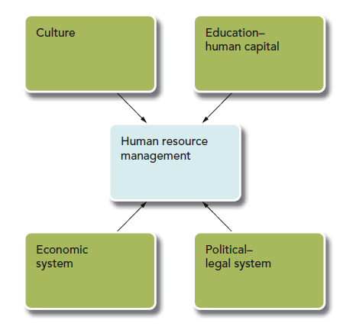
Factors Affecting HRM in International Markets
Copyright © 2016 McGraw-Hill Education. All rights reserved. No reproduction or distribution without
the prior written consent of McGraw-Hill Education.
Notes:
Figure 15.1
Companies that enter global markets must recognize that these markets are not simply mirror images of their home country. These differences may have a particularly strong impact on the HRM function. A number of factors can affect HRM in global markets, and four factors, culture, education/ human capital, the political, legal system, and the economic system
Culture is defined as the set of important assumptions (often unstated) that members of a community share. Culture is the most important factor influencing international HRM. Culture is important to HRM because it often determines laws, education, and economic systems affecting HRM in global markets and the effectiveness of various HRM practices.
Practices effective in U.S. may not be effective in a culture that has different beliefs and values. For example, U.S. companies rely heavily on individual performance appraisal, and rewards are tied to individual performance.

Slide 6
Hofstede’s Cultural Dimensions
Individualism-Collectivism
  degree which people act as individuals rather than members of group
Power Distance
  how a culture deals with hierarchical power relationships
Uncertainty Avoidance
  how cultures handle that the future is not perfectly predictable
Masculinity-Femininity
  division of roles between the sexes within a society
Long-Term – Short-Term Orientation
  tendency to focus on long-term benefit or short-term outcomes
Notes:
Geert Hofstede identified five dimensions on which various cultures could be classified or characterized. (see Table 15.2 in the text for scores of ten various countries).
Individualism/collectivism is the strength of the relation between an individual and other individuals in the society, that is, the degree to which people act as individuals rather than as members of a group.
Power distance describes how a culture deals with hierarchical power relationships.
Uncertainty avoidance is how cultures seek to deal with the fact that the future is not perfectly predictable, and the degree to which people in a culture prefer structured over unstructured situations.
Masculinity‑femininity is the division of roles between the sexes within a society.
Long‑term/short‑term orientation is the tendency of a culture to focus on long‑term benefit or short‑term outcomes. These five dimensions help us understand the potential problems of managing employees from different cultures. these differences can
have a profound influence on whether a company chooses to enter a given country. One interesting finding of Hofstede’s research was the impact of culture on a country’s economic health. He found that countries with individualist cultures were more wealthy. Collectivist cultures with high power distance were all poor. Cultures seem to affect a country’s economy through their promotion of individual work ethics and incentives for individuals to increase their human capital.

Slide 7
Implications of Culture for HRM
Culture impacts approaches to managing people.
Culture differs on how employees expect leaders to lead, how decisions are handled and what motivates individuals.
Culture influences appropriateness of HRM practices.
Cultures influences compensation systems and communication and coordination processes.
Cultural diversity programs foster understanding of other cultures to better communicate.
Notes:
Implications of Culture for HRM:
Culture has an impact on approaches to managing people.
Culture differs on how employees expect leaders to lead, how decisions are handled within the hierarchy and what motivates individuals.
Culture may influence appropriateness of HRM practices.
As Hofstede found, culture has a profound impact on a country’s economic health by promoting certain values that either aid or inhibit economic growth. Cultural characteristics influence the ways managers behave in relation to subordinates, as well as the perceptions of the appropriateness of various HRM practices. Cultures can influence compensation systems and communication and coordination processes. Cultural diversity programs foster understanding of other cultures to better communicate with them.

Slide 8
Education – Human Capital
Countries differ in their levels of human capital
Human capital is the productive capabilities of individuals— knowledge, skills, and experience that have economic value
Determined primarily by educational opportunity
Countries with low human capital attract facilities that require low skills and low-wage levels
Countries with high human capital are attractive sites for direct foreign investment that creates high-skill jobs
Notes:
Human capital refers to the productive capabilities of individuals, that is, the knowledge, skills, and experience that have economic value. A company's potential for finding and maintaining a qualified work force is a critical element of any decision to expand internationally.
Countries differ in their levels of human capital.
A country's human capital is determined by a number of variables, primarily, educational opportunity.
Countries with low human capital attract facilities that require low skills and low wage levels.
Countries with high human capital are attractive sites for direct foreign investment that creates high‑skill jobs.

Slide 9
Political-Legal System
Dictates requirements of certain HRM practices, such as training, compensation, hiring, firing and layoffs.
Legal system is an outgrowth of the culture, reflecting societal norms.
  U.S. leads the world in eliminating discrimination in the workplace and controlling the process of labor management negotiations.
  European Economic Community (EEC) EEC provides fundamental social rights of workers: freedom of movement and freedom to choose one's occupation and be fairly compensated.
Notes:
The political/legal system often dictates the requirements of certain HRM practices, such as training, compensation, hiring, firing, and layoffs. The legal system is an outgrowth of the culture, reflecting societal norms. The United States has led the world in eliminating discrimination in the workplace. Federal regulations control the process of labor management negotiations. EEC's Community Charter provides the fundamental social rights of workers: freedom of movement, freedom to choose one's occupation and be fairly compensated.

Slide 10
Economic System
Under socialist economies, little economic incentive to develop human capital, but ample opportunity exists because education is free.
In capitalist systems, less opportunity to develop human capital without higher costs.
Every country varies in terms of culture, human capital and legal, political and economic systems.
An economic system affects HRM directly through its taxes on compensation packages.
Notes:
A country's culture is integrally tied to its economic system, which provides many of the incentives for developing its human capital. Under socialist economies, there is little economic incentive to develop human capital, but ample opportunity because education is free. In capitalist systems, the opposite situation exists, with higher tuitions at state universities but with economic incentives through individual salary differences. Those who invest in their individual human capital, particularly through education, are more able to reap monetary rewards, thus providing more incentive for such investment. In the U.S., individuals’ salaries usually reflect differences in human capital (high-skill workers receive higher compensation than low-skill workers) Research estimates that an individual’s wages increase by between 10% and 16% for each additional year of schooling Every country varies in terms of culture, human capital and their legal, political and economic systems.
An economic system also affects HRM directly through its taxes on compensation packages. Differential labor costs do not always reflect the actual take-home pay of employees These variations directly influence types of HRM systems that must be developed to accommodate the particular situation.

Slide 11
Managing Employees in a Global Context
Parent Country Host Country Third Country
Notes:
Before discussing the levels of global participation, let’s distinguish between parent countries, host countries, and third countries.
A parent country is the country in which the company's corporate headquarters is located.
A host country is the country in which the parent country organization seeks to locate (or has already located) a facility.
A third country is a country other than the host country or parent country. Every country varies in terms of its culture, human capital, legal system, and economic system.

Slide 12
Types of Expatriates
Parent-country nationals
  Employees who were born and live in parent country
Host-country nationals
  Employees who were born and raised in host country
Third-country nationals
  Employees born in a country other than the parent and host country but who work in the host country
Notes:
Types of International Employees An expatriate is an employee sent by a company in one country to manage operations in a different country. Three types of expatriates:
Parent‑ country nationals (PCNs) are employees who were born and live in a parent country.
Host‑country nationals (HCNs) are those employees who were born and raised in the host country, as opposed to the parent country.
Third‑country nationals (TCNs) are employees born in a country other than the parent country or host country but who work in the host country.
“Inpatriates” refers to managers from different countries who become part of the corporate headquarters staff

Slide 13
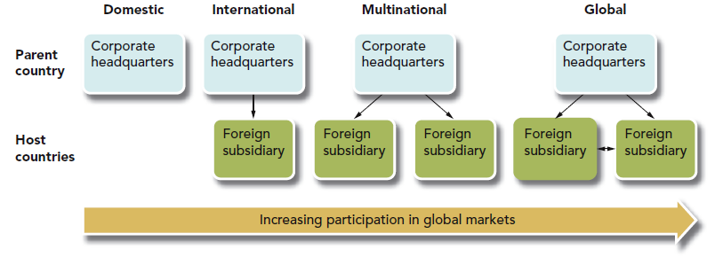
Levels of Global Participation
Notes:
Figure 15.3
Figure 15.3 depicts the level of international participation from which an organization can choose. Most companies begin by operating within a domestic marketplace. International participation occurs as companies seek new markets for their products through exporting and ultimately by building production facilities in other countries. Whereas international companies build one or a few facilities in another country, they become multinational when they build facilities in a number of different countries, attempting to capitalize on lower production and distribution costs in different locations. Global organizations compete on state‑of‑the‑art, top‑quality products and services with the lowest possible costs.

Slide 14
Global Organisations
Global organisations compete on top-quality products and services at the lowest costs possible.
Transnational Scope: HR decisions must be made from a global rather than a national or regional perspective
Transnational Representation: reflects the multinational composition of a company's managers
Transnational Process: extent to which the company's planning and decision-making processes include representatives and ideas from a variety of cultures.
Notes:
Global companies increasingly emphasize flexibility and mass customization of products to meet the needs of particular clients. HRM systems must encourage flexible production and must be responsive to the many systems that they operate.
Transnational scope - HR decisions must be made from a global rather than a national or regional perspective.
Transnational representation - multinational composition of a company's managers.
Transnational process - extent to which the company's planning and decision‑making processes include representatives and ideas from a variety of cultures. These three characteristics are necessary for cultural synergy. Companies must manage employees who are sent to foreign countries (expatriates and third country nationals). This causes the need to shift from focusing only on the culture, human capital, political–legal, and economic influences of the host country to examining ways to manage the expatriate managers who must be located there.
Selection systems must be developed that allow the company to identify managers capable of functioning in a new culture. These managers must be trained to identify the important aspects of the new culture in which they will live as well as the relevant legal–political and economic systems and must be compensated to offset the costs of uprooting themselves and their families to move to a new situation vastly different from their previous lives.
Source: www.nirb.gov/publications/engulp.html

Slide 15
Selection of Expatriate Managers
Successful expatriates have technical competence and ability to adjust to, and be sensitive to, a new culture.
Three dimensions of adaptive skills:
  Self
  Relationship
  Perception
Notes:
As companies internationalize, use of expatriates becomes more frequent. One of the major problems in managing expatriate managers is determining which individuals in the organization are most capable of handling an assignment in a different culture. Successful expatriates have technical competence and an ability to adjust to, and be sensitive to, a new culture. These adaptive skills have been categorized into three dimensions: (1) the self dimension (the skills that enable a manager to maintain a positive self-image and psychological well-being), (2) the relationship dimension (the skills required to foster relationships with the host-country nationals), and (3) the perception dimension (those skills that enable a manager to accurately perceive and evaluate the host environment). Five factors considered to be important in descending order of importance include family situation, flexibility and adaptability, job knowledge and motivation, relational skills, and extracultural openness.
Use of women in expatriate assignments has proven beneficial for companies; recent evidence men and women can perform equally well even in countries that have a predisposition to women in management.

Slide 16
Cultural Intelligence
Cultural intelligence (CQ) refers to an individual’s ability to adapt across cultures through sensing the different cues regarding appropriate behavior across cultural settings or in multicultural settings.
Notes:
Cultural intelligence (CQ) refers to an individual’s ability to adapt across cultures through sensing the different cues regarding appropriate behavior across cultural settings or in multicultural settings. In fact, one set of researchers found that CQ was related to cultural adjustment and task performance among a sample of international executives.

Slide 17
Training and Development of Expatriates
Cross Cultural Training
Behavior in Meetings and Social Settings
Interpersonal and Communication Skills
Culture in the new Work Environment
Notes:
Cross Cultural Training creates an appreciation of the host country’s culture so that expatriates can behave appropriately
Behavior in Meetings and Social Settings Expatriates must be clear about their own cultural background, particularly as it is perceived by host nationals to modify their behavior to accentuate the effective characteristics while minimizing those that are dysfunctional.
Interpersonal and Communication Skills to identify the types of behaviors and interpersonal styles that are considered acceptable in both business meetings and social gatherings.
Culture in the New Work Environment to communicate with others when language barriers exist.

Slide 18
Compensation of Expatriates
Base Salary
Tax Equalization Allowances
Benefits
Allowances
Notes:
The cost of a U.S. expatriate working in another country is approximately three to four times that of a comparable U.S. employee. Careful balancing must occur to assure that expatriates are rewarded in an equitable manner. Allowances for housing, taxes, moving costs, and children's schooling are part of the package.
Total pay packages have four components:
Base Salary—Annual salary, unadjusted.
Tax Equalization allowances—Payments for higher tax rates of other countries.
Benefits—Continuation of, or substitute for, home benefits package.
Allowances—Cost‑of‑living, housing, education, and relo­cation payments to make the assignment more attractive.

Slide 19
Re-acculturation of Expatriates
Reentry may result in culture shock.
    60 to 70% do not know what position will be upon return
    25% leave the company within one year upon returning
Transition process necessitates communication of corporate changes while the expatriate is overseas and validation of the importance of the expatriate's international work.
Training and rewards beyond salary and benefits are key.
Communication and validation efforts help expatriates.
Notes:
Reentry may result in culture shock in reverse. The individual changed, company changed, and the culture changed while the expatriate was overseas.60 to 70% of expatriates do not know what their position will be upon their return. 25% leave the company within one year upon returning. Transition process necessitates communication of corporate changes while the expatriate is overseas and validation of the importance of the expatriate's international work. Training and rewards beyond salary and benefits are key.
Companies are increasingly making efforts to help expatriates through reacculturation. Two characteristics help in this transition process: communication and validation. Communication refers to the extent to which the expatriate receives information and recognizes changes while abroad. The closer the contact with the home organization while abroad, the more proactive, effective, and satisfied the expatriate will be upon reentry. Validation refers to the amount of recognition received by the expatriate upon return home. Expatriates who receive recognition from their peers and their bosses for their foreign work and their future potential contribution to the company have fewer troubles with reentry compared with those who are treated as if they were “out of the loop.” and satisfied the expatriate will be upon reentry.

Slide 20
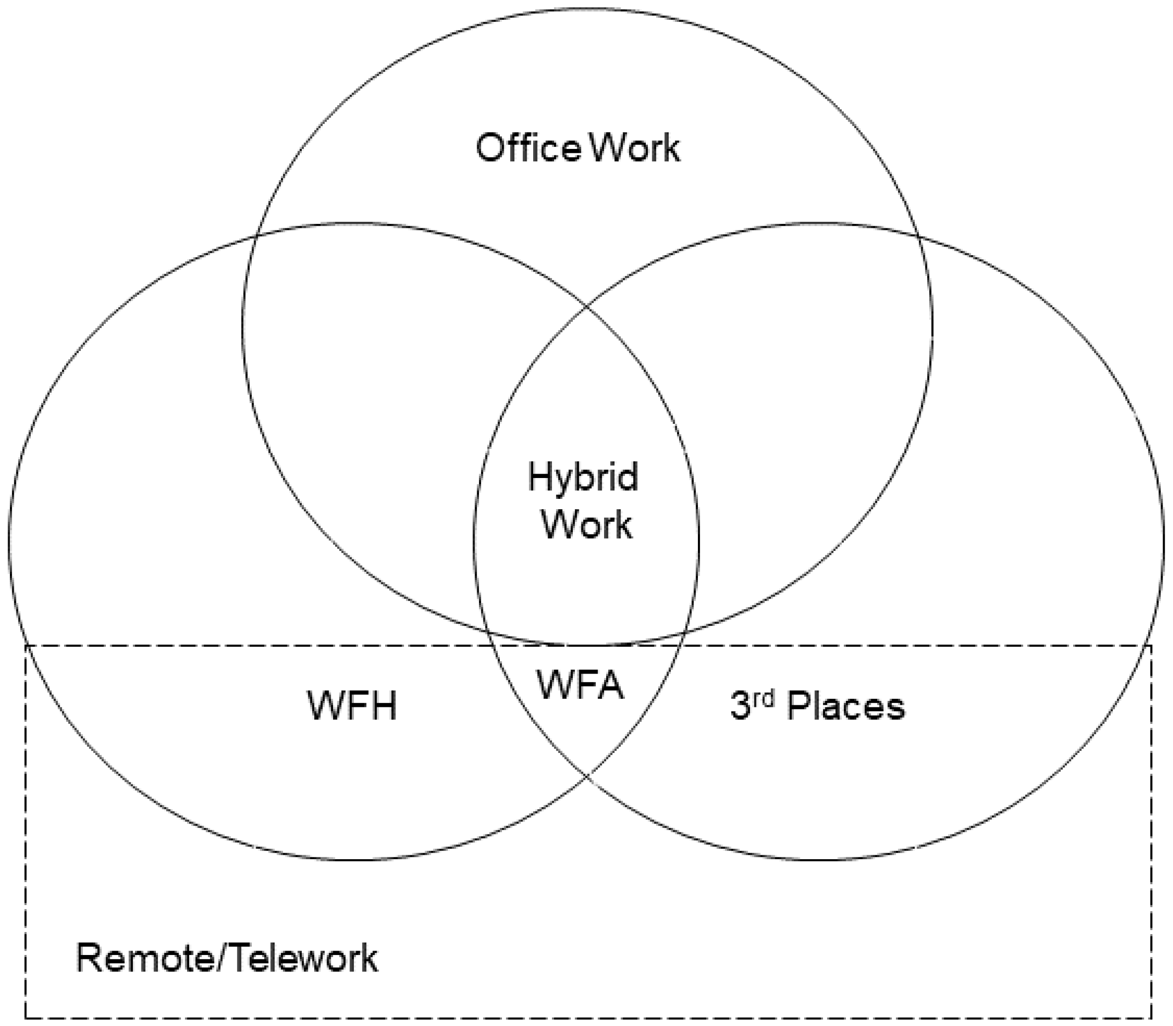
Hybrid work:
The work trend?
Employees Increasingly Seek Value and Purpose at Work (gartner.com)
Source : Hopkins, J.; Bardoel, A. (2023)
Notes:
Hybrid work in the current context involves a mixture of on-site work and remote work, with the latter predominantly related to work-from-home. In many cases, the pandemic context shifted thinking around remote work from the question of whether remote work was beneficial to employees and organisations to the question of the appropriate mix of remote and on-site work, which justifies the focus on hybrid work arrangements.
2.1.3. Third Places
The concept of ‘third places’ is attributed to sociologist Ray Oldenburg, who introduced it as a term to describe the places where people spend time between home and work—“locations where we exchange ideas, have a good time, and build relationships” [26]. In urban planning, third places are viewed as an important ingredient in community building, and for stabilizing neighbourhoods. They are defined as social surroundings, separate from the two usual social environments of home—“the first place”, and work—“the second place” [27,28]. Examples of these third places might include cafes, libraries, bookstores, restaurants, or parks.
2.1.4. Working from Home
Bloom et al. [29] define working from home as “also called telecommuting or telework”, but the authors disagree with this for the reason that working from home is, by definition, limited to just the home. Telework is not limited to the home, telework can be conducted from pretty much anywhere, so working from home is a form of telework but not the exact same thing.
2.1.5. Remote Work
Remote work describes the “organization and/or performance of work, whereby an employee can carry out work that could also be carried out at the employer’s premises regularly out of these premises through the use of information technology” [31]. The key difference here is the inclusion of the word regularly, and remote workers are often regarded as spending the majority of their time, or in many cases all their time, working away from the employer’s premises.

Slide 21
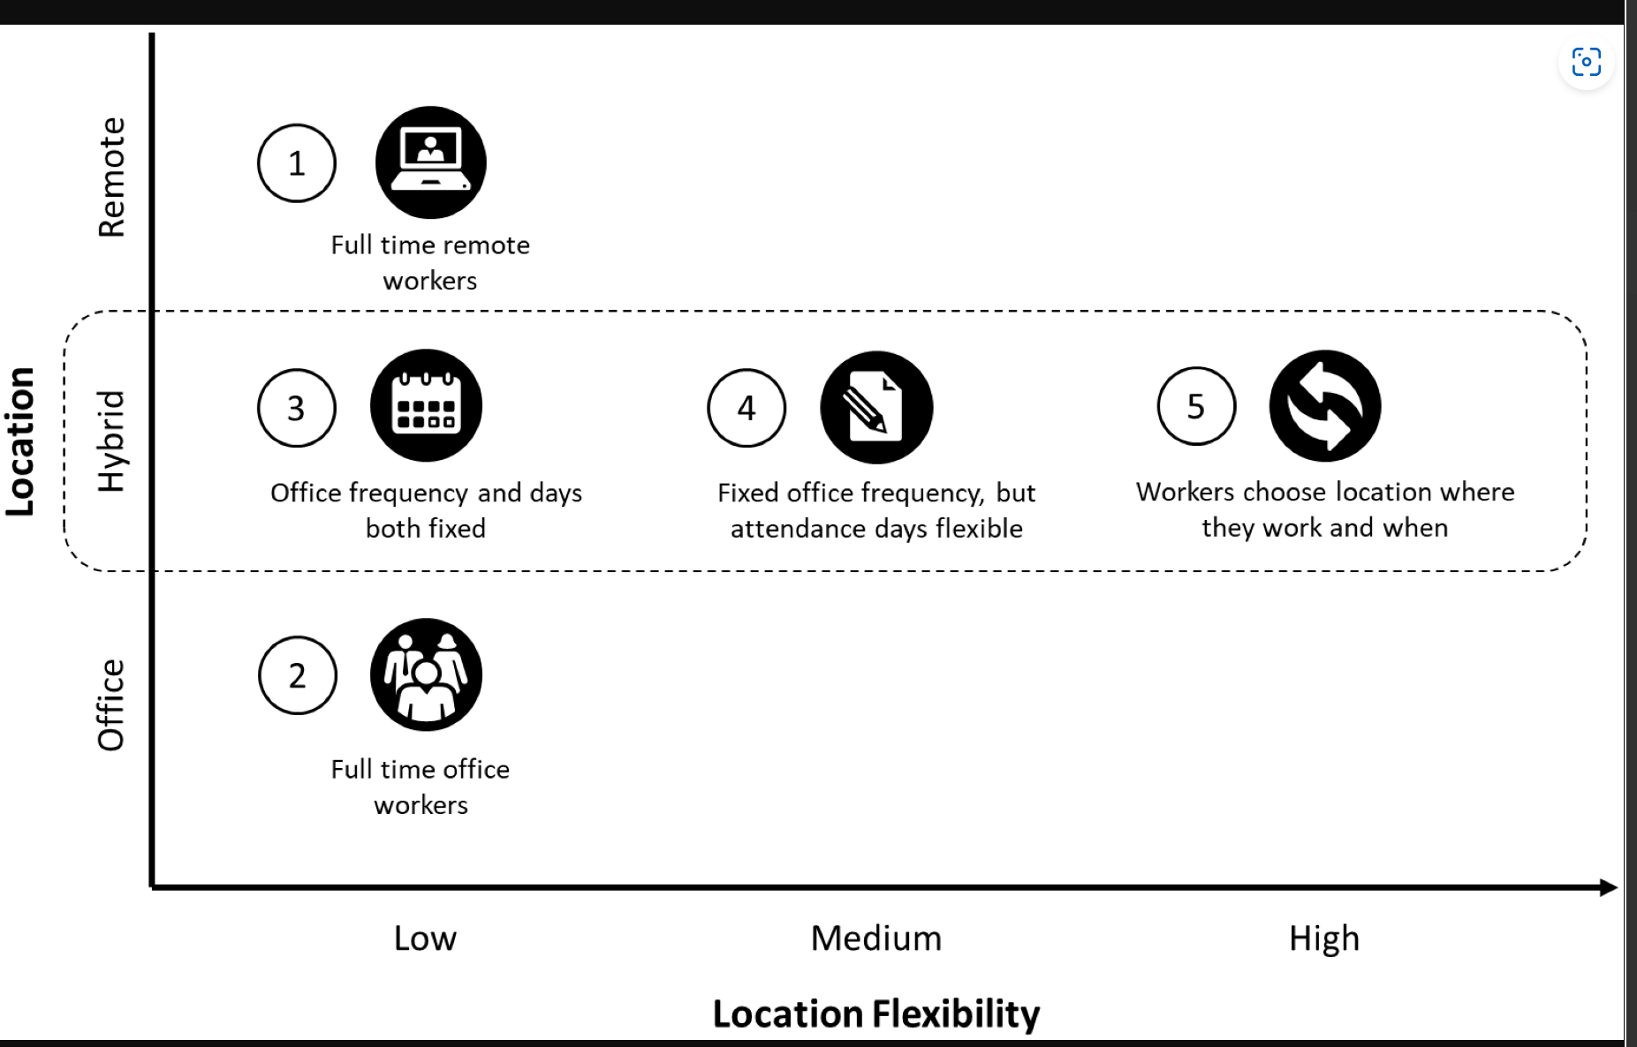
How do we manage hybrid work?
Source : Hopkins, J.; Bardoel, A. (2023)
Notes:
Hybrid work is a relatively new term, gaining popularity during the pandemic to define a working arrangement where an employee divides their time between working at a traditional workplace and working remotely (typically at home, or from ‘third places’ such as a coworking space, library, or local café, etc.), which attempts to combine the best parts of both telework and office-based work [1,11]. It describes an employee’s ability to have some level of autonomy and flexibility over the location where they perform their work tasks, and builds upon Halford’s research into hybrid workplaces, which investigated the use of ICT to “maintain workloads and relationships across both domestic and organisational spaces. (where) individuals work at home and engage in embodied organisational spaces” almost 20 years ago [20].
2.1.4. Working from Home Bloom et al. [29] define working from home as “also called telecommuting or telework”, but the authors disagree with this for the reason that working from home is, by definition, limited to just the home. Telework is not limited to the home, telework can be conducted from pretty much anywhere, so working from home is a form of telework but not the exact same thing

Slide 22
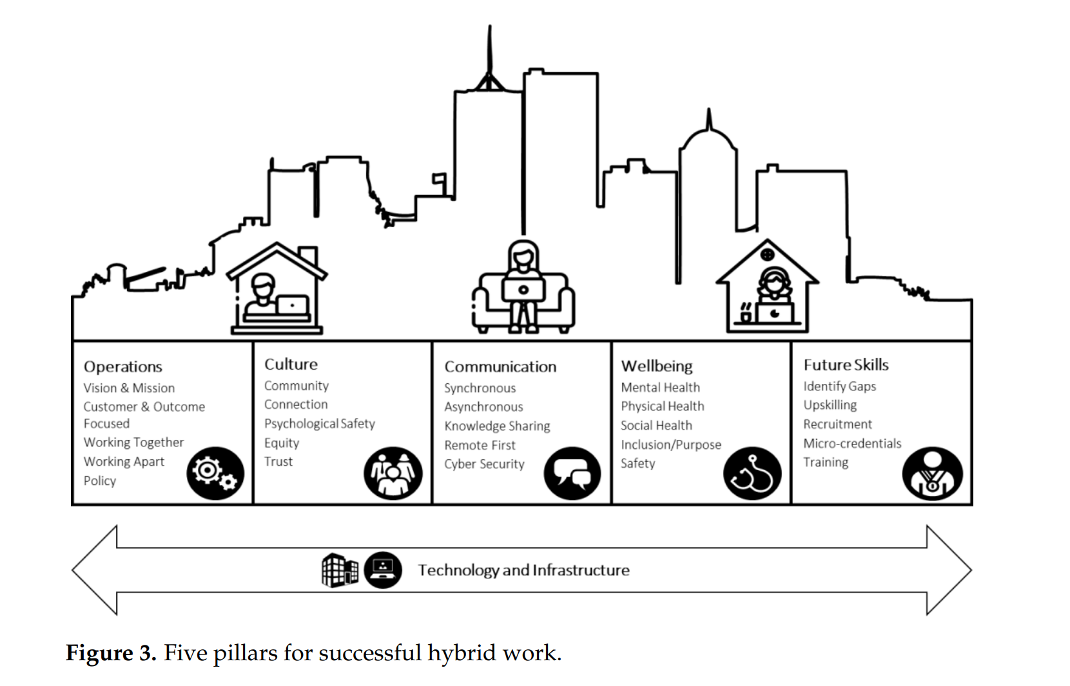
Five Pillars of Successful Hybrid Work
Source : Hopkins, J.; Bardoel, A. (2023)
Notes:
1. Operations
It was clear from the interviews that, whatever work arrangements were going to be adopted, they needed to align with and support the existing focus, vision, and mission of the organisation. The key focus of any organisation is to deliver value to customers, so that had to be maintained or improved upon.
A number of the participants talked about the office as being a ‘place of purpose’, and that it would be difficult to attract workers into an office to simply conduct tasks they have been comfortably performing at home for nearly two years.
2.Culture
Another theme arising from the semi-structured interviews was the importance of establishing and maintaining an aligned workplace culture in a hybrid setting.
3.Communication
The ways in which organisations communicate in a hybrid work arrangement, having some employees at the office and others working remotely at any one time, requires different tools and processes. The importance of videoconferencing software was frequently emphasised, in addition to online collaboration tools, such as Miro and Mural, and asynchronous communication platforms such as Slack.
4.Wellbeing
One of the most prominent themes to emerge from our interviews, was the increased focus on the health and wellbeing of staff, in alignment with SDG3 targets.
5.Future Skills
The talent and skills requirements for operating as a hybrid workforce are predicted to be different than those of a traditional face-to-face office environment. In particular, the roles and responsibilities of line managers/supervisors have changed, and these new ways of working require different leadership skills. Managers now need to deal with more emotional issues than before, requiring different communication styles, and new coordination issues with distributed teams.

Slide 23
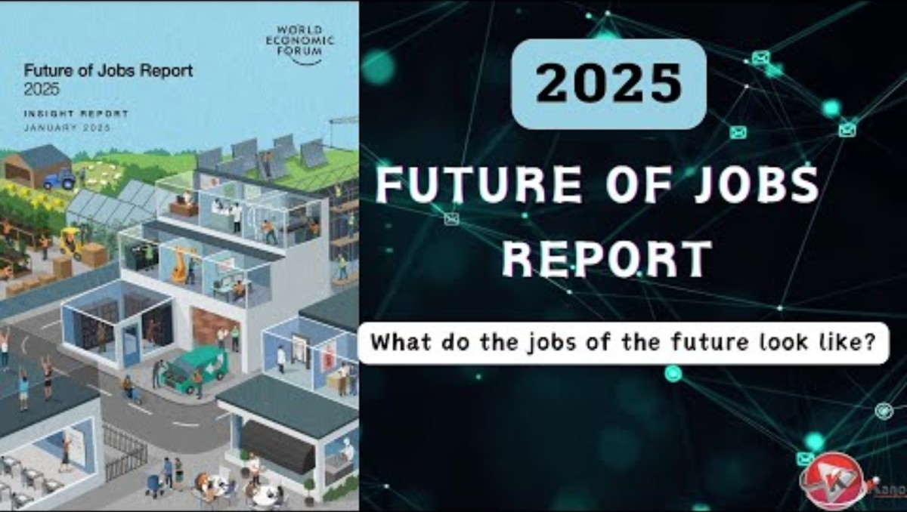
Top 10 skills of 2025
The Future of Jobs Report 2025 | World Economic Forum

Slide 24
Future mode of work
A Global Workforce View
MainStreet Macro: People at Work-A Global Workforce View - ADP Research Institute (adpri.org)
Future Hybrid working
Employees Increasingly Seek Value and Purpose at Work (gartner.com)

Slide 25
Summary
Companies competing globally require top-quality people.
Many factors affect HRM in global environment such as culture, human capital and political, legal and economic systems.
Need to effectively manage HR, especially regarding expatriates.
Copyright © 2016 McGraw-Hill Education. All rights reserved. No reproduction or distribution without
the prior written consent of McGraw-Hill Education.
Notes:
Today organizations are more involved in international commerce than ever before, and the trend will continue. The development of the EEC, NAFTA, the economic growth of Asia, and GATT have accelerated the movement toward a global market. Companies competing in the global marketplace require top-quality people to compete successfully. This requires that managers be aware of the many factors that significantly affect HRM in a global environment, such as culture, human capital, and the political/l, legal, and economic systems, that they understand how these factors come into play in the various levels of global participation and that they be adept at developing HRM systems that maximize the effectiveness of all human resources, particularly with regard to expatriate managers.

Slide 26
Employees and Attitude
Question: How well do you understand yourself or/and your employees?

Slide 27
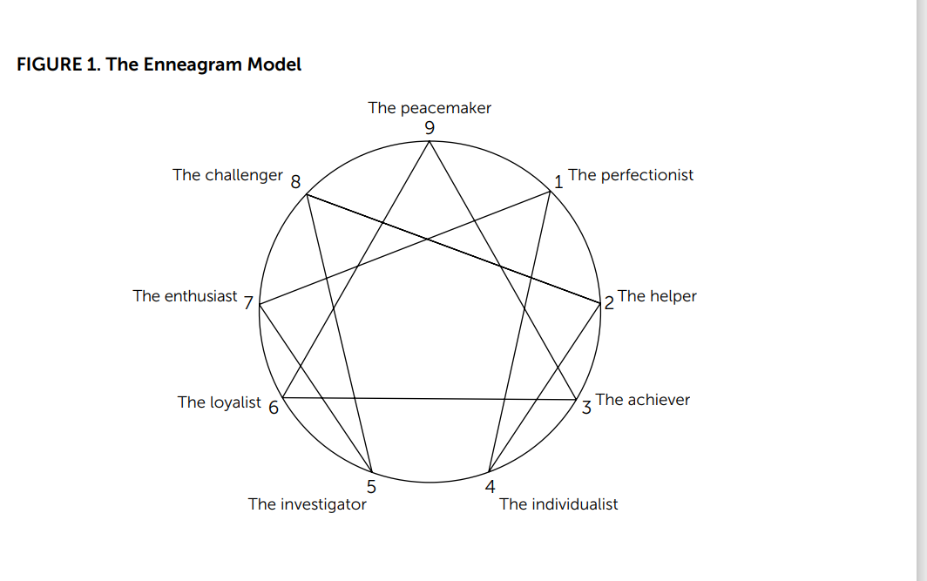
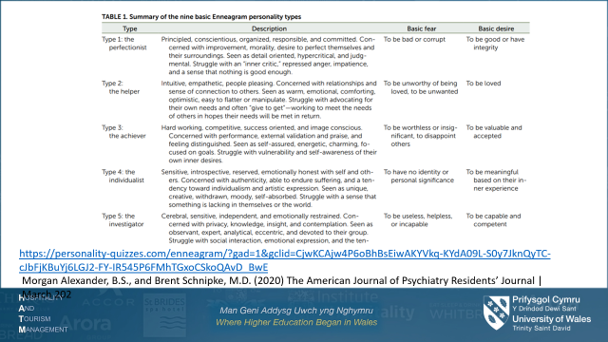
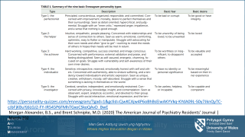
Enneagram – A personality Test
Categorised nine distinct strategies by which the human psych

Slide 28
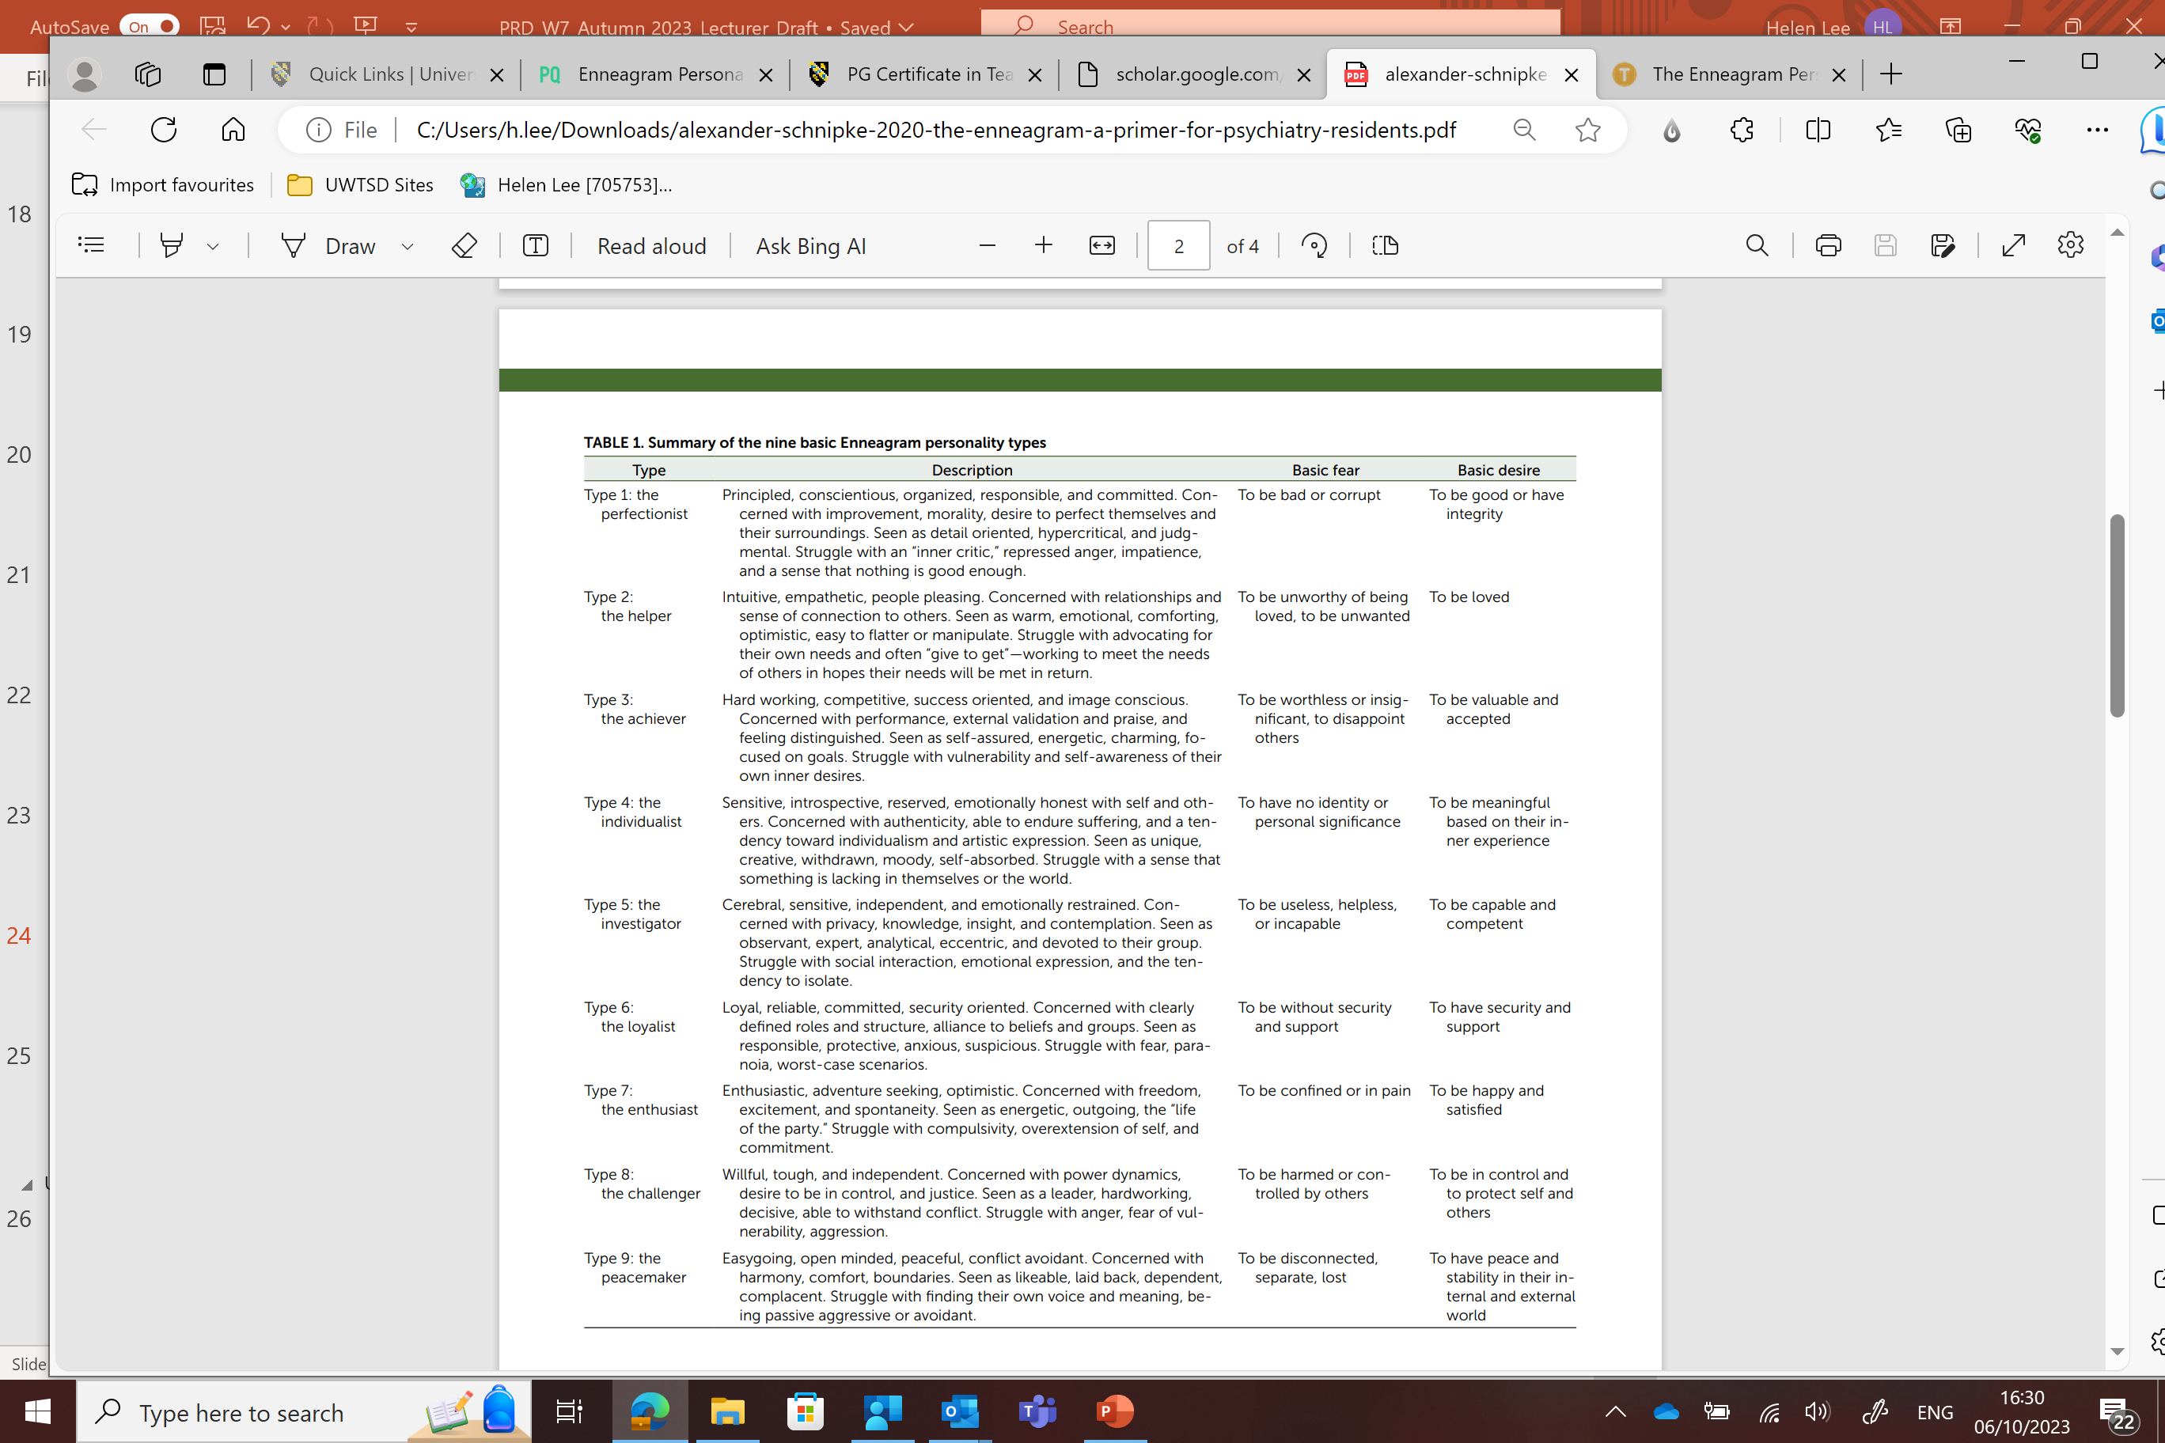
https://personality-quizzes.com/enneagram/?gad=1&gclid=CjwKCAjw4P6oBhBsEiwAKYVkq-KYdA09L-S0y7JknQyTC-cJbFjKBuYj6LGJ2-FY-IR545P6FMhTGxoCSkoQAvD_BwE
Morgan Alexander, B.S., and Brent Schnipke, M.D. (2020) The American Journal of Psychiatry Residents’ Journal | March 202

Slide 29
Ennegramm Test
https://personality-quizzes.com/enneagram/?gad=1&gclid=CjwKCAjw4P6oBhBsEiwAKYVkq-KYdA09L-S0y7JknQyTC-cJbFjKBuYj6LGJ2-FY-IR545P6FMhTGxoCSkoQAvD_BwE
Source : Morgan Alexander, B.S., and Brent Schnipke, M.D. (2020) The American Journal of Psychiatry Residents’ Journal | March 202

Slide 30
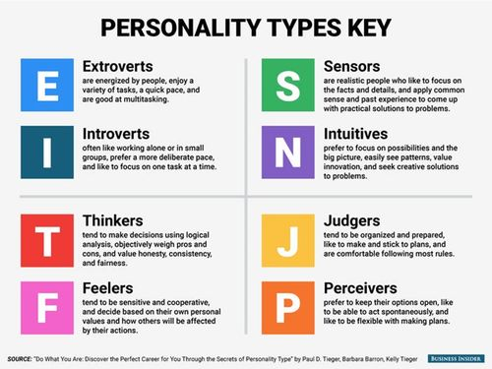
The Myers Briggs Type Indicator (MBTI) Test
The big five versus the big four: the relationship between the MyersBriggs Type Indicator (MBTI)
and NEO-PI five factor model of personality
https://practicalpie.com/myers-briggs-type-indicator/
Notes:
Myers–Briggs Type Indicator (MBTI)
(Myers et al., 1998).
The MBTI has been developed to measure the assignment of individuals into one of 16 personality types (derived from the combination of four dichotomous attitudes or functioning styles: Extraversion–Introversion, Judgment–Perception, Thinking–Feeling, and Sensing–Intuition) inspired from Jung’s (1921/1971) theory.
Personality tests can be appealing because the questions encourage individuals to evaluate themselves, helping them to assess their own qualities and validate their self-concept.
“Tests like the MBTI help us to organize our self-perceptions and experiences into coherent wholes,” says Stephen Benning, director of the Psychophysiology of Emotion and Personality Laboratory at the University of Nevada, Las Vegas. “The MBTI promises rich narratives to describe a respondent's personality, whereas other descriptions may feel more fragmented.”
Even though personality profiles are generic, people often feel that the descriptions accurately portray the image they have of themselves. This fallacy of personal validation is called the Barnum effect, which describes a person’s tendency to believe that vague personality descriptions are specifically tailored to them. The psychological phenomenon may also explain the appeal of astrology and fortune-telling.
Aside from self-assessment, personality tests also allow individuals to identify with a particular label that encompasses who they are as a person, making them feel understood and fostering a sense of belongingness within that group.
“We are fundamentally driven to understand ourselves and others, and often seek that understanding in the form of labels that can stand in for complicated ideas,” says Jaime Lane Derringer, PhD, a psychologist at the University of Illinois, Urbana-Champaign. “The idea of being able to know a person from a single word or acronym is appealing because, if accurate, it would save us a lot of time. But we’re more complicated than that, and there are certainly more than 16 types of people in the world.”

Slide 31
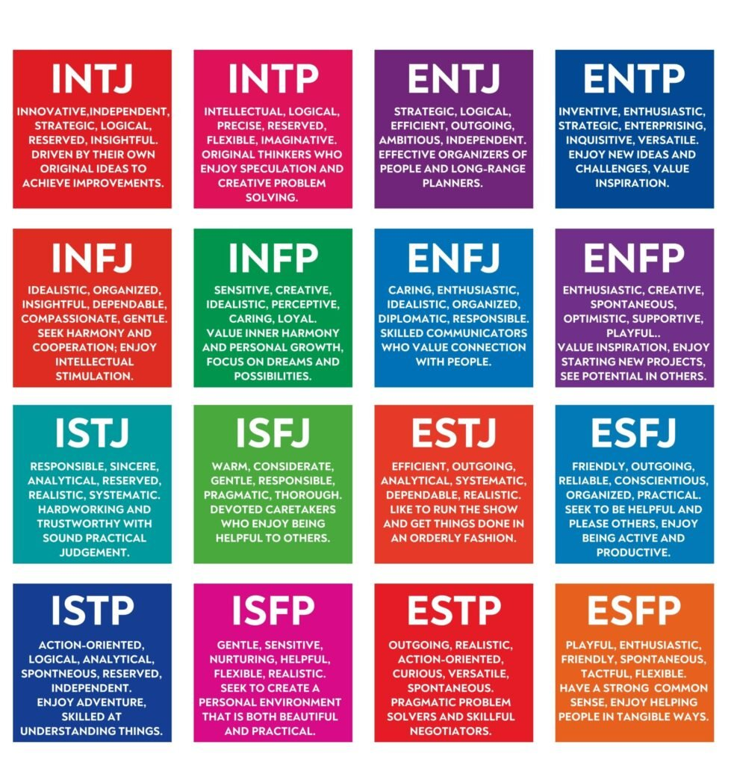
The Myers Briggs Type Indicator (MBTI) Test
Source: https://www.verywellmind.com/esfj-extraverted-sensing-feeling-judging-2795983
Notes:
The Myers Briggs Types (16 types)
Each type is then listed by its four-letter code:
ISTJ - The Inspector: Reserved and practical, they tend to be loyal, orderly, and traditional.
ISTP - The Crafter: Highly independent, they enjoy new experiences that provide first-hand learning.
ISFJ - The Protector: Warm-hearted and dedicated, they are always ready to protect the people they care about.
ISFP - The Artist: Easy-going and flexible, they tend to be reserved and artistic.
INFJ - The Advocate: Creative and analytical, they are considered one of the rarest Myers-Briggs types.3Center for Applications of Psychological Type. Estimated frequencies of the types in the United States population.
INFP - The Mediator: Idealistic with high values, they strive to make the world a better place.
INTJ - The Architect: High logical, they are both very creative and analytical.⁴
INTP - The Thinker: Quiet and introverted, they are known for having a rich inner world.
ESTP - The Persuader: Out-going and dramatic, they enjoy spending time with others and focusing on the here-and-now.
ESTJ - The Director: Assertive and rule-oriented, they have high principles and a tendency to take charge.
ESFP - The Performer: Outgoing and spontaneous, they enjoy taking center stage.
ESFJ - The Caregiver: Soft-hearted and outgoing, they tend to believe the best about other people.
ENFP - The Champion: Charismatic and energetic, they enjoy situations where they can put their creativity to work.
ENFJ - The Giver: Loyal and sensitive, they are known for being understanding and generous.
ENTP - The Debater: Highly inventive, they love being surrounded by ideas and tend to start many projects (but may struggle to finish them).
ENTJ - The Commander: Outspoken and confident, they are great at making plans and organizing projects.

Slide 32
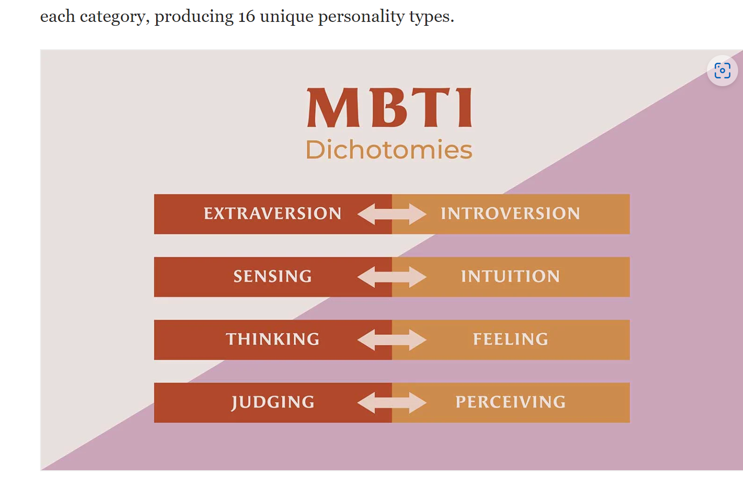
The Myers Briggs
Type Indicator (MBTI)
Test

Slide 33
Question: How well you understand yourself?

Slide 34
Question: How well you understand your employees?

Slide 35
Why personality testing is useful in the workplace?
Understand employees or/and potential employees’ skills and interests.
Identify promising career paths.
Good match between the candidate and the given work role.
Identify ideal work environments and relationships.
Be aware of potential challenges in a given work role or environment.
Notes:
Understand your own skills and interests: Having insight into your personality type will shine a light on strengths you can highlight on your resume while also surfacing skills you could potentially improve.
Identify promising career paths: When considering potential training or college majors or possible career shifts, a personality test can be helpful in guiding your vocational development.
Present yourself positively to employers: Personality assessments may come up during the interview process. It could be beneficial to know your personality type beforehand so you're prepared to discuss it with your interviewer.
Identify ideal work environments and relationships: In a broader context, you're probably already aware if you're more introverted or extroverted, but having a more thorough view into how your personality classifies can help you understand what environments or relationships are most likely to help you thrive.
Be aware of potential challenges in a given work role or environment: Understanding what circumstances are likely to be more difficult can help you to prepare for them or avoid them entirely. You'll also be able to focus on self-improvement if you're aware of traits and situations more likely to pose obstacles for you.
Source : 8 Personality Tests Used in Psychology (And by Employers) | Indeed.com

Slide 36
References
Adrian, F. (1996). The big five versus the big four: the relationship between the Myers-Briggs Type Indicator (MBTI) and NEO-PI five factor model of personality, Personality and Individual Differences, Volume 21, Issue 2, 1996, Pages 303-307, ISSN 0191-8869 https://doi.org/10.1016/0191-8869(96)00033-5.
Indeed Career Guide 8 Personality Tests Used in Psychology (And by Employers) | Indeed.com
Hopkins, J.; Bardoel, A. (2023) The Future Is Hybrid: How Organisations Are Designing and Supporting Sustainable Hybrid Work Models in Post-Pandemic Australia. Sustainability 2023, 15, 3086. https:// doi.org/10.3390/su1504308

