Slide 1
Consumerism in Western Culture
By Niamh Provan

Slide 2
consumerism
“the theory that an increasing consumption of goods is economically desirable; also : a preoccupation with and an inclination toward the buying of consumer goods”
Notes:
https://www.merriam-webster.com/dictionary/consumerism – link to definiton

Slide 3
consumer
“one that utilizes economic goods ”
Notes:
https://www.merriam-webster.com/dictionary/consumer– link to definiton

Slide 4
so what is it?

Slide 5


Slide 6
Amazon

Slide 7


Slide 8
Google

Slide 9


Slide 10
Nike

Slide 11


Slide 12
Disney

Slide 13


Slide 14
Instagram

Slide 15


Slide 16
Facebook

Slide 17


Slide 18
Twitter

Slide 19


Slide 20
Apple

Slide 21





Slide 22
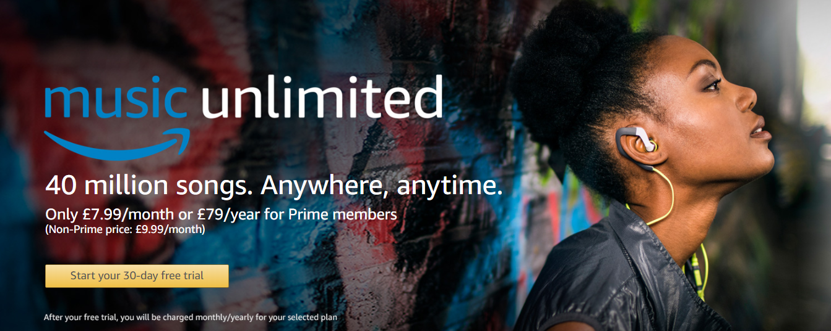
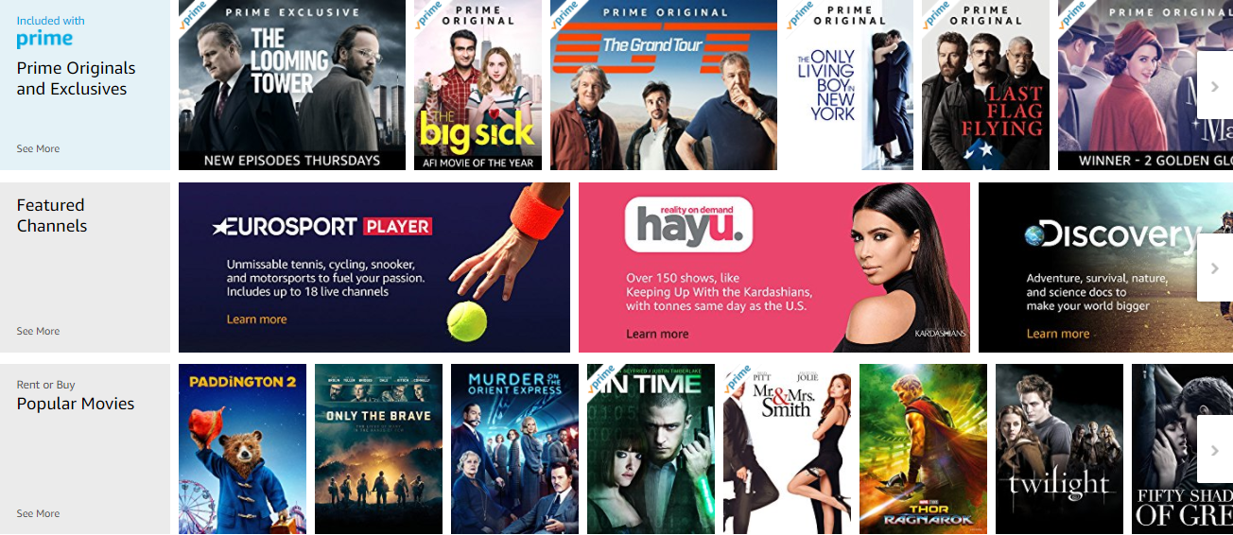

Slide 23
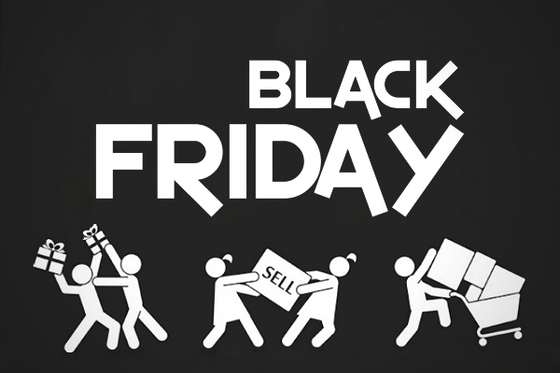
Notes:
http://www.dailymail.co.uk/femail/article-2345121/Bargain-hunters-beware-How-sale-prices-discounts-stores-mark-original-cost-20-sticker-slapped-on.html

Slide 24
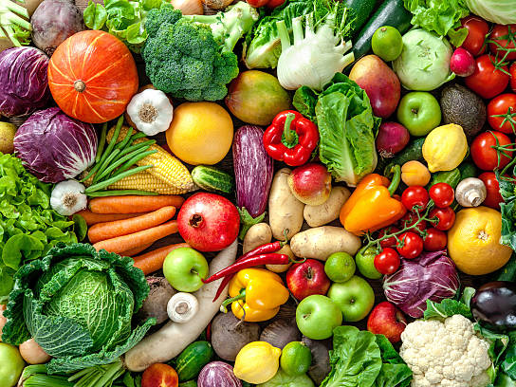

Slide 25
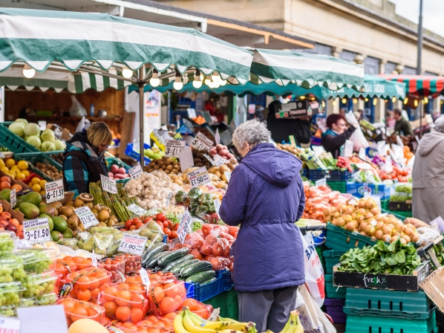

Slide 26
Our enormously productive economy demands that we make consumption our way of life, that we convert the buying and use of goods into rituals, that we seek our spiritual satisfactions, our ego satisfactions, in consumption. (Lebow, 1955, p3)
Notes:
http://www.gcafh.org/edlab/Lebow.pdf – page 3

Slide 27
Humans are the only species that pay to live on earth. (Dunning, 2014)
Notes:
https://thoughtcatalog.com/david-dunning/2014/04/humans-pay-to-live-and-its-not-natural/

Slide 28
socialism
“a : a system of society or group living in which there is no private property
b : a system or condition of society in which the means of production are owned and controlled by the state”
Notes:
https://www.merriam-webster.com/dictionary/socialism

Slide 29


Slide 30
Culture is one of the two or three most complicated words in the English language. (Williams, 1976, p76)
Notes:
https://tavaana.org/sites/default/files/raymond-williams-keywords.pdf

Slide 31
Bibliography:
Amazon Logo, [image] Available at: https://www.google.co.uk/search?biw=1366&bih=637&tbm=isch&sa=1&ei=dYueWq3vBeqOgAbQtrDYBA&q=amazon+logo&oq=amazon+logo&gs_l=psy-ab.3..0l10.107142.109575.0.109827.11.11.0.0.0.0.225.1826.0j9j2.11.0....0...1c.1.64.psy-ab..0.11.1824...0i67k1.0.XYB2cSa56Us - imgrc (Accessed 06 March 2018)
Google Logo, [image] Available at: https://www.google.co.uk/search?biw=1366&bih=637&tbm=isch&sa=1&ei=boyeWpCuIoPXgAbu1JRY&q=google+logo&oq=google+&gs_l=psy-ab.3.1.0i67k1l2j0l4j0i67k1l3j0.124657.125422.0.126629.7.6.0.1.1.0.228.862.0j3j2.5.0....0...1c.1.64.psy-ab..2.5.706....0.HYEZaQIoyPY - img (Accessed 06 March 2018)
Nike Logo, [image] Available at: https://www.google.co.uk/search?q=nike+tick&source=lnms&tbm=isch&sa=X&ved=0ahUKEwjJ9o6r3NfZAhXnJ8AKHfeaD_oQ_AUICigB&biw=1366&bih=637 - imgrc=JMNefqVxqrR0eM: (Accessed 06 March 2018)
Disney Logo, [image] Available at: https://www.google.co.uk/search?q=disney+logo&source=lnms&tbm=isch&sa=X&ved=0ahUKEwj-x7T83NfZAhVKa8AKHa1nDBIQ_AUICigB&biw=1366&bih=637 - imgrc=qwsHZ7IgXUBCDM: (Accessed 06 March 2018)

Slide 32
Bibliography:
Instagram Logo, [image] Available at: https://www.google.co.uk/search?q=instagram+logo&source=lnms&tbm=isch&sa=X&ved=0ahUKEwiHk7nE3dfZAhVEWsAKHa7rAc0Q_AUICigB&biw=1366&bih=637 - imgrc=H_KFm_GPiUbjoM: (Accessed 06 March 2018)
Facebook Logo, [image] Available at: https://www.google.co.uk/search?q=facebook+logo&source=lnms&tbm=isch&sa=X&ved=0ahUKEwi1meLh3dfZAhXFe8AKHUYQCVUQ_AUICigB&biw=1366&bih=637 - imgrc=90WE6L54oQBt1M: (Accessed 06 March 2018)
Twitter Logo, [image] Available at: https://www.google.co.uk/search?q=twitter+logo&source=lnms&tbm=isch&sa=X&ved=0ahUKEwjmlJ743dfZAhWnLMAKHfAmBi4Q_AUICigB&biw=1366&bih=637 - imgrc=Ga0XAWLzNnBbLM: (Accessed 06 March 2018)
Apple Logo, [image] Available at: https://www.google.co.uk/search?q=apple+logo&source=lnms&tbm=isch&sa=X&ved=0ahUKEwixwfuN3tfZAhXLL8AKHQijCSMQ_AUICigB&biw=1366&bih=637 - imgrc=nSA_obBbLMs_EM: (Accessed 06 March 2018)
Black Friday, [image] Available at: https://www.google.co.uk/search?q=black+friday&source=lnms&tbm=isch&sa=X&ved=0ahUKEwi1sMuHzdjZAhUUSsAKHWZ9B3sQ_AUICygC&biw=1366&bih=637 - imgrc=vojdp_AU4S1zFM: (Accessed 06 March 2018)

Slide 33
Bibliography:
Confused Man Cartoon, [image] Available at: https://www.google.co.uk/search?biw=1366&bih=637&tbm=isch&sa=1&ei=pQ6fWufCNMKbgAaulo_YAg&q=confused+cartoon&oq=confused+cartoon&gs_l=psy-ab.3..0l10.2083.5612.0.5798.16.9.3.4.5.0.97.718.9.9.0....0...1c.1.64.psy-ab..0.16.887...0i13k1j0i67k1j0i10k1.0.IXSNJ59UiaQ#imgrc=mxMDkU6lx-IQxM: (Accessed 06 March 2018)
Vegetables, [image] Available at: https://www.google.co.uk/search?q=vegetables&source=lnms&tbm=isch&sa=X&ved=0ahUKEwi7sZuE49jZAhUBIsAKHWmsA2IQ_AUICigB&biw=1366&bih=637#imgrc=cWh_HXoJT3w6AM: (Accessed 06 March 2018)
Market Stalls, [image] Available at: https://www.google.co.uk/search?biw=1366&bih=637&tbm=isch&sa=1&ei=SBqfWsP0DoLWgQb9i57QBA&q=market&oq=market&gs_l=psy-ab.3..0i67k1l2j0j0i67k1l2j0j0i67k1l3j0.11730.12497.0.12749.6.6.0.0.0.0.126.492.5j1.6.0....0...1c.1.64.psy-ab..0.6.491....0.F6CNJ25J5qE#imgrc=dJCYJbj2K69-7M: (Accessed 06 March 2018)

Slide 34
Bibliography:
Williams, R. (1976) Keywords. Oxford University Press, New York.
Lebow, V. (1955) ‘Price Competition’, Journal of Retailing, pp 3. Available at: www.gcafh.org/edlab/Lebow.pdf (Accessed 06 March 2018)
Symester, C. (2018) ‘Tesco launch new vegan ready meal range from Wicked Kitchen - and shoppers are loving it’, The Mirror, 11th January. Available at: https://www.mirror.co.uk/money/shopping-deals/tesco-launch-new-vegan-ready-11829128 (Accessed 06 March 2018)
Dunning, D. (2014) ‘Humans Pay To Live And It’s Not Natural’, Thought Catalog [blog]. 28 April. Available at: https://thoughtcatalog.com/david-dunning/2014/04/humans-pay-to-live-and-its-not-natural/ (Accessed 06 March 2018)
(2013) ‘Bargain hunters beware! How sale prices are not discounts at all as stores mark-up original cost before that '20% off' sticker is slapped on’ Daily Mail, 20th June. Available at: http://www.dailymail.co.uk/femail/article-2345121/Bargain-hunters-beware-How-sale-prices-discounts-stores-mark-original-cost-20-sticker-slapped-on.html

Slide 35
Script for PowerPoint
Slide 1 – Through the course of this presentation I am going to be talking about Consumerism and how in western society we have integrated ourselves into it. I hope to explain the positives and negatives of this as well as question how a large group of people can be part of a culture without knowing about it.
Slide 2 - Merriam Webster’s definition of Consumerism goes; “The theory that an increasing consumption of goods is economically desirable; also : a preoccupation with and an inclination toward the buying of consumer goods”
I understand this as, having a large group of people buying products such as phones or clothes is positive to help the economy keep moving forward and is also giving the consumer something positive to, which would be the item that they purchased.
A large part of Consumerism is access to free choice, you are able to wear what you can afford, earn different amounts depending on your job and buy things that you want to buy.
Slide 3 – As for the consumer itself, Merriam Webster defines the consumer as “One that utilizes economic goods”
Very simply, the consumer is the person who buys the products that are available to them.

Slide 36
Slide 4 – So what is it really? What does it mean?
In life you are constantly fluctuating between being the consumer and the provider.
When you are using your phone, you are consuming first of all the product. When you send a text message, you are then consuming the telephone company’s service. Once you go to search something on Google, you are consuming both the internet provider’s service as well as the search engine. So by doing very simple things, you are actively consuming from multiple companies.
On the flip side you become the provider. In your job you are paid to complete a certain service that is later consumed by someone down the line. Whether that be a teacher providing information to their students, a nurse who is providing care for their patients or a chef providing food for customers.
The cycle in ongoing.
When you look at the structure of being a consumer, it seems like a necessity. You’re always going to need food and clothing, phones and technology are part of day to day life in the way society now runs. So these companies are doing positive things, providing easy access to all the products we want and need.
Since they do play such an important part in our lives, I wanted to play a small game to see how many of you can guess the company by their logo.
SLIDES 5-20 LOGO GAME

Slide 37
Slide 21 – So by playing that game and seeing each of those companies we’ve found that we know them. Or we at least know of each of these companies, whether or not we have purchased or used them before. The logos have been given meaning and are now symbols for each of these brands so that they are easily recognisable.
It’s quite incredible that we remember them so much, that they have made an imprint on our minds. This is down to advertisement. Adverts are everywhere, they’re on the television, in magazines and now that technology has ingrained itself in the world, they are everywhere online. The big brands that we all know are very smart when it comes to advertising. If we take Facebook for example, they own multiple companies and one of those companies in Instagram. Now since not many people read the terms and conditions when signing up for websites, some people may not be aware that all of these websites and social media platforms share information with each other.
When you search something through Google, that information can be bought and seen by multiple companies. It’s how advertising has gotten so much bigger, these websites can learn what things you do like and more importantly what it is that you want to buy and then show you it through multiple different platforms.

Slide 38
Slide 22 – Amazon is another example of this. The company has become bigger and bigger over the years and had the brilliant idea to create Amazon Prime. This service gives you access to cheaper prices as well as free next day delivery. It makes assumptions based on products you have bought previously and suggests items that you may like. It has even expanded further, with a Prime membership you have access to unlimited music streaming as well as being able to watch television shows and movies, all included with a yearly subscription.
So what does that mean, does Amazon become the new Netflix but better because they also sell everything you could possibly need in your home. On top of that did you know you can buy food from Amazon now, so not only are they expanding, they are making it possible to watch films, listen to music, do your food shopping and buy yourself something nice to wear on the weekend all in one website. This creates quite the competition for other companies.
These companies are great at getting you to buy things, but why do we buy them? Consumerism expands as we buy more products that we don’t necessarily need. We all do it, for example; you’ve gone to Tesco’s to get a few bits and bobs for tea and then your eye is caught by the many reduced shelves scattered around the place. Of course you don’t need Christmas lights in April but they’re reduced by 75% so you have to get them of course, it’s a steal.

Slide 39
Slide 23 – This is all an act, because reductions are especially popular. It is why Black Friday is such a big event in America and has made its way over here. We love thinking that we’re getting the upper hand because we just bought a pair of jeans that should be £150 and are reduced to £30 instead.
Black Friday creates huge profits for companies, especially since it isn’t set to one day or weekend anymore. Companies will start early and have a week or two of sales. Unfortunately it is once again a trap to make you spend money on things that you don’t need and actually can’t afford. The Daily Mail (2013) revealed that commonly before a sale, companies used raise their prices so that when the sale happens you are paying almost the same as you usually would. At least the law changed recently to prevent that happening, or does that mean we just won’t notice it now.

Slide 40
Slide 24 – Consumerism tends to take over and profit from certain trends, for example; being vegan. A vegan is someone who doesn’t eat any produce from animals and could be seen as previously being a counter culture to Consumerism. A counter culture being an opposed view or act to the norm. People would grow their own plants and produce their own food, creating a somewhat healthy and cost effective way of living. However ideal this seemed, being a vegan became quite popular which has led companies to support it too so that they can reap the benefits of a new dietary trend. Tesco has recently made a deal with Wicked kitchen to sell vegan ready meals in their stores, (Symester, 2018) which then creates profit for both companies as well as increasing the cost of being vegan whilst also making it easier to access. So even though being vegan started out as a counter culture, it has been changed and has integrated itself into the larger culture of consumerism.
Although it may not be obvious we as a society have fully integrated ourselves into this culture, without really realising that it was happening. As a large group of people we support these chains of stores and companies by continuing to buy their products, without really knowing what happens behind the curtain.

Slide 41
Slide 25 – But what does that mean for smaller businesses. For corner shops and places that can’t deliver within a day. Before larger companies became so prominent, we relied on smaller shops in our day to day lives. You would purchase your meal from the butchers, vegetables from the market and your bread would come freshly made from the bakery. Each of these items were grown or produced near you so you knew where they came from. Although you can argue life is easier now, has it changed our way of life and how we communicate when communities aren’t as close knit as they were before. Whether or not that is a good or bad thing is another discussion, but when we skip forward to modern day and places like Tesco’s have everything, smaller businesses struggle to stay afloat. I bring you back to Amazon, who can provide food, clothing, movies, music and almost every other item you can think of. There’s no way to compete with the places that have the money to stay open twenty-four hours a day. So even though Consumerism does mean a lot of things are more accessible, it creates problems for the smaller companies who cannot compete.
Slide 26 – This leads me into a quote from Lebow. (1955) Consumerist culture has become a part of our lives, it’s a nice feeling when you can spend money on yourself. Whether that be on some nice clothes or just something that we really don’t need, we feel good about it. But how has that developed. As Lebow says, consumption is our way of life and gives us satisfaction. How did that happen, did we rewire our brains or did the companies do it for us to change the things that make us happy.

Slide 42
Slide 27 – But why does happiness cost so much? We spend our entire lives working. We start by working to learn, which leads to paying to learn because need to learn to earn the money to pay back what we spent to learn to get the job we wanted so we have earn more and spend more on things we don’t need until we either run out of money or time. Why do we do that? In a Journal Dunning’s (2014) talks about the fact that we are the only species on earth who plays to live here. We created this structure because we won’t work for free or just for fun, you can’t survive on that. As humans we seem to seek some reward at the end.
But what if we didn’t. I’d like to refer to a book and film called ‘The Host’. Very simply, the story is of an alien invasion. Now these aliens implant themselves in humans, using them as host bodies and taking over. But they are not malicious, in this story the humans aren’t able to fight back but the aliens aren’t aggressive and don’t want to hurt any humans. They actually help and improve the planet by reducing greenhouse gases, practically ending global warming. But the point I’m trying to make with this is that they work because it’s their job, not for reward. In this new society, you are not paid and you do not pay for anything, because the aliens are happy to work to support the planet so everything runs smoothly without the cost. Think about it, a world without money.

Slide 43
Slide 28 – Now that is getting into different waters, and moving into a counter culture if you will. If we talk about Socialism for a moment. Very simply Socialism is about community, although there is a lot more around it, I understand it as a community working together rather than relying on outside exports. As I spoke about earlier businesses, in Socialism you would do the job you wanted to do to help the community so that you could all help each other. But of course as I said the downsides are that we don’t want to work for free, we don’t want to earn less than the person next to us because we want to be on the top of the ladder.
Although socialism works on the basis that it is for the people, lesser wanted jobs reap more benefits and this again creates a new sense of community.
Slide 29 – But what does any of this mean, is Socialism a counter culture of Consumerism? Would we need to completely change our personalities to be able to commit to such a change? Are we bad because we don’t change the things we don’t know? I’d say, yes, yes and no. But where does that leave us?
Slide 30 – In this presentation I have tried to explain what consumerism is, and what it is as a culture but a very short yet relevant quote from Raymond Williams who states “Culture is one of the two or three most complicated words in the English language.” Just puts across that this culture, being one we are actively involved with can be hard to explain considering a lot of people don’t know they’re a part of it to begin with.
I have spoken a lot about different isms, and how companies effect the way we live. I do hope that in the last fifteen minutes I’ve been able to give you something. Whether that be just more information, the thought of going to the market instead of Tesco’s or maybe next week we’ll take on Amazon. Thank you.

