Slide 1
The Respiratory System and Its Regulation
Geraint Forster
Based on Chapter 7 – Kenney, Wilmore & Costill (2015)

Slide 2
Respiratory System Introduction
Purpose: carry O₂ to and remove CO₂ from all body tissues
Carried out by four processes
  Pulmonary ventilation (external respiration)
  Pulmonary diffusion (external respiration)
  Transport of gases via blood
  Capillary diffusion (internal respiration)

Slide 3
Pulmonary Ventilation
Process of moving air into and out of lungs
  Transport zone
  Exchange zone
Nose/mouth → nasal conchae → pharynx → larynx → trachea → bronchial tree → alveoli
(continued)

Slide 4
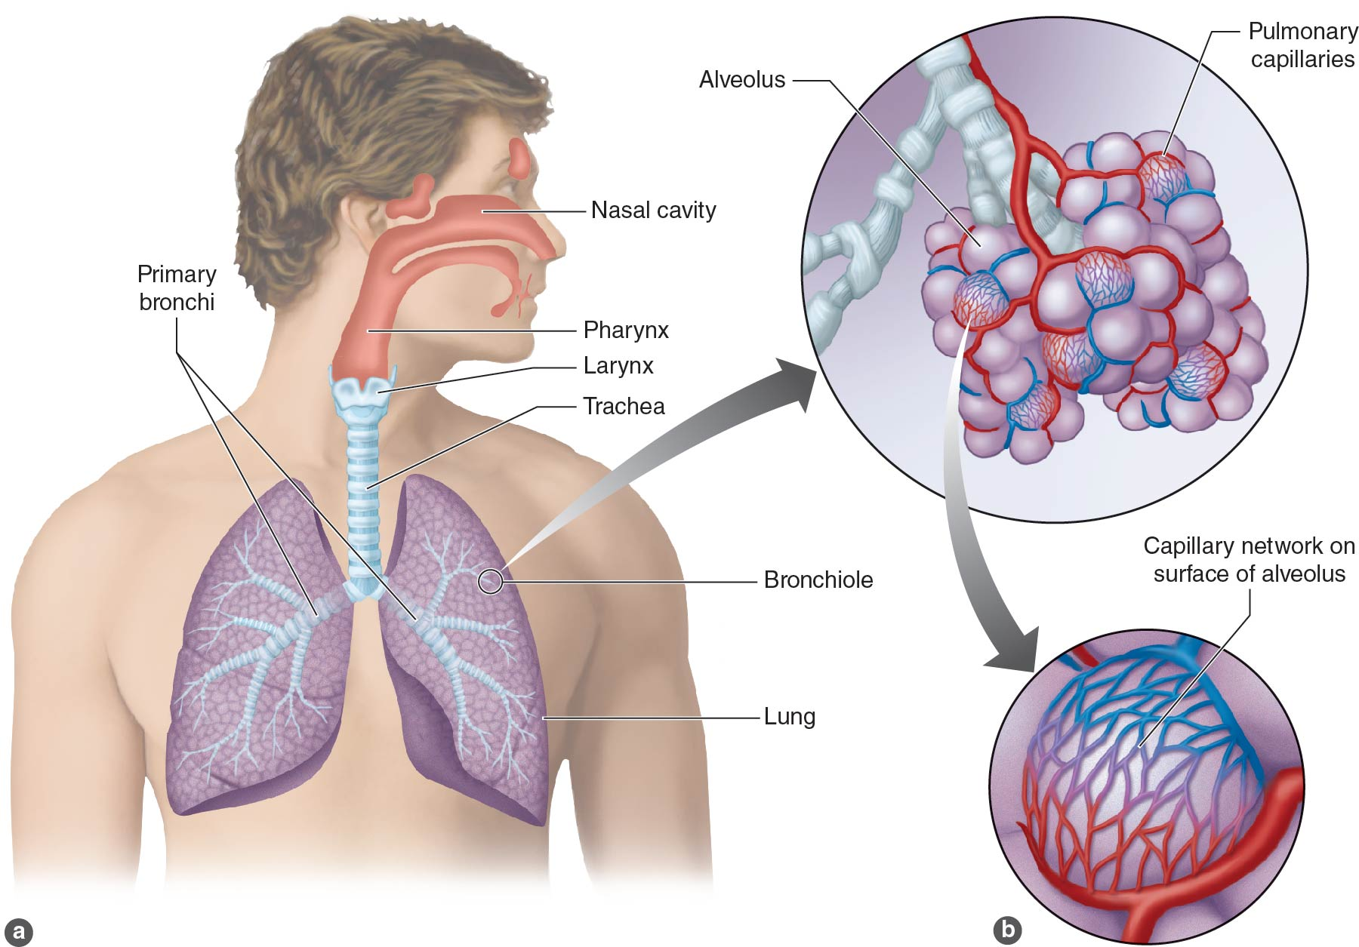
Figure 7.1

Slide 5
Pulmonary Ventilation:
Inspiration
Active process
Involved muscles
  Diaphragm flattens
  External intercostals move rib cage and sternum up and out
Expands thoracic cavity in three dimensions
Expands volume inside thoracic cavity
Expands volume inside lungs
(continued)

Slide 6
Pulmonary Ventilation:
Inspiration (continued)
Lung volume ↑, intrapulmonary pressure ↓
  Boyle’s law regarding pressure versus volume
  At constant temperature, pressure and volume inversely proportional
Air passively rushes in due to pressure difference
Forced breathing uses additional muscles
  Scalenes, sternocleidomastoid, pectorals
  Raise ribs even farther

Slide 7
Pulmonary Ventilation:
Expiration
Usually passive process
  Inspiratory muscles relax
  Lung volume ↓, intrapulmonary pressure ↑
  Air forced out of lungs
Active process (forced breathing)
  Internal intercostals pull ribs down
  Also, latissimus dorsi, quadratus lumborum
  Abdominal muscles force diaphragm back up
  (continued)

Slide 8
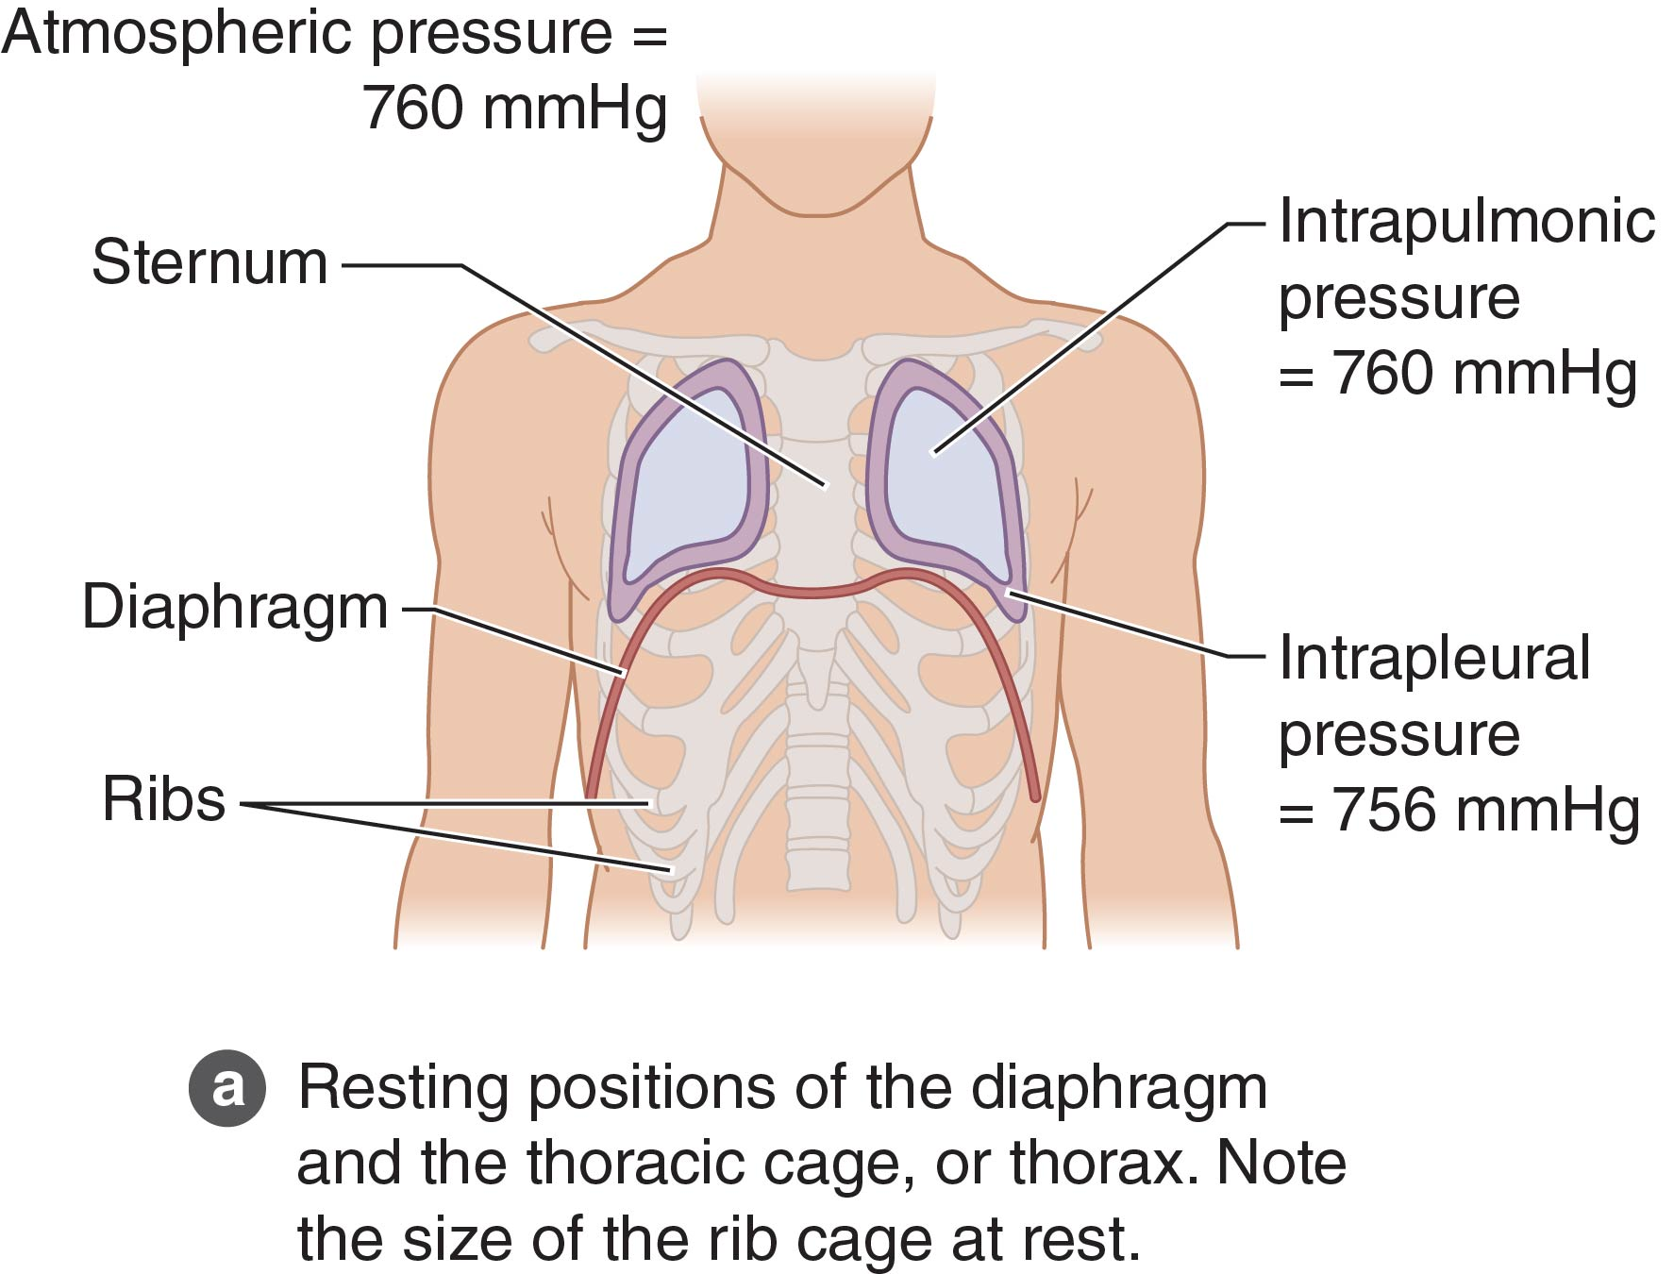
Figure 7.2a

Slide 9
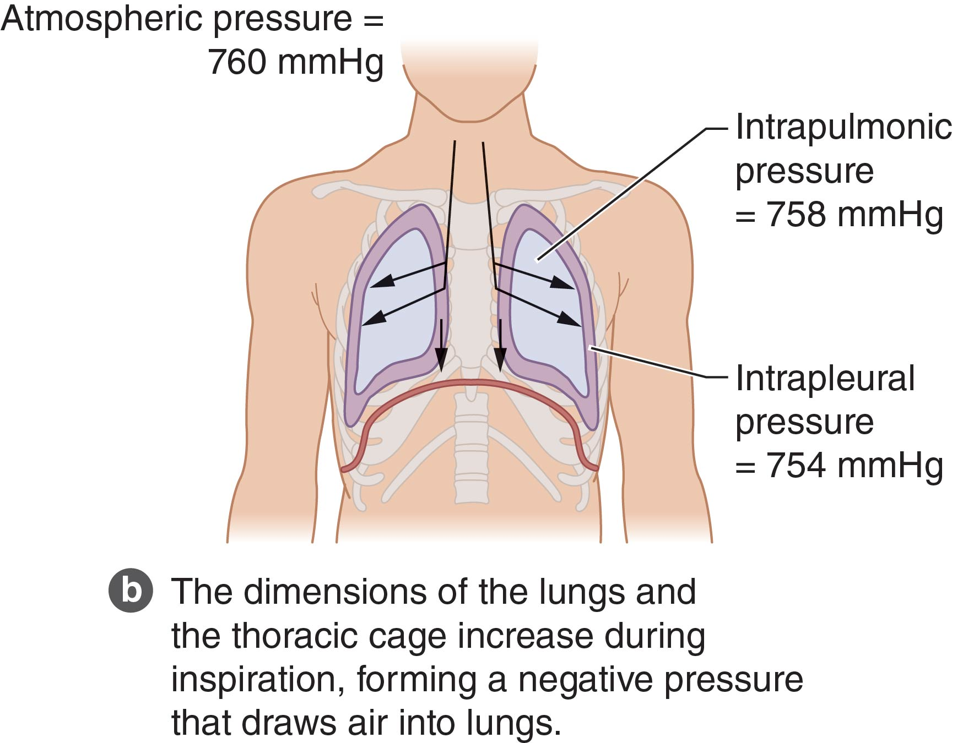
Figure 7.2b

Slide 10
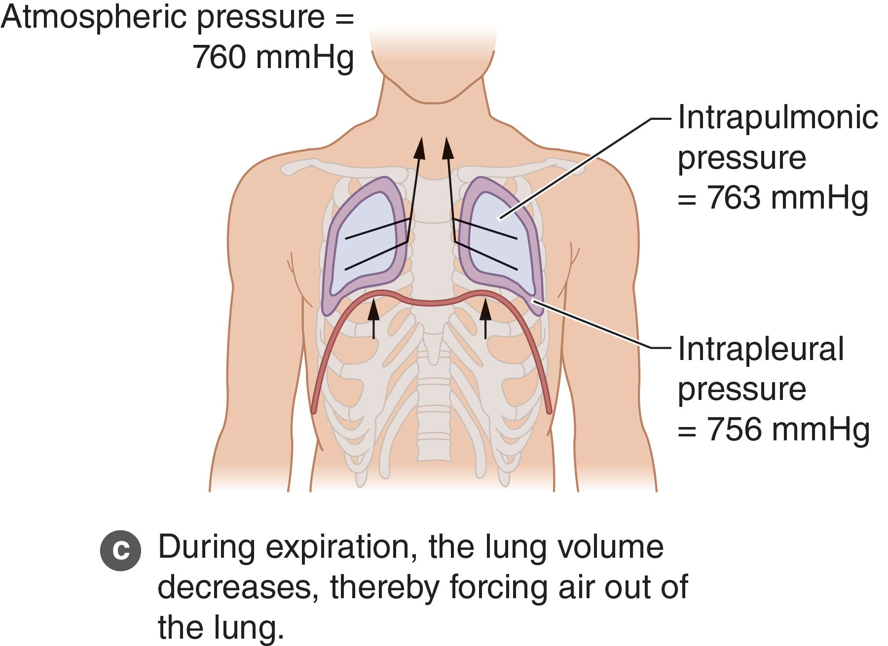
Figure 7.2c

Slide 11
Pulmonary Ventilation:
Expiration (continued)
Respiratory pump
  Changes in intra-abdominal, intrathoracic pressure promote venous return to heart
  Pressure ↑ → venous compression/squeezing
  Pressure ↓ → venous filling
Milking action from changing pressures assists right atrial filling (respiratory pump)

Slide 12
Pulmonary Volumes
Measured using spirometry
  Lung volumes, capacities, flow rates
  Tidal volume
  Vital capacity (VC)
  Residual volume (RV)
  Total lung capacity (TLC)
Diagnostic tool for respiratory disease

Slide 13
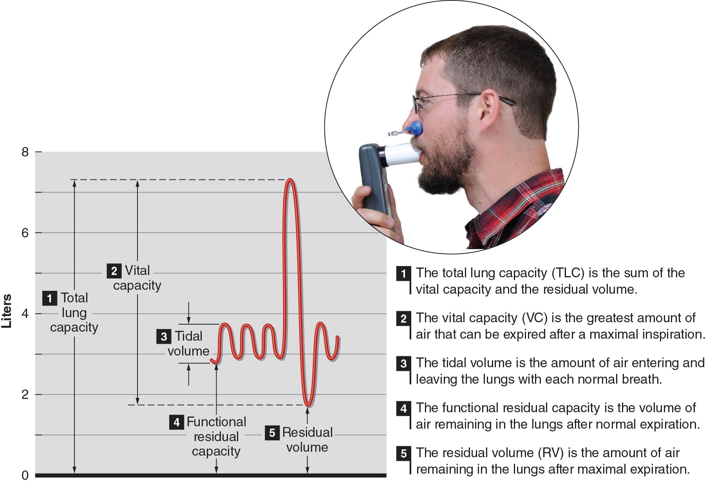
Figure 7.3

Slide 14
Pulmonary Diffusion:
Respiratory Membrane
Also called alveolar-capillary membrane
  Alveolar wall
  Capillary wall
  Respective basement membranes
Surface across which gases are exchanged
  Large surface area: 300 million alveoli
  Very thin: 0.5 to 4 μm
  Maximizes gas exchange

Slide 15
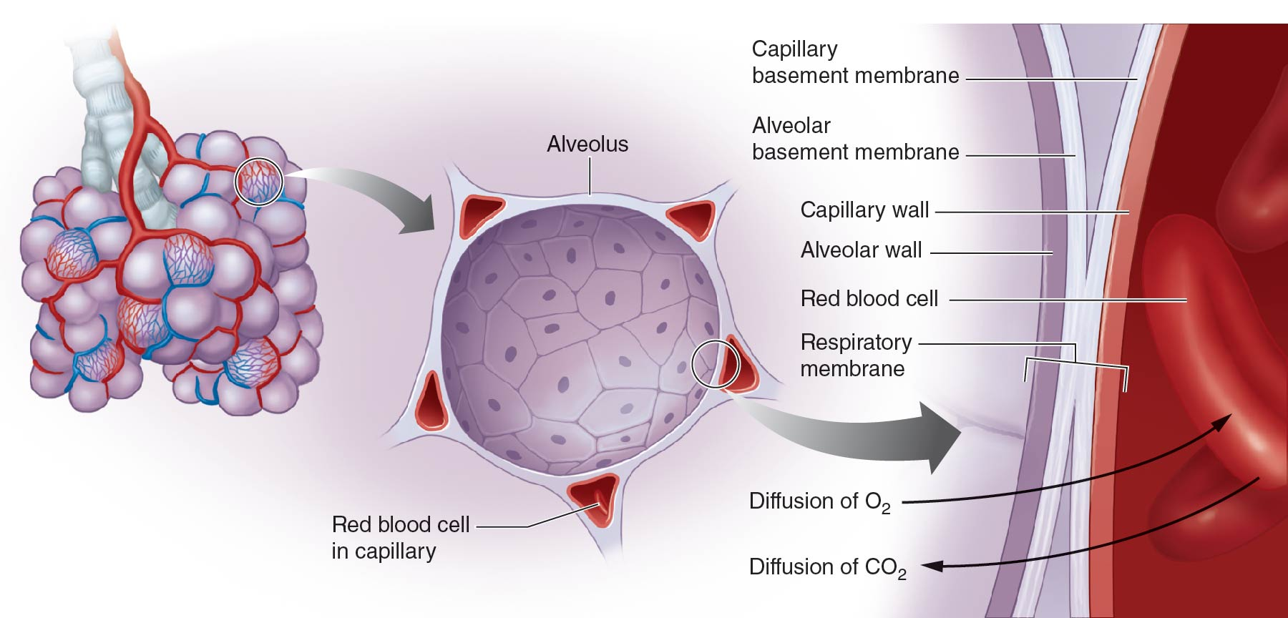
Figure 7.5

Slide 16
Pulmonary Diffusion:
Partial Pressures of Gases
Air = 79.04% N₂ + 20.93% O₂ + 0.03% CO₂
  Total air P: atmospheric pressure
  Individual P: partial pressures
Standard atmospheric P = 760 mmHg
  Dalton’s law: total air P = PN₂ + PO₂ + PCO₂
  PN₂ = 760 x 79.04% = 600.7 mmHg
  PO₂ = 760 x 20.93% = 159.1 mmHg
  PCO₂ = 760 x 0.04% = 0.2 mmHg
  (continued)

Slide 17
Pulmonary Diffusion:
Partial Pressures of Gases (continued)
Henry’s Law: gases dissolve in liquids in proportion to partial P
  Also depends on specific fluid medium, temperature
  Solubility in blood constant at given temperature
Partial P gradient most important factor for determining gas exchange
  Partial P gradient drives gas diffusion
  Without gradient, gases in equilibrium, no diffusion

Slide 18
Gas Exchange in the Alveoli:
Oxygen Exchange
Atmospheric PO₂ = 159 mmHg
Alveolar PO₂ = 105 mmHg
Pulmonary artery PO₂ = 40 mmHg
PO₂ gradient across respiratory membrane
  65 mmHg (105 mmHg – 40 mmHg)
  Results in pulmonary vein PO₂ ~100 mmHg
  (continued)

Slide 19
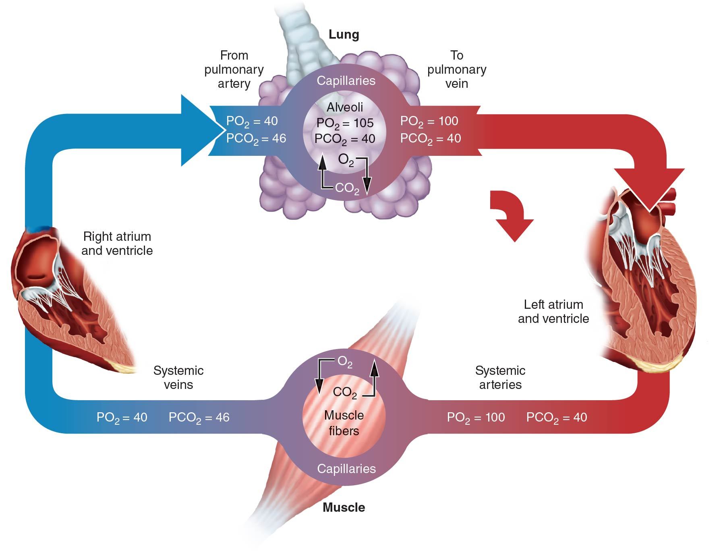
Figure 7.6

Slide 20
Animation 7.6
Notes:
When you are in the normal view of the PowerPoint slides, you should right-click on the image and then choose “Open hyperlink” to play the video. In the slide show view, you will simply click on the image to play the video. You must have an Internet connection in order to link to the streaming video.

Slide 21
Gas Exchange in the Alveoli:
Carbon Dioxide Exchange
Pulmonary artery PCO₂ ~46 mmHg
Alveolar PCO₂ ~40 mmHg
6 mmHg PCO₂ gradient permits diffusion
  CO₂ diffusion constant 20 times greater than O₂
  Allows diffusion despite lower gradient

Slide 22
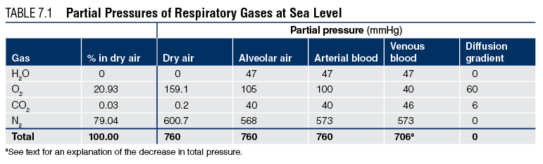
Table 7.1

Slide 23
Transport of Oxygen in the Blood
Can carry 20 mL O₂ / 100 mL blood
~1 L O₂ / 5 L blood
>98% bound to hemoglobin (Hb) in red blood cells
  O₂ + Hb: oxyhemoglobin
  Hb alone: deoxyhemoglobin
<2% dissolved in plasma

Slide 24
Transport of Oxygen in the Blood:
Hemoglobin Saturation
Depends on PO₂ and affinity between O₂, Hb
High PO₂ (i.e., in lungs)
  Loading portion of O₂-Hb dissociation curve
  Small change in Hb saturation per mmHg change in PO₂
Low PO₂ (i.e., in body tissues)
  Unloading portion of O₂-Hb dissociation curve
  Large change in Hb saturation per mmHg change in PO₂

Slide 25
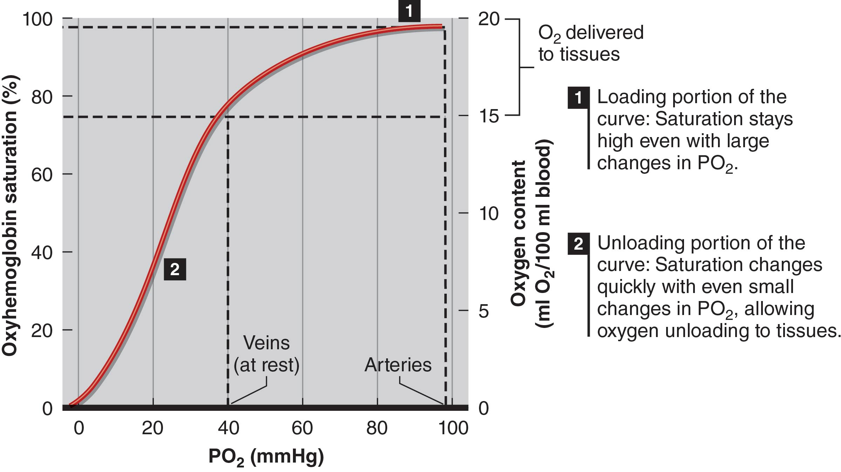
Animation 7.9

Slide 26
Factors Affecting
Hemoglobin Saturation
Blood pH
  More acidic → O₂-Hb curve shifts to right
  Bohr effect
  More O₂ unloaded at acidic exercising muscle
Blood temperature
  Warmer → O₂-Hb curve shifts to right
  Promotes tissue O₂ unloading during exercise

Slide 27
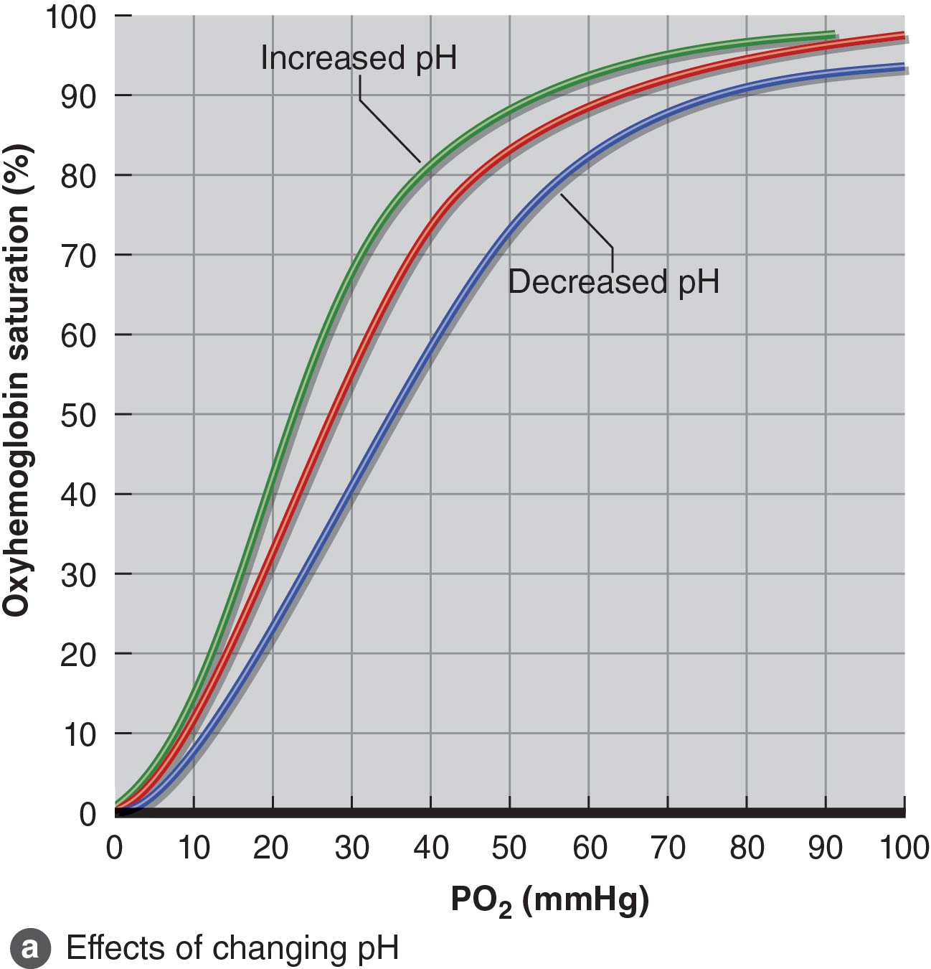
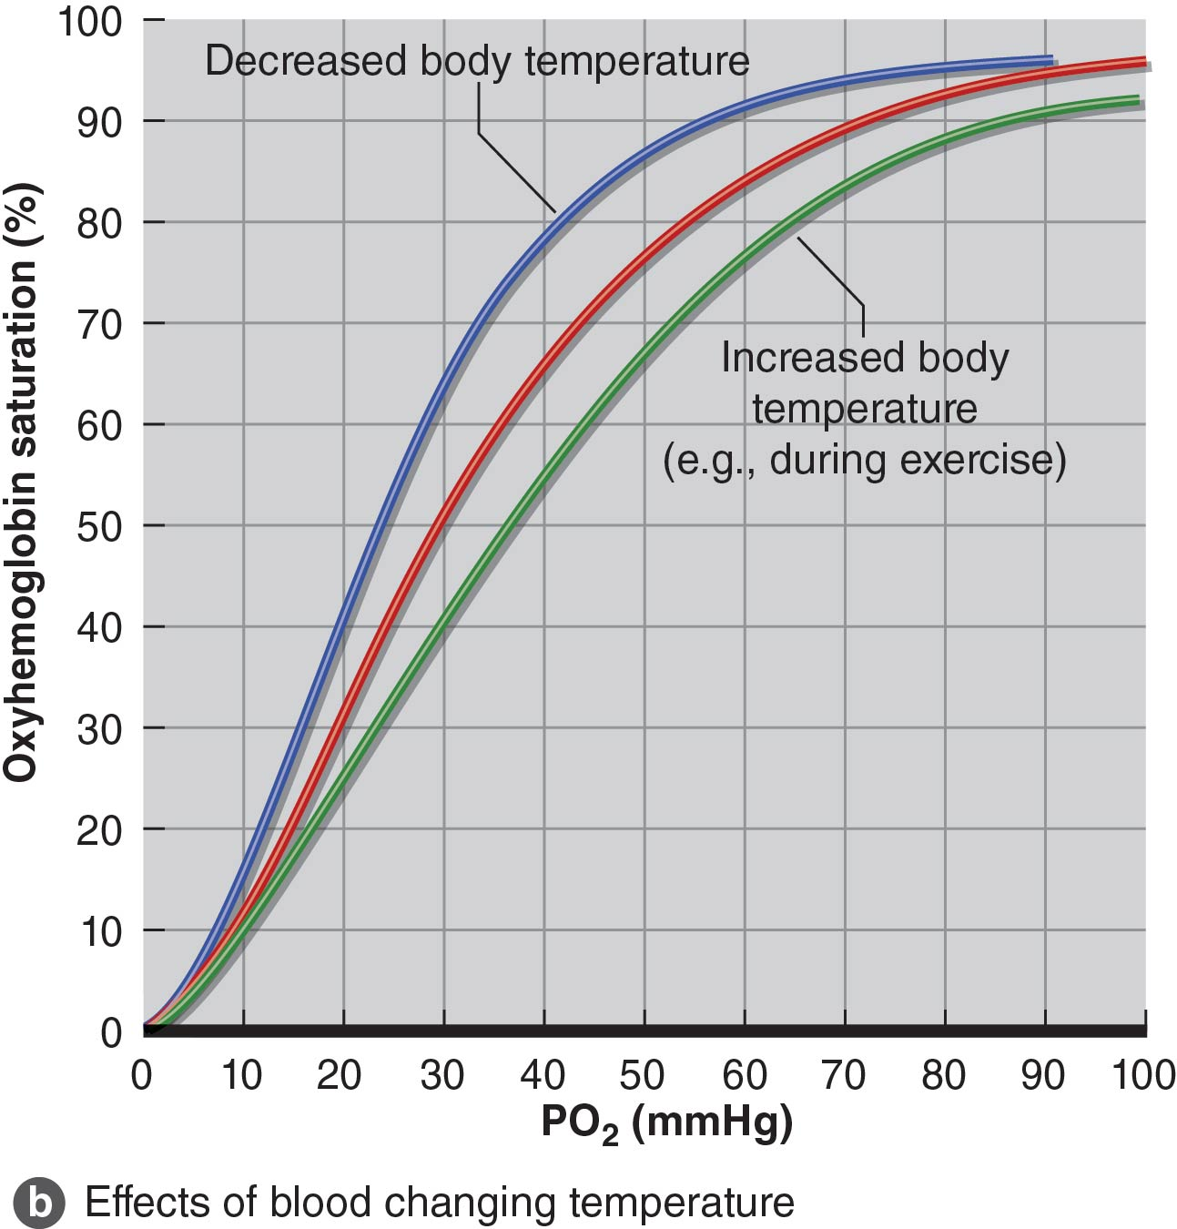

Slide 28
Carbon Dioxide Transport
Released as waste from cells
Carried in blood three ways
  As bicarbonate ions
  Dissolved in plasma
  Bound to Hb (carbaminohemoglobin)

Slide 29
Carbon Dioxide Transport:
Bicarbonate Ion
Transports 60 to 70% of CO₂ in blood to lungs
CO₂ + water form carbonic acid (H₂CO₃)
  Occurs in red blood cells
  Catalyzed by carbonic anhydrase
Carbonic acid dissociates into bicarbonate
  CO₂ + H₂O → H₂CO₃ → HCO₃⁻ + H⁺
  H⁺ binds to Hb (buffer), triggers Bohr effect
  Bicarbonate ion diffuses from red blood cells into plasma

Slide 30
Carbon Dioxide Transport:
Dissolved Carbon Dioxide
7 to 10% of CO₂ dissolved in plasma
When PCO₂ low (in lungs), CO₂ comes out of solution, diffuses out into alveoli

Slide 31
Carbon Dioxide Transport:
Carbaminohemoglobin
20 to 33% of CO₂ transported bound to Hb
Does not compete with O₂-Hb binding
  O₂ binds to heme portion of Hb
  CO₂ binds to protein (-globin) portion of Hb
Hb state, PCO₂ affect CO₂-Hb binding
  Deoxyhemoglobin binds CO₂ easier versus oxyhemoglobin
  – ↑ PCO₂ → easier CO₂-Hb binding
  – ↓ PCO₂ → easier CO₂-Hb dissociation

Slide 32
Gas Exchange at the Muscles:
Arterial–Venous Oxygen Difference
Difference between arterial and venous O₂
  (a-v⁻ )O₂ difference
  Reflects tissue O₂ extraction
  As extraction ↑, venous O₂ ↓, (a-v⁻ )O₂ difference ↑
Arterial O₂ content: 20 mL O₂ / 100 mL blood
Mixed venous O₂ content varies
  Rest: 15 to 16 mL O₂ / 100 mL blood
  Heavy exercise: 4 to 5 mL O₂ / 100 mL blood

Slide 33
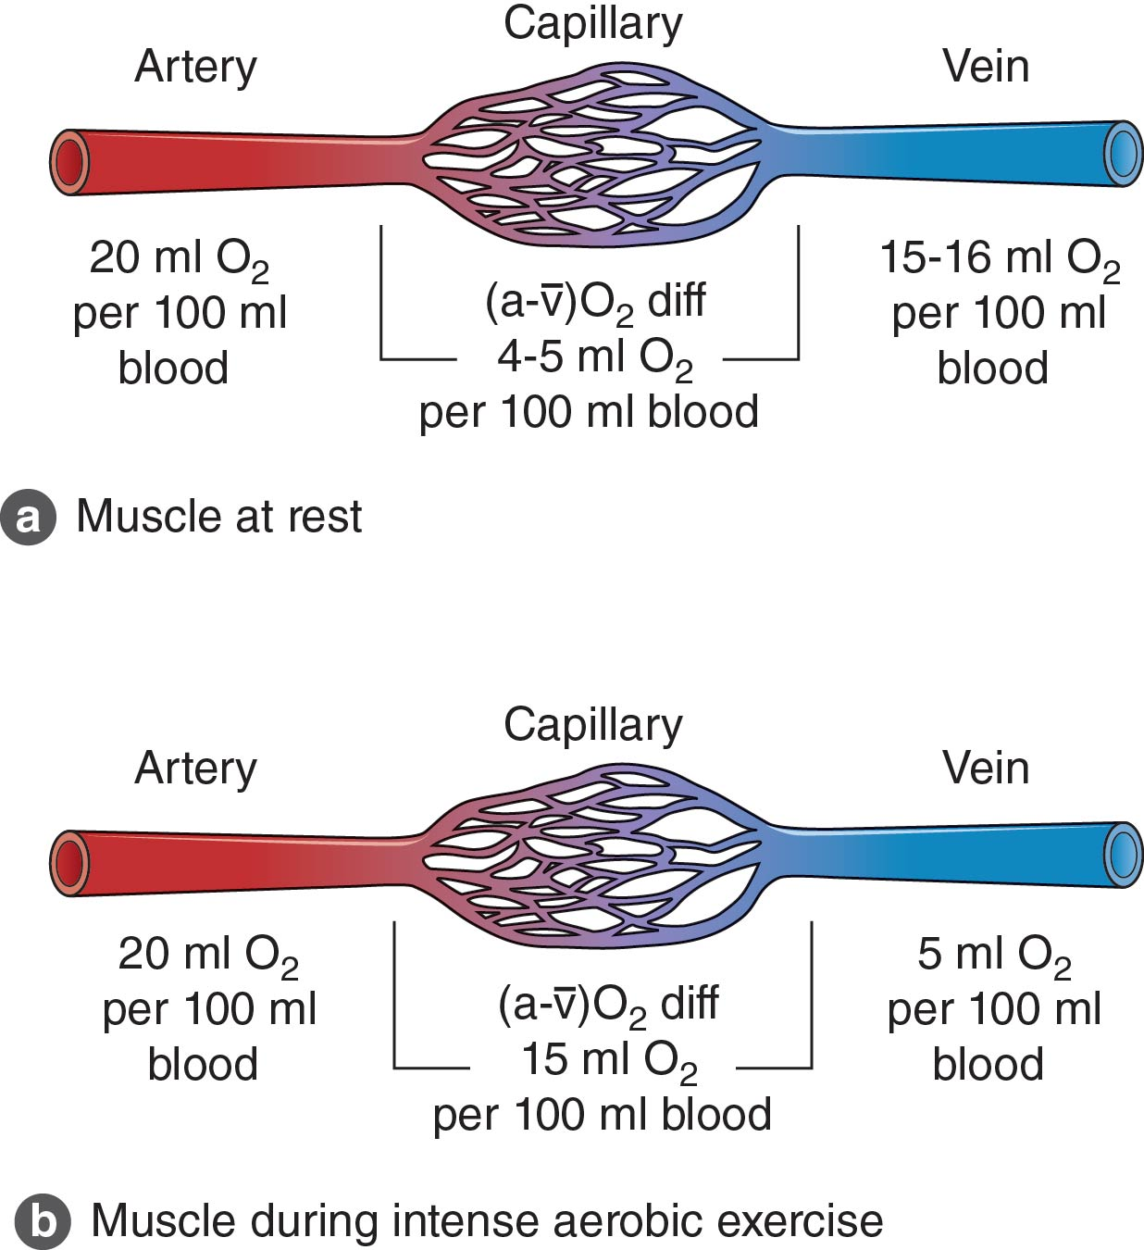
Figure 7.11

Slide 34
Gas Exchange at the Muscles:
Oxygen Transport in the Muscle
O₂ transported in muscle by myoglobin
  Similar structure to hemoglobin
  Higher affinity for O₂
O₂-myoglobin dissociation curve shaped differently
  At PO₂ 0 to 20 mmHg, slope very steep
  Loading portion at PO₂ = 20 mmHg
  Releasing portion at PO₂ = 1 to 2 mmHg

Slide 35
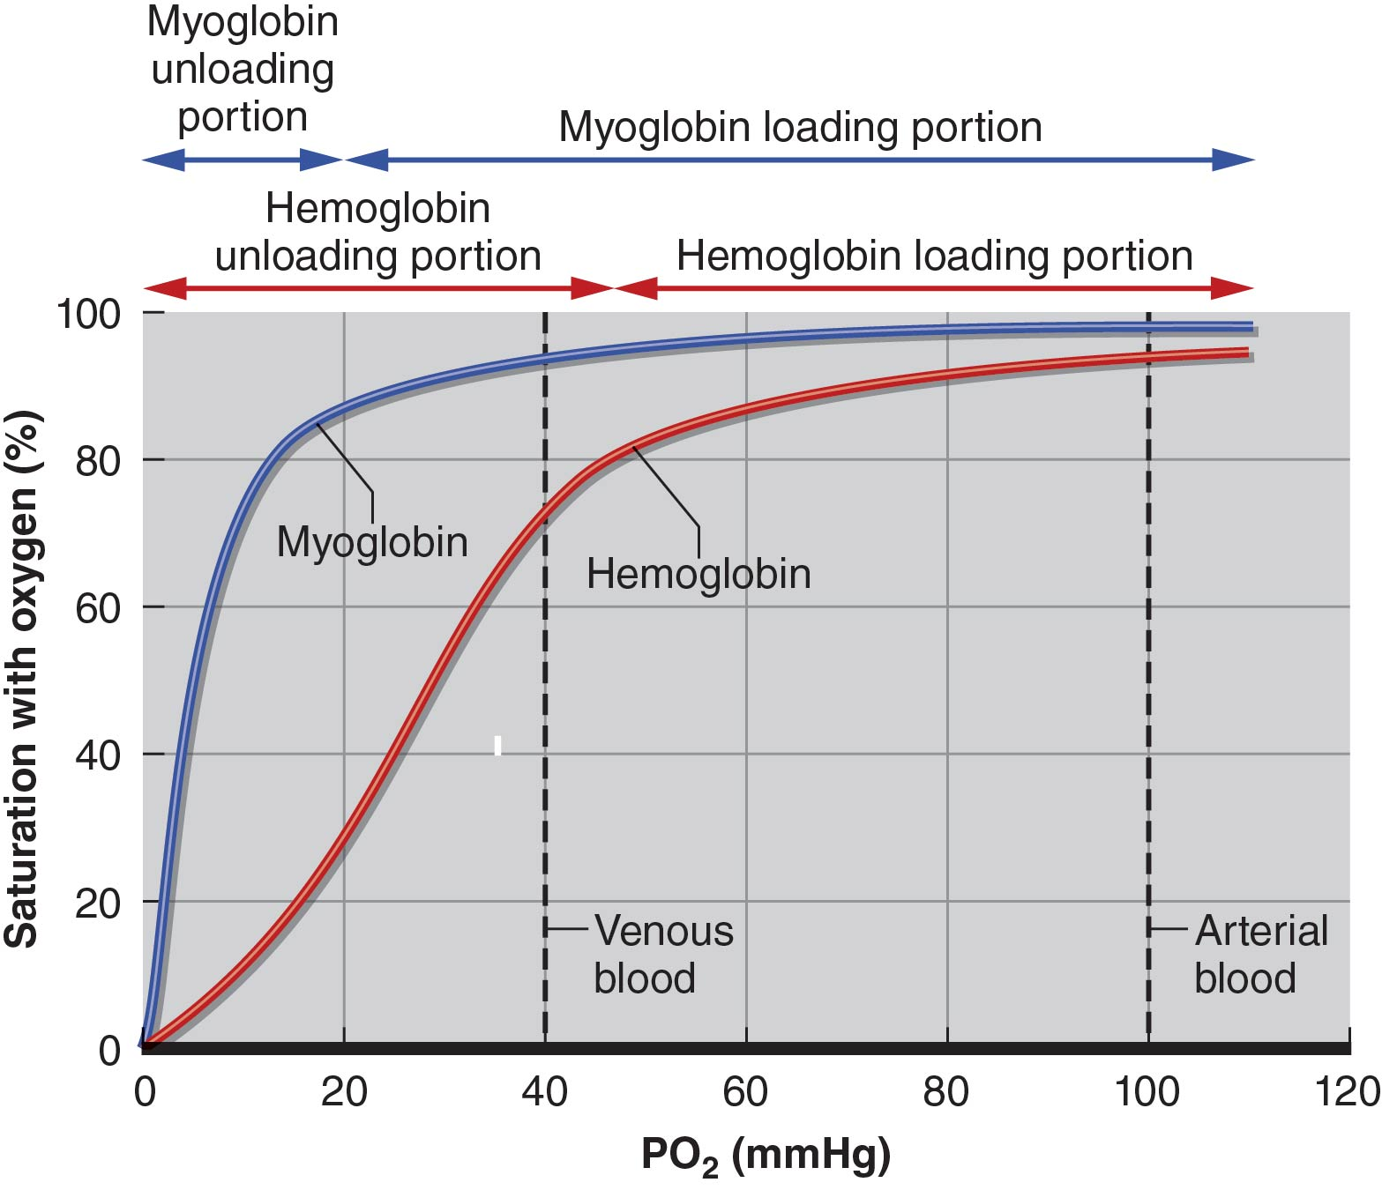
Figure 7.12

Slide 36
Factors Influencing Oxygen
Delivery and Uptake
O₂ content of blood
  Represented by PO₂, Hb percent saturation
  Creates arterial PO₂ gradient for tissue exchange
Blood flow
  – ↓ Blood flow = ↓ opportunity to deliver O₂ to tissue
  Exercise ↑ blood flow to muscle
Local conditions (pH, temperature)
  Shift O₂-Hb dissociation curve
  – ↓ pH, ↑ temperature promote unloading in tissue

Slide 37
Gas Exchange at Muscles:
Carbon Dioxide Removal
CO₂ exits cells by simple diffusion
Driven by PCO₂ gradient
  Tissue (muscle) PCO₂ high
  Blood PCO₂ low

Slide 38
Regulation of Pulmonary Ventilation
Body must maintain homeostatic balance between blood PO₂, PCO₂, pH
Requires coordination between respiratory and cardiovascular systems
Coordination occurs via involuntary regulation of pulmonary ventilation

Slide 39
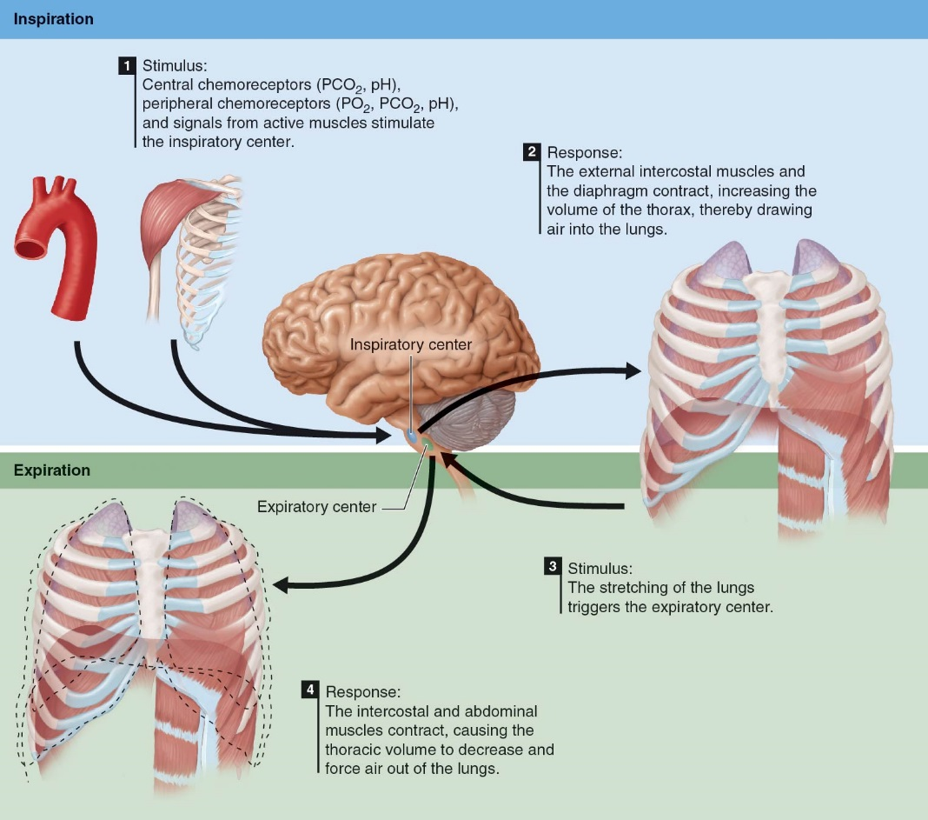
Animation 7.13

