Slide 1
Role of Psychology
Working as family social worker
By Shamila Altaf
2108744
Psychology for social and health care
BMHP4003

Slide 2
INTRODUCTION
A family social worker has many responsibilities. They have to deal with sensitive issues and help families get through the difficult time of their lives.
Helping dysfunctional families as a family social worker highlights the role of psychology. They have to be more considerate, empathetic, and compassionate towards the situation of the families they are helping.
Family social workers have to understand their family dynamics, their past traumas, and dysfunctional behaviour, and how they have developed over the years to provide the best possible solution for them.

Slide 3
Jean Piaget
In this Presentation, I will explain Piaget’s stages of cognitive development. This theory is presented by Jean Piaget.
This theory describes four different stages of learning and development in which children goes through growing up.

Slide 4
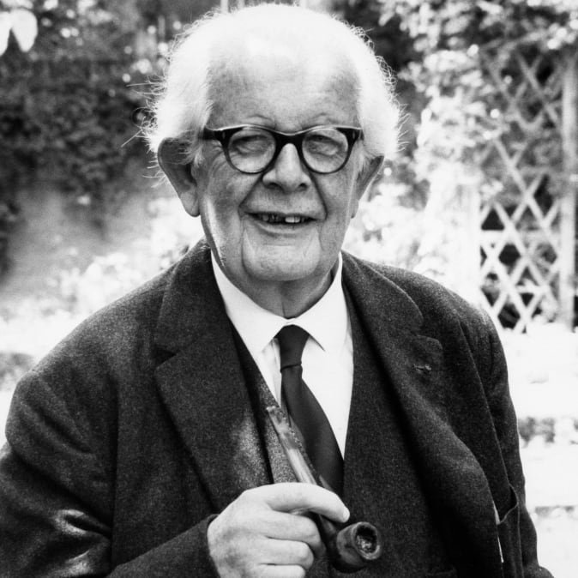
https://www.biography.com/scientist/jean-piaget

Slide 5
Stages of cognitive development
Piaget’s four stages
Sensorimotor stage
Proportional
Concrete operational
Formal operational

Slide 6
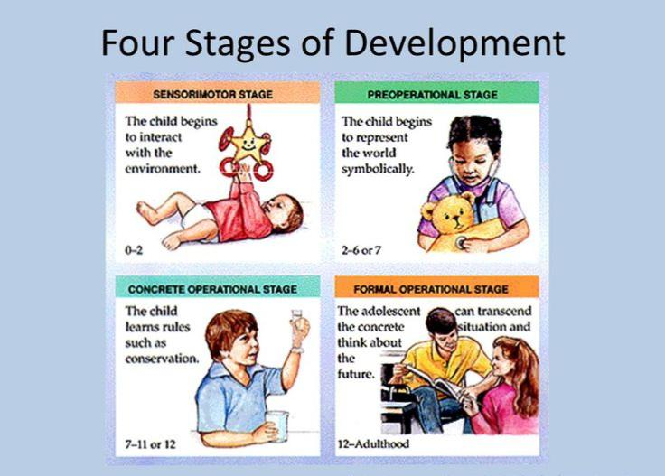
https://psych2go.net/facts-cognitive-development-recognize/

Slide 7
Concrete operational stage
This is the third stage of jean Piaget's theory; the child is between the age of 7- 11 years of age. At this stage, children start thinking about logical rules of concrete events, and they can feel the change in their improvement in solving daily tasks. Although they still have problems with abstract thinking. Children begin to understand the concept of meaningful conservation, decentration, reversible, seriation, and socio centricity. They start to think that people around them see the world differently, so they begin to feel how people will think about their behaviour (Timothy J. Legg).

Slide 8
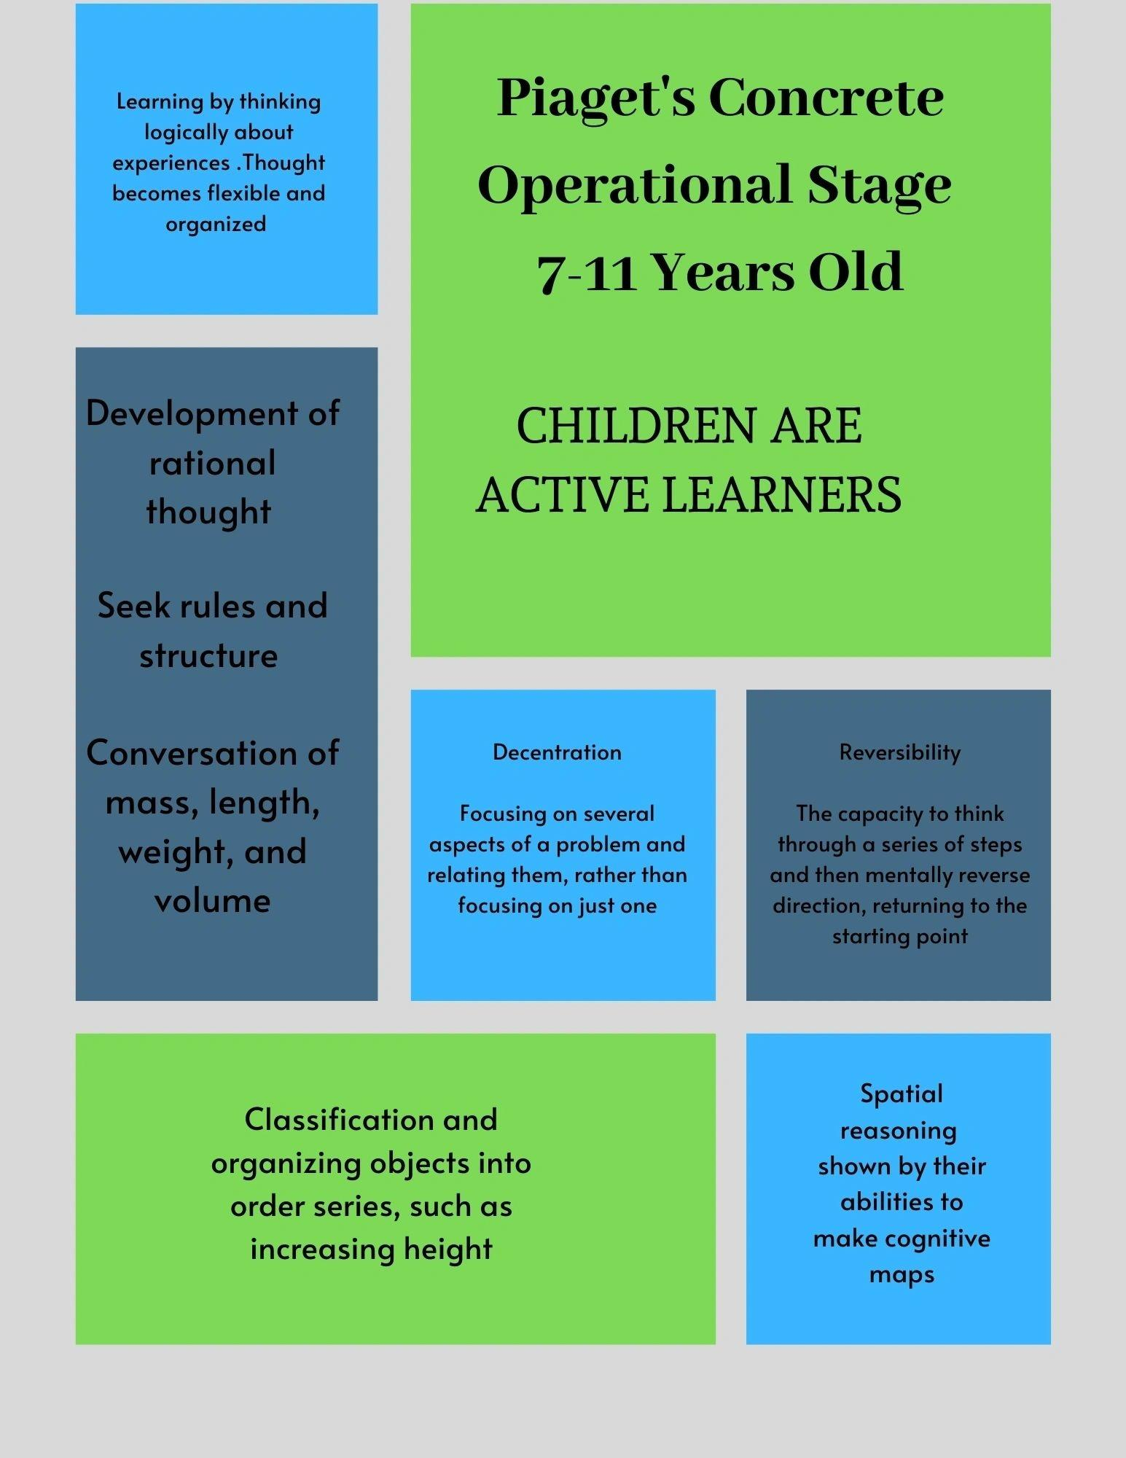
https://beholdbegold.org/my-blog/f/piagets-concrete-operational-stage-of-development

Slide 9
The turning point in children’s life
Piaget explained how this stage is a turning point in a child's life because children can create a scenario with the help of logical and operational thoughts in their minds without actually trying things out in the real world. (Saul McLeod)

Slide 10
Example
Working as a family social worker, understanding the behavior of children belonging to dysfunctional families is very important. Because as they are growing up, they start to understand the trauma they are going through. So being a social worker, you must make sure you are empathetic towards your client.

Slide 11
References
Biography, Jean Piaget. Available at: https://www.biography.com/scientist/jean-piaget (Accessed on 06-Oct-2022).
Beholdbegold, March (2020) Piaget’s concrete operational stage of development. Available at: https://beholdbegold.org/my-blog/f/piagets-concrete-operational-stage-of-development (Accessed on 06-Oct-2022).
Career explorer, What is family social worker? Available at: https://www.careerexplorer.com/careers/family-social-worker/ (Accessed on 06-Oct-2022).
Kendra Cherry, (2022). Piaget’s 4 stages of cognitive development explained. Available at: https://www.verywellmind.com/piagets-stages-of-cognitive-development-2795457 (Accessed on 07-Oct-2022).
Psych2Go, 4 Stages of Cognitive Development. Which ones have you been through? Available at: https://psych2go.net/facts-cognitive-development-recognize/ (Accessed on 06-Oct-2022).
Saul Mcleod, August 2022. Piaget’s stages of cognitive development. Available at: https://www.simplypsychology.org/piaget.html (Accessed on 05-Oct-2022).
Timothy J. Legg, February 2022. The concrete operational stage of cognitive development. Available at: https://www.healthline.com/health/childrens-health/concrete-operational-stage (Accessed on 08-Oct-2022).

