Slide 1
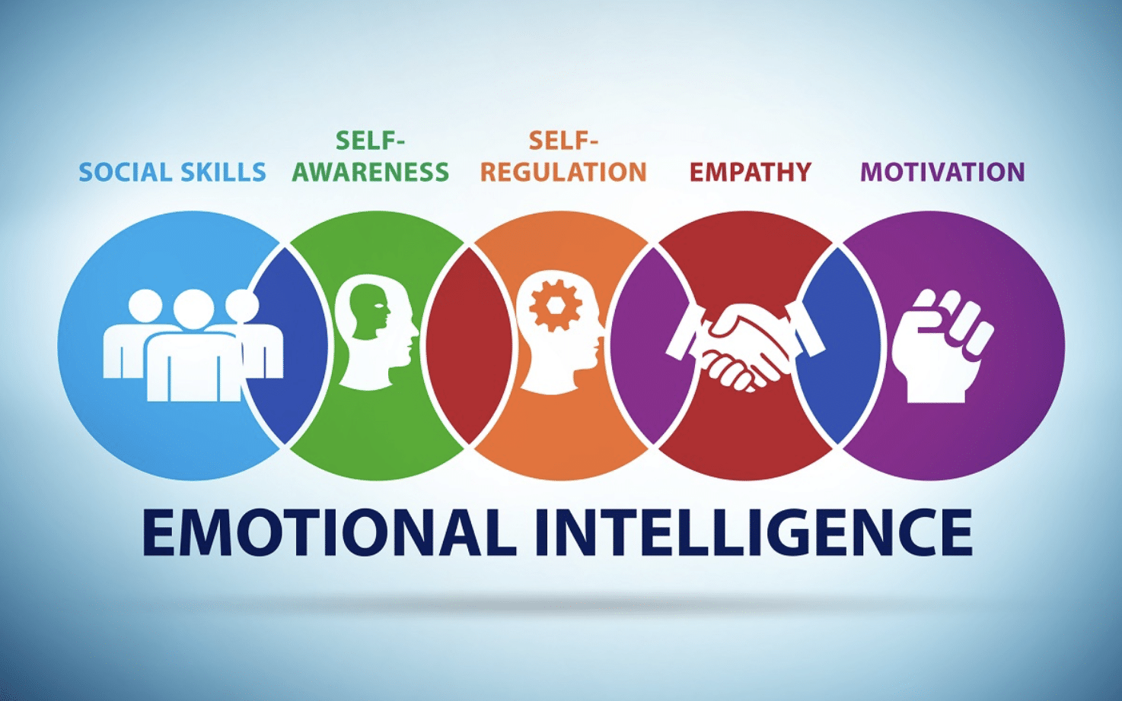
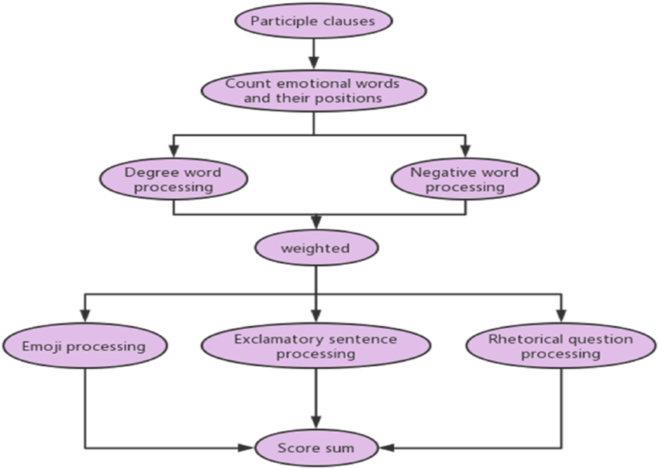
Title: Leading Group Projects with Emotional Intelligence
Module: Developing Emotional Intelligence Skills
Module code: LCLM 5006
C1 – Academic Poster Presentation
Student Name: Ahmed Hassanen
Student ID: 2413130
Lecturer: Dr Abdallah Naser
Introduction
Emotional intelligence (EI) is skills associated with the recognition, comprehension and regulation of emotions. Coronado-Maldonado and Benítez-Márquez (2023) suggest that emotional intelligence helps to enhance teamwork and leadership. Students in group project activities in universities tend to feel pressured, disagree on various views and deadlines. Good emotional intelligence to the students allows students to express themselves more, resolve conflicts and collaborate more effectively.
Section 2 – Managing Your Own Emotional Intelligence
During group projects, it is important to control personal feelings. The students first need to be aware of the manifestations of stress, frustration or anxiety. Greene, Bernacki and Hadwin (2023) emphasise that self-regulation not only enables people to keep their emotions controlled but also to remain focused on their objectives. Some of the practical methods entail mindfulness, strategising activities, introspection of errors and taking mini breaks prior to response. These are some of the basic activities that will help alleviate stress and help in decision-making. Emotionally mature students are able to stay cool when pressured. They engage in positive discussions and do more positively during the project.
Section 1 – Emotional Intelligence in Teamwork
EI aids students in working towards success in groups. It begins with self-consciousness. When students know their emotions, they will be in control of their reactions in the discussion. Self-regulation will assist them in remaining calm when there are issues. Describing the functioning of the teams with high emotional intelligence, Coronado-Maldonado and Benitez-Marsquez (2023) state that the teams in question outperform the rest due to open communication and mutual support of the team members. Motivation will also make the students work on their tasks motivated and unable to forget about common aims. Empathy will enable them to learn about the feelings of fellow team members in stressful circumstances. Social skills enhance communication and ease the work with a team. To illustrate this point, in case a team member fails to meet his or her deadline, the team ought to resolve the issue in a respectful manner, rather than pointing out his or her way.
Section 3 – Understanding Others' Emotional Intelligence
It is better to know the feelings of other people, and this enhances teamwork. Sanmas et al. (2023) state the importance of collaboration and trust, which are enhanced by good interpersonal communication. Teachers should teach pupils to listen actively and be respectful to be able to listen to various opinions. Empathy helps them to comprehend the problems of their teammates. Constructive feedback is constructive in its manner, yet it does not result in a conflict. Positive communication establishes more relationships and augmented involvement. Each of the members will feel respected and supported when he/she feels part of the entire group, which will work better towards a successful achievement of better academic outcomes.
References
Coronado-Maldonado, I. and Benítez-Márquez, M.D., (2023). Emotional intelligence, leadership, and work teams: A hybrid literature review. Heliyon, 9(10).
Greene, J.A., Bernacki, M.L. and Hadwin, A.F., (2023). Self-regulation. In: Handbook of Educational Psychology, pp.314–334.
Sanmas, M., Qadir, A., Nahria, N. and Laili, I., (2023). The role of interpersonal communication in enhancing teamwork effectiveness in the digital era. Literatus, 5(2).
Conclusion
EI assists students to express themselves, control and handle emotions, as well as support others. Establishing self-knowledge and sympathy leads to greater cooperation and less impetus in university group activities.
Notes:
Introduction
Emotional intelligence (EI) is skills associated with the recognition, comprehension and regulation of emotions. Coronado-Maldonado and Benítez-Márquez (2023) suggest that emotional intelligence helps to enhance teamwork and leadership. Students in group project activities in universities tend to feel pressured, disagree on various views and deadlines. Good emotional intelligence to the students allows students to express themselves more, resolve conflicts and collaborate more effectively.
Section 1 – Emotional Intelligence in Teamwork
EI aids students in working towards success in groups. It begins with self-consciousness. When students know their emotions, they will be in control of their reactions in the discussion. Self-regulation will assist them in remaining calm when there are issues. Describing the functioning of the teams with high emotional intelligence, Coronado-Maldonado and Benitez-Marsquez (2023) state that the teams in question outperform the rest due to open communication and mutual support of the team members. Motivation will also make the students work on their tasks motivated and unable to forget about common aims. Empathy will enable them to learn about the feelings of fellow team members in stressful circumstances. Social skills enhance communication and ease the work with a team. To illustrate this point, in case a team member fails to meet his or her deadline, the team ought to resolve the issue in a respectful manner, rather than pointing out his or her way.
Section 2 – Managing Your Own Emotional Intelligence
During group projects, it is important to control personal feelings. The students first need to be aware of the manifestations of stress, frustration or anxiety. Greene, Bernacki and Hadwin (2023) emphasise that self-regulation not only enables people to keep their emotions controlled but also to remain focused on their objectives. Some of the practical methods entail mindfulness, strategising activities, introspection of errors and taking mini breaks prior to response. These are some of the basic activities that will help alleviate stress and help in decision-making. Emotionally mature students are able to stay cool when pressured. They engage in positive discussions and do more positively during the project.
Section 3 – Understanding Others' Emotional Intelligence
It is better to know the feelings of other people, and this enhances teamwork. Sanmas et al. (2023) state the importance of collaboration and trust, which are enhanced by good interpersonal communication. Teachers should teach pupils to listen actively and be respectful to be able to listen to various opinions. Empathy helps them to comprehend the problems of their teammates. Constructive feedback is constructive in its manner, yet it does not result in a conflict. Positive communication establishes more relationships and augmented involvement. Each of the members will feel respected and supported when he/she feels part of the entire group, which will work better towards a successful achievement of better academic outcomes.
Conclusion
EI assists students to express themselves, control and handle emotions, as well as support others. Establishing self-knowledge and sympathy leads to greater cooperation and less impetus in university group activities.
References
Coronado-Maldonado, I. and Benítez-Márquez, M.D., (2023). Emotional intelligence, leadership, and work teams: A hybrid literature review. Heliyon, 9(10).
Greene, J.A., Bernacki, M.L. and Hadwin, A.F., (2023). Self-regulation. In: Handbook of Educational Psychology, pp.314–334.
Sanmas, M., Qadir, A., Nahria, N. and Laili, I., (2023). The role of interpersonal communication in enhancing teamwork effectiveness in the digital era. Literatus, 5(2).

