Slide 1

Y Meddwl Ymholgar
The Enquiring Mind
Chwarae Creadigol a Dysgu drwy Ymholiad
Creative Play and Enquiry Based Learning

Slide 2
Nod ac Amcanion /
Aim and Objectives
Nod:
Ymchwilio i'r cysyniad o chwarae a sut mae'n berthnasol i ymholiad creadigol
Amcanion:
Ystyried ystod o strategaethau chwarae sy'n cefnogi ymholi creadigol
Dadansoddi effeithlonrwydd chwarae creadigol fel offeryn ar gyfer dysgu
Aim:
To investigate the concept of play and how it relates to creative enquiry
Objectives:
To consider a range of play strategies that support creative enquiry
To analyse the efficiency of creative play as a tool for learning
Notes:
Overall aims and objectives

Slide 3

Dysgu Trwy Chwarae – Datblygiad Creadigol
Learning Through Play – Creative Development
Dysgu Trwy Chwarae - Dysgu Creadigol
Learning Through Play - Creative Development
Gwnewch nodiadau ar unrhyw beth sy’n ddiddorol i chi a byddwch yn barod i adrodd nôl i weddill y grŵp.
Make notes on anything that you find interesting and be prepared to feedback to the rest of the group.

Slide 4
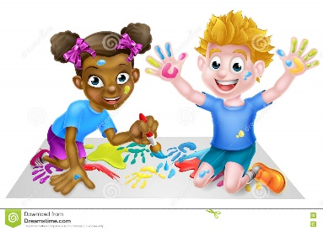
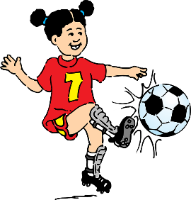
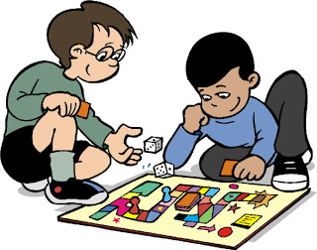
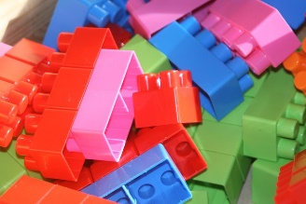
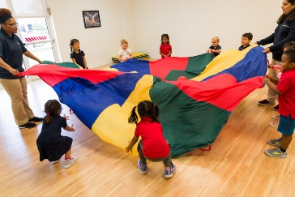

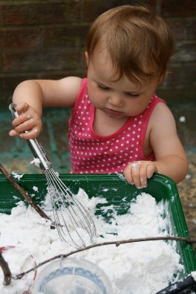

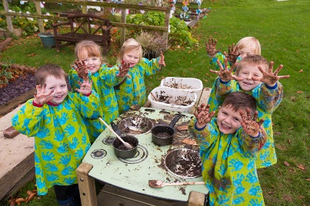
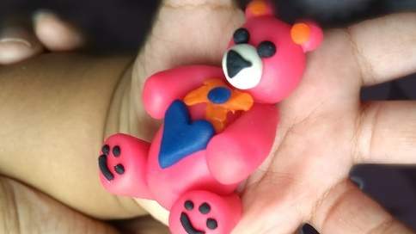
Mathau o Chwarae / Types of Play
Allwch chi enwi gwahanol fathau o chwarae?
Can you name different types of play?

Slide 5

Mathau o Chwarae / Types of Play
Corfforol
Dychmygol
Creadigol
Adeiladol
Ymchwiliol
Cymdeithasol
Gemau gyda rheolau (Moyles, 2010)
Chwiliwch am esiamplau
o bob un? (Tasg 20 munud)
Physical
Imaginary
Creative
Constructive
Exploratory
Social
Games with rules
(Moyles, 2010)
Look for examples of each
one? (20 minute task)
Notes:
According to Moyles there are 7 types of play.
Physical – tree climbing, chasing
Imaginary – role play, playing with cars/dolls
Creative – drawing, playing with play dough
Constructive – lego, building
Exploratory – den building , using senses (messy play)
social – playing with peers, skipping, etc
Games with rules – hide and seek, tag,
Other theorists may refer to them differently eg. Imaginary play = Fantasy play. Types of play can overlap and it is possible for more than one type of play to occur in each play episode eg.
Ouestion – can someone give me an example of when two types of play occur at the same time
Social and games with rules can occur at same time. Same as creativity and constructive play

Slide 6

Chwarae Creadigol / Creative Play
“Creative play is about encouraging children to experiment and explore the world around them. Through their senses they are able to explore the properties of different materials. Creative play can enhance children’s self esteem and confidence.”
(Wilson, 2012).
Notes:
Wilson’s definition of creative play – big emphasis on experiential learning and using all senses to explore and experiment with different properties and materials.
As children express themselves through creativity this enhances their self esteem.
Problem solving plays a big part in creative play – this also increase confidence and self esteem
Question = give an example of an creative play activity that might be carried out in the classroom

Slide 7
Chwarae Creadigol a’r Cyfnod Sylfaen
Creative Play and the Foundation Phase
Mae chwarae creadigol yn gysylltiedig â 'Datblygiad Creadigol' – o fewn y saith maes dysgu
Sgiliau Datblygiad Creadigol: celf, crefft, dylunio a cherddoriaeth
Pwyslais ar chwarae dan do ac yn yr awyr agored
Mae datblygiad creadigol yn ymwneud â datblygu ffyrdd unigol plant o gynrychioli eu syniadau, eu teimladau a'u hemosiynau yn ddychmygus drwy wahanol fathau o hunanfynegiant
Llywodraeth Cymru (2008)
Creative play is linked to ‘Creative Development’ with the seven areas of learning
Creative Development skills: art, craft, design and music
Emphasis on indoor and outdoor play
Creative development relates to the development of children’s individual ways of representing their ideas, feelings and emotions imaginatively through various forms of self-expression
WAG (2008)
Notes:
Creative play – included in creative development in FP 7 areas of learning but should cross over to other areas such as knowledge and understanding of the world (link between art and science)
Four main areas focused on: Art, craft, design and music (not massive emphasis on drama/role play = this is covered in language, literacy and communication skills). Also included as ‘creative movement’
Indoor and outdoor play important – especially using materials from the natural environment – free play (children play naturally) = making perfume with roses, Structured activity – collage with leaves
Through creative play children should be encouraged to develop their individual ideas (teacher as facilitator) – creative play most used form of play in play therapy (along with role play)

Slide 8
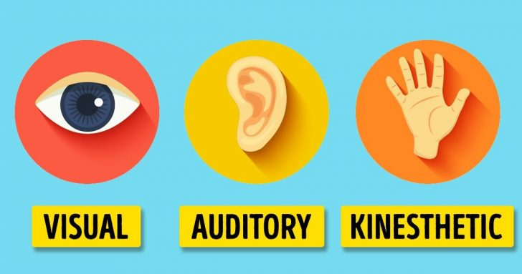
Chwarae Creadigol a Datblygiad
Creative Play and Development
Cyfleoedd i ddatblygu pob steil o ddysgu – VAK (Gweledol, Sain, Cinesthetig)
Rôl yr ymarferydd: Darparu dysgu drwy brofiad gweithredol, cynllunio gofalus, trefnu, hwyluso, herio, arsylwi, rhyngweithio, ymyrryd/cefnogi, monitro a gwerthuso.
Dylai'r amgylchedd dysgu gynnwys deunyddiau sy'n adlewyrchu gwahanol ddiwylliannau.
Llywodraeth Cymru (2008)
Canllawiau Datblygiad Creadigol
Opportunities to develop all VAK learning styles (Visual, Auditory, Kinaesthetic)
Role of practitioner: To provide experiential and active learning, careful planning, organising, facilitating, challenging, observing, interacting, intervening/supporting, monitoring and evaluating.
Learning environment should reference materials reflecting different cultures.
WAG (2008)
Creative Development Guidance
Notes:
VAK = Visual, Auditory and Kinaesthetic = seeing – the colours , hearing – may paint to music, doing – feeling materials
Role of practitioner – to facilitate and not lead (creative play must be children’s own ideas in order to express themselves)
Practitioner must ensure that the learning environment is equipped for facilitating creative play – plenty of materials which are accessible to children.
Practitioner may challenge children by introducing new materials (will need to develop manipulation skills).
Creative play will be assessed through observing, monitoring and evaluation – documenting through photographs (will not necessary have a finished product to display in class e.g it could be a mud pie)
Learning environments and activities should reflect culture e.g Welsh dances in creative movements or dances from other cultures. Looking at artists from Wales and other countries
Discuss - are there more opportunities for creative play outdoors of indoors

Slide 9

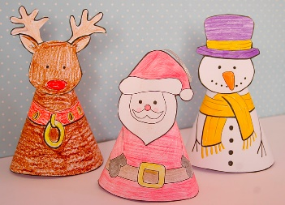
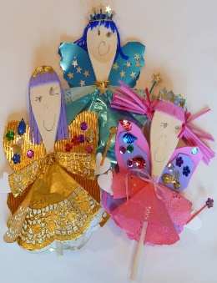
Datblygiad mewn Dysgu
Progress in Learning
Celf, Crefft a Dylunio:
archwilio ac arbrofi gydag amrywiaeth o dechnegau a deunyddiau
datblygu a defnyddio eu dealltwriaeth o liw, llinell, tôn, gwead, patrwm, siâp a ffurf
defnyddio amrywiaeth o ddefnyddiau ac offer ar gyfer arbrofi a datrys problemau
gwneud dewisiadau wrth ddewis deunyddiau ac adnoddau
datblygu eu dealltwriaeth o gynllunio, dylunio, modelu, addasu ac adlewyrchu
Llywodraeth Cymru (2008)
Art, Craft and Design:
explore and experiment with a variety of techniques and materials
develop and use their understanding of colour, line, tone, texture, pattern, shape and form
use a variety of materials and tools for experimentation and problem solving
make choices when choosing materials and resources
develop their understanding of planning, designing, modelling, modifying and reflecting
WAG (2008)
Notes:
Creative development categorised in two areas: art, craft and design and music.
Through play children will become familiar with different textures, objects and materials – Creative play
In simplest terms, drawing, painting and creating models but out of what? Outside environment – house for bugs, drawing a picture with a stick in the sand. Messy play

Slide 10

Datblygiad mewn Dysgu
Progress in Learning
Music:
Children can respond to music through movement, dance, pictures, words or other forms of expression.
Games and stories with recordings of everyday sounds can be used to develop understanding and recognition of sounds made by different objects, animals or materials.
Opportunities to use their voices, to participate in nursery rhymes, action songs, chants, etc., individually and in a group.
Playing simple melodies and accompaniments as well as creating sound patterns, will lead on to simple compositions.
Children can develop awareness both of music of different periods and genres and of some of the singers or composers whose music they hear.
Welsh Government (2008)
Cerddoriaeth:
Gall plant ymateb i gerddoriaeth drwy symud, dawns, lluniau, geiriau neu fathau eraill o fynegiant.
Gellir defnyddio gemau a straeon gyda recordiadau o synau bob dydd i ddatblygu dealltwriaeth a chydnabyddiaeth o synau a wneir gan wahanol wrthrychau, anifeiliaid neu ddeunyddiau.
Cyfleoedd i ddefnyddio eu lleisiau, i gymryd rhan mewn hwiangerddi, caneuon actol, siantiau, ac ati, yn unigol ac mewn grŵp.
Bydd chwarae melodion a chyfeiliant syml yn ogystal â chreu patrymau sain, yn arwain at gyfansoddiadau syml.
Gall plant ddatblygu ymwybyddiaeth o gerddoriaeth o wahanol gyfnodau a genres ac o rai o'r cantorion neu gyfansoddwyr y maent yn clywed eu cerddoriaeth.
Llywodraeth Cymru (2008)
Notes:
Children should enjoy practical opportunities to create sounds, explore a range of different sound sources, play simple musical instruments, and respond to different sounds. This will encourage many skills, including listening which is a key skill in all Areas of Learning.
Music and dance are linked together – areas of learning can interlink e.g traditional music and Personal and Social Development, Well-being and Cultural Diversity

Slide 11
Datblygiad mewn Dysgu
Progress in Learning
Symud Creadigol
Cyfleoedd i actio rolau sy’n cynnwys symudiadau.
Teithio, neidio, cydbwyso, troi, ystumio ac aros yn llonydd.
Dyfeisio eu dilyniannau eu hunain gan ddefnyddio cyfarpar syml dan do ac yn yr awyr agored.
Gweithio gyda’i gilydd i greu dawns syml mewn ymateb i gerddoriaeth a pherfformio dawnsfeydd traddodiadol.
Wrth i sgiliau hunanwerthuso plant ddatblygu gallan nhw gofnodi a gwerthuso eu symudiadau creadigol nhw a symudiadau pobl eraill.
(Llywodraeth Cymru, 2008)
Creative Movement
Opportunities to act out roles involving movement.
Traveling, jumping, balancing, turning, gesturing and staying still.
Devise their own sequences using simple indoor and outdoor equipment.
Working together to create a simple dance in response to music and perform traditional dances.
As children's self-evaluation skills develop they can record and evaluate their own and others' creative movements.
(Welsh Government, 2008)

Slide 12
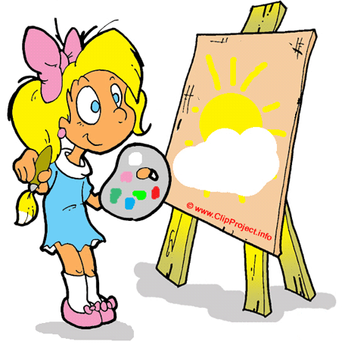
Datblygiad Creadigol / Creative Development
Datblygir y sgilau yma wrth i blant ymwneud â gweithgareddau chwarae creadigol: The following skills develop as children engage in creative play activities:
Trin / Manipulating | Modelu / Modelling | Gwrando / Listening
Ymateb / Responding | Trafod / Discussing | Cyfathrebu / Communicating
Meddwl / Thinking | Adfyfyrio / Reflecting | Datrys Problemau / Problem Solving
Dyfalbarhau / Persevering | Cydweithio / Collaborating | Gwerthuso / Evaluating
Archwilio / Exploring | Arbrofi / Experimenting | Ymchwilio / Investigating
Arsylwi / Observing | Oes cysylltiad gyda sgiliau gwyddonol? | Any connection to scientific skills?
Notes:
Skills enhanced are skills that promote enquiry.
These skills are also associated with confidence (therefore creative development will assist independent and active learning).
All skills are relevant to real world and will equip children with skills for the future (world of work)
Why is it useful for children to develop these skills for later life?
Skills relate to world of work

Slide 13

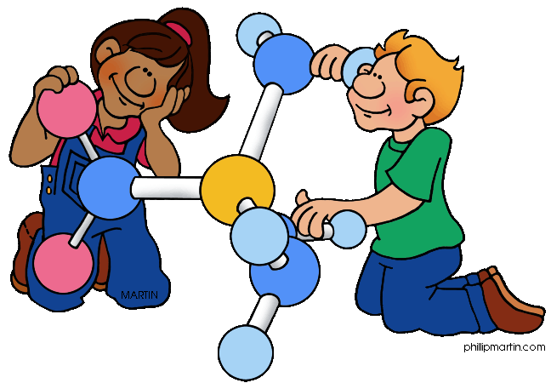
A yw sgiliau creadigol a gwyddonol yn debyg?
Datblygiad Sgiliau Gwyddonol
Arsylwi | Didoli a grwpio
Cymharu | Trefnu
Dosbarthu | Gofyn/ateb cwestiynau
Ymholi | Ymchwilio
Archwilio ac arbrofi | Meddwl
Gwrando | Datrys problemau
Gwneud penderfyniadau | Cofnodi
Rhagfynegi a phrofi | Cyfathrebu
Myfyrio | Gwerthuso
Disgrifio
Notes:
These skills are essential to this area of learning and can also be developed across the curriculum.
Important to understand that these skills are built on throughout the FP – get more complex as phase progresses.
All skills are linked closely with science.

Slide 14
Are creative and scientific skills similar?
Development of Scientific Skills
Observing | Sorting and grouping
Comparing | Sequencing
Classifying | Asking/answering questions
Enquiring | Investigating
Exploring and experimentation | Thinking
Listening | Solving problems
Making decisions | Recording
Predicting and testing | Communicating
Reflecting | Evaluating
Describing
Notes:
These skills are essential to this area of learning and can also be developed across the curriculum.
Important to understand that these skills are built on throughout the FP – get more complex as phase progresses.
All skills are linked closely with science.

Slide 15

Tasg grŵp / Group task
Cynlluniwch dasg chwarae creadigol ar gyfer dosbarth Cyfnod Sylfaen
Ystyriwch:
- pa adnoddau fydd angen arnoch
- faint fydd y weithgaredd yn para?
- pwy fydd ynghlwm?
- pa sgiliau a ddatblygir?
-pa faes/feysydd dysgu a phrofiad fydd yn cael sylw?
Ystyriwch y cysylltiadau rhwng chwarae creadigol a gwyddonol
Plan a creative play task that could be carried out in a Foundation Phase classroom
Consider:
- which resources you will need
- how long will it last
- who will be involved
- what skills will be developed
which area(s) of learning and experience will be covered
Consider the links between creative and scientific play

Slide 16

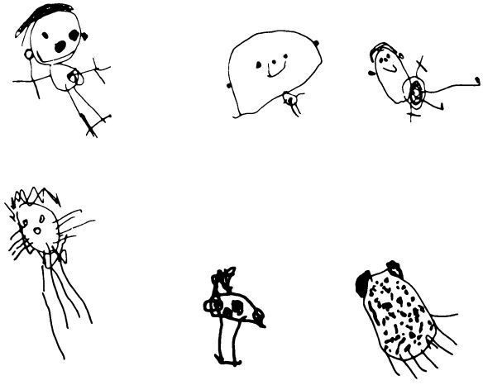
Creadigrwydd a Chwarae
Creativity and Play
Trowch eich camerau ymlaen os gwelwch yn dda. Cyn inni wylio’r fideo…tynnwch lun cyflym o’ch partner mewn 30 eiliad! 3, 2, 1…ewch!
Please turn on your cameras.
Before we watch the video…draw a quick picture of your partner in 30 seconds!
3, 2, 1…go!
http://www.ted.com/talks/tim_brown_on_creativity_and_play
http://www.ted.com/talks/tim_brown_on_creativity_and_play
Notes:
Tim Brown

Slide 17
Cyfeirnodau / References
Moyles, J. (2010) The excellence of play, Maidenhead; McGraw Hill Education
http://wales.gov.uk/dcells/publications/policy_strategy_and_planning/early-wales/whatisfoundation/foundationphase/2274085/frameworkforchildrene.pdf?lang=en
http://wales.gov.uk/topics/educationandskills/earlyyearshome/foundation_phase/foundationphasepractitioners/creativedevelopment/?lang=en

