Slide 1
BMSW5007
Building a Sustainable Marketing Relationship
LECTURE
ETHICS AND SUSTAINABILITY

Slide 2

Business Ethics and Sustainability

Slide 3
Today’s Lecture
Business Ethics and Sustainability
This relates to Task 3 of the assignment report:
Provide examples and critically discuss Tesco’s ‘Marketing Relationship’ strategy based on the following areas:
Segmentation, Pricing Strategies, Differentiation, Ethical and Sustainability policies and practices and identify how these may help to achieve ‘Customer Centrality’

Slide 4

Business Ethics: What Does It Really Mean?

Slide 5
Business Ethics: What Does It Really Mean?
Ethics involves a discipline that examines good or bad practices within the context of a moral duty.
Moral conduct is behaviour that is right or wrong
Business ethics include practices and behaviors that are good or bad

Slide 6
The Importance of Business Ethics
Trust and Reputation – Ethical behaviour builds trust with stakeholders and can enhance a company’s reputation and long term success.
Risk Reduction – poor ethical performance can lead to bad publicity which can damage a company.
Employee Morale – Workers feel valued, motivated and perform better in their roles.
Customer Loyalty – Customers prefer to build relationships with companies they trust and respect.

Slide 7


Slide 8
Business Ethics
Business ethics provide standards or guidelines for the conduct and decision making of employees and managers.
In the absence of a code of ethics,
There is usually a lack of consensus about appropriate ethical behavior; and
Different people use different ethical criteria to determine whether a practice or behaviour is ethical or unethical.
Business ethics are not the same things as laws.

Slide 9
Business Ethics
Business ethics refer to the principles, values, and standards that guide behaviour in the world of business.
They establish a framework for businesses and individuals to act responsibly and with integrity toward their stakeholders, including customers, employees, shareholders, and the broader community.
Business ethics influence decisions about what is considered right or wrong in a given business situation, building an environment of trust and transparency.

Slide 10
Making Ethical Judgments
Behavior or act that has been committed
Prevailing norms of acceptability
compared with
Value judgments and perceptions of the observer

Slide 11
Class Exercise
Working in pairs or small groups, select and organisation you are familiar with.
List as many different aspects of company ethical behaviour that you can.
Which aspects do you think are most important for customer retention and loyalty? Why?

Slide 12
Ethical Standards that Customers Expect
Transparency in Product Information and Pricing
  Honest Pricing: No hidden fees or misleading discounts. A fair price for the quality of the product / service.
  Clear Product Information: Accurate and transparent product labelling, nutrition, ingredients, sourcing details, and potential allergens, origins of products, such as fair-trade certifications or sustainable sourcing.
Fair Employment Practices
  Fair Wages and Employee Rights: Competitive wages, safe working conditions, and respectful treatment. Support for employee well-being, work-life balance, and career development reflects positively on the company’s ethical standing.
  Diversity and Inclusion: Customers are increasingly conscious of companies’ commitments to diversity, equity, and inclusion.

Slide 13
Ethical Standards that Customers Expect
Ethical and Transparent Supply Chains
  Fair Treatment of Suppliers: Ethical treatment of suppliers, especially small producers, is a major concern.
  Prevention of Labor Exploitation: Customers expect that supply chains are free from forced labour, child labour, and unfair working conditions. Customers want reassurance that the products they buy are not linked to exploitation.
Good Customer Service and Respect for Customer Rights
  Respect and Fairness in Customer Interactions: Ethical treatment of customers is highly valued. Customers expect courteous, respectful, and fair treatment from staff, as well as effective and timely responses to complaints or issues.
  Customer Privacy and Data Security: With the extensive data collected, particularly through loyalty programs, customers expect robust data protection policies and transparency regarding data usage. They want assurance that their personal information is secure, used responsibly, and not shared without consent.

Slide 14
Ethical Standards that Customers Expect
Commitment to Community and Social Responsibility
  Local Community Engagement: Support for local communities through initiatives like charity donations, food bank partnerships, and sponsorship of local events aligns with customer expectations for social responsibility. Customers often want to see large companies giving back to communities.
  Charitable Initiatives: Involvement in charitable causes like hunger relief and support for education or healthcare is seen as a key ethical obligation. These initiatives build goodwill, especially when customers see an impact on issues they care about.
Commitment to Environmental Sustainability
  Reduction in Plastic and Waste: To minimize its environmental impact, particularly in areas like plastic use and food waste. Customers appreciate efforts to reduce single-use plastics, such as reusable shopping bags, recyclable packaging, and food waste reduction initiatives.
  Eco-Friendly Product Options: Customers want access to environmentally friendly products, including organic, sustainably sourced, and locally produced options. They expect companies to prioritize eco-friendly suppliers and reduce its overall carbon footprint by using renewable energy, reducing emissions, and improving the sustainability of logistics and supply chains.

Slide 15
Ethical Standards that Customers Expect
Proactive Health and Wellness Initiatives
  Promoting Healthier Options: With a growing interest in health and wellness, customers expect Tesco to offer healthier food options, promote balanced diets, and encourage well-being. Tesco’s efforts to reduce sugar, salt, and fat content in its private-label products meet customer expectations for health-conscious products.
  Clear Nutrition Information: Providing accessible nutrition information helps customers make healthier choices, and they expect Tesco to present this information transparently and prominently

Slide 16
What is sustainability?
“An approach to economic growth and development which takes account of the social and environmental consequences.”
    (Worthington & Britton, 2003 p23)

Slide 17

What is Business Sustainability?
Sustainability in business refers to a company's strategy and actions to reduce adverse environmental and social impacts resulting from business operations in a particular market.

Slide 18
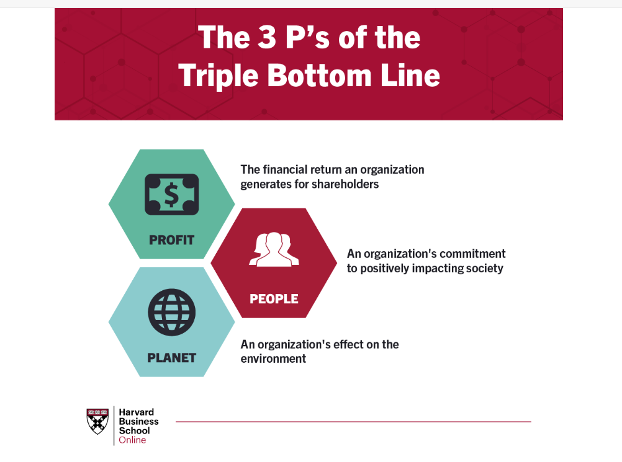
The triple bottom line is a business concept that states firms should commit to measuring their social and environmental impact—in addition to their financial performance—rather than solely focusing on generating profit, or the standard “bottom line.”

Slide 19
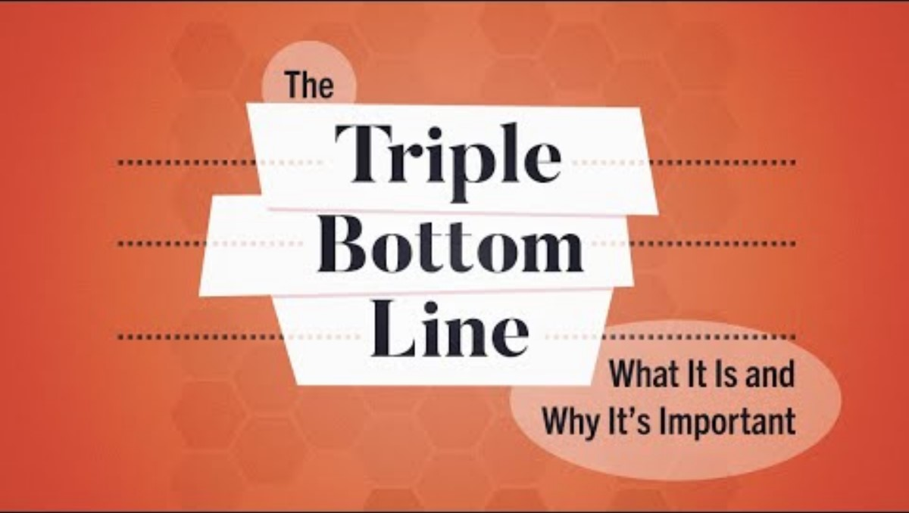

Slide 20
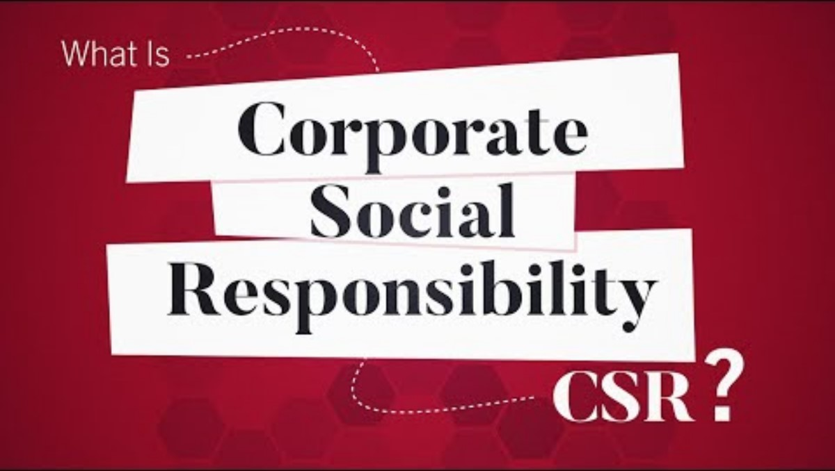

Slide 21
Examples of Business Sustainability Practice
IKEA: Known for its commitment to sustainability, IKEA sources wood from certified forests and promotes a circular model through furniture take-back and recycling programs.
Unilever: Unilever focuses on reducing waste, cutting carbon emissions, and using sustainable palm oil.
LUSH: This cosmetics brand focuses on cruelty-free, handmade, and eco-friendly products with minimal packaging. LUSH’s commitment to sustainability resonates with customers who prioritize ethical consumption, making them loyal to the brand.
Patagonia: The outdoor clothing company promotes environmental responsibility through initiatives like using recycled materials, supporting environmental activism, and encouraging customers to repair and reuse products.

Slide 22
Select one of the areas of sustainability and research current policies at Tesco
Farming and animal welfare
Carbon footprint
Packaging
Human rights
Nature and the environment
Food waste

Slide 23
Sustainable Practices and Customer Retention
Builds trust
Aligns with customer values
Increases emotional connections with customers
Enhances the customer experience
Differentiates from the competition – Unique Selling Point
Encourages repeat purchase
Generates positive word of mouth

Slide 24
Remember to be Critical!
How sustainable are Supermarkets?
Where are they failing?
What are the consequences of this?

Slide 25


Slide 26
Further Resources
What is business ethics? | Institute of Business Ethics – IBE
The Triple Bottom Line: What It Is & Why It’s Important
The Rise of Consumer Loyalty Through Sustainable Practices | EnvironBuzz™ Magazine
The Role of Sustainability in Customer Loyalty | CustomerThink
Sustainability Reports – Tesco
Supermarkets and the environment - Which?

