Slide 1
Academic and employability skills
Week 2: Harvard Referencing
Laura James

Slide 2
Welcome to academic and employability skills!
What are the aims of the module?
To provide students with the underlying study/research strategies and software skills to facilitate effective study in Higher Education.
To enable students to take responsibility for their own learning
To enable students to gain confidence and competence as effective employees by developing a range of employability skills such as reflection, time management and presentation skills.
What are the Learning Outcomes of the module?
Upon the successful completion of this module, the student should be able to demonstrate the ability to:
Analyse published literature relating to a specific topic or subject area and produce a fully referenced, appropriately structured academic report.
Reflect on their learning using recognised models of reflection.
Research and present their findings in a variety of formats on a range of employability skills and collect and analyse feedback on their delivery.

Slide 3

So what does that actually mean?
It means that you will be learning a variety of important topics such as….
Interpersonal Communication
Conflict and Negotiation
Harvard Referencing
Research Methods
Reflection Skills
Study Skills
Time Management
Networking
Presentation skills

Slide 4
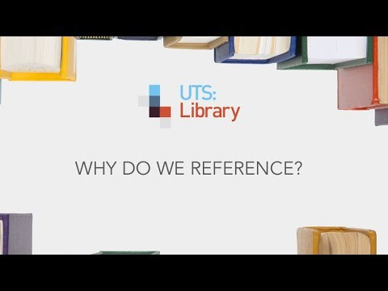
Why do we Reference?
Why do we Reference?
Notes:
When producing an academic assignment, you will be expected to acknowledge other peoples work by referencing them in a recognised and consistent format. You will also need to provide details of the resources you have read for your assignment.

Slide 5

What Referencing System does
UWTSD use?
Notes:
There are a number of different referencing systems that are in use. For this Programme, you will be using Harvard

Slide 6
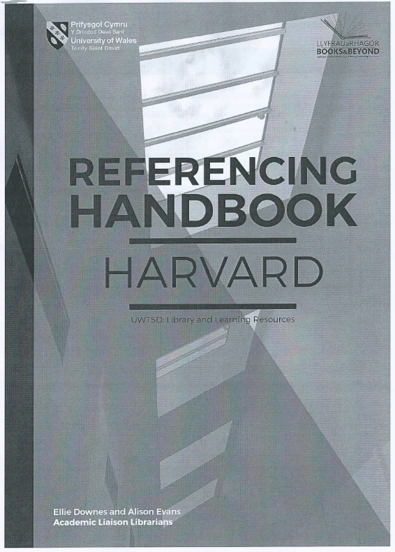
UWTSD Harvard Referencing Handbook
This handbook was created by UWTSD Library, Learning resources, the Academic Office and academic staff members.
Notes:
Your new best friend- use it every time you reference!

Slide 7

Make sure you are using the right referencing style
Keep a record of the sources you read as you go along
Be consistent in the records you keep and in the way you reference
Build in enough time to check your referencing
If in doubt, put yourself in the shoes of the reader and ask if you could easily find the source from your referencing
If in doubt, seek clarification or ask for help

Slide 8
Harvard Referencing: The Basics
In-text citations
A reference list
Harvard referencing
Notes:
In-text citations re used when referring to a source of information within the text of your assignment to show where it came from.
2) The In-text citations then refer you to the REFERENCE LIST or bibliography at the end of your work which has full publication details.

Slide 9
3 ways to Reference
Quote
A quotation means that you take the exact wording as used by another author ad insert it in your work.
Direct quotations should be used sparingly and only when they are relevant to the argument that you are making in your work
Paraphrase
Paraphrasing is when you take someone else’s idea and put it into your own words.
Summarise
Summarising is when you provide a brief overview of someone else’s idea.

Slide 10

I’m going to read a short passage to you all.
Group 1: has to Quote my passage
Group 2: has to paraphrase my passage
Group 3: has to summarise my passage
Notes:
Passage:
“When you are leading, you have to have a good understanding of the individuals you are leading. Every decision you make, every problem-solving process and every opportunity for communication you take require you have some kind of understanding of those you lead directly and how they might react.”

Slide 11
So how do these look on paper?
Long Quotation:
When you are leading, you have to have a good understanding of the individuals you are leading. Every decision you make, every problem-solving process and every opportunity for communication you take require you have some kind of understanding of those you lead directly and how they might react (Morgan, 2017, p.237).
Enter as a separate paragraph
Indent the paragraph
Quotation marks are not required
Follow with the in-text citation

Slide 12
So how do these look on paper?
Short Quotation:
It could be argued that leaders, “have to have a good understanding of the individuals”(Morgan, 2017, p.237).
Include the body of the text
Enclose in double quotation marks; “example”
Follow with the author’s surname, year of publication and page number/URL enclosed (in round brackets)

Slide 13
So how do these look on paper?
Paraphrasing and Summarising:
Morgan (2017) argues that in order for a leader to be successful, they must first understand their followers.
Do not quote word for word
Either Paraphrase or Summarise

Slide 14
What can I reference?
There are a variety of sources that you can reference. There are some important points to note, however;
Ensure that the sources are credible; Academic Journals and Text Books are the most reliable sources
Do not use Wikipedia as a reference- Why?
There are significant differences in how to reference each different source depending on where you got it from.
This is why it is very important that you use the referencing guide whenever you reference.
Notes:
In-text citations re used when referring to a source of information within the text of your assignment to show where it came from.
2) The In-text citations then refer you to the REFERENCE LIST or bibliography at the end of your work which has full publication details.

Slide 15


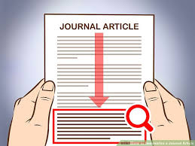

Conferences
Full conference proceedings
Individual conference paper
Journal article
Books
E-Books
Edited Books
Books with 2 or 3 authors
Books with 4 or more authors
Chapter within a book
Book without an author
Editions
Secondary citation
Legal and Government Publications
Internet
Website
Blog
Vlog
Video/ filmsharing website (e.g. Youtube)
Facebook
Newspaper article
Whole newspaper
Newspaper article
Electronic Newspaper article not in print

Slide 16

There are many more examples
And each has its own variation.
PLEASE CHECK THE HANDBOOK!
Notes:
In-text citations re used when referring to a source of information within the text of your assignment to show where it came from.
2) The In-text citations then refer you to the REFERENCE LIST or bibliography at the end of your work which has full publication details.

Slide 17
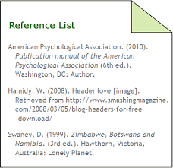
Reference List
Essentially, this is a list of all of the references that you have used in your assignment, giving full publication information.
Again, the content within the reference list for each reference differs depending on where the source is from.
The reference lists needs to be listed alphabetically.

Slide 18
 | In-Text Citation | Reference List
Book | (Author’s surname, year of publication, page number) (Smith, 2016, p.5) | Authors surname and first initial, publication year in brackets, Title in italics, Edition (if relevant), Place of publication: Publisher Smith, E. (2016) How to improve your research project. 2nd Ed. Plymouth: Kiln Press.
Book with 4 or more authors | (Morton et al. 2014, p.37) | Morton, A. C. et al. (2014) Walking and learning. Swansea: Sandpaper Press.
Journal Article | (Author’s surname, year of publication, page number) (Price, 2014, p.157) | Author’s surname and first initial, Publication year in round brackets, Article title enclosed in single quotation marks, Journal title in italics, Volume, Issue/part, page number and range of whole article. Price, S. (2014) ‘Planning for change’, Leadership and Business Planning, 15 (3), pp. 154-166.
Website | (Author’s surname/ organisation, year of publication) | Author’s surname and first initial, Publication year in round brackets, website title in italics, enclose medium [], available at : URL, (Accessed date). McCormack, E. (2016) Dog Breed characteristics. Available at: http://www.dogbreedchar.co.uk/ (Accessed: 19th march 2017).

Slide 19

Important!
Your work will be checked for plagiarism so it is vital that you reference correctly
If you have placed a text etc in your reference list you do not need to mention it again in your bibliography
Make sure you have listed them alphabetically

Slide 20

Now, get into groups of 4/5. You are going to be taking part in a scavenger hunt.
On the piece of paper that I give you, there will be a list of statements.
Your challenge is to find references to support these statements within the Text books in the class.
You may have to swap books with another team to get all of the references!
It is your choice whether you quote directly, summarise or paraphrase. But, if you don’t reference correctly, your team is disqualified! Good luck!

Slide 21
Either go online and take the quick Harvard referencing Quiz to test your knowledge.
https://www.ncl.ac.uk/library/assets/external/teaching/referencing_quiz.html

