Slide 1



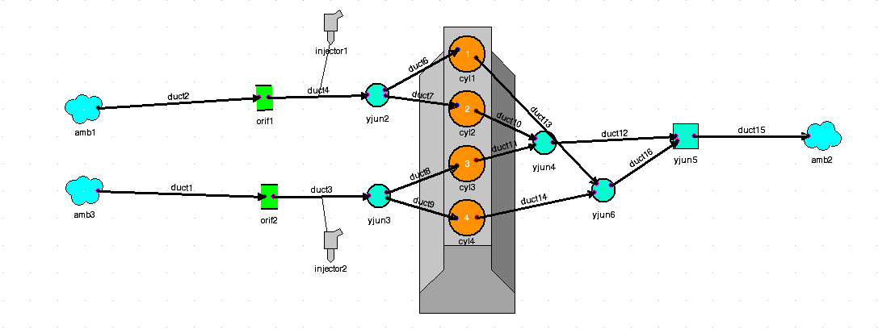








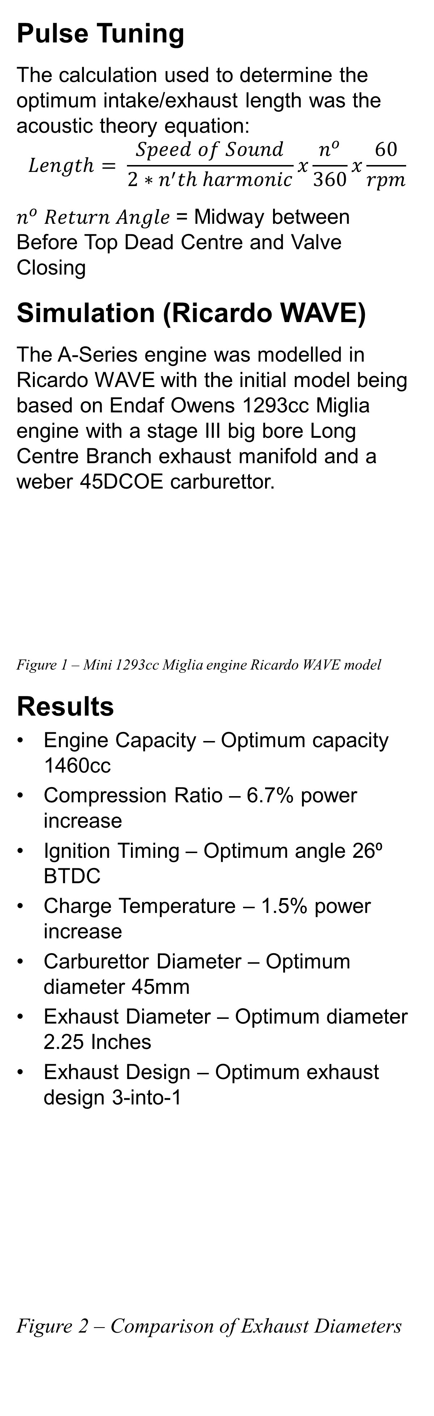
Investigating the tuning potential of the Mini A-Series Engine,
based on theories proposed by David Vizard in his book,
Tuning BL’s A-Series Engine (Vizard, 1990).
Christian Parry
School of Engineering
MSc Motorsport Engineering
Introduction
The British-Leyland A-Series engine is a 61-year-old siamese port 4-cylinder engine design notably utilised to power the Mini from 1959-2001. The Mini is synonymous with motorsport success often offering giant killing performances against bigger more powerful opposition. It is still utilised in a myriad of motorsport disciplines/categories with two of the most popular races/series being the Fastest Mini in the World Race (FMitW), and the Mini Racing 7 Club’s Mini Miglia race championship.
The basis of this project was to analyse the performance potential of the A-Series engine based on a series of factors that could lead to the ultimate A-Series engine which could be used in the FMitW Race. As well as to identify if any performance increase could be achieved via pulse tuning on Endaf Owens 1293cc Mini Miglia engine.
Project Aims
Develop a more expansive knowledge of the A-Series Engine
Investigate the performance potential of the A-Series in different configurations
Create a model of the A-Series engine in Ricardo WAVE so the performance can be analysed
Calculate the ideal intake and exhaust lengths dependent on rpm using first principle pulse tuning equations
Variables Tested
Engine Capacity (848cc – 1596cc)
Compression Ratio (11:1 – 15:1 CR)
Ignition Timing (10⁰ - 30⁰ BTDC)
Charge Temperature (5⁰C - 90⁰C)
Carburettor Diameter (32mm – 50mm)
Exhaust Diameter (1.125 – 3 Inches)
Exhaust Designs (Long Centre Branch, 3-into-1, 3-into-2, 3-into-3)
Pulse Tuning
The calculation used to determine the optimum intake/exhaust length was the acoustic theory equation:
$$Length= \frac{Speed of Sound}{2∗n^{′}th harmonic}x\frac{n^{o}}{360}x\frac{60}{rpm}$$
$n^{o} Return Angle$= Midway between Before Top Dead Centre and Valve Closing
Simulation (Ricardo WAVE)
The A-Series engine was modelled in Ricardo WAVE with the initial model being based on Endaf Owens 1293cc Miglia engine with a stage III big bore Long Centre Branch exhaust manifold and a weber 45DCOE carburettor.
Figure 1 – Mini 1293cc Miglia engine Ricardo WAVE model
Results
Engine Capacity – Optimum capacity 1460cc
Compression Ratio – 6.7% power increase
Ignition Timing – Optimum angle 26⁰ BTDC
Charge Temperature – 1.5% power increase
Carburettor Diameter – Optimum diameter 45mm
Exhaust Diameter – Optimum diameter 2.25 Inches
Exhaust Design – Optimum exhaust design 3-into-1
Figure 2 – Comparison of Exhaust Diameters
Figure 3 – Comparison of FMitW A-Series engines
Figure 4 – Comparison of Exhaust Designs
Analysing Figures 2,3 and 4 show that the optimum exhaust diameter is 2.25 inches as it offers the best power throughout the rpm range. The optimum FMitW engine would either be the 1330cc high compression engine for absolute power or the 1460cc lower compression engine for longevity and low-down power. The optimum exhaust design is the 3-into-1 offering significantly more power than the LCB currently utilised on Endaf Owens Miglia.
Figure 5 – Comparison of Pulse Tuned Critical Lengths
Figure 5 shows that the critical length for the Miglia is 10k rpm resulting in a length of 1532mm.
Conclusion
A-Series Engine study resulted in a power increase of 21.4%
Pulse Tuned 3-into-1 Exhaust design for Endaf Owens Miglia resulted in a 3.3% power increase over the standard Maniflow LCB.
School of Engineering

