Slide 1
Rich Internet Application Development
Linq to SQL

Slide 2


Linq Limitations
Linq allows for querying of standard C# objects.

Slide 3

Linq Limitations
Two obstacles exist in Linq:
  1. The objects need to be populated
  2. The objects are memory resident
Populating objects can be done directly in code, or by loading in from an external source

Slide 4
Linq Limitations
Where there is a large dataset it is not efficient to either code or store Linq objects as memory resident objects
For example a person class may contain millions of rows
Where data is held in a Microsoft SQL database the Linq to SQL framework provides a mechanism to overcome both these obstacles

Slide 5

Linq to SQL
With Linq to SQL the Linq query is directly translated to TSQL so only the query result is held in memory
As part of the query execution Linq compatable C# objects are automatically created and dynamically populated

Slide 6
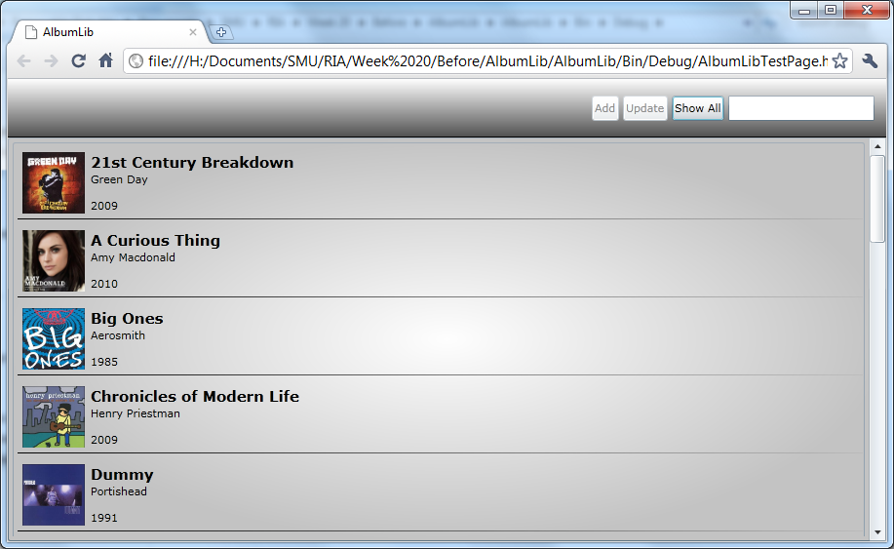
Linq to SQL example

