Slide 1
Taking notes

Slide 2

Notes from sources
Have a notebook or file per module/subject
Create a reference trail
Write book reference at top of page
Be accurate
Ensure clarity between author’s ideas and your comments

Slide 3
An example
Nidhal Guessoum, 2011, Islam's Quantum Question: Reconciling Muslim Tradition and Modern Science,
London: I. B. Tauris
Indeed, Nasr notes that modern science, being a secular enterprise, is an anomaly with regard to human history. He remarks that the Western civilization is the first one to construct a science, a knowledge and description of nature that negates the sacred altogether. He makes a causal link between this fact and the problems that have resulted from science and its applications (technology); indeed, Nasr blames modern science in toto for all the ills that can be found in modern society, from the onslaught on the environment, to the ‘debasement’ of man. (p. 112)
Guessoum acknowledges Nasr’s hypothesis of modern science negating the sacred – cross ref. with physicist Muhammad Abdus Salam’s ideas on page 133.

Slide 4

Online sources
Book mark or ‘favourite’ the whole site
Store useful quotes only
Cut and paste URL, author, date and quote into file of info
Store whole PDF file of journal article – in named file
Or cut and paste quote

Slide 5
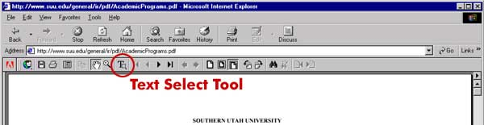
Cut and pasting from a PDF
Go to ‘Tools’
Choose ‘Select and Zoom’
Choose ‘Select Tool’
Now you can cut and paste…

Slide 6
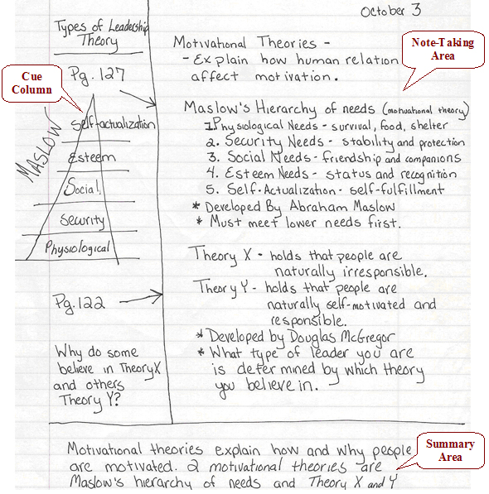
Linear notetaking

Slide 7
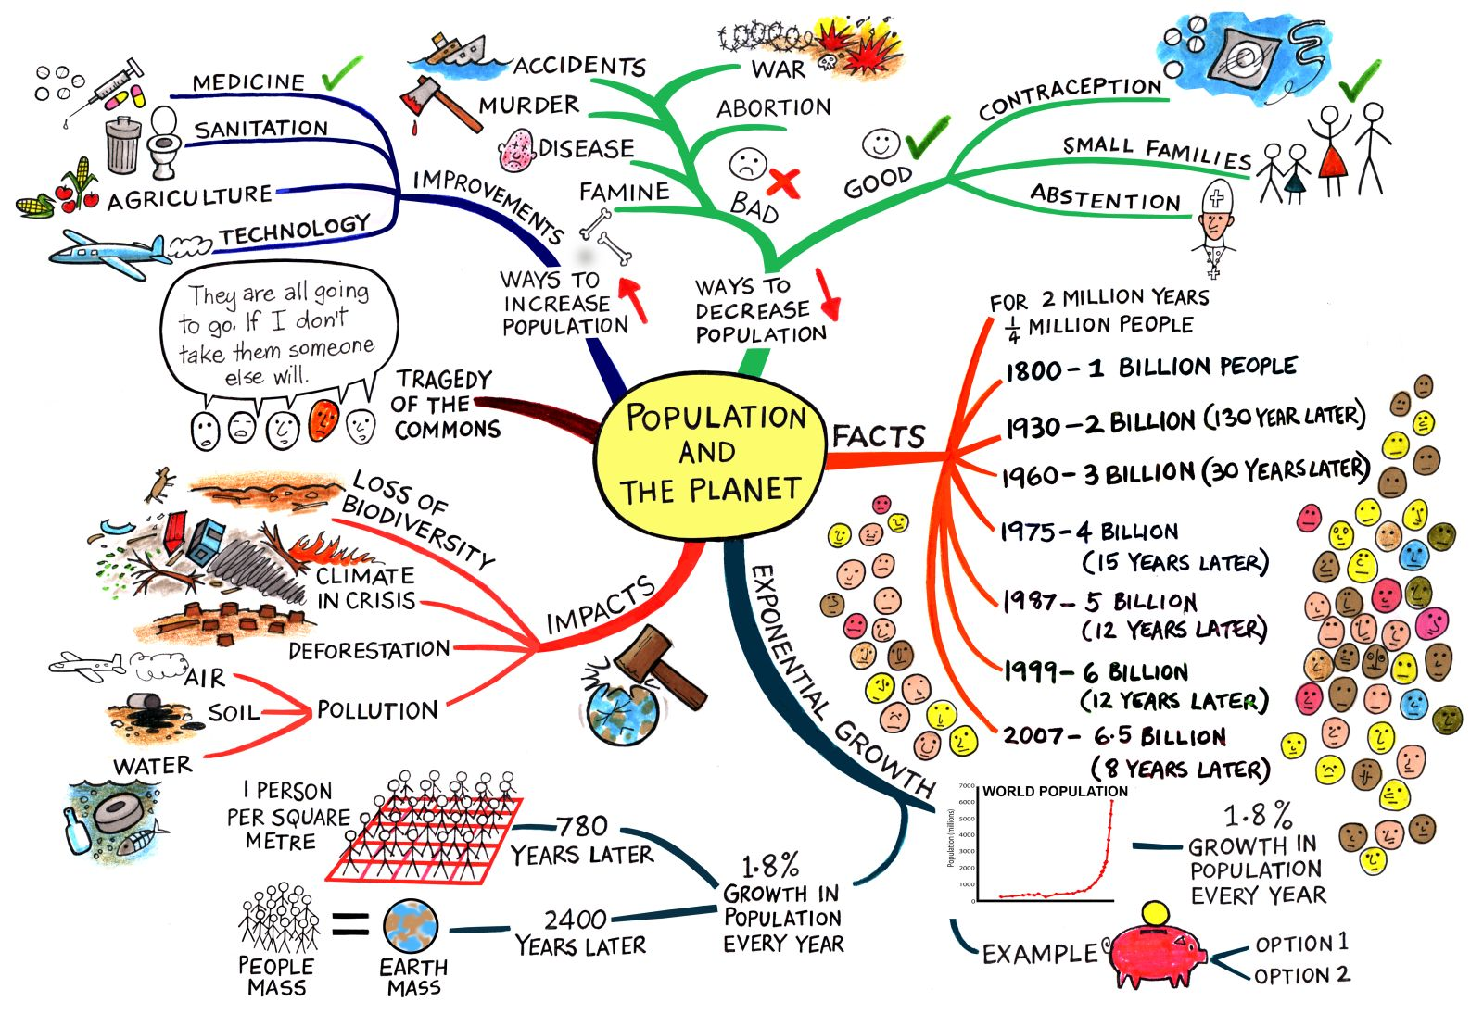
Diagrammatical notetaking

Slide 8

Top tips for taking notes
Accuracy
Brevity
Concentration

Slide 9
Pros and cons
Linear
Diagrammatical
Records in sequence
Can fill any amount of pages
Clearly differentiates between own and other’s ideas
Bullet points can be used
Possibly boring and dull to read back
Good for visual thinkers
Enables personal connections to be made
All info on one page (condensed)
Limited to one sheet
Need software

Slide 10

Search strategies
Break down question to find the topic
  If our topic is the Bible, work out what you want to know about the Bible
  Search databases using search
  principles
Journals, academic books and Qualitative research
Nexis UK – newspaper sources or academic sound websites

Slide 11

How do you apply this?
1. Looking for and choosing texts:
  Module reading lists
  Date/author/publisher
  Contents and index
  Intro or abstract
  Read conclusion
  Use bibliography or reference list

Slide 12
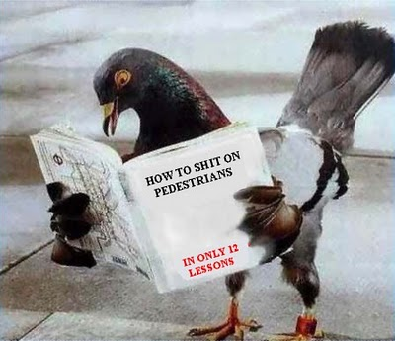
Evaluating texts
Be aware of
  Date/author/publisher
  Primary or secondary source
  Intended audience
  Main thesis
    What evidence is used
  Literary strategies
    Convincing techniques – language, emotions, cited studies, ref to other authors
Notes:
12

Slide 13
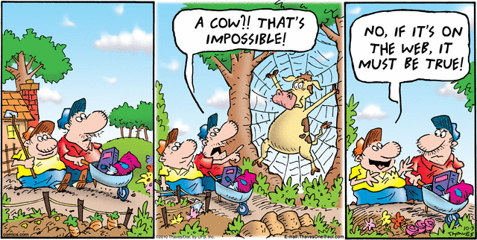
Evaluating online sources
Unregulated
Self-published
Advertising led
Look to URL
  .ac.uk; .edu; .gov.uk, .org
Use Wiki ONLY as stepping stone NOT FOR REFERENCING

Slide 14
Research trail
Log - Places you looked, Search terms you used, Contacts or links made, Things that didn’t work
Bookmark, Favorite or tag web sources
Create a paper trail – Notebooks and files per subject

Slide 15

Your notes should…
Be an overview of the book, chapter or article
Be brief… NOT EVERY WORD
Be constructed of abbreviations
Only contain salient points
Be accurate
Be legible

Slide 16
In summary
Research is fundamental to being a student
Effective research means being aware of the sources’ aims and objectives
There are a variety of methods to do this well
Receiving and storing info needs to be done effectively to be able to access it
Searching for info should be a very large part of your student experience
Searching is best achieved following basic principles
Sources need to be evaluated and stored effectively

