Slide 1

REALISM vs FORMALISM
Saving Private Ryan (Spielberg, 1998)
HPHI5903 War and Cinema

Slide 2
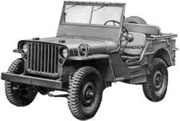
‘The finest war movie of our time’
Janet Maslin, NY Times. 24/7/98
‘It is the Citizen Kane of war movies
Chapman, James . War and Film. Reaktion Books. 2008

Slide 3

International success

Slide 4
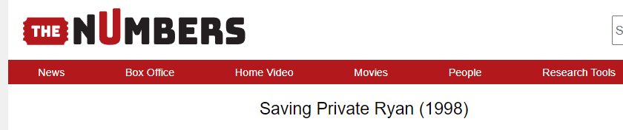
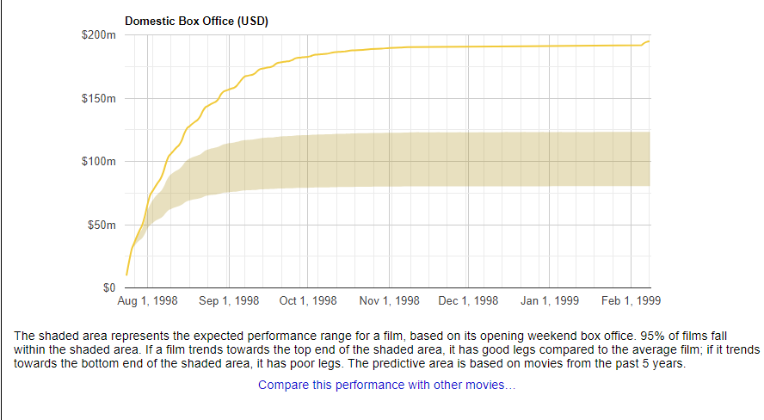

Slide 5
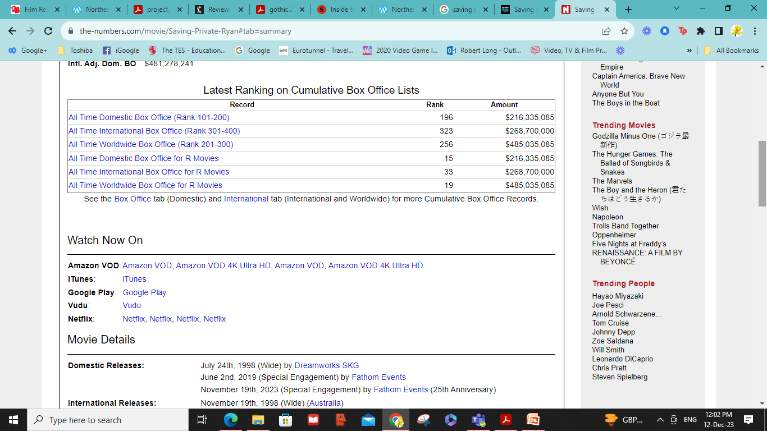
Good numbers for a war film!

Slide 6
Realism?
‘Hollywood’s most grimly realistic and historically accurate depiction of a World War II battlefield’
Landon, P. Realism, Genre, and Saving Private Ryan. Film and History XXVIII/3-4. (1998) Pg.58
‘war as one has never seen it before on screen and hopes to never see it again’
Walker, A. London Evening Standard. 24/7/98. Pg. 37

Slide 7
‘I have never seen combat portrayed so realistically in any other war film I have seen in 60+ years of moviegoing’
US Marine Corp Vet in ‘An Internet Discussion of Saving Private Ryan’ . Film and History XXVII/3-4. (1998) Pg.77
Spielberg War Film Reawakens Veterans’ Fears. The Times (1998)

Slide 8
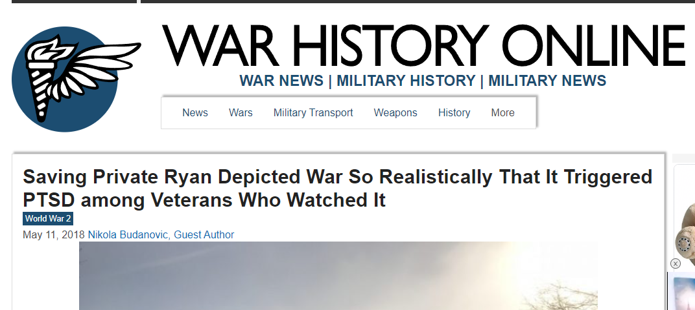
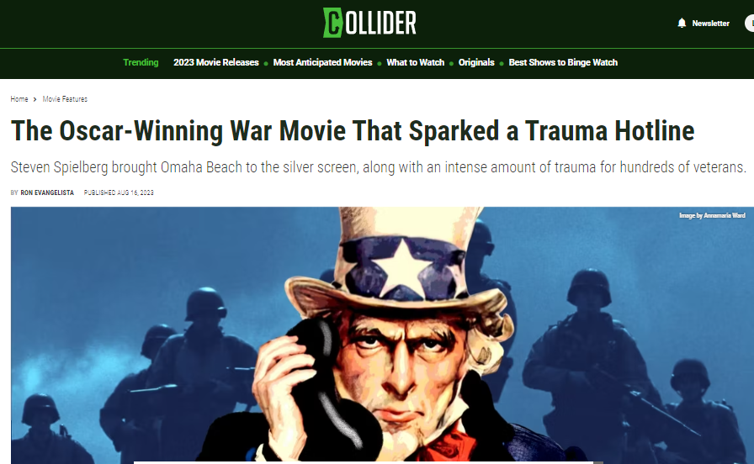
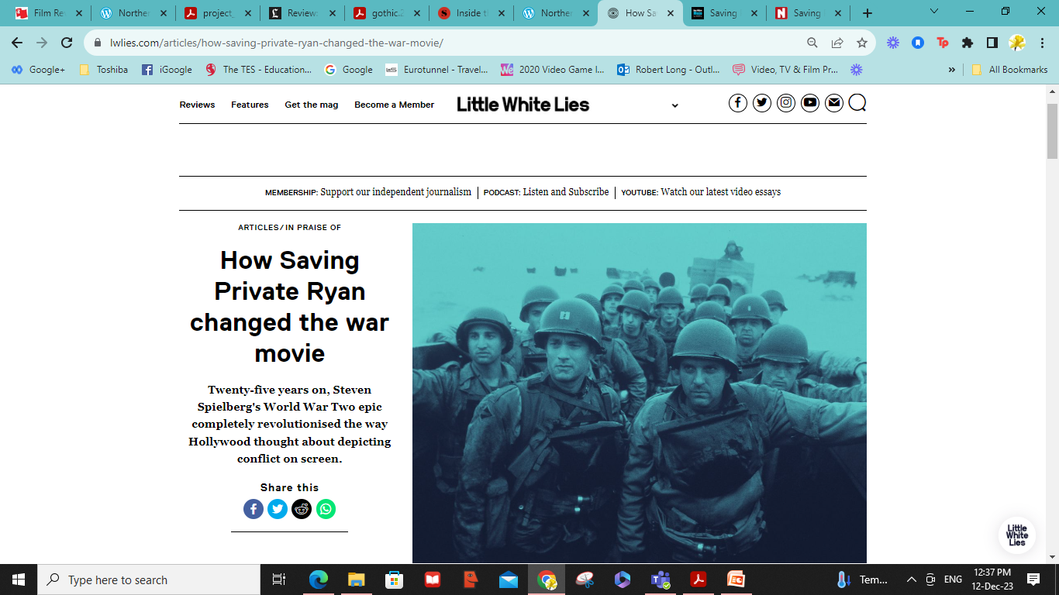

Slide 9
“There were small details he [Spielberg] learned from veterans – GI’s vomiting as they approached the beach from seasickness and fear; dead fish floating on top of the water; the blue ocean stained red with blood – that would completely immerse viewers and set the standard going forward for war films.”

Slide 10
Cinema and immersion theory
‘Contemporary film instigates a level of psychoemotional engagement with a filmic text, typically termed “immersion,” which Janet Murray defines as ‘a metaphorical term derived from the physical experience of being submerged in water [it describes] the sensation of being surrounded by a completely other reality.’ She furthers that, if attained, this state ‘takes over all of our attention, our whole perceptual apparatus.’
Murray, Janet H. Hamlet on the Holodeck .New York: Free Press.(1999) pg.98 (cited in Chapman)

Slide 11
Immersive techniques
[to make viewers ‘forget’ film is a CONSTRUCT]
Invisible or continuity editing
Unobtrusive camera techniques (shot-reverse-shot, point-of-view shots, etc.)
Performance / acting…
...in (usually) linear narratives
In believable mise-en-scene
Continuous dialogue / diegetic or ‘natural’ sounds
Natural(istic) lighting
Etc.

Slide 12
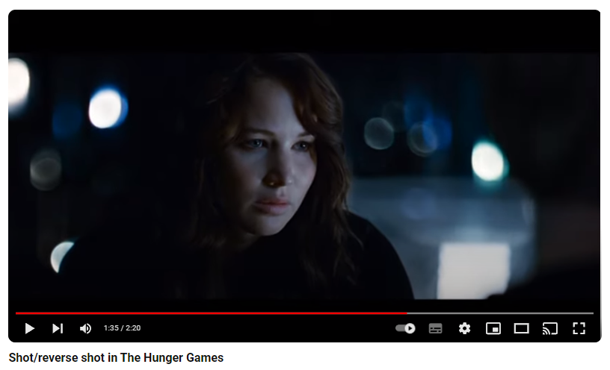
Unobtrusive / immersive camera techniques: shot-reverse-shot
https://www.youtube.com/watch?v=o1Ey0a6LJRA
Viewer as voyeur

Slide 14
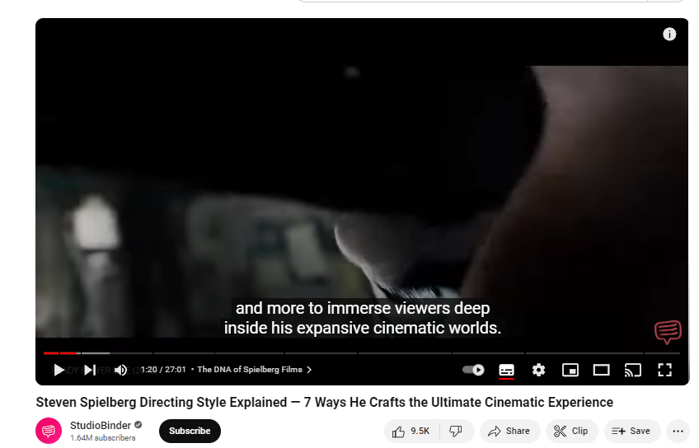
https://www.youtube.com/watch?v=ZyGCyXeVYYg

Slide 15
Perceptual Apparatus
Spielberg used military advisors to choreograph action sequences
Aural authenticity - bullets shot into meat / whizzing through the air / shot into metal
Amputees as actors
Colour desaturation for ‘combat film’ look
Camera ‘image shaker’ when explosions went off
‘splatter’ left on camera lenses
Special effects of men shot / blown up

Slide 16
In Virtual Reality Marie-Laure Ryan differentiates between three distinct types of immersion,
emotional immersion: ‘the response to character,’
spatial immersion, ‘the response to setting,’ and
temporal immersion ‘the response to plot’ (2001: 121).
Further to these, Ryan now identifies a fourth type: epistemic immersion, which is concerned with ‘the desire to know’
Ryan, Marie-Laure. ‘From Narrative Games to Playable Stories: Toward a Poetics of Interactive Narrative’, StoryWorlds: A Journal of Narrative Studies 1, (2009) pg.43-59

Slide 18
Realism vs Formalism
‘Far from being an authentic representation of the experience of battle, Saving Private Ryan was entirely constructed, and therefore inauthentic.
What the film offers is not the reality of war but a sensory simulation of it. In this way the spectator is allowed the thrill (or nausea) of battle without the inconvenience of actually being shot or blown to pieces. In this sense, Saving Private Ryan is no more realistic than a computer game.’
Kolker, R A Cinema of Loneliness. 3rd Edition. Oxford. (2000). Pg 131

Slide 19
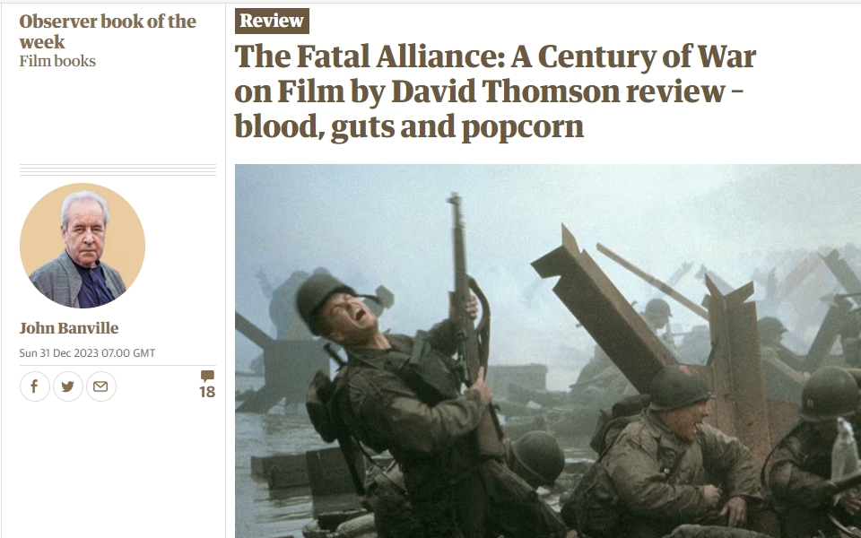
https://www.theguardian.com/books/2023/dec/31/the-fatal-alliance-a-century-of-war-on-film-by-david-thomson-blood-guts-and-popcorn

Slide 20
“…Thomson’s book is as much about war and our non-combatants’ attitudes to it as it is about war movies. This is the dilemma that he returns to again and again, “that there is a tension in all war films between the vivid peril on screen and our demure safety in the dark”. When we enter a cinema, we leave our sense of responsibility behind in the popcorn-strewn foyer. Thomson notes that in what he wonderfully describes as “the vain pandemonium of Hollywood moviemaking”, the playing field – the battlefield – is flat, with no rising ground.”

Slide 21
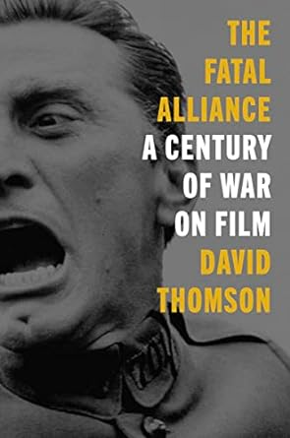
“Something in us, some dark and ultimately unfulfillable longing, is fed by images on a screen of soldiers slaughtering one another, and machines slaughtering soldiers, and cities toppling. In his superb and masterfully engineered book, Thomson …is unflinching in his contemplation of this disturbing hunger.”
https://www.theguardian.com/books/2023/dec/31/the-fatal-alliance-a-century-of-war-on-film-by-david-thomson-blood-guts-and-popcorn

Slide 22
Anti-realist (immersive) devices
Point-of-view shots (in eyes of Hanks)
Slow motion (perception of Hanks)
Muted sounds (in head of Hanks)
Ariel shots
Outside shots e.g. when the door of the lander opens as the marines are shot up
Reverse (over-shoulder) shot of German gunners
Underwater shots
Et.al.

Slide 23
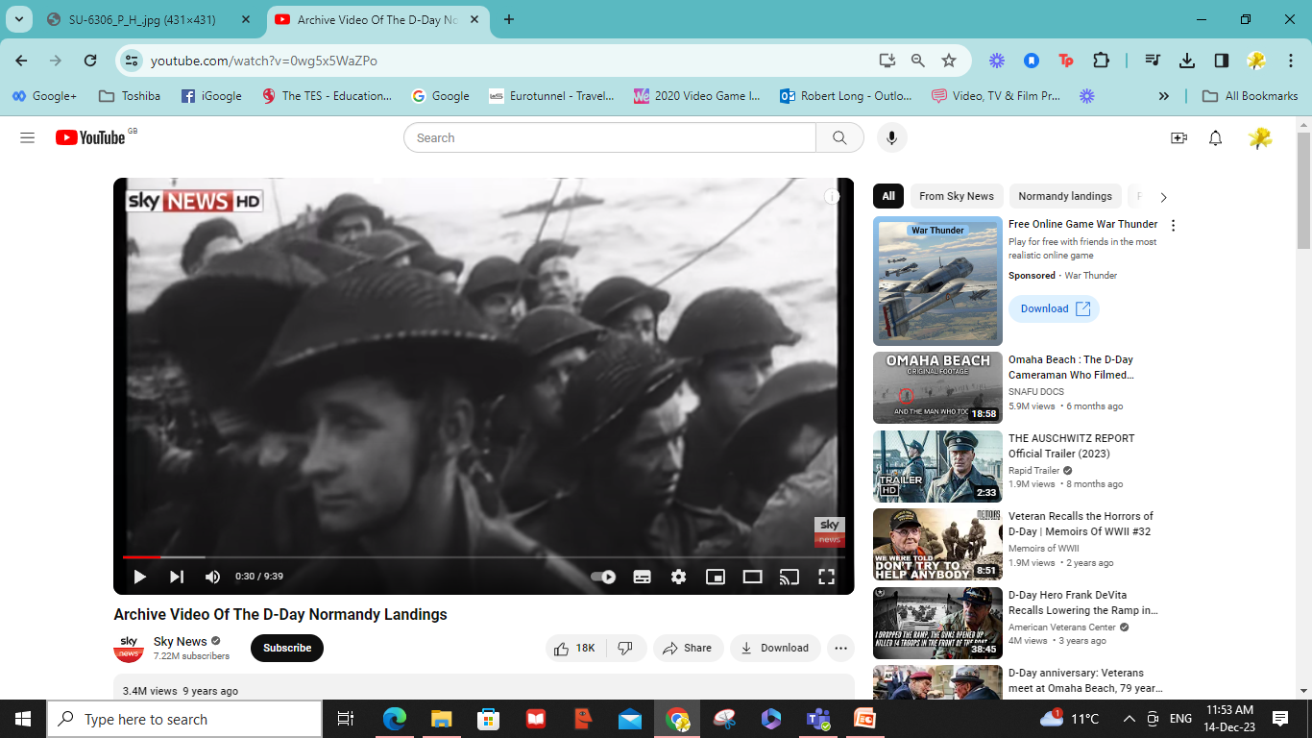
Archive footage

Slide 24
Realism
Formalism
Actual footage / real events
Diegetic sounds
Natural lighting
Natural dialogue
Acknowledgement of camera
Minimal editing
Acting / narrative .
Controlled sound
Artificial lighting
Scripted dialogue
Internal world (diegesis)
Montage edit

Slide 25
Yet, by using anti-realist and artificial devices and techniques, Spielberg achieves a heightened sense of realism…
…the close-ups and carnage ‘more real’ than anything captured by a cameraman on the beaches at D-Day (for obvious reasons!)
REALISM (actual footage) vs FORMALISM
(aesthetic manipulation for desired effect)

Slide 26
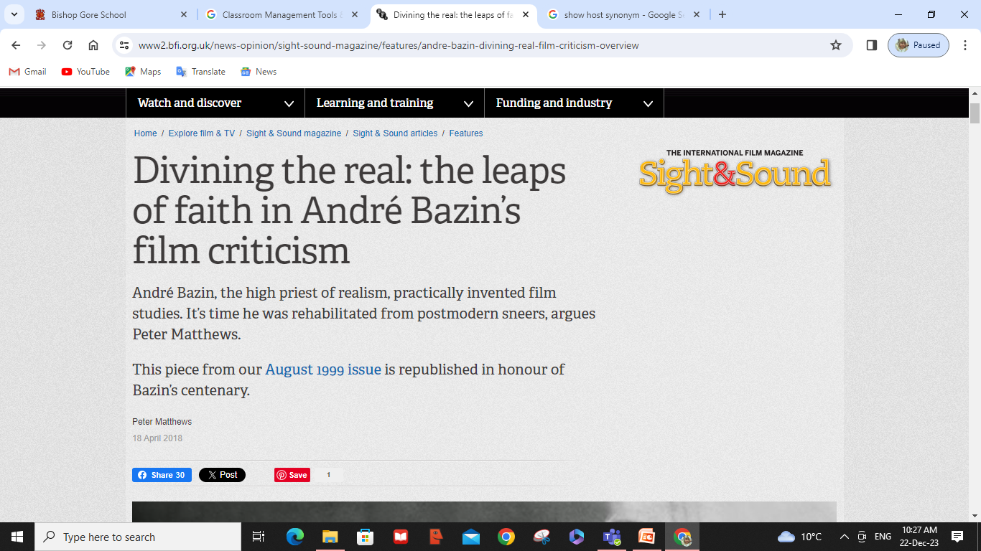
Andre Bazin

Slide 27
https://www2.bfi.org.uk/news-opinion/sight-sound-magazine/features/andre-bazin-divining-real-film-criticism-overview
Bazin recognised that film art always condenses, shapes and orders the reality it records, but what he looked for in filmmakers was a kind of spiritual disposition towards reality – an intention to serve it by a scrupulous effacement of means and a corresponding unwillingness to do violence to it through ideological abstraction or self-aggrandising technique.

Slide 28
Bazin concedes that there is no art without artifice and that one must surrender a measure of reality in the process of translating it on to celluloid. The cinematic staging of the real can be carried out in untold ways, so it would be more suitable to speak of ‘realisms’ than of a single definitive realist mode.
https://www2.bfi.org.uk/news-opinion/sight-sound-magazine/features/andre-bazin-divining-real-film-criticism-overview

Slide 29

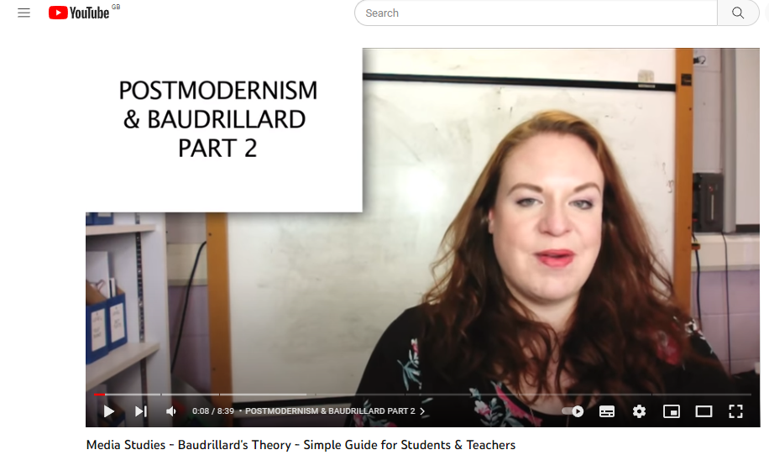
Simulacra and Simulation by Jean Baudrillard
https://www.youtube.com/watch?v=KNd-qSF698A

Slide 30


4 Stages of the Sign-Order
1) The first stage is a faithful image/copy, where we believe, and it may even be correct, that a sign is a “reflection of a profound reality” (pg 6), this is a good appearance, in what Baudrillard called “the sacramental order”. For example, a photo of a king on a piece of paper, we have faith that it is the king in question.
2) The second stage is perversion of reality, this is where we come to believe the sign to be an unfaithful copy, which “masks and denatures” reality as an “evil appearance—it is of the order of maleficence”. Here, signs and images do not faithfully reveal reality to us, but can hint at the existence of an obscure reality which the sign itself is incapable of encapsulating. For example, a fake painting, which is made to look like a real painting. The fake painting is capable of communicating something to the viewer, but the viewer is not capable of deciphering what this means.
Saving Private Ryan

Slide 31


4 Stages of the Sign-Order (continued…)
3) The third stage masks the absence of a profound reality, where the simulacrum pretends to be a faithful copy, but it is a copy with no original. Signs and images claim to represent something real, but no representation is taking place and arbitrary images are merely suggested as things which they have no relationship to. Baudrillard calls this the “order of sorcery”, a regime of semantic algebra where all human meaning is conjured artificially to appear as a reference to the (increasingly) hermetic truth. For example, an advertisement which uses a celebrity to sell a product. The celebrity is not actually endorsing the product, but their image is used in order to make the product seem more appealing.
4) The fourth stage is pure simulation, in which the simulacrum has no relationship to any reality – there is no longer any distinction between the original and the copy. For example, in the movie The Matrix, the characters are actually living in a simulated world, and the world around them is fake.

Slide 32
Which stage is Saving Private Ryan?
The first stage: The faithful image?
The 2nd stage: The unfaithful copy?
The 4th stage: Pure Simulation
The 3rd stage: The absence of reality?

Slide 33
Consider…
Our perception of D-Day has been largely shaped by other films (we live in a mediated society/world)
Spielberg’s perception of D-Day was (probably) also shaped by watching films of the D-Day landings
Yourself when growing up- when you were a teenager did you act the way you did because ‘it’s natural’ or did you watch hundreds of influential media programmes / films featuring ‘teenage behaviour’ that shaped / changed/ justified your own behaviour?

Slide 34
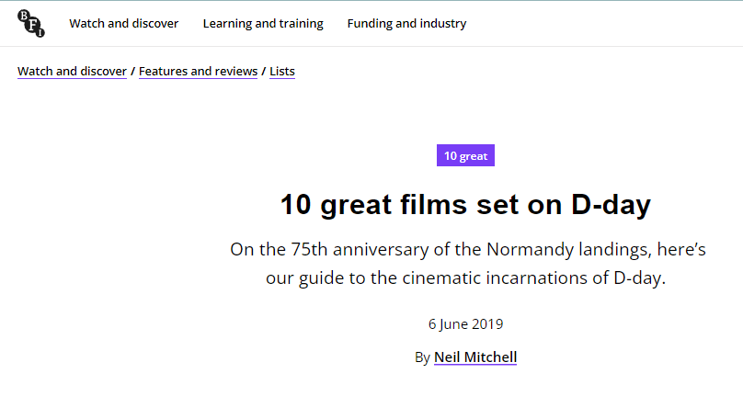
BFI recommends…
https://www.bfi.org.uk/lists/10-great-films-set-d-day

Slide 35
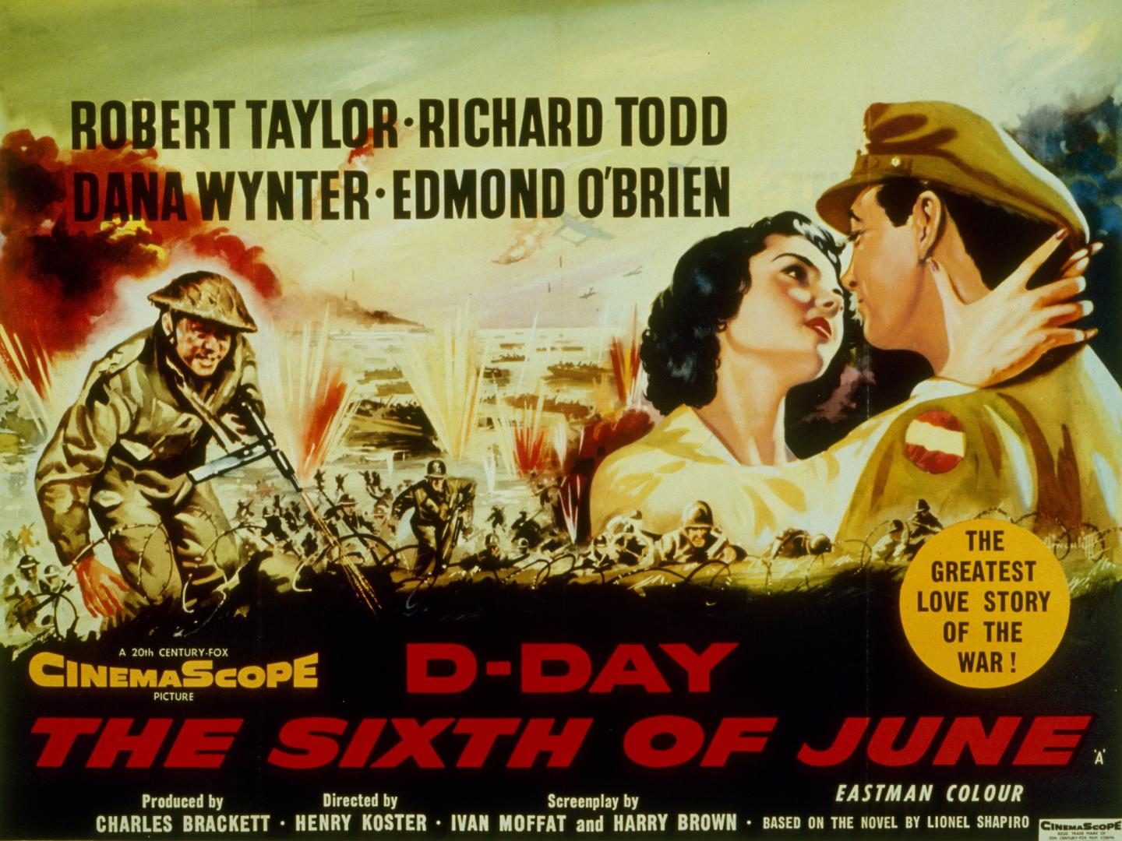

Slide 36
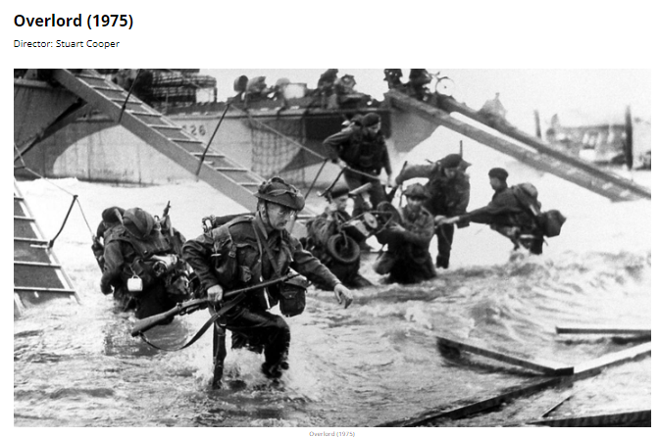

Slide 37
Sombre, poetic and elegiac, American filmmaker, writer and actor Stuart Cooper’s 1975 black and white war drama, Overlord, is stylistically and tonally at odds with the majority of D-day themed films. Eschewing any hints of heroism, bombast or spectacle, Overlord instead explores the grim reality that for thousands of young men the allied invasion was to be a fait accompli ending in their deaths. With no star names in the cast…

Slide 38


Slide 40
Baudrillard
Is Saving Private Ryan a copy of a copy of a copy …
The third stage masks the absence of a profound reality, where the simulacrum pretends to be a faithful copy, but it is a copy with no original

Slide 41
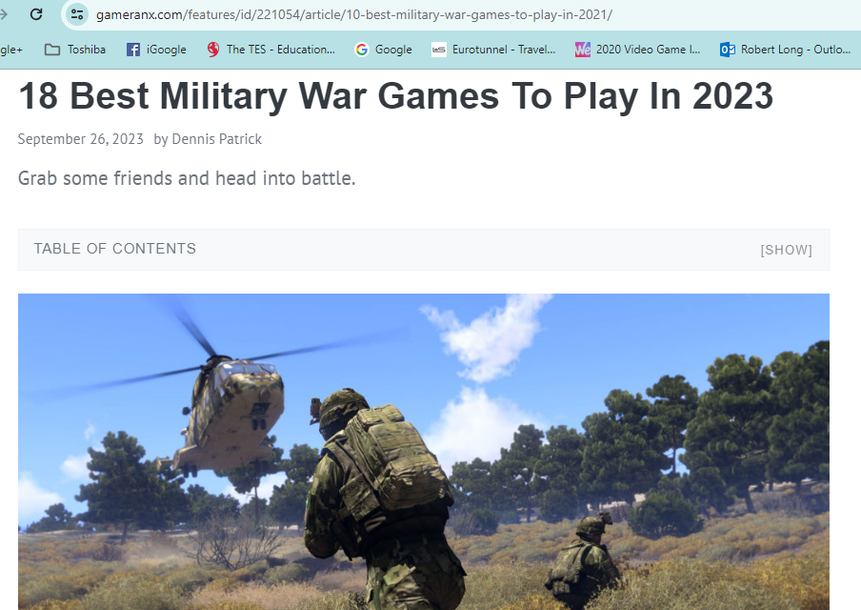
https://gameranx.com/features/id/221054/article/10-best-military-war-games-to-play-in-2021/

Slide 42
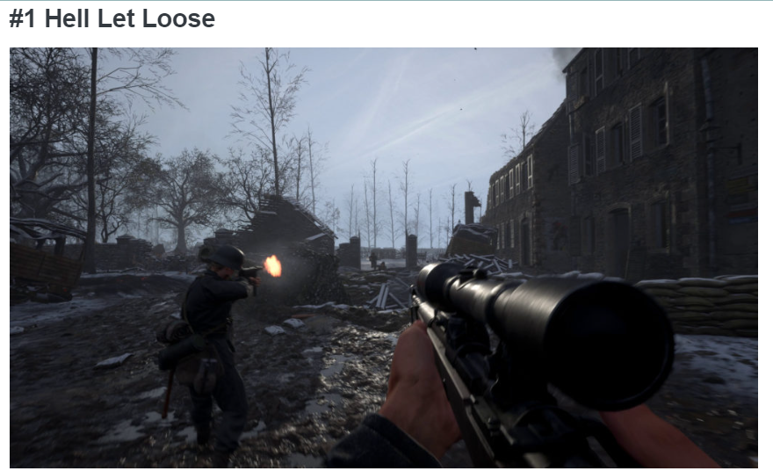
Hell Let Loose is another early access title with the game putting players into an FPS set in World War II. The video game takes players to different iconic battles where you’ll be just another soldier looking to help out your squad in a victory.

Slide 43
‘takes over all of our attention, our whole perceptual apparatus’
Spectacle of danger [war?]
To tell a story [inform/educate]
To set a scene
To feel about a subject
To make money?
Murray, Janet H. Hamlet on the Holodeck .New York: Free Press.(1999) pg.98

Slide 44
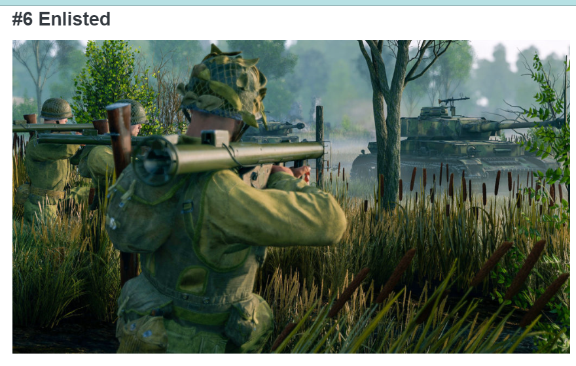
It’s set during World War II, and players will be going through some of the big encounters from that war.

Slide 45
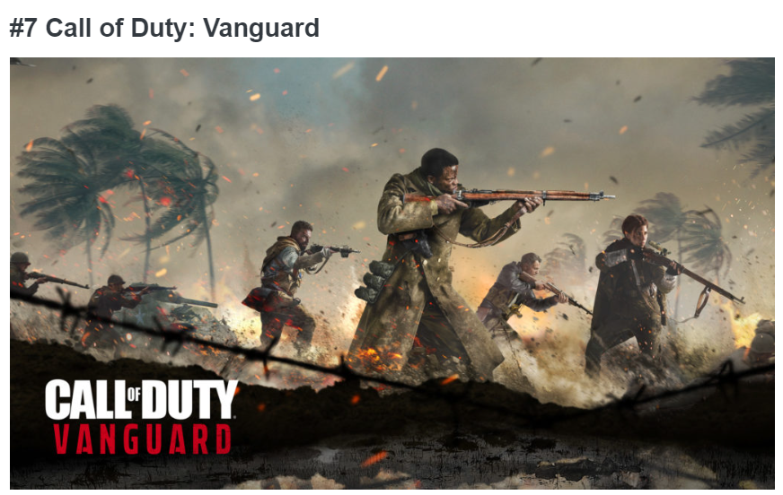
This game puts players right back into the gritty World War II era. The campaign is a bit short, just like previous iterations for the franchise, but you do get to see different frontlines of the war. Most often, players pick these games up for the competitive online multiplayer. You have various game modes to compete in, such as your team deathmatch, domination, search and destroy, and free for all.

