Slide 1

Topic-Business Information Systems in a Growing Business
Course- BA (Hons) Leadership and Management Skills for the Workplace
Module: Managing Business Information (LCLM5004)
Lecturer: Chinomso Nwagboso
Toshko Trifonov – Student ID: 2407602
Kingsley Kuku-Ogunfeibo – Student ID: 2211882

Slide 2
Business Information Systems in a Growing Business
Real-World Examples Including Gymshark

Slide 3
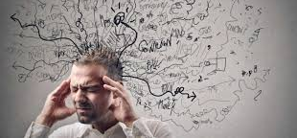

Introduction
Businesses that are on the rise are special to information systems.
The problem of information overload complicates the decision-making of managers.
Digitalisation makes data larger and more complex.
IS facilitates productivity and management (Valacich & Schneider, 2022).
Its emphasis is on business, not technical value.
Scaling organisations Consulting perspective.
Notes:
This presentation discusses how business information systems can be applied in the expansion of organisations. Bigger the business, the more the amount of data it produces that will have to be handled efficiently to aid business and decision making. Lack of proper systems mean that organisations will be inefficient, time wasting, and have low-quality decisions. This presentation takes the consulting approach, which involves the contribution of various information systems to the performance of organisations. Gymshark has been taken as a real world case to provide application however the major focus was on the information systems as opposed to the organization itself.

Slide 4
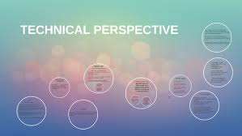

Defining Information Systems
Integration of processes, technology, people and data.
Enhances business and strategic operations.
Business view: creation of value and control (F.M. Mulaydinov, 2024).
Technical perspective: software, databases, hardware.
Allows interdepartmental coordination.
Organisations that rely on data to make decisions start by sustaining a data culture through organizations that are founded on it.
(Mehmood, 2021)
Notes:
Information system could be described as a combination of factors, which gather, process, archive, and exchange information to assist in decision-making and control in an organisation. In terms of business, the information systems help to provide efficiency, coordination and strategic advantage (Mehmood, 2021). Technically, they entail hardware, software, databases and networks. Good information systems help in the alignment of the technical and business goals; data is then converted into meaningful information that can be utilised by the managers to enhance the organisational practices.

Slide 5
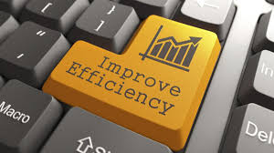
Importance of Information Systems in Business
Improves operational efficiency
Enhances quality of managerial decisions
Supports scalability and growth
Enables competitive advantage
Facilitates real-time reporting
Improves customer experience
Eliminates uncertainty at management levels due to the systematic flow of information.
Facilitates evidence-based decision-making at different levels of the hierarchy.
Facilitates synchronization among the functional departments.
Enhances market and customer responsiveness.
(Zhang et al., 2023)
Notes:
Information systems are very important in the present day organisations as they enhance efficiency and do away with manuals. They give managers accurate and up to date information thus being able to make informed decisions (Zhang, Xu and Ma, 2023). Scalability is especially significant to scaling enterprises where more data and transaction volumes are to be supported. Furthermore, information systems help to lead the competitive advantage as the reactions to the market changes are quicker, customer experience is enhanced by means of better management of data and personalisation of the service. The information systems can be used particularly in the growing organisations where uncertainty is decreased due to the escalating data volumes and complexity of the organisations. Using raw data, systems like MIS and DSS help managers to make the right decisions instead of making them based on their intuition. Information systems also facilitate the coordination across the departments like the marketing, operations and finance departments and this is more essential as firms grow bigger. More so, real-time reporting enables organisations to act promptly with regard to customer behaviour and market dynamics and enhance competitive positioning.

Slide 6
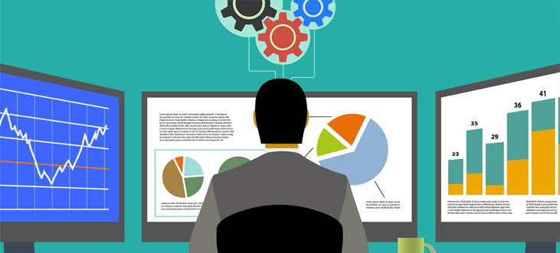
Overview of Business Information Systems
Multiple systems serve different organisational needs
Operational, managerial, and strategic levels
Systems must be integrated
Focus on three key systems
MIS, DSS, and CRM selected
Widely adopted in growing businesses
(Rahman & Ashfaq, 2021)
Notes:
The various kinds of information systems are applied by organisations to facilitate the activities at different levels of management. Operational systems are concerned with routine system and the managerial and strategic systems assist in planning and decision making (Rahman and Ashfaq, 2021). This presentation is on three systems which are used extensively; Management Information systems, decision support systems, and Customer relationship management systems. Such systems apply especially to business that are expanding since they can help to control, analyze and connect with customers. One has to integrate these systems to enhance organisational value.

Slide 7
Management Information Systems (MIS): Benefits and Limitations
Benefits of MIS | Limitations of MIS
Improves monitoring and organisational control | Limited analytical flexibility
Supports structured decision-making | Not suitable for unstructured or strategic decisions
Enhances reporting efficiency | Highly dependent on data accuracy
Facilitates coordination between departments | Can become rigid in rapidly changing environments
Improves operational visibility | Requires ongoing system maintenance
(Aminuddin Hamdat et al., 2024)
Notes:
While MIS enhances managerial control and reporting efficiency, its reliance on structured internal data limits its effectiveness in dynamic strategic environments. Moreover, the system’s limited analytical flexibility can restrict managerial responsiveness when rapid decision-making is required

Slide 8
Comparative Analysis of MIS, DSS, and CRM
System | Primary Users | Decision Type | Strength | Limitation
Management Information Systems (MIS) | Middle-level managers | Structured and routine decisions | Provides regular, standardised reports that support monitoring, control, and operational efficiency | Limited analytical capability and flexibility for unstructured or strategic decision-making
Decision Support Systems (DSS) | Senior managers and analysts | Semi-structured and strategic decisions | Supports complex analysis, scenario modelling, and data-driven strategic planning | High dependency on data quality and analytical expertise; can be costly to implement
Customer Relationship Management (CRM) | Marketing, sales, and customer service teams | Customer-focused and relationship-based decisions | Centralises customer data, enabling personalised communication and improved customer retention | Privacy, security, and compliance risks; high implementation and training costs
Notes:
In this comparison we find that MIS, DSS and CRM systems play a different albeit complementary roles in organisations. MIS is efficient and controls, DSS facilitates analytical and strategic cognitive, and CRM is customer-oriented decision-making. There is no single system which is adequate alone, however, system integration maximises organisational value and helps to support sustainable growth.

Slide 9
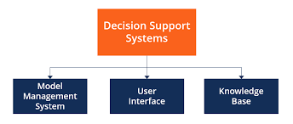
Decision Support Systems (DSS)
Supports semi-structured decisions
Uses data models and analytics
Combines internal and external data
Enhances strategic planning
Improves managerial judgement
Requires high-quality data
Big analytical skills are needed.
Exorbitant implementation costs and maintenance costs.
(Wang & Wang, 2022)
Notes:
The Decision Support Systems are used to help managers to make semi-structured and complex decisions through the help of analytical models and simulations. DSS, unlike MIS, enables users to see alternative scenario and compare the alternatives (Wang and Wang, 2022). Such systems have a tendency to combine both internal and external data aiding the strategic planning and forecasting. Decision Support Systems help managers to deal with semi-structured and complex decisions through synthesising both analytical models and internal and external data sets. Despite the fact that DSS is more effective in strategic planning and analyzing the scenarios, it needs users who are proficient in analytical results. Moreover, costs of implementation and difficulty of integration of the data can restrict its use by smaller or resource-starved businesses.
Although DSS better enhances the quality of decision-making process, the quality of data underlying decision-making is considered to play a paramount role in its effectiveness, which is why data governance is an essential factor of consideration.

Slide 10
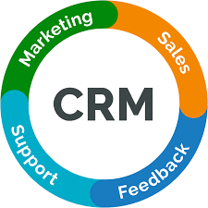
Customer Relationship Management (CRM)
Centralises customer data
Supports marketing and sales activities
Enables personalised communication
Improves customer retention
Enhances customer experience
Raises privacy and security concerns (Stefanov et al., 2023)
Large implementation and training expenses.
The risk of excessive gathering of personal information.
Notes:
Customer Relationship Management systems are aimed at dealing with customers across the customer lifecycle. CRM simplifies customer management by centralising customer information which helps an organisation to offer customer tailored communication and enhance retention. In the case of expanding companies, CRM facilitates the ability to engage customers at magnitude and base marketing decisions. Nonetheless, mass gathering of customer information carries with it ethical and legal dangers especially in data privacy and data security. When working with CRM systems, organisations need to be responsible in regards to data protection rules. CRM ensures customer data is centralised in order to facilitate the marketing, sales and service activities. Although CRM increases customer interaction and retention, it brings major problems concerning data privacy, system expenditures, as well as employee training. Companies have to strike the balance between the advantages of individualised communication and ethical and legislative demands concerning the privacy of customer information, namely, in the provisions of GDPR.

Slide 11
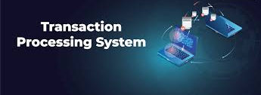
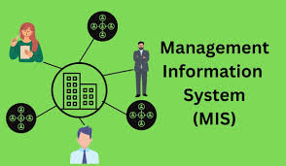
Information Systems Across Decision Levels
Operation level: Transaction Processing Systems (TPS).
Managerial level: Control and monitoring MIS.
Strategic level: BI and DSS of long-term planning(Alasiri & Salameh, 2020).
Notes:
Information systems facilitate decision making in various levels of the organisation. Operational-level The routine business activities are captured in transaction processing systems. MIS at the managerial level combines this information in form of structured reports to help it monitor and control. DSS and BI systems allow senior managers to evolve trends and compare options and make long-term decisions at the strategic level. The interpretation of this fit would be a guaranteed implementation by organisations of systems that would fit their requirements as managers.

Slide 12
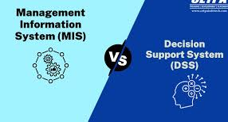
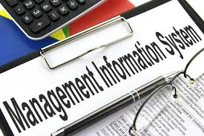
Comparative Analysis of Systems
MIS: operational control and reporting
DSS: analytical and strategic support
CRM: customer-focused information management
Different users and decision levels
Complementary, not standalone systems
Integration maximises value
(Mattke et al., 2022)
Notes:
MIS, DSS, and CRM complement each other in various capacities in organisations. MIS is efficiency and routine reporting oriented, DSS is analytic and strategic decision-making oriented and CRM is customer-related information management. The systems focus on the various managerial requirements and users (Mattke et al., 2022). These systems instead of being independent should be integrated to bring uniformity in data flow and well-informed decision-making in the organisation. Integration enables the overall performance of an organisation in general, and facilitates sustainable growth.

Slide 13
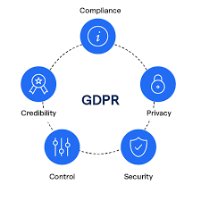

Ethical and Legal Considerations
Data privacy and GDPR compliance
Risk of data breaches
Ethical use of customer data
AI decision-making bias
Employee monitoring concerns (Taherdoost, 2023)
Need for governance frameworks
Data ownership and consent
Algorithmic transparency
Surveillance vs productivity balance
Notes:
The application of information systems initiates strong ethical and legal issues. To protect personal data, organisations should meet the data protection laws including GDPR. Lack of proper data security may lead to breach which breaks trust and reputation. The growing dependency on information systems evokes ethical and legal issues of privacy of data, security of data and determining the influence of algorithms. To remove bias and discrimination, organisations need to be transparent about the decisions that are made using AI. Monitoring systems also present ethical dilemmas in the face of employee monitoring systems that need a balance between employee productivity and personal privacy. Negligence to meet these issues may lead to the reputation and prosecutions.
Also, decision-making with the support of AI can come with bias due to insensitive design of systems. Ethical issues are also associated with employee and customer surveillance. Well established governance systems are necessary to make information systems use responsible and transparent.

Slide 14
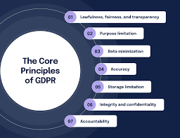

Mitigation Strategies and Governance Frameworks
Data policies in conformity to GDPR
Role-based access controls
AI decisions being controlled by humans.
Regular system audits
Notes:
Organisations are well advised to have sound governance structures as a measure of curbing the risks posed by ethics and legal issues. These are data policies that comply with the requirements of the GDPR, access controls in the prevention of misuse, and regular audits to guarantee the integrity of the systems. In the systems that utilize AI, human supervision is necessary to avoid bias or unethical results. All this indicates good management and boosts the trust of the stakeholders.

Slide 15


Gymshark as a Real-World Example
Rapidly growing UK-based business
Heavy reliance on digital systems
Use of CRM for customer engagement
Analytics to support decision-making
Challenges of data scalability
Importance of ethical data handling
(Kowsar & Rahman, 2022)
Notes:
A good example to demonstrate how growing businesses utilize information systems in the support of operations and customer interaction is presented by Gymshark. By referring to CRM systems to manage customer relationships, the company depends on analytics to make decisions. The issues that come with rapid growth are large volumes of data and integrations required in systems (Kowsar and Rahman, 2022). The case of Gymshark shows how efficient and ethical data use and scalable systems are crucial to reduce the organisation and ensure profitability, trust, and compliance in time of growth.

Slide 16


Gymshark – Impact of Information Systems on Performance
Quicker decision-making with the use of analytics.
Improved customer relationship through CRM
Difficulties in expanding data
(Zhang et al., 2023)
Notes:
The growth of Gymshark proves the effectiveness of information systems and their role in improving the operational efficiency and customer experience. CRM systems are helpful in customised marketing, whereas analytics-based tools help in making strategic decisions. Nevertheless, high growth rates also present the problems associated with data scalability and the ethical usage of the data, which support the necessity of the well-controlled and combined systems.

Slide 17
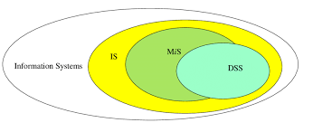
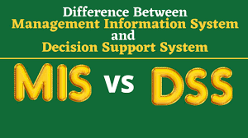
Consulting Recommendations for Growing Businesses
Incorporate MIS, DSS and CRM systems.
Invest strategically in data governance frameworks and advanced analytics capabilities.
Realign IS strategy to growth goals
Notes:
As a consulting firm, expanding companies are advised to emphasise the consolidation of the main information systems to guarantee the consistency of the data and strategy. To manage ethical risks, analytics capabilities and governance frameworks should be greatly invested in to maximise system value. Choosing information systems in a strategic manner increases the quality of decision making and the long term organisational performance.

Slide 18

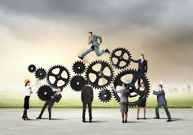
Information Systems Integration and Organisational Performance
Incorporation connects information between departments.
Eliminates redundancy and information isolation.
Enhances the precision and predictability (Som & Anyigba, 2022)
Improves the cross-functional decision-making.
Facilitates the expansion of business.
Notes:
Information systems integration: this is the harmonisation and integration of the various systems like MIS, DSS and CRM to facilitate a smooth flow of data between organisational processes. Increasing businesses, disintegrated systems usually cause replicated information, inconsistent reports, and slow decision-making. Integrated systems also contribute to improved accuracy of the data and allows the managers to retrieve one reliable source of information. This encourages cross-functional integration of various departments e.g. marketing, operations, and finance. Performance wise, integration enhances operational efficiency, increases strategic planning and makes sure that the information systems scale as the organisations grow.

Slide 19
Information Systems as a Source of Competitive Advantage
Facilitates strategic decision making which is data-driven.
Enhances responsiveness in a timely manner.
Improves customer understanding and contact.
Favors innovativeness and flexibility.
Very hard to be replicated by the competitors.
Notes:
Information systems give sustainable competitive advantage provided that they are strategically aligned to organisational goals. Systems like DSS and CRM can enable firms to make decisions more quickly and more responsive to market changes because the system facilitates the implementation of data-driven decisions. Better business understanding assists in personalised customer interaction that enhances their satisfaction and loyalty. Also, information systems support innovation in the way that they help organisations experiment on new business models and processes. Well incorporated and implanted into the organisational practices, these systems become inaccessible to competition and this enhances competitive advantage in the long run.

Slide 20
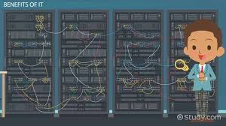

Conclusion & Recommendations
Information systems are critical for growth
Different systems serve different needs
Integration enhances decision-making
Ethical risks must be managed proactively
Growing firms should prioritise scalability
Strategic system selection improves performance
(Aminuddin Hamdat et al., 2024)
Notes:
In the expanding businesses, information systems are crucial in ensuring efficiency, decision making and customer experience. CRM, MIS, and DSS perform different roles in organisation and are to be applied in a combination of a form(Aminuddin Hamdat et al., 2024). Ethical issues such as those related to data privacy and security need to be dealt with ahead of time. In case of scaling organisations, the need to focus on flexible and scalable information systems will result in sustainable expansion and competitive advantage.

Slide 21
References
Aminuddin Hamdat, Ceskakusumadewi B, Samalam, AG, Muhammad Rizal & Izaac L.D Lawalata 2024, ‘The Impact of Management Information Systems on Decision-Making Efficiency’, VIFADA MANAGEMENT AND DIGITAL BUSINESS, vol. 1, no. 2, pp. 56–74.
Bambang Widjanarko Susilo & Susanto, E 2024, ‘Employing Artificial Intelligence in Management Information Systems to Improve Business Efficiency’, Journal of Management and Informatics, vol. 3, no. 2, pp. 212–229.
F.M. Mulaydinov 2024, INTEGRATED INFORMATION SYSTEMS IN INDUSTRIAL ENTERPRISES AND BUSINESS ACTIVITIES, Kokand University Research Base.
Kowsar, MM & Rahman, MA 2022, ‘ENTERPRISE RESOURCE PLANNING AND CUSTOMER RELATIONSHIP MANAGEMENT INTEGRATION: A SYSTEMATIC REVIEW OF ADOPTION MODELS AND ORGANIZATIONAL IMPACT’, Review of Applied Science and Technology, vol. 01, American Scholarly Publishing Group Inc, no. 02, pp. 26–52.
M. Alasiri, M & Salameh, AA 2020, The Impact of Business Intelligence (BI) and Decision Support Systems (DSS): Exploratory Study, papers.ssrn.com, Rochester, NY.
Mattke, J, Maier, C, Weitzel, T, E. Gerow, J & B. Thatcher, J 2022, ‘Qualitative Comparative Analysis (QCA) In Information Systems Research: Status Quo, Guidelines, and Future Directions’, Communications of the Association for Information Systems, vol. 50, pp. 208–240.
Mehmood, T 2021, ‘Does Information Technology Competencies and Fleet Management Practices lead to Effective Service Delivery? Empirical Evidence from E- Commerce Industry’, International Journal of Technology, Innovation and Management (IJTIM), vol. 1, no. 2, pp. 14–41.

Slide 22
References
Rahman, MdM & Ashfaq, S 2021, ‘DATA-DRIVEN DECISION SUPPORT IN INFORMATION SYSTEMS: STRATEGIC APPLICATIONS IN ENTERPRISES’, International Journal of Scientific Interdisciplinary Research, vol. 02, no. 02, pp. 01-33.
Som, JO & Anyigba, H 2022, ‘Examining the Effects of Information Systems Usage and Managerial Commitment on Supply Chain Performance: The Mediating Role of Supply Chain Integration’, SAGE Open, vol. 12, no. 2, p. 215824402210912.
Stefanov, T, Varbanova, S, Stefanova, M & Ivanov, I 2023, ‘CRM System as a Necessary Tool for Managing Commercial and Production Processes’, TEM Journal, vol. 12, no. 2, pp. 785–797.
Taherdoost, H 2023, ‘Legal, Regulatory, and Ethical Considerations in E-Business’, EAI/Springer Innovations in Communication and Computing, pp. 379–402.
Valacich, JS & Schneider, C 2022, Information Systems Today.
Wang, H & Wang, S 2022, Teaching Tip: Improving Student Performance by Introducing a No-Code Approach: A Course Unit of Decision Support Systems, AIS Electronic Library (AISeL).
Zhang, X, Xu, YY & Ma, L 2023, ‘Information technology investment and digital transformation: the roles of digital transformation strategy and top management’, Business Process Management Journal, vol. 29, no. 2, pp. 528–549.

