Slide 1

Cop culture, Diversity and professionalism in the police
Christopher Grey
SN: 1800281

Slide 2
Introduction
Throughout the years, there have been concerns over the way in which the police operate and conduct themselves. From instances of misconduct to the police being described as institutionally racist, these issues have made people question the integrity and capability of the police. Moreover, these issues have also brought about calls for a total transformation of our police service, with some going as far as to say that the police force should be defunded. This presentation will aim to analyse cop culture, diversity, and professionalism in the police and determine whether there currently is a fundamental issue with our police service.

Slide 3

What is cop culture
Shared beliefs, values, and attitudes (Sage Publications, 2022).
Informal rules and promises (Sage Publications, 2022).
Cop Culture: Good or Bad?

Slide 4
Core characteristics of cop culture
Mission - Action – Cynicism - Pessimism
Suspicion
Prejudice
Isolation – solidarity
Conservatism
Machoism
Pragmatism
(Korander. 2019; Reiner, 2010)

Slide 5

Social Identity theory
Henri Tajfel
Identifying with specific groups
Provides a sense of belonging
Provides a sense of self-esteem
(McLeod, 2023)

Slide 6
Social identity theory and cop culture
Individuals identify with specific attributes
Common mission
Provides a feeling of belonging
Boosts self-esteem

Slide 7
Examples of cop culture
Mission orientated
Us versus them mentality
Blue wall of silence
Warrior mentality

Slide 8

Mission orientated
Clear Goals
Complete focus on the task at hand
Comprehensive plan
Multiple tactics and strategies
(Home Office, 2022; Veteran Affairs, 2012)

Slide 9
Positives?
Hard stance on crime
Deter crime
Improve public trust and confidence
Crime Control model (Burke et al., 2022)
Broken windows theory (Ruhl, 2023)

Slide 10
Negatives?
Some crimes could be overlooked
Lack of community interaction
Community policing (US DOJ, 2014)

Slide 11

Us versus them mentality
Officers can feel as if they are distinct and different from those they serve
Officers may feel that they have authoritarian power over communities
Can lead to officers perceiving individuals as a potential threat
Social identity theory
(American Military University, 2019)

Slide 12
Negatives
Conflicts
Excessive and extreme force
Damages the reputation of the police
Reduces effectiveness of the police
(American Military University, 2019; Sachs, 2020)

Slide 13
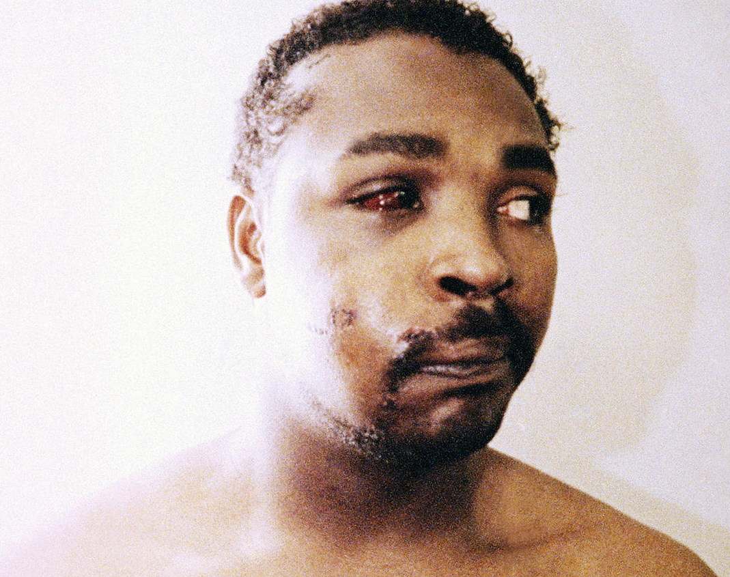
Rodney King
(CBS News, 2013)

Slide 14

Blue wall of silence
Unofficial agreement between officers
Refers to officers not reporting another officer for their conduct
Also refers to officers not questioning the conduct or motives of another officer.
.
(Skolnick, 2002; Nolan, 2009; Walker, 2023)

Slide 15
Negatives
Covering up corruption, negligence, misconduct etc (Walker, 2023; Nolan, 2009).
Those who break the “code” are punished (Al-Gharbi, 2020).
Damages public trust in the police

Slide 16
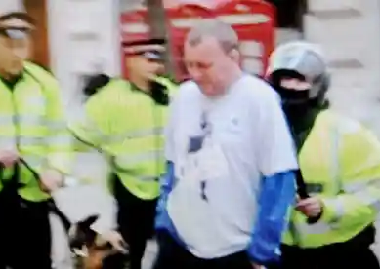
Ian Tomlinson
(The Guardian, 2009)

Slide 17
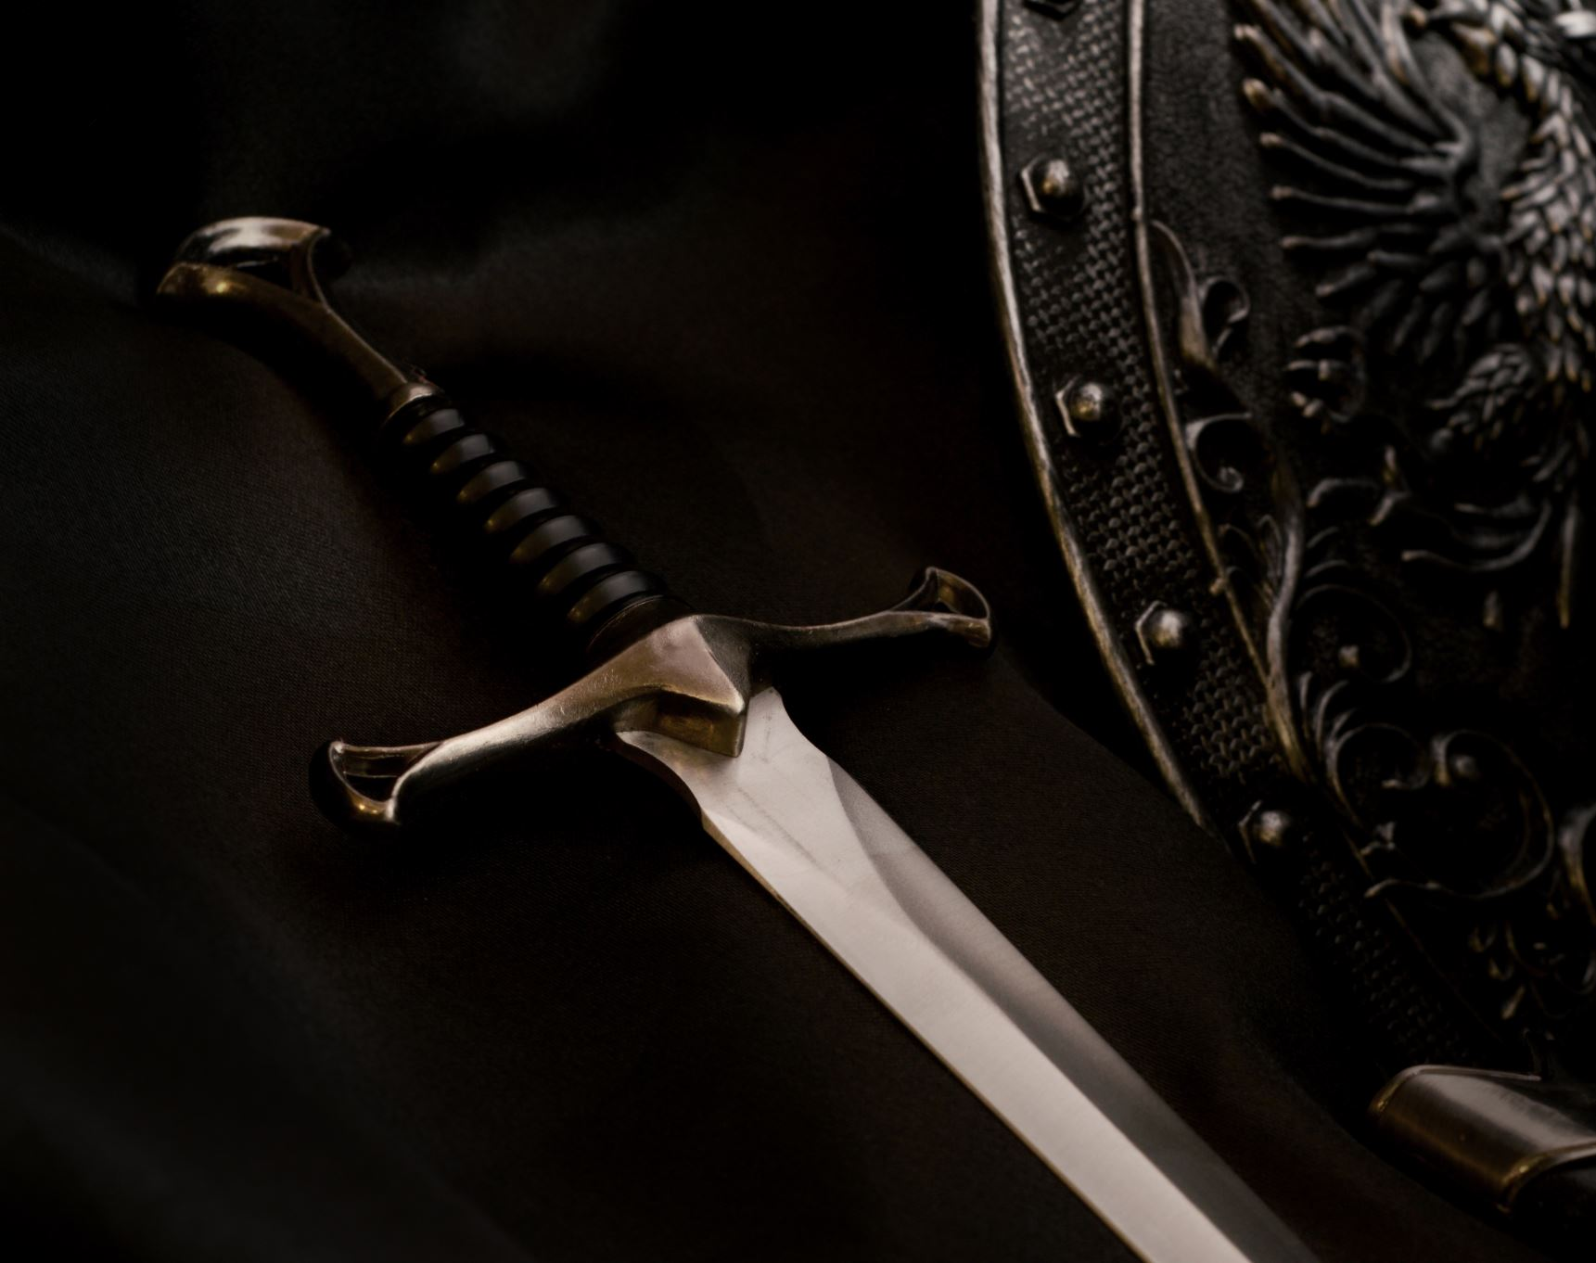
Warrior mentality
Militaristic
Fearless
Never quitting
(American Military University, 2019)

Slide 18
Negatives
Relies on aggressive forms of policing
Creates avoidable violence
Guardian Mindset has been argued to be more effective
(American Military University, 2019; Rahr & Rice, 2015)

Slide 19
Is police culture unavoidable?
Not unchangeable (Chan, 1996).
Can be resisted

Slide 20
Diversity in the police
Historically – Very little diversity
Rampant amounts of discrimination
Attempts have been made to diversify

Slide 21
The Equality Act 2010
116 pieces of legislature into 1 act
Protects people from discrimination
Some Protected characteristics: Age, Sex, Race, Religion, Disabilities

Slide 22

Statistics
93.1% of police officers are White (UK Government, 2020)
64.5% of police officers are Men (Statista, 2022)

Slide 23

Reasons for a lack of diversity in the police?
Racism
Discrimination
Sexism

Slide 24
Diversity and the police
Described as institutionally racist
Discrimination
Over-policing of ethnic minority communities (Llanos, 2021)
Numerous cases of police failures and negligence

Slide 25
Over policing
Ethnic minority communities have been over-policed (Llanos, 2021).
Ethnic minorities have been unfairly targeted with stop and searches (Waddington, 2004)
Damages trust
Rational Choice theory (Nickerson, 2023).

Slide 26
Hate crimes
155,851 in 2020/2021 (Home Office, 2022)
Many go unreported
Many go Unresolved
Victims being failed

Slide 27
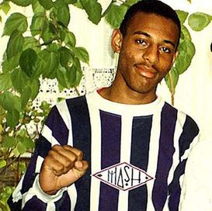
Stephen Lawrence
(The Guardian, 2012)

Slide 28
How to improve
More Diversity in the police
Tearing down the blue wall
Taking accountability
Transparency

Slide 29
Professionalism in the police
Working above and beyond to ensure law and order
Working above and beyond to ensure the safety of the public
Treating all members of the public fairly, equally, and with respect
Officers are expected to have and exert key principles
College Of Policing (n.d.); Local Government Association, 2008)

Slide 30
Code of ethics
Accountability
Integrity
Openness
Fairness
Leadership
Respect
Honesty
Objectivity
Selflessness
(College Of Policing, 2014)

Slide 31
Legislation
The Police (Conduct) Regulations 2020
The Police Reform Act 2002

Slide 32
Are the police always professional?
Victim blaming
Corruption
Discrimination
Negligence
Cover ups

Slide 33
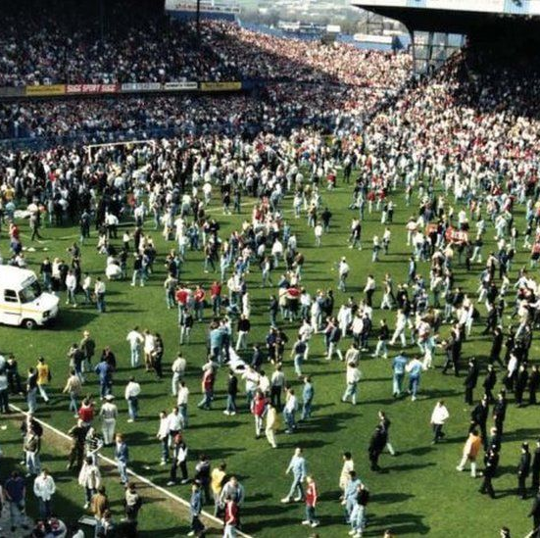
The Hillsborough disaster
(BBC, 2022)

Slide 34
Conclusion
In conclusion, although attempts have been made to change the lack of diversity, anti-professionalism and cop culture in the police, these issues still persist and pose a serious and credible threat to the integrity and effectiveness of our police force. To change this, Diversity and community outreach should be further increased. Police forces should operate with more openness, transparency, and honesty, even when failures have been made. Finally, the blue wall should be torn to reduce the instances of negligence, corruption, and cover-ups and to reveal the bad apples that currently hide behind the badge and dishonour the police service.

Slide 35
Image references
CBS News (2013) “Rodney King Beating: FBI releases files documenting early investigation” Available at: https://www.cbsnews.com/news/rodney-king-beating-fbi-releases-files-documenting-early-investigation/ (Accessed: May 8, 2023)
The Guardian (2009) “How Ian Tomlinson's death at the G20 protests changed policing” Available at: https://www.theguardian.com/politics/2009/nov/25/ian-tomlinson-death-changed-policing (Accessed: May 8, 2023).
The Guardian (2012) “Stephen Lawrence verdict: Dobson and Norris guilty of racist murder” Available at: https://www.theguardian.com/uk/2012/jan/03/stephen-lawrence-verdict-guilty-murder (Accessed: May 8, 2023)
BBC (2022) “Hillsborough: Timeline of the 1989 stadium disaster” Available at: https://www.bbc.co.uk/news/uk-england-merseyside-47697569 (Accessed: May 8, 2023.

Slide 36
References
Korander, T. (2019) “Police Culture - Still live and kicking“ Available at: https://www.nsfk.org/wp-content/uploads/sites/10/2019/06/Timo-Korander-Police-Culture_Still-live-and-kicking.pdf (Accessed: May 8, 2023)
Sage Publications (2022) “The Police Culture” Available at: https://www.sagepub.com/sites/default/files/upm-binaries/38432_4.pdf (Accessed: May 8, 2022)
Reiner, R. (2010) The politics of the police. Oxford: Oxford University Press.
McLeod, S. (2023) “Social Identity Theory: Definition, History, Examples, & Facts” Available at: https://www.simplypsychology.org/social-identity-theory.html (Accessed: May 8, 2023).
Ruhl, C. (2023) “Broken Windows Theory of Criminology” Available at: https://www.simplypsychology.org/broken-windows-theory.html (Accessed: May 8, 2023)
US DOJ (2014) “Community Policing Defined” Available at: https://cops.usdoj.gov/RIC/Publications/cops-p157-pub.pdf (Accessed: May 8, 2023)
Rahr, S. and Rice, SK. (2015) “From Warriors to Guardians: Recommitting American Police Culture to Democratic Ideals” Available at: https://www.ojp.gov/pdffiles1/nij/248654.pdf (Accessed: May 11, 2023).
Nickerson, C. (2023) “Rational Choice Theory: What It Is in Economics, With Examples” Available at: https://www.simplypsychology.org/rational-choice-theory.html (Accessed: May 11, 2023)

Slide 37
References
Sachs, SM. (2020). “Police Transformation: Moving From "US vs. Them" to "We“ Available at: https://www.indigenouspolicy.org/index.php/ipj/article/view/685/658 (Accessed: May 8, 2023)
American Military University (2019) “Us Versus Them” in Policing: What Causes Warrior Cops?” Available at: https://amuedge.com/us-versus-them-in-policing-what-causes-warrior-cops/ (Accessed: May 8, 2023)
Skolnick, J. (2002) ‘Corruption and the blue code of silence’, Police Practice and Research, 3(1), pp. 7–19. doi:10.1080/15614260290011309.
Al-Gharbi, M. (2020) “Police Punish the “Good Apples” Available at: https://www.theatlantic.com/ideas/archive/2020/07/what-police-departments-do-whistle-blowers/613687/ (Accessed May 8, 2023)
Walker, J. (2023) “The ‘blue wall’ of silence allows bullying, sexual abuse and violence to infect police forces” Available at: https://theconversation.com/the-blue-wall-of-silence-allows-bullying-sexual-abuse-and-violence-to-infect-police-forces-198487 (Accessed: May 8, 2023)
Chan, J. (1996). “Changing Police Culture” Available at: https://www.ojp.gov/ncjrs/virtual-library/abstracts/changing-police-culture (Accessed: May 8, 2023)
The Equality Act (2010) Available at: https://www.legislation.gov.uk/ukpga/2010/15/contents (Accessed 8 May, 2023)

Slide 38
References
Statista (2022) “Distribution of police ranks in England and Wales in 2022, by gender” Available at: https://www.statista.com/statistics/382525/share-of-police-officers-in-england-and-wales-gender-rank/ (Accessed: May 8, 2023)
UK Government (2020) “Police Workforce” Available at: https://www.ethnicity-facts-figures.service.gov.uk/workforce-and-business/workforce-diversity/police-workforce/latest (Accessed: May 8, 2023)
Llanos, MB. (2021) “The over-policing of the Black community has not been furloughed” Available at: https://co-power.leeds.ac.uk/blog3_mbl/ (Accessed: May 8, 2023)
Home Office (2022) “Hate crime, England and Wales, 2021 to 2022” Available at: https://www.gov.uk/government/statistics/hate-crime-england-and-wales-2021-to-2022/hate-crime-england-and-wales-2021-to-2022 (Accessed: May 8, 2023).
College Of Policing (n.d.) “Professional Standards” Available at: https://www.college.police.uk/app/professional-standards (Accessed: May 8, 2023)
Local Government Association (2008) “Police Staff Standards of Professional Behaviour” Available at: https://www.local.gov.uk/our-support/workforce-and-hr-support/police/police-staff/police-staff-council-handbook/police-staff (Accessed: May 8, 2023)

Slide 39
References
College Of Policing (2014) “Code Of Ethics” Available at: https://assets.college.police.uk/s3fs-public/2021-02/code_of_ethics.pdf (Accessed: May 8, 2023)
The Police (Conduct) Regulations (2020) Available at: https://www.legislation.gov.uk/uksi/2020/4/made (Accessed: May 8, 2023)
Police Reform Act (2002) Available at: https://www.legislation.gov.uk/ukpga/2002/30/contents (Accessed: May 8, 2023)
Burke, A.S. et al. (2022) ‘The Crime Control and Due Process Models ’, in Introduction to the american criminal justice system. Minneapolis, MN: Open Textbook Library.
Nolan, T. (2009) ‘Behind the Blue Wall of Silence’, Men and Masculinities, 12(2), pp. 250–257. doi:10.1177/1097184x09334700.

