Slide 1
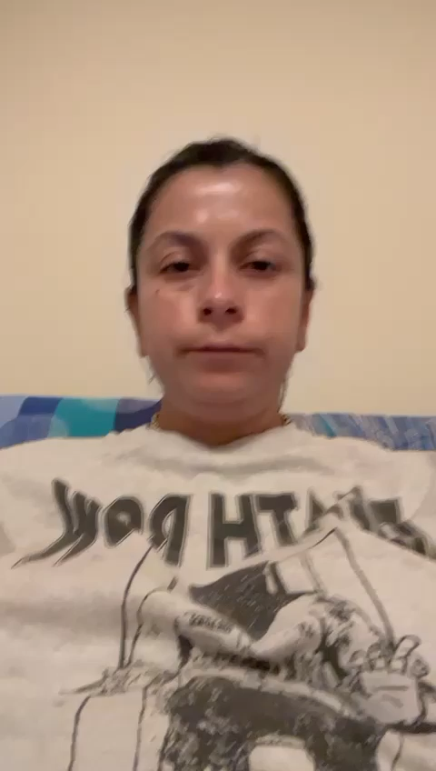
INTRODUCTION VIDEO
Name: Adriana Alexandra Birsan
Student Number: 2118849
Module: Foreign Languages and Cultural Awareness BMIH5003 Mandarin
Tutor: Li Jin Ping

