Slide 1
ACCA7025
Machine Learning Workflow
Unsupervised Learning in Machine Learning

Slide 2
Learning Objectives
Understand the fundamentals of unsupervised learning.
Explore different types of unsupervised learning algorithms.
Implement unsupervised learning techniques using Scikit-Learn.

Slide 3
What is Unsupervised Learning?
A type of machine learning where models learn patterns from unlabeled data.
Unlike supervised learning, there are no explicit outputs or labels.
The goal is to identify hidden structures or patterns in the data.
Common applications:
  Clustering,
  Dimensionality Reduction,
  Anomaly Detection.

Slide 4
Types of Unsupervised Learning
Clustering - Grouping similar data points together.
Dimensionality Reduction - Reducing the number of features while preserving key information.
Anomaly Detection - Identifying unusual data points.

Slide 5
Clustering Techniques
K-Means Clustering: Assigns data points to K clusters based on similarity.
Hierarchical Clustering: Forms a tree-like structure of nested clusters.
DBSCAN (Density-Based Spatial Clustering): Groups data based on density.

Slide 6
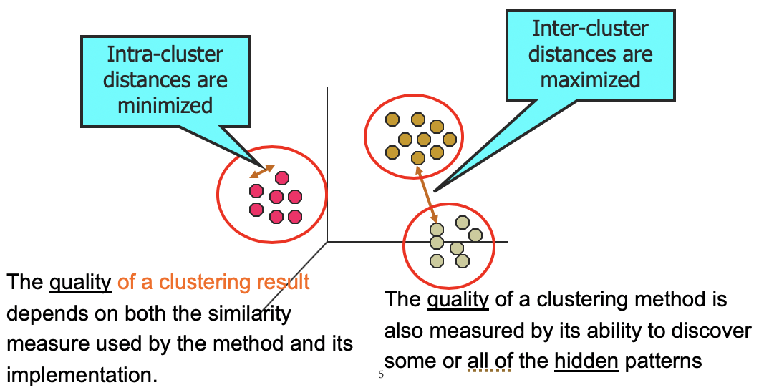
How Good is the Clustering
Intra-cluster and Inter-cluster distances

Slide 7
K-Means Clustering
-An iterative algorithm that selects K initial centroids and updates them iteratively.
from sklearn.cluster import KMeans
from sklearn.datasets import make_blobs
import matplotlib.pyplot as plt
X, _ = make_blobs(n_samples=300, centers=3, random_state=42)
kmeans = KMeans(n_clusters=3, random_state=42)
kmeans.fit(X)
labels = kmeans.labels_
plt.scatter(X[:, 0], X[:, 1], c=labels, cmap='viridis')
plt.scatter(kmeans.cluster_centers_[:, 0], kmeans.cluster_centers_[:, 1], s=300, c='red', marker='X')
plt.show()

Slide 8
Hierarchical Clustering
Builds a hierarchy of clusters using agglomerative or divisive approaches.
  from sklearn.cluster import AgglomerativeClustering
  import scipy.cluster.hierarchy as sch
  hc = AgglomerativeClustering(n_clusters=3)
  labels_hc = hc.fit_predict(X)
  plt.figure(figsize=(8, 5))
  dendrogram = sch.dendrogram(sch.linkage(X, method='ward'))
  plt.show()

Slide 9
DBSCAN Clustering
Groups dense regions and identifies noise points.
from sklearn.cluster import DBSCAN
dbscan = DBSCAN(eps=0.5, min_samples=5)
labels_dbscan = dbscan.fit_predict(X)
plt.scatter(X[:, 0], X[:, 1], c=labels_dbscan, cmap='rainbow')
plt.show()

Slide 10
Dimensionality Reduction Techniques
Relates to Feature Selection!
Principal Component Analysis (PCA): Converts high-dimensional data into fewer dimensions.
t-SNE (t-Distributed Stochastic Neighbor Embedding): Non-linear technique for visualization.
LDA (Linear Discriminant Analysis): Used for supervised dimensionality reduction.

Slide 11
PCA Example
from sklearn.decomposition import PCA
pca = PCA(n_components=2)
X_pca = pca.fit_transform(X)
plt.scatter(X_pca[:, 0], X_pca[:, 1], c=labels, cmap='viridis')
plt.show()

Slide 12
Association Rule Learning
What is Association Rule Learning?
A technique used to find relationships between variables in large datasets.
Often used in market basket analysis, recommendation systems, and healthcare.
Example: "Customers who buy bread also tend to buy butter.“
Key Concepts:
Support: Frequency of an itemset appearing in transactions.
Confidence: Probability that when item A is bought, item B is also bought.
Lift: Strength of a rule compared to random chance.
Common Algorithms:
Apriori Algorithm
FP-Growth Algorithm

Slide 13
Example: Market Basket Analysis using mlxtend
import pandas as pd
from mlxtend.frequent_patterns import apriori, association_rules
# Sample dataset: Transactions with items bought
data = {'Milk': [1, 0, 1, 1, 0],
'Bread': [1, 1, 1, 0, 1],
'Butter': [0, 1, 1, 1, 1]}
df = pd.DataFrame(data)
# Generate frequent itemsets with min support of 0.5
frequent_itemsets = apriori(df, min_support=0.5, use_colnames=True)
# Generate association rules with min confidence of 0.7
rules = association_rules(frequent_itemsets, metric="confidence", min_threshold=0.7)
# Display rules
print(rules[['antecedents', 'consequents', 'support', 'confidence', 'lift']])

Slide 14
Summary
Unsupervised learning finds patterns in unlabeled data.
Clustering algorithms (K-Means, Hierarchical, DBSCAN) help group similar data.
Dimensionality reduction (PCA, t-SNE) simplifies complex datasets.
Selecting the right technique depends on the dataset and use case.

Slide 15
Questions?
Open discussion and hands-on implementation suggestions.

