Slide 1
historical overview of Athens and Attika

Slide 2
General Overview for Athens
Bronze Age – c3000-1050 BCE
Iron Age – c1050 BCE-500 CE
  Archaic period 800-500 BCE
  Classical period 500-336 BCE
  Hellenistic 336-31 BCE
  Imperial Roman 31 BCE -284 CE
  Late Antiquity 284 – 500
Byzantine 324-1204
Latin (crusader) kingdoms 1204-1446
Ottoman 1458-1830
Modern Greece 1830-today

Slide 3
Continuous Settlement
From Neolithic to today
Effect on archaeology
  Reuse of land and materials
  Important heritage identifiers
Settlement focused on Acropolis and surrounds

Slide 4
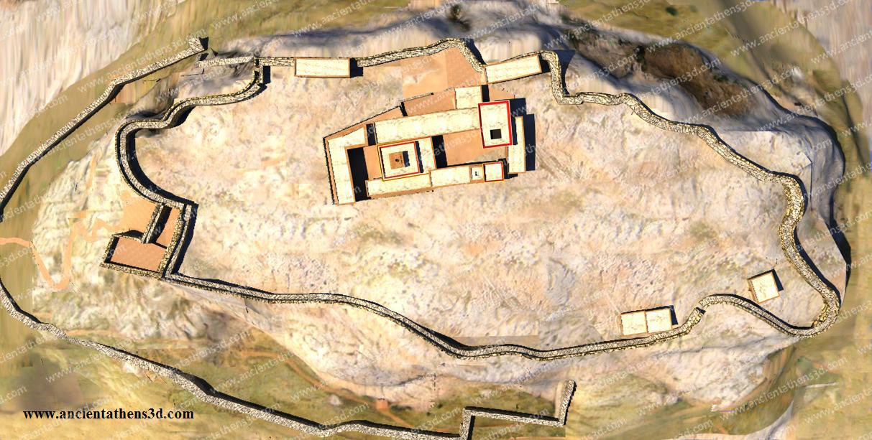
Bronze Age
Mycenean Palace 15th century.

Slide 5
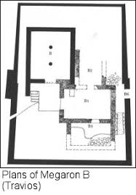
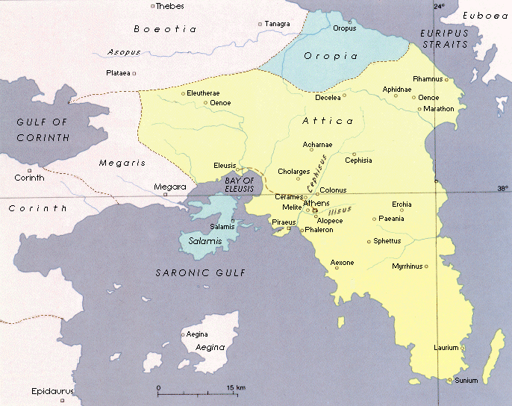
Bronze Age: Eleusis

Slide 6
After 1200 BCE
Athens not as affected by fall of the palaces – greater continuity
Athens remained main settlement in Attika 1200-800

Slide 7
Archaic period (all BCE)
Large-scale synoikismos – unlike “normal” development
Internal issues but no settlement abroad
Internal strife and constitutional changes:
  Draco (and laws) – c624
  Solon (and laws) – 594
  Peisistratids (tyranny) – 546-510

Slide 8
Constitutional Changes
Aristocracy till 594 BCE
Oligarchy (timocratic system) 594-510
Democratic elements 510-470
Democracy – classical period – c470-317

Slide 9
5th century BCE
Persian Wars – 490-479 (Marathon, destruction of Athens, Salamis)
Pentekontaetia – 479-431 (between Persian Wars and Peloponnesian War II)
Delian League 478-404
1st Peloponnesian War 461-446
2nd Peloponnesian War 431-404

Slide 10
4th century
Democracy continues
Resurgence of empire: 378-355
Conflict with Macedon: 356-317

Slide 11
Hellenistic
Demetrius of Phalerum 317-307 (oligarchy imposed)
Demetrius Poliorketes 307-294 (democracy restored)
Rebellion and Macedonian occupation 294-229
With the Romans against Macedon 200

Slide 12
Athens and Rome
Allied with Mithridates against the Romans 88 BCE
86 BCE Destruction by Sulla
Centre of Learning (no political importance) c50 BCE – 250 CE

Slide 13
Late Antiquity and beyond
Destruction by the Heruli 267 CE
Centre of Learning c300-529
421 Athenian Eudocia – Empress of Byzantium – wife of Theodosius II
529 Academy closed by Justinian
Plundered but not destroyed by Slaves 582
Byzantine period: Dual identity: Philosophy and culture (pagan), Christian centre

Slide 14
The Duchy of Athens
De la Roche 1204-1311
Compagnie 1311-1385
Acciaiuoli 1385-1446
Byzantine 1446-1456

Slide 15
Ottoman Athens
1458 – Sultan Mohamed the Conqueror visits Athens.
1470-1610 Part of the sandzak of Euboea, but ferman stopped any incursion by the Pasah to Athens
1610-1687 Directly belonging to the Sultan’s harem for taxes.
1687-1690 Venetian take-over - destruction/abandonment of Athens
1690-1754 Quiet period, small population
1754-1833 Malikane of the Sultan

Slide 16
Athens in Time and Space

