Slide 1
Understanding Academic Misconduct
Session 1:
Plagiarism, Turnitin & Self-Plagiarism

Slide 2
What are we learning?
By the end of the short session you should be able to:
Explain what plagiarism and self-plagiarism mean.;
Understand what a Turnitin Similarity Report is showing you;
Tell the difference between a match that is OK and a match that you need to check or change;

Slide 3
Key terms
Academic integrity means doing your university work in an honest way.
Your work should show your own learning, and you should make it clear when you have used ideas, information or words from someone else.
UWTSD describes plagiarism as presenting another person's work or ideas as your own. It also identifies self-plagiarism as reusing work that you have already submitted for another assessment when this is not permitted.
Complete the matching task to check that you understand the key terms and why they are important.
Notes:
Printable resource – requires cutting reading for sorting and labelling.

Slide 4
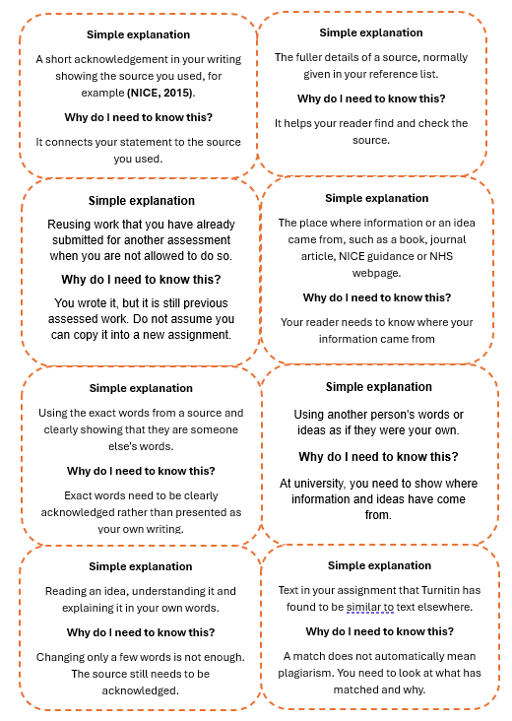
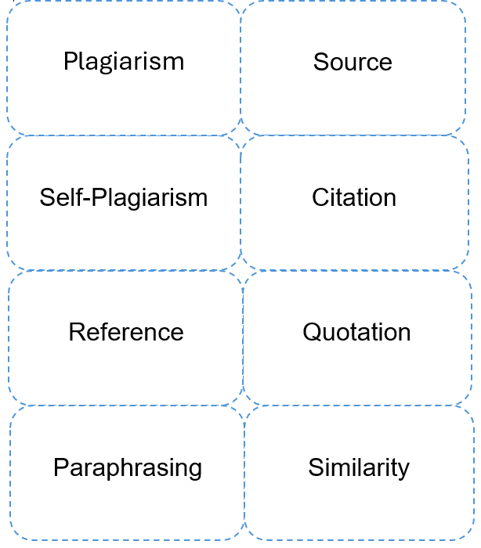
Sort and Match
Did you find the task easy or difficult?
Which word was the most challenging?

Slide 5
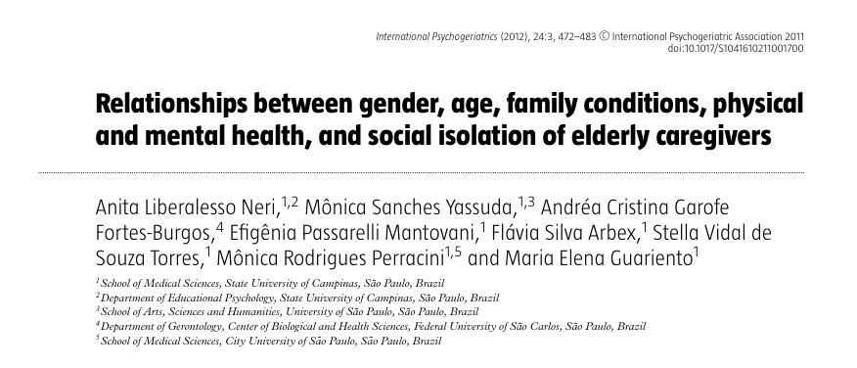
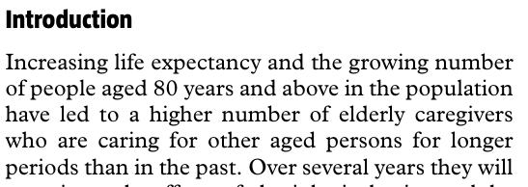
Using a source
A Journal Article
An extract from the article.
Notes:
https://librarysearch.uwtsd.ac.uk/permalink/44WHELF_UWTSD/1bmis16/cdi_proquest_journals_917234984

Slide 6
Student writing examples
Extract from student writing | Classification
Increasing life expectancy and the growing number of people aged 80 years and above in the population have led to a higher number of elderly caregivers. | 🔴 Plagiarism
Increasing life expectancy and the growing number of people aged 80 years and above have led to more elderly caregivers (Neri et al., 2012). | 🟠 Poor academic practice
Neri et al. (2012) explain that people are living longer. This means that more older people are now caring for other older adults, often for longer periods. | 🟢 Good paraphrasing
People are living longer. This means that some older people may need to care for someone else. Neri et al. (2012) explain that more older people are now providing care. | 🟢 Good academic writing

Slide 7

Turnitin Similarity scores
Turnitin is a tool used to help students and tutors check academic work. When you submit your work, Turnitin compares the text with material in its databases from universities globally.
This may include webpages, published material and other student submissions. It then produces a Similarity Report, which highlights text that matches other sources.
The report also gives an overall similarity score, shown as a percentage. For example, a score of 20% means that Turnitin has found text in the submission that matches material in its databases.
It does not mean that 20% of the work is plagiarised. UWTSD guidance makes clear that the similarity percentage is not an absolute way of identifying academic misconduct; the matches need to be considered using academic judgement.

Slide 8
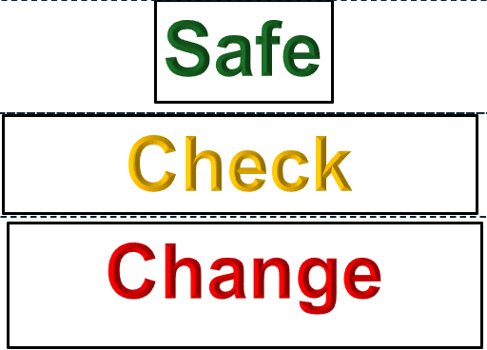
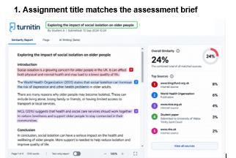
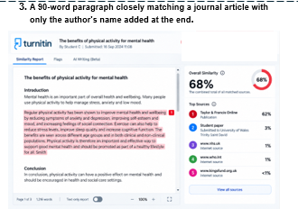
Activity
Similarity: Look Beyond the Score
Work in pairs to sort the cards into three categories: Safe, Check and Change before submission
Notes:
Printable resource – requires cutting reading for sorting and labelling.

Slide 9
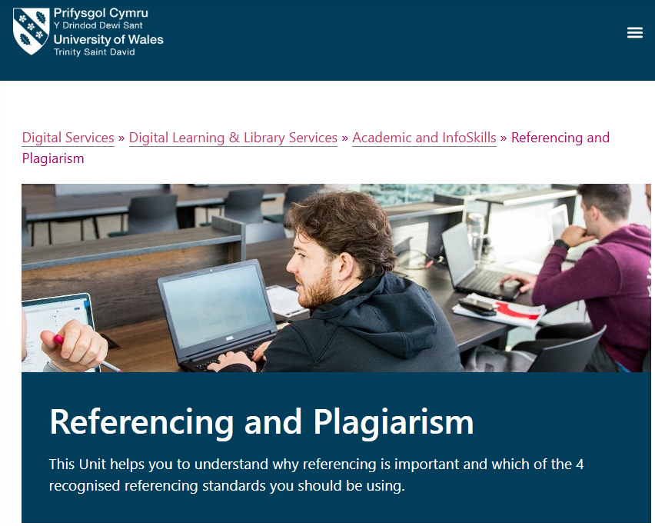
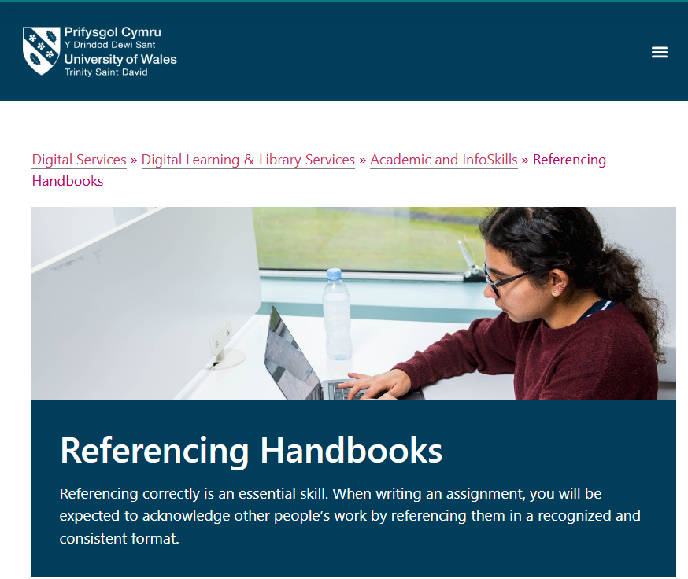
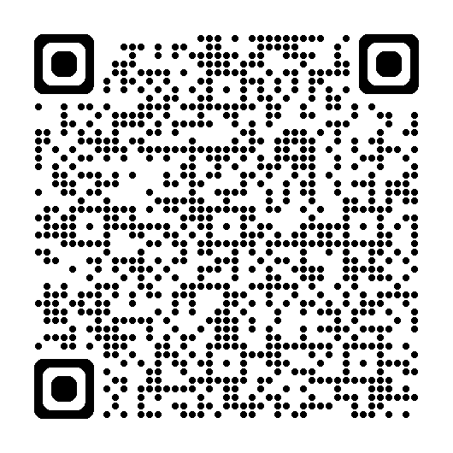
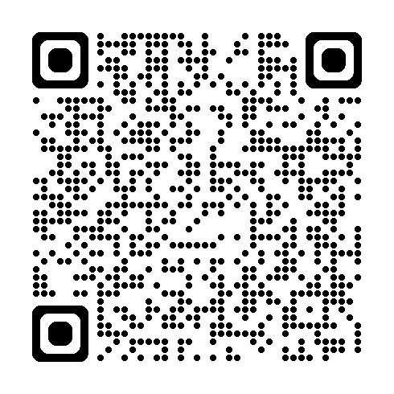
Further Learning
Use UWTSD's Referencing and Plagiarism InfoSkills unit and Referencing Handbooks. The Library's Academic and InfoSkills programme provides self-directed units and appointment support.
Notes:
https://digitalservices.uwtsd.ac.uk/library/academic-and-infoskills/referencing-and-plagiarism/?utm_source=
https://digitalservices.uwtsd.ac.uk/library/academic-and-infoskills/referencing-handbooks/?utm_source=

Slide 10
References
Neri, A.L., Yassuda, M.S., Fortes-Burgos, A.C.G., Mantovani, E.P., Arbex, F.S., Torres, S.V.S., Perracini, M.R. and Guariento, M.E. (2012) ‘Relationships between gender, age, family conditions, physical and mental health, and social isolation of elderly caregivers’, International Psychogeriatrics, 24(3), pp. 472–483. doi:10.1017/S1041610211001700
University of Wales Trinity Saint David (n.d.) Referencing handbooks. Available at: https://digitalservices.uwtsd.ac.uk/library/academic-and-infoskills/referencing-handbooks/ (Accessed: 19 September 2026).
University of Wales Trinity Saint David (n.d.) Referencing and plagiarism. Available at: https://digitalservices.uwtsd.ac.uk/library/academic-and-infoskills/referencing-and-plagiarism/ (Accessed: 19 September 2026).
University of Wales Trinity Saint David (n.d.) Procedures for academic appeals, complaints and other student cases. Available at: https://www.uwtsd.ac.uk/procedures-academic-appeals-complaints-and-other-student-cases (Accessed: 19 September 2026).

