Slide 1
Student Name : Saeed Ahmad​
Student ID : 2027769​
Module : Developing Relationships and Workplace Achievement​
Module Code : BMSW5102​
Lecturer : Sujeewa Herath​
​

Slide 2

What is motivation:
A set of forces that causes people to behave in a certain way
Indicates any kinds of factors that can help everyone to do something and that can help everyone to perform accordingly
It initiates, guides, and maintains goal-oriented behaviors (Peters, 2015).
This Photo by Unknown author is licensed under CC BY.

Slide 3
Effects of intrinsic factors on motivation
These are the inherent factors that arises from inside the individual for personal growth and drive them to finish any task successfully.
Intrinsic factors are the internal spirits of becoming successful for own and long-term growth. Herzberg’s two-factor theory that relates intrinsic factors to job satisfaction and associates extrinsic factors with dissatisfaction.
Motivators like promotional opportunities, personal growth opportunities, recognition, responsibility and achievement can be used to motivate and bring back the satisfaction of the employees in any organization (Hung et al., 2011).

Slide 4

Effects of extrinsic factors on motivation
These factors arises from outside the individual Such as praise, money, fame, benefits work as factors for motivation or sometimes punishment that reduces negative attitudes.
Reinforcement theory that describes positive reinforcement such as bonus for employees outstanding work. These are the rewards that motivate the individuals. On the other hand, Negative reinforcement such as salary cut for absence in work. So, at work, extrinsic motivation works more (Yahaya et al., 2010).

Slide 5

Difference between intrinsic and extrinsic motivation types
Intrinsic motivation-
Inner motivation
Experiencing new things
Learning new language
Spending time with a favorite people
Learning a new technology (Kuvaas et al., 2017).

Slide 6
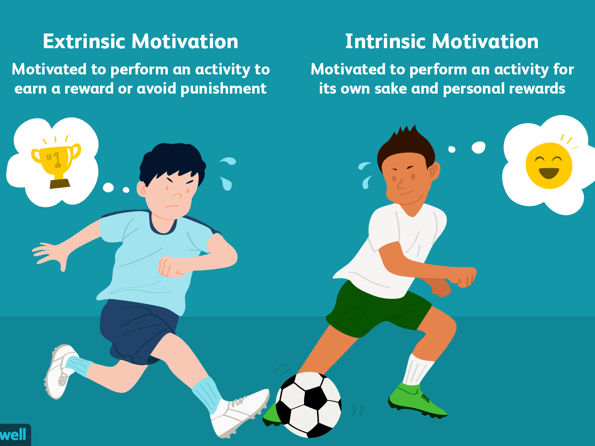
Extrinsic motivation-
Outside factors of motivation
Learning a new technology or Language for the sake of job
Spending time with someone for social purpose (Legault, 2020).

Slide 7

According to Hertzberg two factor theory Motivators as intrinsic factors-
Promotional opportunities
Personal Growth and opportunities
Recognition
Responsibility and achievement (Trevino et al., 2014).

Slide 8

According to Hertzberg two factor theory-
Hygiene factor as extrinsic factors-
Company policy and administration
Supervision and salary
Work condition
Relationship with others
Job security
When these factors are adequate, people will not be dissatisfied, neither will be satisfied (Alshmemri et al., 2017)
This Photo by Unknown author is licensed under CC BY-SA-NC.

Slide 9

Advantages of intrinsic motivation-
Inner spirit that drives towards success
Advantages of extrinsic motivation-
Outside incentives, rewards or punishment to push the performance (Lei, 2010).

Slide 10
Disadvantages of intrinsic motivation-
Intangible so not quantifiable
Disadvantages of extrinsic motivation-
Outside incentives, rewards or punishment to push the performance not according to individual’s own free will (Chen and Shinkai, 2017).

Slide 11
References:
Peters, R.S., 2015. The concept of motivation. Routledge.
Alshmemri, M., Shahwan-Akl, L. and Maude, P., 2017. Herzberg’s two-factor theory. Life Science Journal, 14(5), pp.12-16.
Yahaya, N., Yahaya, A., Ramli, J., Hashim, S. and Zakariya, Z., 2010. The effects of extrinsic motivational factors in learning among students in secondary school in Negeri Sembilan. International Journal of Psychological Studies, 2(1), p.128.
Kuvaas, B., Buch, R., Weibel, A., Dysvik, A. and Nerstad, C.G., 2017. Do intrinsic and extrinsic motivation relate differently to employee outcomes?. Journal of Economic Psychology, 61, pp.244-258.
Hung, S.Y., Durcikova, A., Lai, H.M. and Lin, W.M., 2011. The influence of intrinsic and extrinsic motivation on individuals' knowledge sharing behavior. International journal of human-computer studies, 69(6), pp.415-427.
Legault, L., 2020. Intrinsic and extrinsic motivation. Encyclopedia of personality and individual differences, pp.2416-2419.
Lei, S.A., 2010. Intrinsic and extrinsic motivation: Evaluating benefits and drawbacks from college instructors' perspectives. Journal of Instructional psychology, 37(2).
Chen, A. and Shinkai, K., 2017. Rethinking how we select dermatology applicants—turning the tide. JAMA dermatology, 153(3), pp.259-260.

