Slide 1

University of Wales Trinity Saint David
A DBA RESEARCH PROPOSAL ON THE TOPIC OF AN EXPLORATION OF BOKO HARAM’S CONFLICT IMPACT ON WOMEN'S LIVELIHOODS, BUSINESS RESILIENCE, AND ECONOMIC SUSTAINABILITY IN NORTHEASTERN NIGERIA: A SYSTEMATIC LITERATURE REVIEW
Converting Research into Practice LCDB 7010
Presented By: Sabrina Reid DBA Candidate - UWTSD
Student ID: 1920873
Lecturer: Dr Eno Amasi Mycock

Slide 2
Preliminary Findings
The preliminary findings reveal that the Boko Haram insurgency has distinctly gendered economic consequences, with women experiencing amplified livelihood disruptions as a consequence of insecurity, institutional failure, and pre-existing disparities. Regardless of this, women are active economic agents, supporting their families through microenterprises and social networks. The current research fails to include gender-sensitive and intersectional analysis, restricting the understanding of women's resilience tactics and strategies. Applying conflict, feminist security, and sustainable livelihood frameworks illustrates how power dynamics impact women's adaptive capabilities. The data emphasises the necessity of gender-responsive, resilience-oriented solutions, which include targeted microfinance, cooperative models, and increased market access, to promote women's microbusinesses and sustainable long-term regional recovery.

Slide 3
Methodological
This study utilises a pragmatic research paradigm. Pragmatism is relevant since the research aims necessitate the integration of various forms of data, critical interrogation of conceptual and methodological assumptions, and contextual interpretation of women's livelihood experiences in conflict-affected areas. Unlike positivism, which emphasises objective measurement and generalisable causal assertions, pragmatism advocates for a flexible, problem-oriented approach that values both qualitative and quantitative discoveries. This is consistent with the study's objectives of synthesising, evaluating, and interpreting complicated, context-dependent evidence on women's economic resilience during an insurgency. Furthermore, this study utilises the PRISMA framework to facilitate the process of systematic review. PRISMA provides a transparent, meticulous, and reproducible structure for identifying, screening, and synthesising the evidence, which is in alignment with this study's objectives of critically analysing existing literature on women's livelihoods, economic resilience, and adaptation strategies within Boko Haram-affected communities. Given the subject matter's multidisciplinary and context-dependent nature, implementing PRISMA ensures an extensive and impartial search method, transparent documentation of inclusion and exclusion assessments, and a meticulous audit trail. This further strengthens the review's credibility, methodological rigour, and analytical breadth, whilst additionally supporting the study's pragmatic paradigm by allowing for the incorporation of various forms of evidence and critical interrogation of conceptual, methodological, and contextual gaps within the existing literature.

Slide 4
Ethical Issues
Ethical concerns can consist of safeguarding vulnerable women from re-traumatisation. The study must avoid promoting gender stereotypes, respect cultural sensitivities, and protect data in insecure settings. Power inequalities, the study's positionality, and the potential harm from misrepresentation all necessitate rigorous ethical management.

Slide 5
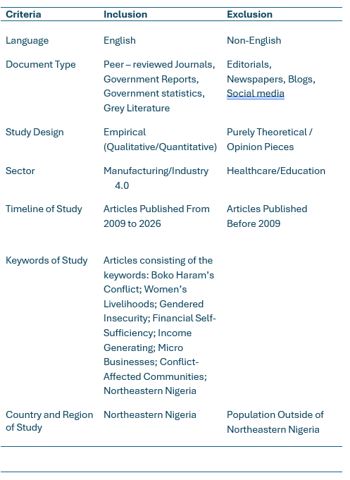
Inclusive and Exclusive Criteria

Slide 6
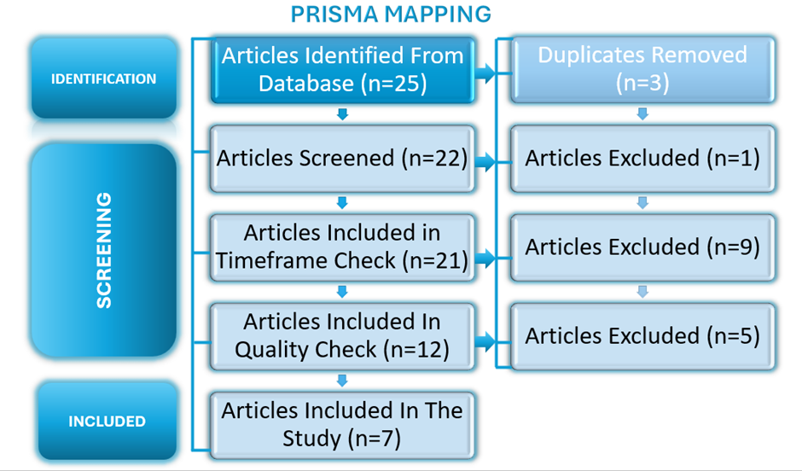
Systematic Literature Review
PRISMA MAPPING
During the initial data collection, twenty-five items were identified. Three were deleted as duplicates, and one was excluded because it was outside the scope of the study. An additional nine were excluded during the timeframe screening, and five did not match the quality criteria based on the ABS journal rankings. Ultimately, only seven papers met all the inclusion criteria and were chosen for final evaluation.

Slide 7
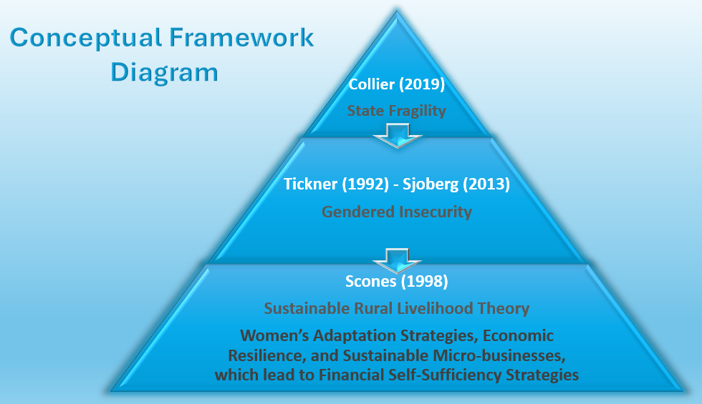
Models Conceptual Framework
This study applies an integrated conceptual framework combining conflict theory, feminist security perspectives, and the Sustainable Rural Livelihoods Framework to analyse how the Boko Haram insurgency shapes women’s economic autonomy in northeastern Nigeria. Drawing on Collier’s (2019) fragility theory, feminist scholars such as Tickner (1992), Sjoberg (2013), and Enloe (2016), and Scoones’ (1998) livelihoods model, the framework illustrates how structural fragility, gendered insecurity, and disrupted livelihood systems intersect to constrain women’s financial independence and their ability to sustain income-generating activities.

Slide 8
Introduction
Boko Haram (Jamā’at Ahl al‑Sunnah lid‑Da‘wah wa’l‑Jihād) remains one of West Africa’s most destabilising forces, with northeastern Nigeria most affected since 2009 (Tafida et al., 2023). The insurgency has caused mass displacement, loss of life, and economic collapse, yet its long‑term effects on women’s livelihoods are still underexplored (Daouda, 2020). Driven by poverty, extremism, and political marginalisation, the conflict has destroyed assets, disrupted rural economies, and weakened trade networks (Abubakar and Amurtiya, 2023). In this fragile context, women’s micro‑enterprises, petty trading, food processing, farming, and cross‑border commerce remain essential but highly vulnerable due to their concentration in informal work (El Bushra and Sahl, 2005; Chant and Sweetman, 2012).

Slide 9
Research Aims, Objectives, and Questions
Research Questions
•In what ways has the Boko Haram insurgency impacted women’s livelihoods and their ability to earn income within communities affected by conflict?
•What significant obstacles do women encounter in achieving economic resilience and sustainability amid the insurgency?
•What strategies of resilience and adaptation have women employed to maintain their livelihoods and business operations during market disruptions caused by conflict?
•Where are the main gaps in existing knowledge, especially concerning gender-specific economic impacts and responses within the context affected by Boko Haram?
The Aim
This study aims to systematically review and critically synthesise relevant literature on how Boko Haram’s conflict in northeastern Nigeria affects women’s livelihoods, financial independence, and the resilience and sustainability of their income-generating activities and microbusinesses.
The Objectives
•To critically assess and synthesise existing research on the economic effects of Boko Haram’s conflict on women’s livelihoods and their ability to earn income in conflict-affected communities, assessing the strength of current evidence, interrogating underlying assumptions, and identifying conceptual, methodological, and contextual gaps in the literature.
•To critically evaluate and integrate existing research on the challenges women encounter in attaining economic resilience and sustainable livelihoods in insurgency-affected settings, this involves evaluating the quality and assumptions of current evidence and pinpointing gaps in the literature related to concepts, methods, and context.
•To examine existing research on the resilience and adaptation strategies women employ to sustain their livelihoods and businesses during conflict-related market disruptions, evaluating the strengths and weaknesses of current evidence and identifying gaps in concepts, methods, and context within the literature.

Slide 10
Systematic Literature Review
Database
This study draws on a diverse array of sources, including academic databases, institutional repositories, and recognised international organisations. Notable resources include the university of Wales Trinity Saint David e-library, open Africa, Research online, Emerald publishing, Sage, ResearchGate, Taylor and Francis, Library of Science, Science Direct, SSRN Elsevier, Google Scholar, and Monash university resources. Additionally, the research references reports and datasets from the world health organisation, the united nations development programme, UNICEF, the national bureau of statistics of the federal republic of Nigeria, Academia. Edu, ProQuest, JSTOR, the European journal of education studies, Nigeria nutrition and health platforms, and the world bank group.
Keywords
Boko Haram’s Conflict; Women’s Livelihoods; Financial Self-sufficiency; Income Generating; Micro Businesses; Conflict-affected Communities, Northeastern Nigeria

Slide 11
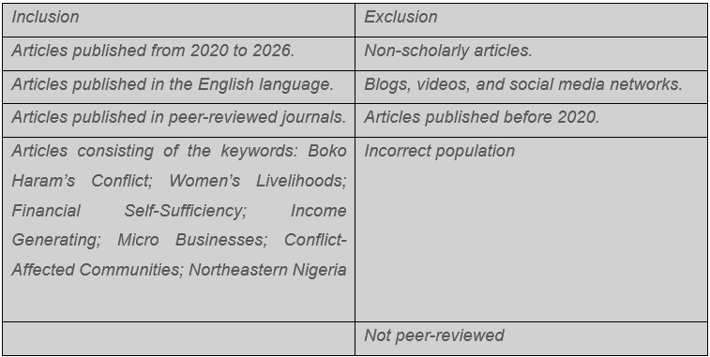
Systematic Literature Review
Inclusive-Exclusive Criteria

Slide 12
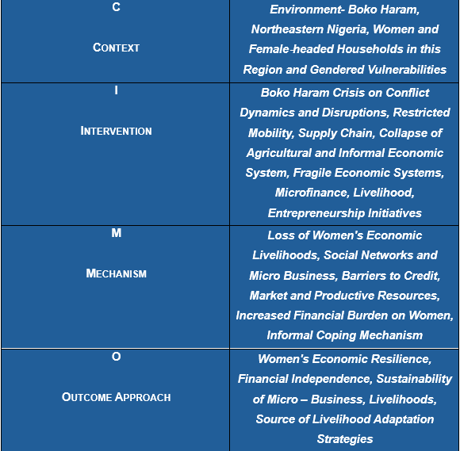
Systematic Literature Review
CIMO Framework

Slide 13
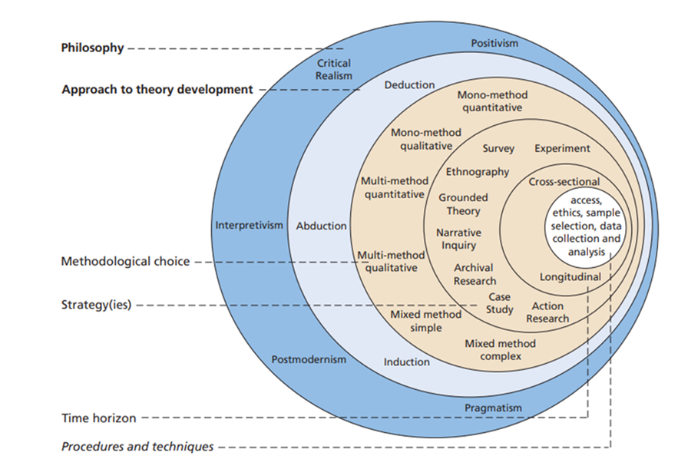
Proposed Methodology
This study adopts an interpretivist philosophy, recognising that women’s economic experiences in conflict‑affected northeastern Nigeria are socially constructed and best understood through the meanings individuals assign to them (Saunders, Lewis and Thornhill, 2023). A multi‑method qualitative design enables a rich, contextual exploration of how Boko Haram’s insurgency shapes women’s livelihoods, resilience, and adaptation strategies.
Drawing on academic journals and grey literature, the study uses thematic analysis to identify patterns across the evidence, while a longitudinal lens traces how women’s economic conditions and coping mechanisms have evolved since 2020. This methodological approach supports a nuanced, critically informed understanding of the economic impacts of insurgency, the barriers to women’s resilience, and the strategies they employ to sustain livelihoods under prolonged insecurity.
The research Onion: Source: © 2022 Mark NK Saunders; developed from Saunders et al. 2023

Slide 14
Expected Contributions and Managerial Implications
Academic Contribution
This study offers a significant theoretical contribution by deepening understanding of the gendered economic impacts of the Boko Haram insurgency in northeastern Nigeria. Moving beyond security‑ and humanitarian‑focused analyses, it systematically synthesises evidence on women’s livelihoods, micro‑enterprises, and financial resilience, reframing women as active economic agents rather than passive victims.
Drawing on conflict and state fragility theory, feminist security and gender‑power perspectives, and the Sustainable Rural Livelihoods Framework, the study explains how institutional breakdown, insecurity, and displacement generate gender‑specific livelihood shocks and shape women’s adaptation strategies. It also addresses key methodological and intersectional gaps in existing research, including the limited use of gender‑sensitive and socioeconomic assessments of resilience in conflict‑affected settings.
Managerial Implications
The Study Emphasises The Significance Of Developing Gender-responsive And Resilience-oriented Interventions From Both A Managerial And Policy Perspective. Sustainable Livelihood Programmes, Specialised Microfinance, Cooperative Enterprise Models, And Reliable Market Access Mechanisms That Foster Women's Economic Potential Should Be Prioritised By Development Agencies, Non-governmental Organisations (Ngos), And Policymakers. Recognising Women-owned Microbusinesses As Vital For Sustainable Economic Recovery Will Improve Long-term Stability In The Region, As It Contributes To Comprehensive Post-conflict Development

Slide 15
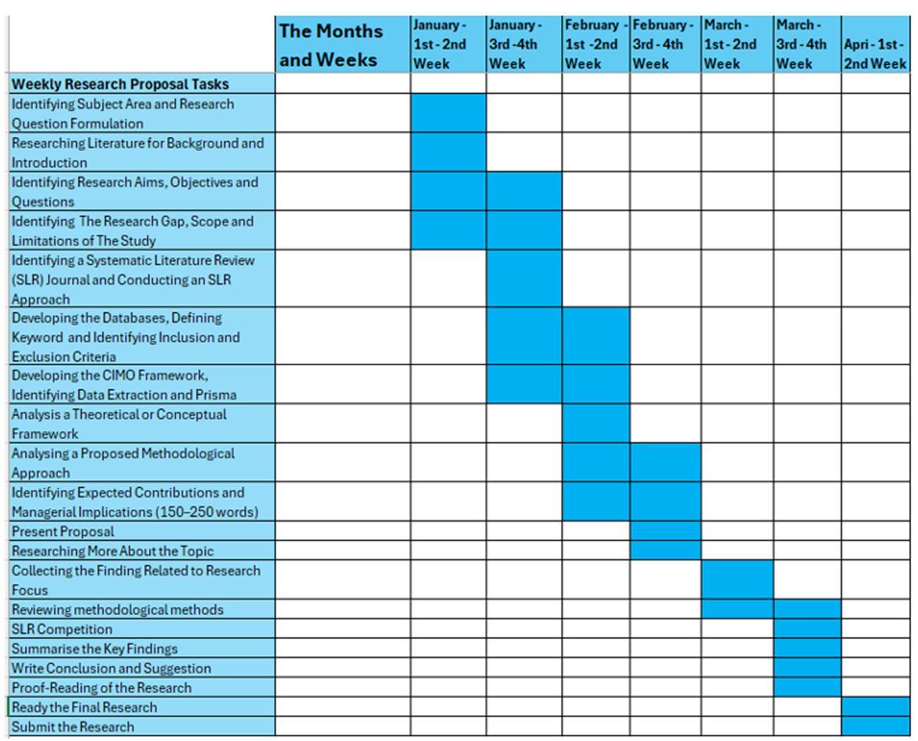
Timeline
Timeline

Slide 16
References
  Abubakar, T. and Amurtiya, M. (2023) 'Boko-Haram Insurgency and Rural Livelihood Dilemma: Implication for Sustainable Development in North-East Nigeria', Library of Science, pp. 216-225. Available at: https://bibliotekanauki.pl/articles/27314038#:~:text=The%20Boko%2DHaram%20insurgency%20has,access%20to%20affordable%20agricultural%20inputs. (Accessed: 2 February 2026).
  Chant, S., Sweetman, C. (2012) 'Fixing women or fixing the world? ‘Smart economics’, efficiency approaches, and gender equality in development', Gender and Development, 20(3), pp. 517-529. Available at: https://doi-org.uwtsd.idm.oclc.org/10.1080/13552074.2012.731812 (Accessed: 4 February 2026).
  Collier, P. (2019). Fixing Fragility: The role of the private sector and local institutions. Available at: https://www.researchgate.net/profile/Mamane-Bello/publication/330423386_FIXING_FRAGILITY/links/5c3f5b34a6fdccd6b5b18633/FIXING-FRAGILITY.pdf (Accessed: 13 February 2026).
  Daouda, Y. (2020) 'Poverty and living conditions with Boko Haram in the Lake Chad Basin: the case of southeastern Niger', Review of African Political Economy, 47 (163), pp. 126-134. Available at: https://doi.org/10.1080/03056244.2020.1722086 (Accessed: 2 February 2026)
  El-Bushra, J., Sah, I. (2005) Cycles of Violence: Gender Relations and Armed Conflict. Agency for Co-operation and Research in Development. Available at: https://web.archive.org/web/20200321061535id_/http://johnwatsonsite.com/MyClassNotes/Topics/Gender/cycles_of_violence.pdf (Accessed: 4 February 2026).
  Enloe, C. (2016) Globalization and Militarism: Feminists Make the Link. Rowman and Littlefield. Available at: https://www.google.co.uk/books/edition/Globalization_and_Militarism/zU6HCwAAQBAJ?hl=en&gbpv=1&dq=Feminist+Security+Theory+(FST)+Key+scholars:+Cynthia+Enloe,+J.+Ann+Tickner,+Laura+Sjoberg&pg=PR7&printsec=frontcover (Accessed: 13 February 2026).

Slide 17
References
  Scoones, I. (1998) 'Sustainable Rural Livelihoods. A Framework for Analysis', Institute of Development Studies, 72, pp. 1-22. Available at: https://www.researchgate.net/publication/270588972_Sustainable_Rural_Livelihoods_A_Framework_for_Analysis_IDS_Working_Paper_72 (Accessed: 13 February 2026).
  Saunders, M. (2022). Research Methods for Business Students Ninth Edition 2023.
  Saunders, M., Lewis, P., Thornhill, A. (2023) Research Methods for Business Students Ninth Edition. Pearson. Available at: https://moodle.uwtsd.ac.uk/pluginfile.php/1157902/mod_resource/content/1/2023RMBChapter4andPreface.pdf (Accessed: 19 February 2026).
  Sjoberg, L. (2013). Gendering Global Conflict Towards a Feminist Theory of War. Columbia University Press. Available at: https://pestuge.iliauni.edu.ge/wp-content/uploads/2017/12/Laura-Sjoberg-Gendering-Global-Conflict.-Toward-Feminist-Theory-of-War.pdf (Accessed: 13 February 2026).
  Tafida, A., Tukur, A., Adebayo, E., Ndaghu, A., Onu, and Momodu, J. (2023) 'Boko Haram insurgency and livelihood vulnerability of rural households in Northern Adamawa State, Nigeria', Research in Globalization, 6, pp.1-9. Available at: https://doi.org/10.1016/j.resglo.2023.100116 (Accessed: 2 February 2026).
  Tickner, J. (1992). Gender in International Relations: Feminist Perspectives on Achieving Global Security. Columbia University Press. Available at: https://www.ces.uc.pt/ficheiros2/files/Short.pdf (Accessed: 13 February 2026).

Slide 18
Thank You

