Slide 1
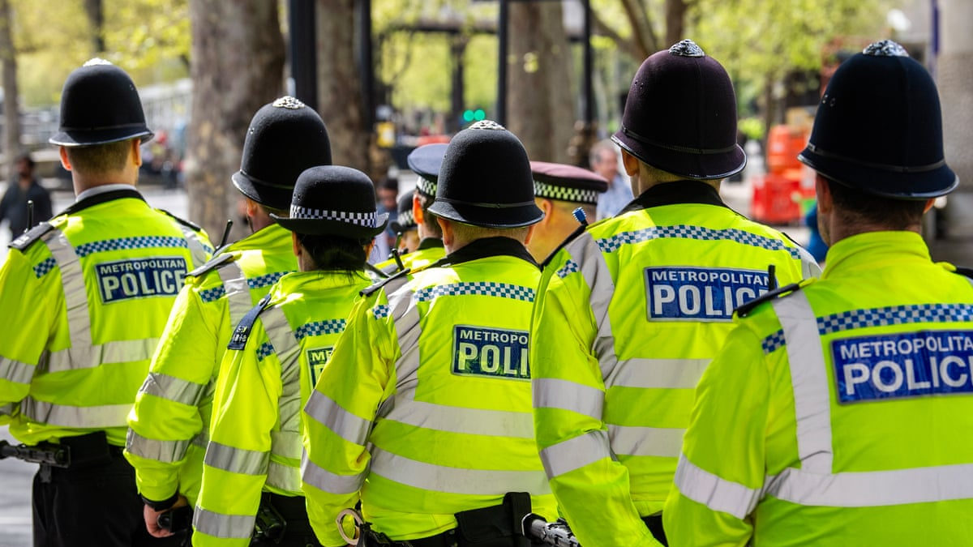
Integration of Information & Intelligence Enhances the
Effectiveness of Operational and Digital Policing in the UK
2312256 – ELLIS REES

Slide 2
B
C
A
KEY BENEFITS
& CHALLANGES
INTERGRATION OF
INFORMATION &
INTELLIGENCE
CONCLUSION

Slide 3
C
B
A
CONCLUSION
INTERGRATION OF
INFORMATION &
INTELLIGENCE
KEY BENEFITS
& CHALLANGES

Slide 4
A
C
B
INTERGRATION OF
INFORMATION &
INTELLIGENCE
CONCLUSION
KEY BENEFITS
& CHALLANGES

Slide 5
What is the Difference Between Information and Intelligence?
A
B
C
INTERGRATION OF
INFORMATION &
INTELLIGENCE
KEY BENEFITS
& CHALLANGES
CONCLUSION

Slide 6

C
A
What is the Difference Between Information and Intelligence?
B
National Crime Agency (n.d)
Information refers to data that has been collected, such as;
Crime Reports
CCTV Footage
Social Media Posts
etc …
Intelligence is information that has been analysed, evaluated, and contextualised to support decision making.
In simple terms, information is just raw material, intelligence is the understanding, and the integration of what brings those insights together to support decision making.
INTERGRATION OF
INFORMATION &
INTELLIGENCE
KEY BENEFITS
& CHALLANGES
CONCLUSION
“All intelligence is information; not all information is intelligence”
(Lowenthal, 2009, p.1)

Slide 7
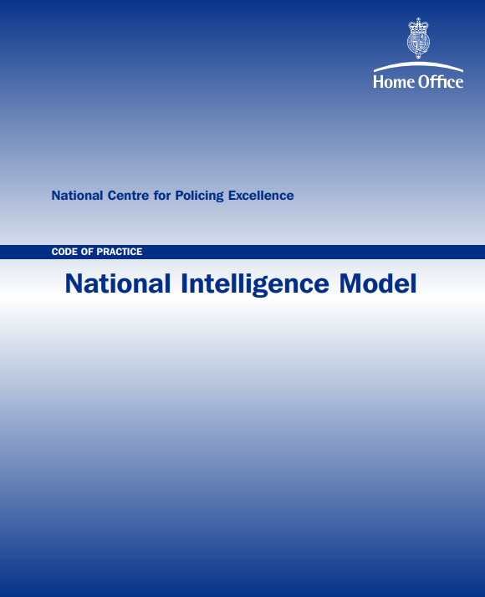
Integration of Information and Intelligence
National Intelligence Model (NIM)
Gather intelligence
Evaluate intelligence
Manage intelligence
This supports;
Underpins intelligence led policing and sets priorities
Uses analysed intelligence to inform tactical and resource decisions
Used to allocate resources and determine operational focus
Home Office (2005)

Slide 8

Integration of Information and Intelligence
Internal & external databases
CCTV systems
Covert human intelligence sources (CHIS)
Automatic number plate recognition systems
Faster identification of suspects
Links between offences
Evidence based decision making
College of Policing (2013)

Slide 9

Integration of Information and Intelligence
Common Types of Online Offending (Cybercrime)
Fraud
Money Laundering
Sexual Abuse of Children
Ransomware
Home Office (2023)

Slide 10
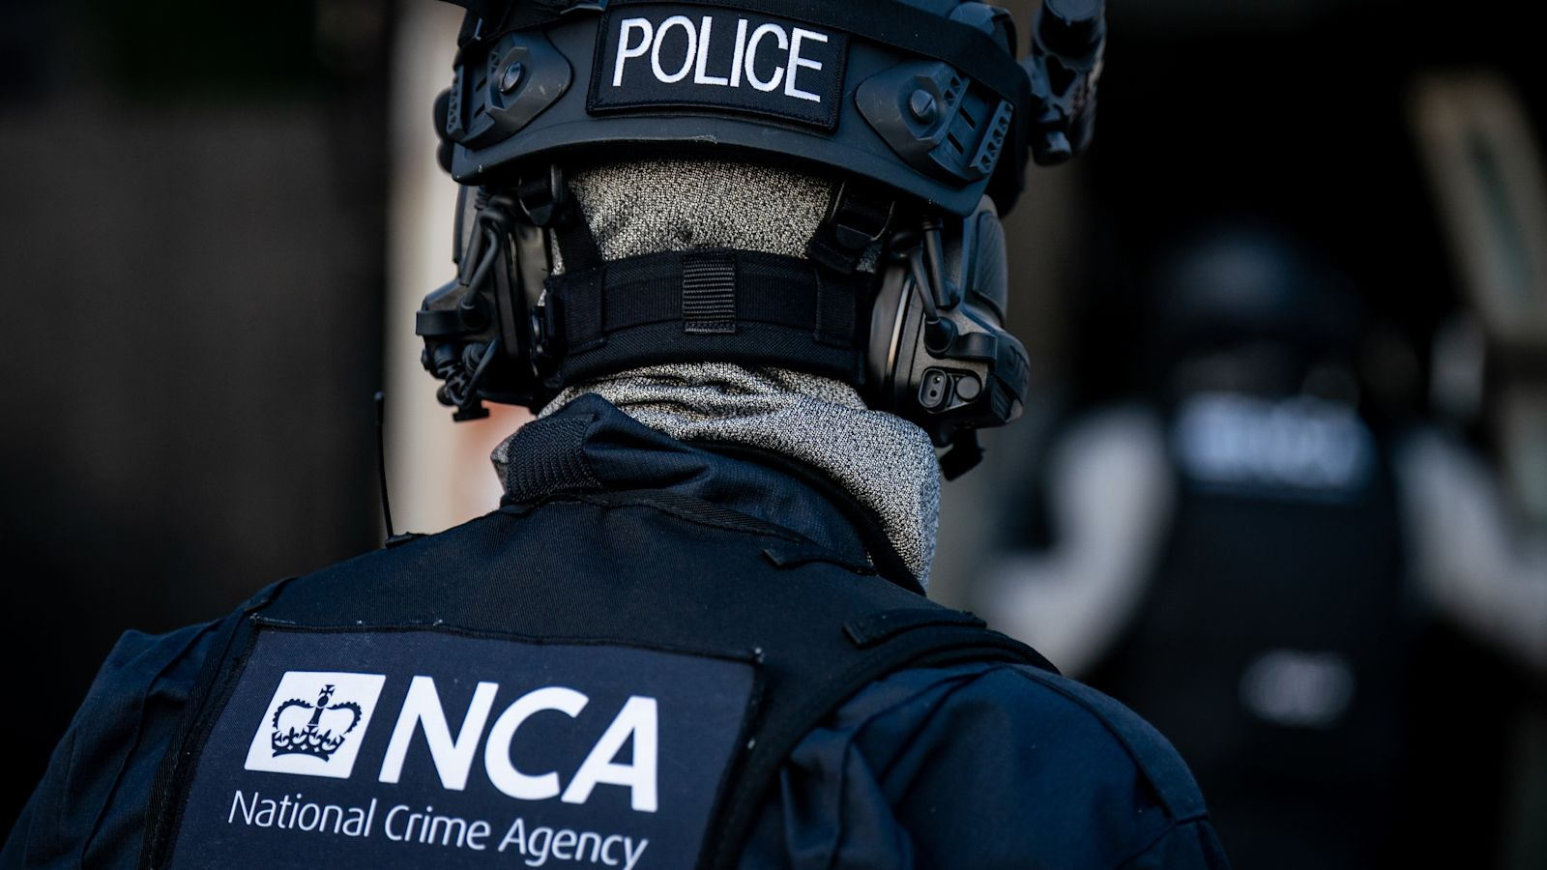

Integration of Information and Intelligence
Border vulnerabilities
Drug trafficking
Modern slavery and human trafficking
Smuggling illegal firearms
etc
National Crime Agency (n.d)

Slide 11


Key Benefits & Challenges
Legislation (2018)
Dictates how within the police, information is stored, analysed, and shared via lawful, necessary, and proportionate means.
Legislation (1998)

Slide 12
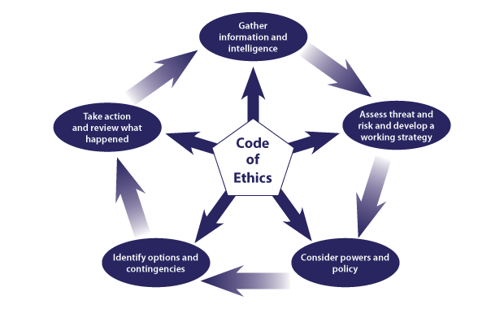
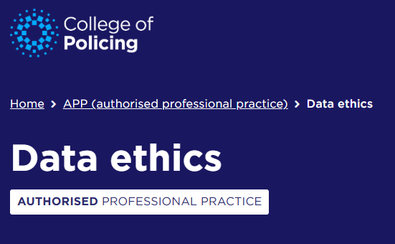
Key Benefits & Challenges + Conclusion
College of Policing (2025)

Slide 13
Research Timeline
Stage 1:
Focus: Understand the role of information and intelligence in UK policing.
Define the concept of information against intelligence
Topic Ideas:
Operational Policing
Digital Policing
Legal & Ethical Concerns
Identify UK specific focuses like NIM
Stage 2:
Intelligence Research.
Research the National Intelligence Model (NIM)
Research intelligence led policing
Research how intelligence informs operational decision – making
Stage 3:
Research cybercrime, online offending, and digital evidence
Examine how digital data is analysed and integrated
Considered national and international intelligence sharing
Linked digital intelligence to emerging threats
Stage 4:
Legal and ethical concerns.
Research UK legislation
Data protection Act 2018
Human rights Act 1998
Reviewed College of Policing APP & Code of Ethics
Stage 5:
Creation of Presentation.
Translated research into presentation.
Structured content into logical presentation flow
Ensured all examples were UK specific
Adjusted content to meet 10-minute quota

Slide 14
References
College of Policing (2013). Intelligence collection, development and dissemination. College of Policing. Available at: https://www.college.police.uk/app/intelligence-management/intelligence-collection-development-and-dissemination (Accessed 02/01/26).
College of Policing. (2025). Data ethics Authorised Professional Practice. [Available at: https://www.college.police.uk/app/data-ethics (Accessed 06/01/26).
Home Office (2005). Code of Practice. National Intelligence Model. National Centre for Policing Excellence. Available at: https://library.college.police.uk/docs/npia/NIM-Code-of-Practice.pdf (Accessed 02/01/26).
Home Office (2023). No place to hide serious and organised crime strategy 2023 to 2028 (accessible version). Crime Prevention. Available at: https://www.gov.uk/government/publications/serious-and-organised-crime-strategy-2023-to-2028/no-place-to-hide-serious-and-organised-crime-strategy-2023-to-2028-accessible-version (Accessed 03/01/26).
Legislation (2018). Data Protection Act 2018. Legislation.gov.uk. Available at: https://www.legislation.gov.uk/ukpga/2018/12/contents (Accessed 05/01/26).
Legislation (1998). Human Rights Act 1998. Legislation.gov.uk. Available at: https://www.legislation.gov.uk/ukpga/1998/42/contents (Accessed 05/01/26).
Lowenthal, M.M. (2009). Intelligence: From Secrets to Policy. ‌P.1. Washington, D.C. CQ Press. Available at: https://archive.org/details/intelligencefrom0004edlowe_o9o8 (Accessed 08/01/26)
National Crime Agency (n.d). What we do - National Crime Agency. Available at: https://www.nationalcrimeagency.gov.uk/what-we-do (Accessed 04/01/26).
National Crime Agency (n.d). Intelligence: Enhancing the Picture of Serious Organised Crime Affecting the UK - National Crime Agency. Available at: https://www.nationalcrimeagency.gov.uk/what-we-do/how-we-work/intelligence-enhancing-the-picture-of-serious-organised-crime-affecting-the-uk (Accessed 01/01/26).
I confirm that I have not presented any AI generated text as my own work. I confirm I have copies of my drafts, notes, and other resources I used before, and after the use of AI tools which I may be asked to provide in evidence.
Signed:
EREES
‌
‌
‌
‌
‌
‌

